Slide 2
Understanding the Public Health Impact of Tuberculosis Diagnostics
Texas Department of State Health Services (DSHS)
Healthcare Safety Conference
July 22, 2025
Presented by:
Elizabeth Foy, MSN, RN, Tuberculosis and Hansen’s Disease Unit
Jan Owen, Mycobacteriology/Mycology Branch Manager

Slide 3
Objectives
Discuss the spectrum of tuberculosis (TB).
Describe screening and diagnosing recommendations for latent TB infection (LTBI) and TB disease.
Define and describe core TB bacteriology testing methods and results.
Outline the role of public health departments in TB care.
Summarize the impact of bacteriology results and their importance to public health.

Slide 4
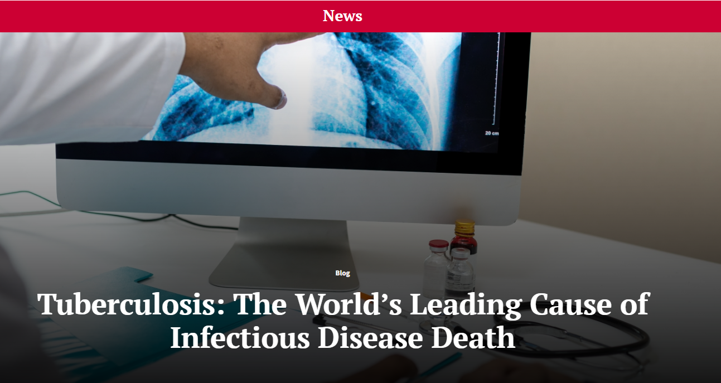
Leading Cause of Infectious Disease Death Worldwide
Notes:
TB is the world’s leading cause of infectious disease deaths today.
A total of 1.25 million people died from tuberculosis (TB) in 2023
TB is present in all countries and age groups; we have it in the US and in Texas.

Slide 5
TB in the United States and Texas, 2024
Texas** has the second highest TB incidence of all U.S. states
TB incidence has been increasing in the U.S. since 2021
10,347* TB cases were reported in the U.S. in 2024
  The U.S. TB rate was 3.0 cases per 100,000 population
  Across the U.S., TB disease was disproportionally reported among non-U.S. born persons
Texas reported 1,238** TB cases in 2024
  Over 60% born outside the U.S.
  Diabetes = largest medical risk factor
  Correctional setting resident = largest social risk factor
* Provisional data. Source: CDC https://www.cdc.gov/tb-data/2024-provisional/index.html
** Provisional data. Source: DSHS TB Program www.texastb.org
Notes:
Post pandemic, TB cases in the US are increasing. In 2024, there were 10, 347 TB cases in the US with a rate of 3.0 per 100,000. In the US, TB disproportionally impacts non US born persons. In Texas we see a similar trend. TX had the 2nd highest incidence in the US, with 1,238 cases reported in 2024. Over 60% of those are born outside the US, and our largest risk factors include diabetes and being a correctional resident, although we of course see TB in other populations including US born children, teens, and US born adults.

Slide 6

TB Elimination Strategies, 2022-2026
Centers for Disease Control and Prevention (CDC) – Division of TB Elimination (DTBE)
  Eliminate TB – defined as <1 case/million persons annually
  Goals:
    Reduce number of new infections
    Lower morbidity and mortality
    Reduce health disparities and promote health equity
https://www.cdc.gov/nchhstp/priorities/tuberculosis-elimination.html
Notes:
Ending the TB epidemic will take coordination from public health entitles along with our community partners to not only recognize TB, but to also understand the domino effect it can have on a person, their family, and their community.
Centers for Disease Control and Prevention (CDC) – Division of TB Elimination (DTBE)’s goal to eliminate TB down to less than 1 case per one million persons includes reducing TB infections and removing barriers to healthcare. Six strategies are outlined including rapid recognition of TB transmission, a robust response, and expanding partnerships. So today we’ll talk though our role in those strategies.

Slide 7
TB Overview
Notes:
Let me jump into what we know about TB.

Slide 8
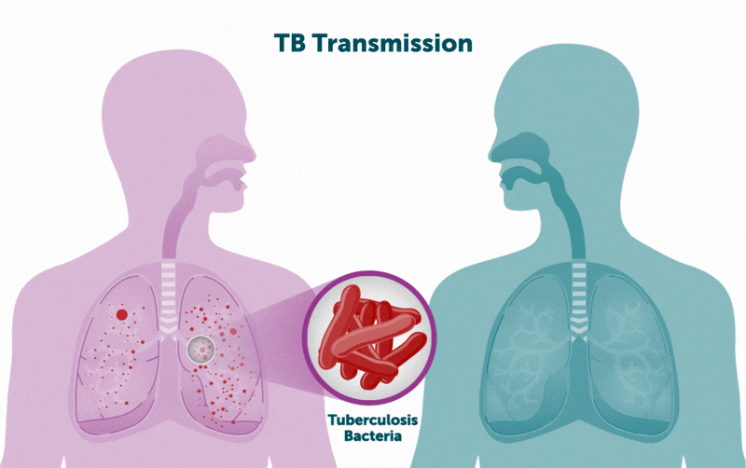
Tuberculosis
Caused by Mycobacterium tuberculosis (M. tb)
TB is cured with the right combination of drugs
Infects lungs or extrapulmonary sites (eyes, bones, brain)
No vaccine available to transmit transmission
Spreads person to person through the respiratory tract
Centers for Disease Control and Prevention. 2024. TB Transmission (image). https://www.cdc.gov/tb/causes
Notes:
TB is caused by the bacterial mycobacterium tuberculosis. You probably associate it as a lung disease but it can be found outside the lungs like the bones, eye, brain. Infectious Tb spreads person to person through the air. While there is no vaccine to prevent infection (the BCG vaccine can prevent severe forms of TB), it is curable to combination drug therapy.

Slide 9
Binary Description of TB
Latent TB Infection
Individual harbors low numbers of viable TB organisms without clinical or radiologic findings of active disease
  Positive TB blood or skin test
  Chest radiograph not-consistent with TB
  No symptoms
  Non-infectious
Active TB Disease
Number of TB organisms increase with clinical and/or radiologic manifestations
  Pulmonary: cough, fever/chills, night sweats, weight loss
  Extrapulmonary: symptoms depending on site (e.g., lymph, bone, pleural space, central nervous system)
Notes:
The old way of thinking of TB is very binary – latent TB infection and active TB disease. In LTBI, someone has inactive bacteria. Their skin or blood test is positive, but they have no additional TB signs or symptoms. They cannot spread the infection. Then there’s active TB disease. About 5-10 percent of healthy adults will develop active TB from a latent infection at some point. Active TB is when that bacteria is multiplying and the patient starts to have those classic symptoms like weigh loss and a cough – or if outside the lungs they can have lymph node swelling or other findings.

Slide 10
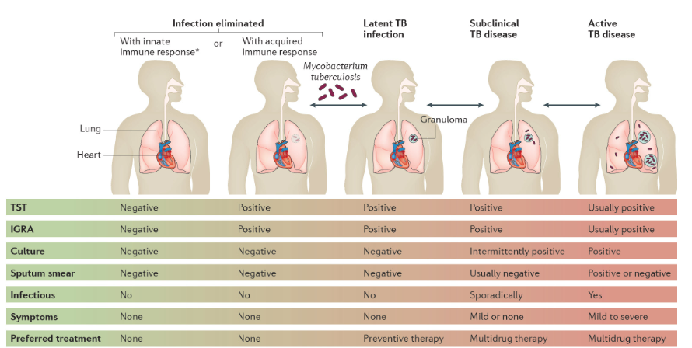
TB Viewed as a Spectrum
https://communities.springernature.com/posts/the-spectrum-of-tuberculosis-and-why-it-matters
Notes:
The newer way to think about TB is on a spectrum. On the left, you have someone who has inhaled the germs but their immune system has eliminated the bacteria either by an innate immune response or by an acquired immunity. We have contacts in the same house as some with with active TB who never test positive on their TB screening, whereas others may go onto develop latent TB infection which we previously described. It is estimated that 25% of the world's population is latently infected. But only a small proportion will progress to active TB disease. I’d like to point out that before active TB when the pt has a cough and other classic TB sigs, we have subclinical TB. That latent infection is awakened, but you may not see extensive disease yet. What’s important to know here is that not all tests are positive in someone with active TB and we can catch disease early when it’s recognized across the spectrum.

Slide 11
Importance of Understating TB Diagnostics
TB can be identified early in the active stage before onset of more obvious signs or symptoms.
Screening tests can be negative in TB disease
2020 study*: 1,230 TB cases; 17.2% were IGRA negative
TB diagnostics impact treatment, care, and the public health response of TB programs statewide.
*https://www.sciencedirect.com/science/article/pii/S2531043719302090
Notes:
This leads to the important of TB diagnostic tests and recognizing TB. Any healthcare provider, ICP, or public health professional should know that TB can be identified early – that’s the goal, so its recognized and contained. Not all screening tests will be positive in someone with active TB. A 2020 study found that out of 1,230 TB cases, 17.2% were IGRA negative. And

Slide 12
TB Risk Factors
Exposure Risks
Progressing to TB Disease
Close contacts to infectious TB
People from or who spend extended time in countries where TB disease is common
Employees, residents of high-risk congregate settings
Health care workers exposed to TB patients
Infants, children, and adolescents exposed to individuals with TB risk factors
Children < 5 years old
Recent MTB infection (2 years)
Substance use disorder
Immunosuppression:
HIV, diabetes, kidney disease, pregnant, head/neck cancer
Medications: biologics, prednisone, chemotherapy
Low body weight
Smoker (current or former)
Notes:
TB should always be considered in someone with TB s/s and who are at risk : we consider who is at risk of exposure to TB? That includes close contacts to TB cases, those born outside the US where TB is more common, and those living in and working in congregate settings where TB can be more common. Once exposed, those individuals and become infected with TB and progress to active TB disease. Those most at risk for that progression are kids under age 5, contacts within the first 2 years of exposure, people whose immune systems can’t fight off the bacteria – due to HIV, diabetes and kidney disease, or medications – you may see those long commercials for biologics meant to suppress the immune system and they say “talk to your doctor about getting tested for TB”. Finally people with poor nutrition and any history of smoking can make someone more susceptible to disease once exposed and infected.
About 10% of healthy individuals with that latent or inactive TB infection will develop active TB in their lifetime – so everyone in this room who is involved in healthcare and in any type of screening activities should really understand the importance of not only how to screen for TB, but how to recognize the disease and make sure patients are connected to care.

Slide 13
TB Diagnostics
Notes:
So – how is TB diagnosed

Slide 14


Multiple Considerations When Diagnosing MTB
Medical History
Signs, Symptoms
Social History
IGRA or TST
Bacteriology
Chest
Radiograph
TB Risk Factors
Notes:
It’s really a combination of understand the patient’s risk for TB, any medical risk factors that can increase their chance of having TB disease, their social history which could point to possible TB exposures, their symptoms, their TB screening test results, and other diagnostics.

Slide 15

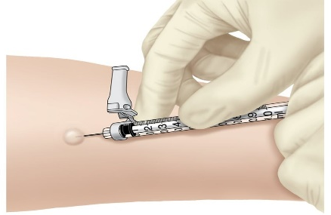
TB Screening Tests
Tuberculin Skin Test (TST)
Interferon Gamma Release Assay (IGRA)
Considered for patients who refuse or unable to tolerate phlebotomy
Requires two visits: placement and reading 48-72 hours later
Subjective results: consideration must be made to placement, reading
QuantiFERON TB Gold or T-Spot
Preferred screening test for at-risk individuals
Discriminates between TB infection
  Non-TB mycobacterium (NTM)
  BCG vaccine
One visit; objective results
Notes:
You may be familiar with the TB blood test called the IGRA and the tuberculin skin test. Both looks for evidence of TB infection. The IGRA is the standard of care now – it discriminates between TB infection and those Non-TB infections and will not interfere with BCG vaccine. The TST is still a usable test – but it takes some skill and subjectivity to interpret. Either test will be positive in someone with LTBI, but could be pos or neg with TB disease.

Slide 16
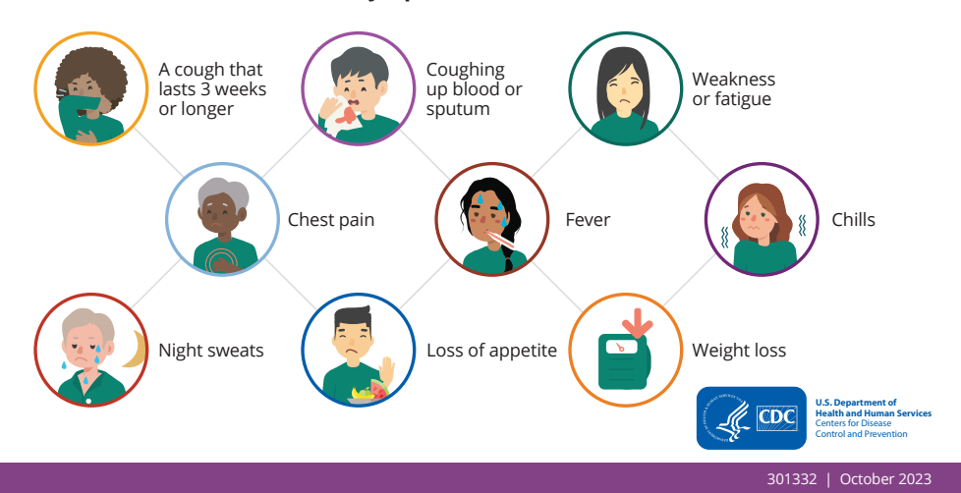
TB Symptoms
Notes:
Along with using the IGRA or TST, patients should always be screened for symptoms - fever chills, night sweats. Keep in mind these can look very different in someone with extrapulmonary TB and in kiddos who may present differently – such as vomiting, lethargy, not playing as much.

Slide 17
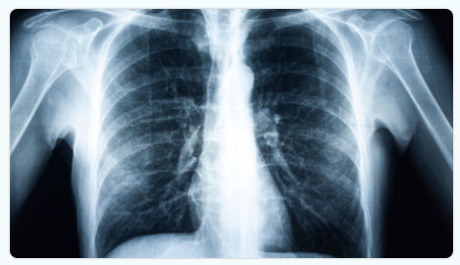
Radiology
Radiology findings that are suspicious for TB:
  Consolidation or ill-defined opacities
  Cavity
  Granuloma
  Lymphadenopathy
  Miliary findings
  Nodules
  Masses
Posterior/anterior (PA) view for age 18 and older
PA and lateral for children under age 18, immunocompromised individuals.
https://www.cdc.gov/niosh/chestradiography/php/about/index.html
Notes:
A key part of the diagnostics puzzle includes radiology– as TB usually affects the lungs, it’s about going to the source. Does that CXR show evidence of that infection brewing – remember the spectrum. TB findings on a CXR may include consolidation, opacities, granuloma or nodules
cavitary lesions have had the infection long enough for an access to form in their lungs, whereas someone with with latent infection will have a normal CXR.
The viewing of the CXR is important – you want a posterior/anterior view for adults and also a lateral view for kids so that the radiologist can really see all angles in kiddos.

Slide 18
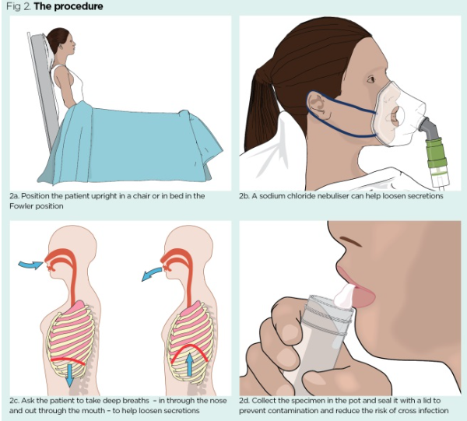
Bacteriology and Ideal Sputum Collection
Sputum – coach patient to have a deep cough
Collected early morning
Three consecutive specimen collected 8-24 hours apart
Biopsies from extrapulmonary sites can be tested. These may be the only specimen to diagnose TB
https://www.nursingtimes.net/assessment-skills/specimen-collection-4-procedure-for-obtaining-a-sputum-specimen-11-09-2017/
Notes:
Finally, the last piece of the diagnostics puzzle includes specimen collection. In a hospital setting, a patient may or may not have access to respiratory therapy where they can be coached, but a good ICN or nurse can instruct the patient on sitting up, taking deep breaths, and expectorating a deep sputum specimen vs. spitting up saliva. For TB testing, the specimen should ideally be collected early morning when it’s been kind of consolidating in the lungs. Three specimen are collected 8-24 hrs apart and submitted to the lab for AFT smear, PCR, and culture. Jan will talk more about why those tests are so important for TB beyond just an initial diagnosis. Biopsies can be done from extra-pulm sites such as lymph node aspirate.

Slide 19
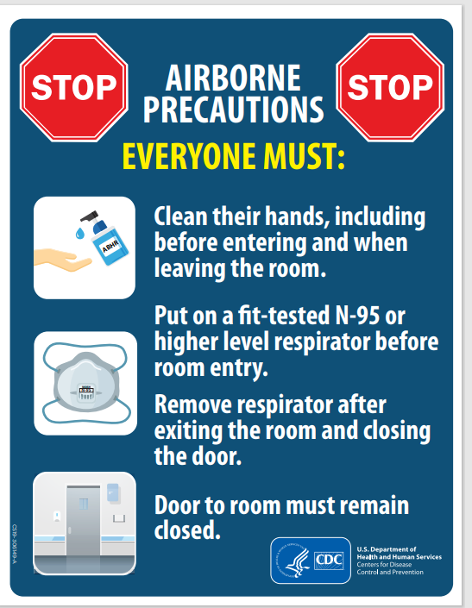
TB Infection Control
In congregate settings: airborne infection isolation (AII)
Controlled airflow/negative pressure
N-95 worn by healthcare worker
Surgical mask worn by patient
Visitation is limited/strict
In public health/home settings: TB isolation and restrictions
Surgical mask for patient
N-95 for healthcare staff
Limitations for going in/around community until no longer infectious
Notes:
When TB is suspected or known, the disease must be contained. In hospital and congregate settings, infection control measures focus on Airborne precautions – in the community, public health programs focus on starting effective therapy and minimizing transmission through surgical masking, and limitations on contact exposures until the patient is cleared from isolation

Slide 20
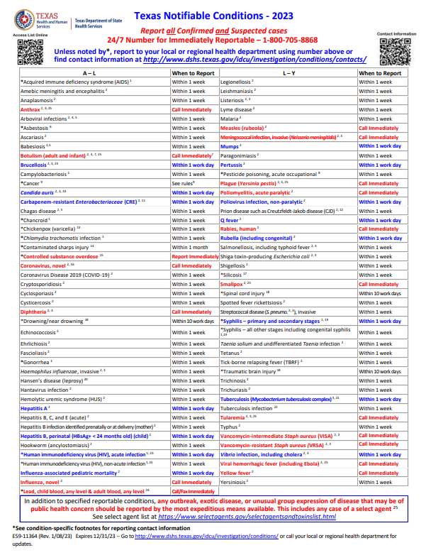
Reporting TB to Public Health Departments
Known/Suspected TB Disease: Report within One Working Day
Clinically or lab confirmed disease
Includes all M. tb complex: M. tuberculosis, M. bovis, M. africanum, M. canettii, M. microti, M. caprae, M. pinnipedii.
Latent TB Infection: Report Within One Week
  https://www.dshs.texas.gov/notifiable-conditions
Notes:
And once TB is diagnosed or even suspected, it should be reported to public health right away. I’ll go into detail later about why this is so crucial, but here is the link to the DSHS notifiable conditions. LTBI is reportable in 1 week.

Slide 21
Understanding TB Bacteriology Results
Jan Owen
DSHS Mycobacteriology/Mycology Laboratory Manager
Notes:
So should we be screening everyone who walks in the front door.

Slide 22
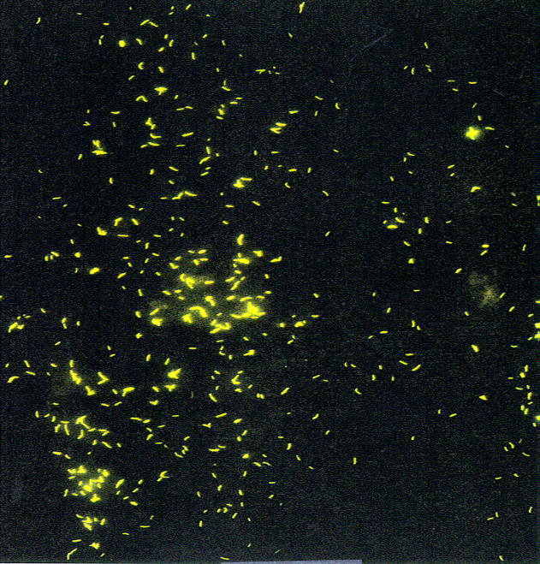
Acid Fast Bacilli Microscopy (AFB Smear)
  Rapid, inexpensive & universally available
    For new patients
      Detects the most infectious patients
      Identifies priority specimens for nucleic acid amplification (NAA) testing
      For existing patients
        Helps monitor response to therapy
Problems
  Not sensitive - misses ~50% of TB
    5,000 to 10,000 AFB/ml must be present to be detected in 1 drop for smear
  Positive smear may be a non-tuberculous mycobacteria species
  Can detect dead organism
5
Notes:
For existing patients, want to see smear quantities decrease.
Because of poor sensitivity, it’s possible to have a negative smear but a positive culture.
NTM needs HPLC for ID
Patient can cough up a deep pocket of dead organism, causing positive smear but culture will be negative.

Slide 23
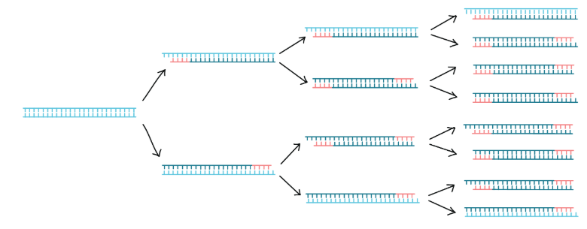
Nucleic Acid Amplification Test (NAAT)
Tiny amounts of DNA/RNA are amplified (copied) until there is enough for easy detection (PCR or Polymerase Chain Reaction)
DNA/RNA is examined
  Identification of MTB culture
  Detection of certain mutations conferring rifampin resistance
Notes:
Rifampin is the most important first line drug.

Slide 24
NAAT
Detects M. tuberculosis complex nucleic acids; does not distinguish between live and dead bacilli
  For initial specimens only
  Not suitable for follow-up specimen or monitoring; cured patients may be NAAT + for years!
  Repeat patient specimens are screened out for 1 year
Sensitivity of test
  >95% for AFB smear-positive
  Only 55-75% for AFB smear-negative
Notes:
Like with the smear, a specimen can be NAAT negative but culture positive and vice versa.

Slide 25
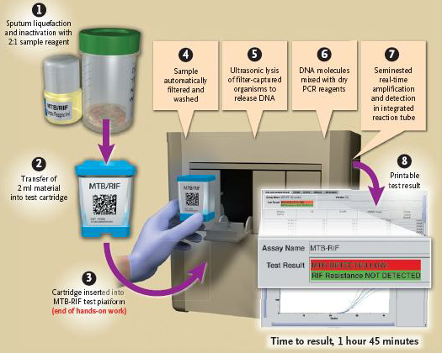
Cepheid GeneXpert MTB/ RIF NAAT Test
Boehme et al. NEJM 2010

Slide 26
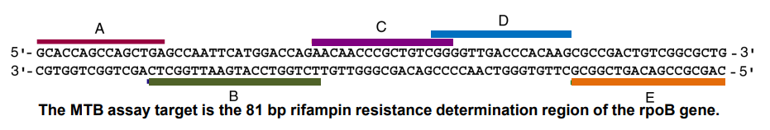
Cepheid GeneXpert ® Target Region
Approximately 10% of rifampin resistant predictions are false and are often found when Probe B does not bind
GX Rifampin resistant results must be confirmed by molecular detection of drug resistance (MDDR)

Slide 27
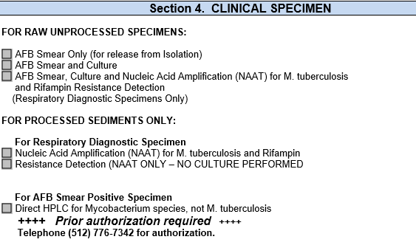
Requesting NAAT from DSHS Austin Laboratory
9
DSHS automatically performs NAAT on new
patient smear positive respiratory specimens
Notes:
Discuss bottom two boxes.

Slide 28
CDC Molecular Detection of Drug Resistance (MDDR)
Test Indications
  Known/possible drug-resistant case or contact to drug resistant TB (DR-TB) case
  Previous TB treatment
  Patient from an area with high rate of DR-TB
  Large public health impact
  Mixed or nonviable culture
  Can be done on culture isolates or directly from NAAT positive specimens

Slide 29
MDDR
Provides 7–10-day DNA sequence analysis for drug resistance prediction
12 different anti-TB drugs sequenced
MDDR complements conventional DST
Used alone, MDDR and conventional DST are imperfect
Used together, accuracy of drug resistance or susceptibility detection can be improved
Conventional DST results are still needed to confirm susceptibility to individual drugs.
Notes:
Discuss why conventional DST is still needed.

Slide 30
AFB Culture
More sensitive than smear
  5,000 to 10,000 AFB/ml must be present to be detected in 1 drop for smear
  ~10 viable AFB/ml must be present for culture to grow
Requires a quality specimen and may be lost due to excess contamination or low volume
Used to monitor patient response to treatment (like smear)
Required for drug susceptibilities & genotype (WGS)
Lengthy
  Cultures are held for 6 weeks before being called negative
12

Slide 31
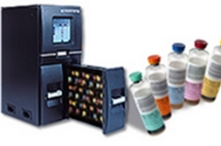

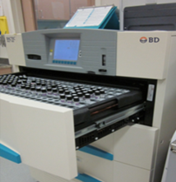
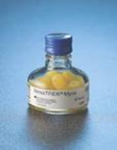
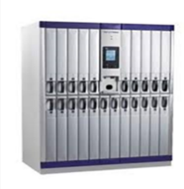
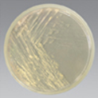
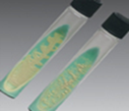
AFB Culture Media
Liquid (broth) culture: Three liquid systems are FDA-cleared
Solid medium
Biomerieux BacT/ALERT®3D
Becton Dickinson BACTEC™ MGIT™
Thermo Scientific VersaTREK™
7H11 media
LJ media

Slide 32
Drug Susceptibility Testing (DST) of M. tuberculosis complex
Current DSHS Regimen
  Initial isolate will be tested against first-line drugs (FLD) and a fluoroquinolone
    Isoniazid (2 concentrations), Rifampin, Ethambutol, Ofloxacin, Pyrazinamide (tested by WGS)
    Repeat test if patient is culture+ after 3 mo. of treatment
  For isolates resistant to Rifampin or to any 2 FLDs: test second-line drug panel
    Ethionamide, Rifabutin, Capreomycin, Kanamycin, Streptomycin
Notes:
This is conventional agar DST; mention PZA issue

Slide 33
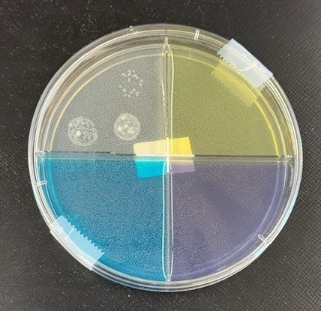
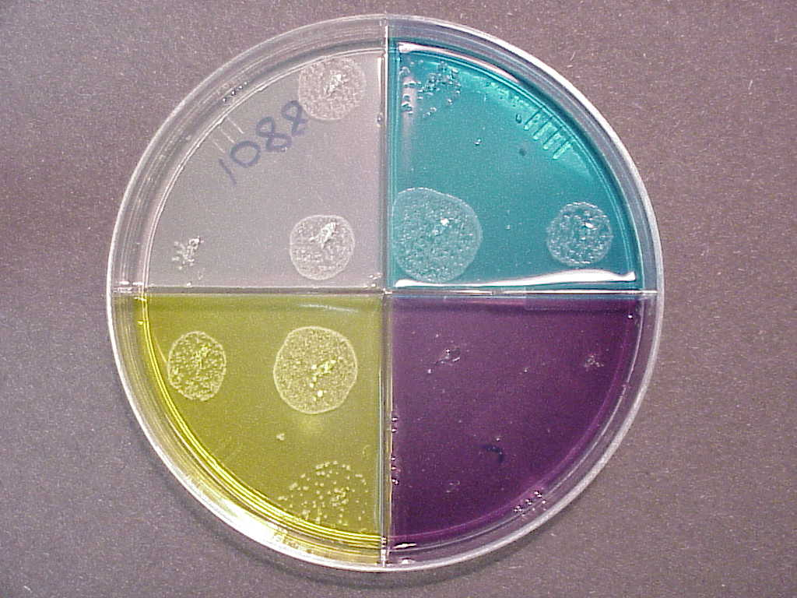
Multidrug Resistant Tuberculosis
Drug Free Control Isoniazid susceptible
Drug Free Control
Rifampin resistant
Rifampin susceptible Ethambutol susceptible
Isoniazid resistant
Ethambutol susceptible
Notes:
Explain colony counts

Slide 34
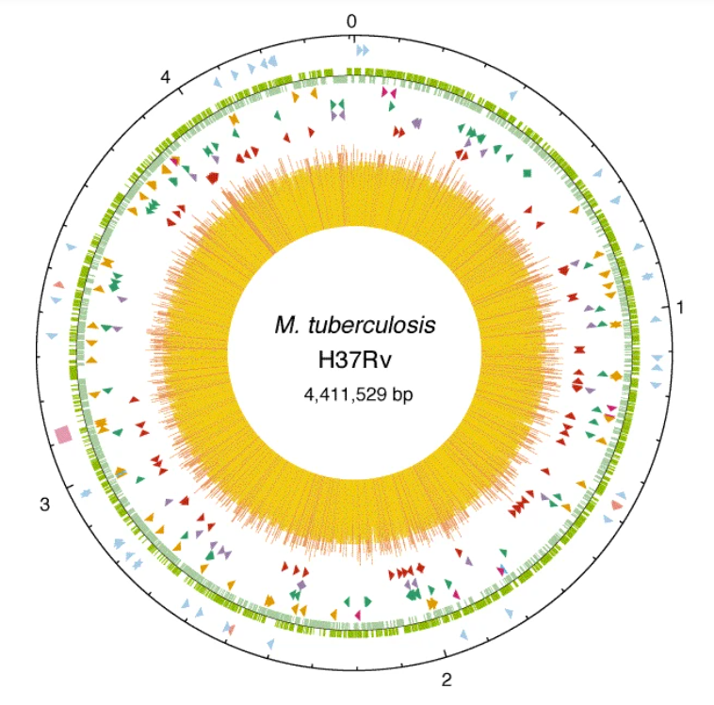
Molecular DST using
Whole Genome Sequencing
WGS looks at entire DNA profile of MTB complex
Originally instated to obtain PZA results
  Results also available for Isoniazid, Rifampin, Ethambutol and Ofloxacin (Fluoroquinolone)
  Reports list specific mutation(s) present and state whether susceptible or resistant
Notes:
Pic is the DNA profile of MTB cx.
Even though it’s called Whole genome sequencing, some resistance may be missed if mutations are present at low frequencies or if a new/novel resistance-associated gene is present. Must use in conjunction with conventional DST.

Slide 35
Public Heath’s Role in TB Care
Notes:
Lets take a deeper dive into the public health’s role in TB care

Slide 36
Patient #1: Suspected TB is Diagnosed in Hospital
Patient presents with cough, fever, weight loss
Radiology (CXR) performed: opacities in lower lobes
IGRA is positive; TB is on the differential
Patient admitted to hospital
Infectious disease is consulted
Sputum is ordered
Notes:
So – what happens when a provider has a patient they think has TB in the hospital setting and why are the tests done in the hospital so very important to public health? Consider this scenario:

Slide 37
Suspected TB In Hospital
Sputum is AFB smear positive
Suspected TB is diagnosed
TB therapy is started
Patient is reported to public health
Patient is discharged and follows up with health department
This specimen is incredibly important for public health follow-up
Notes:
…pt discharged. This scenario is ideal and happens often when ICNs report to the health dept. this is more straightforward TB. But what about those instances when it’s not so straightforward?

Slide 38
Patient #2: TB Disease is Not Yet Diagnosed
Patient presents with fever and cough
Patient is admitted, infectious disease consulted
TB considered on the differential diagnosis
Patient can’t produce sputum; bronchoscopy performed
IGRA negative, AFB is smear negative and culture is pending
Patient is treated for pneumonia and sent home but possible TB was not reported
This specimen can be the key to diagnosing TB and starting the patient on adequate treatment
Notes:
Another scenario is pt #2. present with cough….TB was never really ruled out. In that case – what do you do? The patient is discharged. He may not ever show back up. The specimen was sent off, someone will follow up, right? What may not be considered here is that this patient was recently released for serving 8 months in a state prison. He is a smoker and while he is housed now, he was homeless prior to his incarceration. He had all the TB symptoms and risk factors, but testing was thought to be negative for TB.

Slide 39
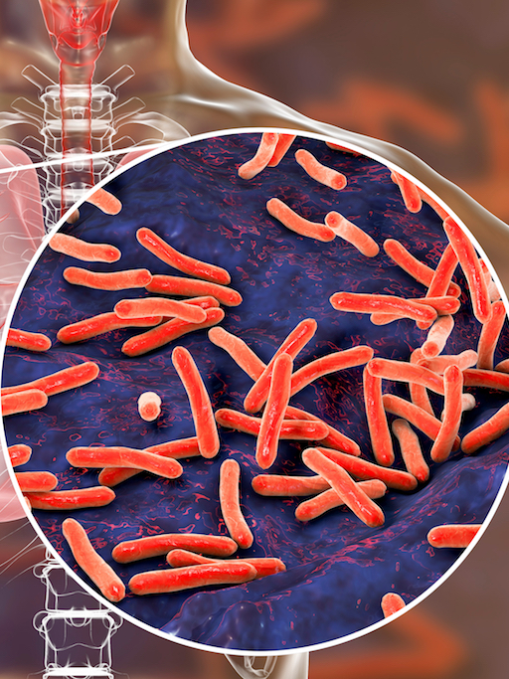
Think TB and Report TB
Anytime TB specimen is collected, and TB remains on the differential, public health should be informed
One negative test does not rule out TB in a patient with concerning signs and symptoms
Infection preventionists, laboratorians, providers, and community clinics all have a roles in supporting the right TB diagnostics that impact public health
Notes:
Anytime TB specimen is collected, and TB remains on the differential, public health should be informed to follow up on final results which may come months later
One negative test does not rule out TB in a patient with concerning signs and symptoms
Infection preventionists, laboratorians, providers, and community clinics all have a roles in supporting the right TB diagnostics that impact public health

Slide 40
Coordinated Efforts to Cure TB and Protect the Public
TB diagnosed in healthcare setting
Reported to public health for treatment, specialized diagnostics
Contact investigations identify exposed persons, protect public health
Notes:
So by now, we’ve emphasized the importance of diagnostic testing in TB – and a lot of that initially happens outside of public health. So when a patient is reported to public health, what is the role of that health department? And how are they prepared to protect the public and the patient when TB is diagnosed?

Slide 41
Statewide TB Infrastructure
Local Health Departments
Public Health Regions
Binational TB Programs
Laboratory Support
DSHS laboratories: Austin, Harlingen
DSHS Pharmacy Unit
Heartland National TB Center
Medical consultation, training, education
Texas Center for Infectious Disease
30 local health department (LHD) contracts for TB services
Eight public health regions (PHRs)
Four binational in border counties serving Texas/Mexico
Directly observed therapy (DOT) packs
Compounding
Free-standing TB hospital
Notes:
We have a robust TB infrastructure in our state for addressing TB. It involves

Slide 42
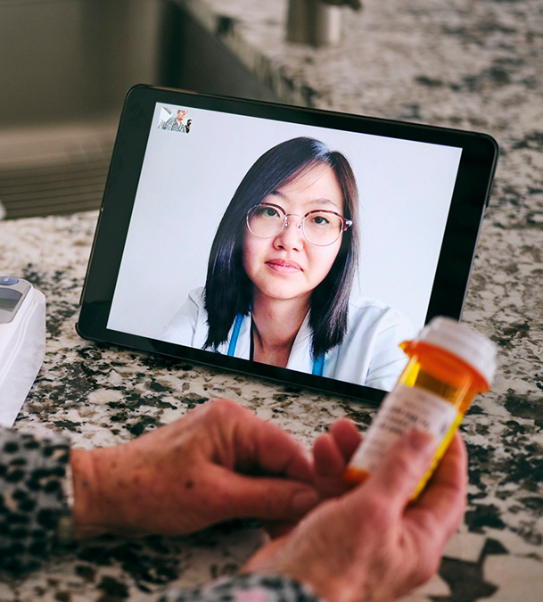
Public Heath's Role in TB Case Management
Treatment is provided by directly observed therapy (DOT)
  Video DOT can be used
  Supports treatment completion (Alipanah et al., 2018)
Diagnostics continue until patient is no longer infectious
Nurse case managers monitor, address medication toxicities
Contact investigators ensure contacts are screened and if needed treated
https://www.cdc.gov/high-impact-prevention/php/case-studies/directly-observed-therapy-tb.html
Notes:
During care we start RIPE and then take off meds once we know the disease type. Our drugs change – for example, a patient who is RR may be started on xxx it’s crucial that we still process that specimen…
a metanalysis in 2018 showed that DOT among other patient-centered approached improved treatment outcomes for TB patients.

Slide 43
TB Specimen Used for Genotyping
Genotyping looks at bacterial DNA to determine genetic relatedness of TB strains from different patients with positive TB cultures
Helps understand transmission relationship between cases
Notes:
Identical genotypes with epidemiologic linkages can indicate recent transmission and confirm suspected exposures
We have used culture results that are genotyped to track in TX
For ex, DSHS is following xx number of clusters
One started in 2019 and xxx
So those pts in your hospital may be part of that cluster –

Slide 44
Case Scenario

Slide 45

A Child with TB Meningitis
9-month-old presented to emergency department with lethargy, fever for 3 weeks
  Recent medical history included fever, diarrhea and vomiting; previous medical exams noted viral infection
Further work-up revealed basilar meningitis – on the differential was fungal meningitis and TB
Child’s TST was 9 mm
Notes:
Elevated white blood cell count; CT scan showed hydrocephalus

Slide 46

Case Study, continued
Lumbar puncture performed; specimen sent for culture
Gastric aspirates collected based on abnormal radiology
Hospital was unaware of any TB exposure; both parents denied having TB symptoms
Subsequently diagnosed with TB meningitis; started on RIPE therapy and steroids until stable for discharge.
Notes:
Elevated white blood cell count; CT scan showed hydrocephalus

Slide 47
Public Health Considerations
Who is following up with the results of the lumbar puncture?
What happens if the specimen is smear negative?
Do the parents know that the medications are available at no cost by the health department?
Is there anyone else sick at home?
Where was the child exposed to TB?
What should the hospital do to support public health’s role in this child’s care?

Slide 48
Impact to Public Health
Responsibility of the health department to make sure the child is cured, and other contacts are identified.
  The child must take TB therapy by DOT as an outpatient.
  The health department can start a source case investigation to determine how the child became infected with TB.
  Genotyping can inform any epidemiologic links and track brewing TB clusters in the state
Follow up on the testing of the lumbar puncture – this may be the only chance to test for TB and drug susceptibilities!
Notes:
Child has a 4 – year old sister at home Child’s babysitter ultimately identified as the source case; she spent one day a week with the child.

Slide 49
Take Home Points

Slide 50
Summary
Think TB in at-risk patients
Report known/suspected TB
Understand basics of TB diagnostics
Consider public health response

Slide 51
References

Slide 52
References
Texas Department of State Health Services:
  https://www.dshs.state.tx.us/idcu/disease/tb/policies/
  TB Prevention and Care for Correctional Facilities | Texas DSHS
Heartland National TB Center: http://www.heartlandntbc.org/training/
CDC’s Morbidity and Mortality Weekly Report: http://www.cdc.gov/tb/publications/reportsarticles/mmwr/default.htm
CDC website on TB Infection: https://www.cdc.gov/tb/topic/basics/tbinfectiondisease.htm
CDC website on TB in Specific Populations: https://www.cdc.gov/tb/topic/populations/correctional/default.htm
J.A. Santos, R. Duarte, C. Nunes. (2020). Host factors associated to false negative and indeterminate results in an interferon‐γ release assay in patients with active tuberculosis. Pulmonology, Volume 26, Issue 6, 2020, Pages 353-362. https://doi.org/10.1016/j.pulmoe.2019.11.001.
Alipanah N, Jarlsberg L, Miller C, Linh NN, Falzon D, Jaramillo E, Nahid P. Adherence interventions and outcomes of tuberculosis treatment: A systematic review and meta-analysis of trials and observational studies. PLoS Med. 2018 Jul 3;15(7):e1002595. doi: 10.1371/journal.pmed.1002595. PMID: 29969463; PMCID: PMC6029765.
The spectrum of TB and why it matters: The Spectrum of Tuberculosis and Why It Matters | Research Communities by Springer Nature

Slide 53
Contact Information
Speaker Contact Information:
Elizabeth.foy@dshs.Texas.gov
jan.owen@dshs.Texas.gov
DSHS TB and Hansen’s Disease Unit Program Website:
https://www.dshs.texas.gov/tuberculosis-tb
DSHS Laboratory Website:
https://www.dshs.texas.gov/laboratory-services/programs-laboratories/microbiology-unit/mycobacteriology-mycology

Slide 54
Thank You

