Slide 1
Preventable Adverse Event Reporting
2016 Spring Update
Vickie Gillespie
PAE Clinical Specialist
Texas
Department of State Health Services
Notes:
Welcome to the Preventable Adverse Event Reporting 2016 Spring Update.

Slide 2
Note Pages
Please view the Notes Pages which are complete with narrative. Thank you!

Slide 3
Objectives
Review the Annual Survey process.
Discuss assessment of harm.
Review reportable PAEs.
Describe the differences between SREs and HACs.
Review selected Tier 2 and 3 PAEs.
Share 2015 PAE findings.
Discuss case scenarios/FAQs.
Review “Report No PAEs” timeline.
Review the resources that are available on the PAE website.
Inform participants of upcoming training.
Give contact information and answer questions.
Notes:
My objectives for this presentation are listed here.

Slide 4
Annual Survey
The Annual Survey—is required for all facilities. It will provide statistics to include on your Healthcare Safety Consumer and Technical Reports:
  Number of hospital beds (Hospitals)
  Number of patient days (Hospitals)
  Number of admissions (Hospitals)
  Number of procedures (ASCs)
Information submitted is also used for the DSHS Annual Healthcare Safety Report.
Notes:
The first few slides are instructions for completing the Annual Survey—which is required for all facilities. It provides statistics that we use in two ways—we post your numbers on your Consumer and Technical Healthcare Safety Reports on the internet for the public. Secondly, we use the aggregate numbers in the Annual Healthcare Safety Report that is available for anyone on Healthcare Safety website.

Slide 5
Where is the Annual Survey?
Facilities that submit HAI data to NHSN for Texas reporting will complete the annual survey in NHSN which is then exported to TxHSN with the HAI data.
All other facilities will complete the annual survey in TxHSN.
PAE users should complete the annual survey NO LATER than June 30th for the previous calendar year.
Notes:
One important distinction is that if your facility reports infection data to NHSN, then you will complete the survey in NHSN. We will import that data with your infection data. All other facilities, including most ASCs and some hospitals that do not have to report to NHSN will complete the annual survey in TxHSN. You should complete the survey no later than June 30th in order for the numbers to be posted with your H1 report.

Slide 6

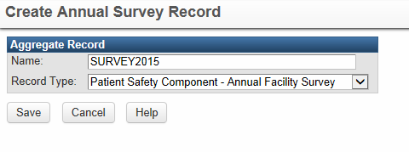
Where is the Annual Survey?
To start, click on the Create Survey Icon on the TxHSN Main page.
Enter SURVEY2016 for the name and choose the Facility Survey record type. Then Save.
Notes:
To enter your annual survey in TxHSN, click on the Create Survey Icon on the TxHSN Main Page. The Create Annual Survey Record screen will then appear and you will need to enter a name for your survey. Enter SURVEY2016, for this year of 2016. The Record Type should already say “Patient Safety Component – Annual Facility Survey”. If not use the pull down menu to find it. Then Save.

Slide 7
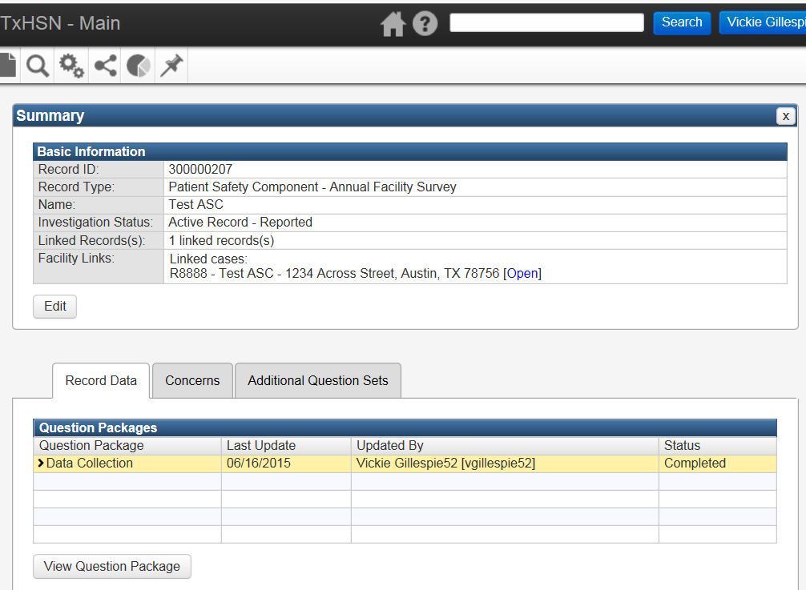
Where is the Annual Survey?
The Annual Facility Survey dashboard will now appear. Double Click on Data Collection or Click on View Question Package.
Notes:
The Annual Facility Survey dashboard will now open. As with all dashboards in TxHSN, the Question Packages appear in the middle of the page. IN this case, it is the Data Collection QP. Highlight it and click on View Question Package or double click on the Data Collection bar to open the QP.

Slide 8
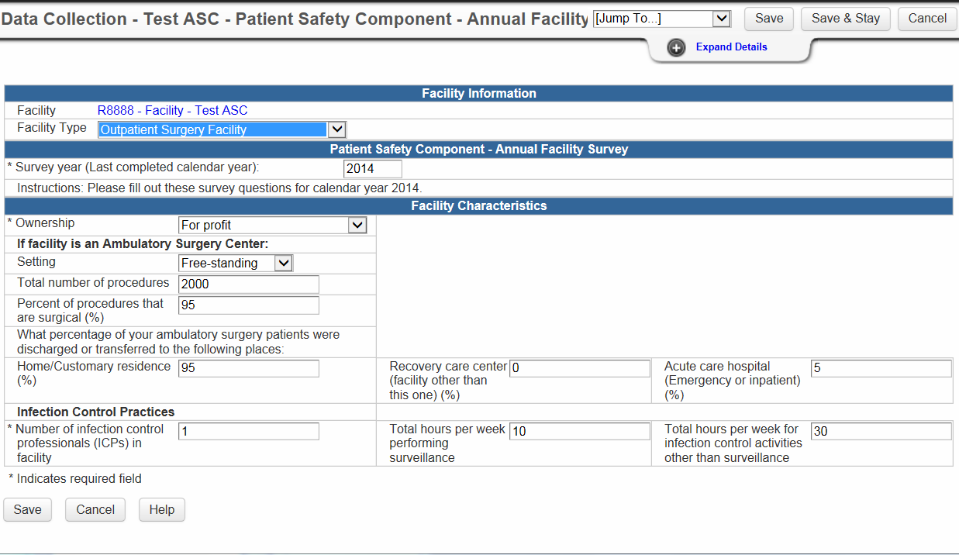
Annual Survey--ASC
Complete all the questions. Enter 2015 as the *Survey Year and answers should be for 2015.
Be sure to SAVE!
Notes:
Now you will enter the data collection page. The slide shows an Annual Survey for ASCs. Your facility ID is at the top in blue. You will need to use the pull down menus or fill in the boxes for all the questions on the screen. NOTE: for the Survey Year question, it says to enter the Last Completed Calendar Year. So in 2016, you would enter 2015 in this box as that is the last year for which you have a full calendar year of data. Therefore, all the answers to the questions on this annual survey that you complete in 2016, should reflect your 2015 data.
Be sure to SAVE!

Slide 9
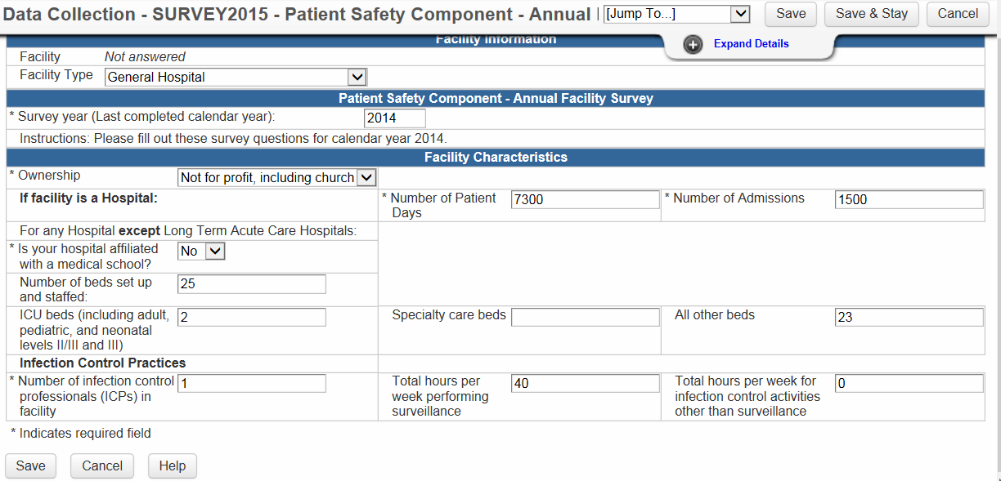
Annual Survey--Hospital
Complete all the questions. Enter 2015 as the *Survey Year and answers should be for 2015.
Be sure to SAVE!
Notes:
The same thing applies for a few hospitals who are not required to and do not report HAI data to NHSN. This slide displays the Annual Survey QP for Hospitals. Complete all the questions -- again for the Last Completed Calendar Year.

Slide 10
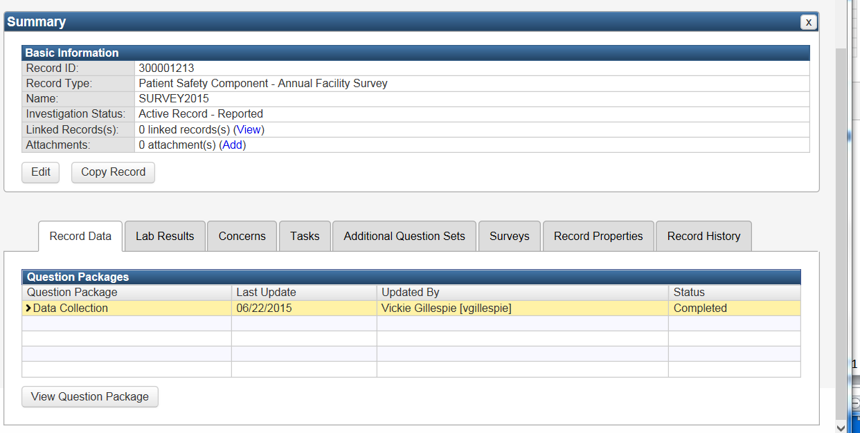
Annual Survey
Ignore Status in the Facility QPs
Once you save, the Annual Facility Survey survey will be maintained in TxHSN. If you return to the question package, your answers should be there.
Notes:
Once you have clicked save, you will be returned to the Annual Facility Survey dashboard. As we have previously stated, ignore the status column as it may not accurately reflect the completion of your survey. If you want to check and see if the survey is completed you can return to this screen and open the Data Collection QP and your answers should all be present. If not you can complete the survey and don’t forget to save.

Slide 11
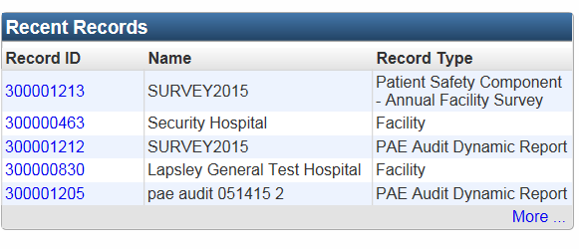
Annual Survey
Your Annual Survey will now appear in your Recent Records Box.
Notes:
Once you X our of the dashboard, your SURVEY2016 will appear in your recent records box. You can also double click on the blue Record ID and you will be returned to the survey screen.

Slide 12
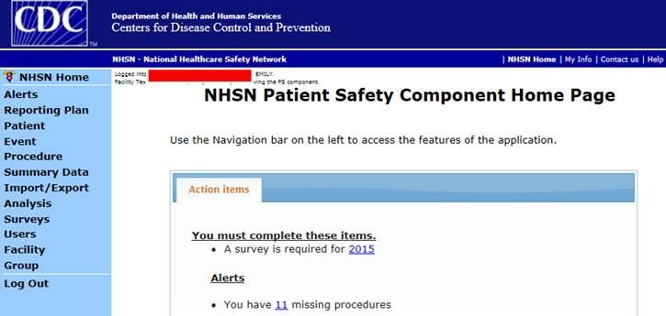
NHSN Users Annual Survey Alert
NHSN users will see this alert when they log into NHSN if they have not completed the annual survey.
Notes:
For those facilities that report HAI data into NHSN and DSHS imports your data (you have conferred rights to do so), your Annual Facility Survey is also imported. However, if you log into NHSN and see this Alert, then you still need to complete the Annual Survey.

Slide 13

IDRR in TxHSN—Note Re: Survey
For all users, HAI and PAE, if this sentence appears in your IDRR report, then you need to complete your survey—in NHSN or in TxHSN as appropriate.
Notes:
Both PAE and HAI users will see this statement at the top of their IDRR (Internal Data Review Report) in TxHSN. This will remind you that you still need to complete your survey.

Slide 14
Assessment of Harm
PAE’s that start with the words “Patient Death or Severe Harm” are reportable if the assessed level of harm is Patient Death or Severe Harm.
PAE’s that do not start with those words, e.g. Foreign object retained after surgery, are all reportable regardless of the assessed level of residual harm.
There are 3 choices for the level of harm question:
  Death
  Severe harm
  Other (includes Moderate harm, Mild harm, No harm, Unknown harm)
Notes:
The Texas Administrative Code Chapter 200 lists each specific PAE. You can also find the lists in the PAE brochure on the resources page at www.paetexas.org.
Those PAEs that start with the words “Patient death or severe harm” are reportable if the assessed level of residual harm is patient death or severe harm.
Those PAEs that do not start with those words, e.g. Foreign object retained after surgery, are all reportable -- regardless of the assessed level of residual harm.
An assessment of the level of harm is required—and there 3 possible choices--Death, Severe Harm, and Other. Those PAEs that start with the words “Patient death or severe harm” must be answered with either of those 2 choices. However, those PAEs, that do not have that terminology “Patient death or severe harm”, can be answered with “Other” which includes Moderate harm, Mild harm, No harm and Unknown harm. Definitions for harm can be found on our website.

Slide 15
Severe Level of Harm
Severe Level of Harm: Bodily or psychological injury (including pain or disfigurement) that interferes significantly with functional ability or quality of life.
Severe Harm—injuries requiring a major intervention e.g.
  Surgery
  Transfer to a higher level of care
  Bone fractures (may exclude minor fractures that do not require surgery or do not significantly interfere with functional ability or quality of life.
Notes:
Here is the definition of Severe Harm which comes from AHRQ, the Agency for Healthcare Research and Quality. In addition, DSHS has added to our Definitions and Guidance document (which can also be found on the Resources Page at www.paetexas.org ) following Texas NOTE: For Texas DSHS Preventable Adverse Event Reporting, Texas agrees with the AHRQ Common Format definition of severe harm as shown above. In addition, a determination of severe harm would be indicated, but not be limited to: injuries requiring a major intervention e.g. surgery, transfer to a higher level of care, and/or injuries resulting in bone fractures or loss of body part, (excluding minor fractures that do not require surgical intervention and that do not significantly interfere with functional ability or quality of life).

Slide 16
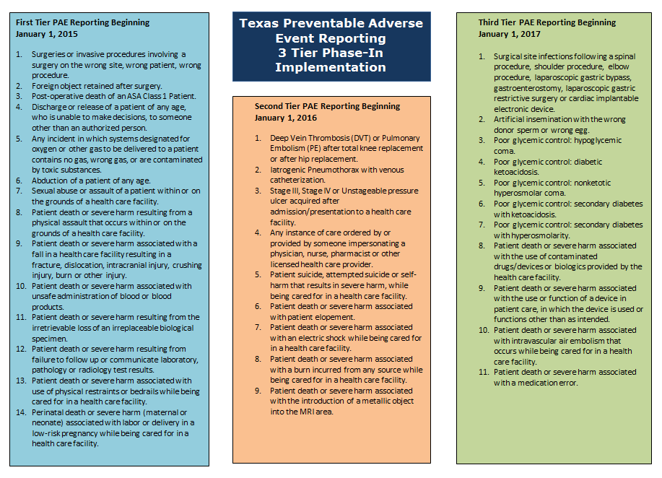
Notes:
This is the current PAE brochure produced by DSHS. Available on the PAE website www.paetexas.org on the Resources page or by contacting paetexas@dshs.state.tx.us

Slide 17
First Tier PAE Reporting--January 1, 2015
SURGICAL OR INVASIVE PROCEDURE EVENTS
Surgeries or invasive procedures involving a surgery on the wrong site, wrong patient, wrong procedure.
Foreign object retained after surgery.
Post-operative death of an ASA Class 1 Patient.
PATIENT PROTECTION EVENTS
Discharge or release of a patient of any age, who is unable to make decisions, to someone other than an authorized person.
Notes:
Here is a listing of the reportable PAEs that started in January 2015. These are divided by category. These categories are the same categories that are used by the NQF in the list of SREs.
You will need to know these categories when you go to enter your data.
You can find a document that displays the PAEs by category on our website www.paetexas.org

Slide 18
First Tier PAE Reporting--January 1, 2015
ENVIRONMENTAL EVENTS
Any incident in which systems designated for oxygen or other gas to be delivered to a patient contains no gas, wrong gas, or are contaminated by toxic substances.
Patient death or severe harm associated with use of physical restraints or bedrails while being cared for in a health care facility.
POTENTIAL CRIMINAL EVENTS
Abduction of a patient of any age.
Sexual abuse or assault of a patient within or on the grounds of a health care facility.
Patient death or severe harm resulting from a physical assault that occurs within or on the grounds of a health care facility.

Slide 19
First Tier PAE Reporting--January 1, 2015
Patient death or severe harm associated with unsafe administration of blood or blood products.
Patient death or severe harm associated with a fall in a health care facility resulting in a fracture, dislocation, intracranial injury, crushing injury, burn or other injury.
Patient death or severe harm resulting from the irretrievable loss of an irreplaceable biological specimen.
Perinatal death or severe harm (maternal or neonatal) associated with labor or delivery in a low-risk pregnancy while being cared for in a health care facility.
Patient death or severe harm resulting from failure to follow up or communicate laboratory, pathology or radiology test results.
CARE MANAGEMENT EVENTS

Slide 20
Second Tier PAE Reporting--January 1, 2016
SURGICAL OR INVASIVE PROCEDURE EVENTS
Deep Vein Thrombosis (DVT) or Pulmonary Embolism (PE) after total knee replacement or after hip replacement.
Iatrogenic Pneumothorax with venous catheterization.
PATIENT PROTECTION EVENTS
Patient suicide, attempted suicide or self-harm that results in severe harm, while being cared for in a health care facility.
Patient death or severe harm associated with patient elopement.
Notes:
These are the reportable PAEs for 2016. They are in addition to the PAEs that started in 2015.

Slide 21
Second Tier PAE Reporting--January 1, 2016
ENVIRONMENTAL EVENTS
Patient death or severe harm associated with an electric shock while being cared for in a health care facility.
Patient death or severe harm associated with a burn incurred from any source while being cared for in a health care facility.
POTENTIAL CRIMINAL EVENTS
Any instance of care ordered by or provided by someone impersonating a physician, nurse, pharmacist or other licensed health care provider.

Slide 22
Second Tier PAE Reporting--January 1, 2016
CARE MANAGEMENT EVENT
Any Stage III, Stage IV or Unstageable pressure ulcer acquired after admission/presentation to a health care facility.
RADIOLOGICAL EVENT
Patient death or severe harm associated with the introduction of a metallic object into the MRI area.

Slide 23
Third Tier PAE Reporting--January 1, 2017
SURGICAL OR INVASIVE PROCEDURE EVENTS
Surgical site infections following spinal, shoulder, elbow procedure; laparoscopic gastric bypass, gastroenterostomy, laparoscopic gastric restrictive surgery or cardiac implantable electronic device.
SURGICAL OR INVASIVE PROCEDURE EVENTS
Patient death or severe harm associated with an intravascular air embolism that occurs while being cared for in a health care facility
Notes:
These are the reportable PAEs that will be added January 1, 2017.

Slide 24
Third Tier PAE Reporting--January 1, 2017
PRODUCT OR DEVICE EVENTS
Patient death or severe harm associated with the use of contaminated drugs/devices or biologics provided by the health care facility.
PRODUCT OR DEVICE EVENTS
Patient death or severe harm associated with the use or function of a device in patient care, in which the device is used or functions other than as intended.

Slide 25
Third Tier PAE Reporting--January 1, 2017
CARE MANAGEMENT EVENT
Artificial insemination with the wrong donor sperm or wrong egg.
Patient death or severe harm associated with a medication error.
CARE MANAGEMENT EVENT
Poor glycemic control:
hypoglycemic coma
diabetic ketoacidosis
nonketonic hyperosmolar coma
secondary diabetes with ketoacidosis
secondary diabetes with hyperosmolarity.

Slide 26
Chapter 98 Requirements
Facilities shall report:
An event included in the list of adverse events identified by the National Quality Forum (SREs)
and
A health care-associated adverse condition or event for which the Medicare program will not provide additional payment to the facility under a policy adopted by the federal Centers for Medicare and Medicaid Services (HACs).
Notes:
Before we talk about some selected reportable 2016 and 2017 PAE events, I would like to remind you that Chapter 98 requires that General Hospitals and ASCs report any SRE events (developed by the National Quality Forum) and the HAC events – or hospital acquired adverse conditions that CMS has identified, and that CMS will not provide additional payment to the facility if they should occur during the hospitalization. In fact, facilities can be penalized now depending on the number that they report. These conditions are found in the claims data that is reported to CMS.

Slide 27
Serious Reportable Events--SREs
Serious Reportable Event (SREs) “Never Events”
  List of 29 events developed by the National Quality Forum (2002)
  https://www.qualityforum.org/Topics/SREs/List_of_SREs.aspx
Most begin with “Death or Severe Harm”.
Some SREs are also HACs.
There is not a list of associated ICD-10 codes for the SREs.
Notes:
The SRE’s or serious reportable events were developed by the National Quality Forum in 2002. Here is a link to the SRE list. All of the SREs are on our list of reportable PAEs. Most of them being with the words “Death or Severe Harm”, but not all of them. Some of the SREs are also on the list of HACs. There is not a specific list of ICD-10 codes for the SRE’s. There is guidance from the NQF and AHRQ in the Definitions and Guidance Document on the resources page at www.paetexas.org.

Slide 28
Hosp Acquired Conditions--HACs
Hospital Acquired Conditions (HACs)
  List of 14 Events/Event categories for which Medicare will not provide additional payment to the facility (2006)
  https://www.cms.gov/Medicare/Medicare-Fee-for-Service-Payment/HospitalAcqCond/icd10_hacs.html
  Condition not present on admission but is present on discharge
Notes:
The HACs comprise a list of 14 events or event categories. Here is a link to the CMS HAC excel workbook containing the applicable ICD-10 codes. If any of these codes appear on a claim for a discharge code and were not present on admission, that constitutes a HAC.
The reportable PAEs for Texas contain both SREs and HACs. Some that are only a SRE, some that are both, and some that are only a HAC.

Slide 29
HACs Reported to NHSN for Texas Reporting
CAUTIs in ICUs
CLABSIs in ICUs/NICUs (VCAIs)
SSI following CABG
SSIs following CIED in Children’s hospitals
SSIs following spinal fusion in Children’s hospitals
Notes:
These HACs have been and will continue to be reported through NHSN. Most hospitals and a few ASCs report to NHSN and confer rights to DSHS. We then import that data into our TxHSN program at which time facilities can review the data, make comments about the data, and then the public reports are published on the DSHS Data website.
These HACs will NOT be reported by PAE contacts into the TxHSN website but rather into NHSN by the HAI designated contacts.

Slide 30
HACs Reported to TxHSN as PAEs
Events that are only HACs are to be reported if they meet or would meet the HAC ICD-10 Codes--
  DVT/PE after hip/knee surgery (2016)
  Iatrogenic Pneumothorax (2016)
  Poor Glycemic Control (2017)
  SSIs for certain events (2017)
Notes:
This slide shows the reportable PAE events that are only HACs.
For these events, the only guidance is the ICD-10 coding. If an event occurs that would meet the coding requirements for a HAC, it would then need to be reported into TxHSN.
Again, events that meet the HAC rules are those that occur during a hospitalization, were not present on admission, and would meet the ICD-10 HAC codes on discharge. Therefore, in the case of DVT/PEs and SSIs--they would be reportable to TxHSN if they occur during the same hospitalization as the surgery. For ASCs, if a patient has a surgery (that is included on the ICD-10 code list for HACs) and during the same surgical stay, an applicable SSI is identified, it would have to be reported as a PAE.

Slide 31
HAC--SSIs to be Reported to TxHSN for PAE Reporting (2017)
Certain spinal, shoulder, elbow procedures (exception spinal fusion in Children’s Hospitals)
Laparoscopic gastric bypass
Gastroenterostomy
Laparoscopic gastric restrictive surgery
Cardiac Implantable Electronic Device (exception Children’s Hospitals)
Notes:
To reiterate, when a procedure is done that is on the HAC ICD-10 code list, and a SSI is identified during the same hospitalization as when the surgery /procedure was done, then these SSIs are reportable to TxHSN as a PAE. These SSI’s do not have to meet NHSN reporting guidelines.
The exceptions noted are this slide is because those SSIs in Children’s Hospitals have to be reported to NHSN, and we don’t want to require duplicate reporting.

Slide 32
ICD-10 Codes for 755 Surgical Orthopedic HACs
Notes:
This is a just a section of the HAC ICD-10 Code list for Orthopedic HACs. There are over 700 applicable specific elbow, shoulder and spinal procedures. In the example, a patient that has a fusion of the shoulder that meets one of the HAC ICD-10 codes as listed AND has a infection as coded above, that would meet as a reportable PAE to TxHSN.

Slide 33
Pressure Ulcers—SRE and HAC
HAC codes—include Stage III and IV
SRE—includes Unstageable
There are no ICD-10 codes for Unstageable (considered Stage III or IV)
Unstageable Ulcers are to be reported as a PAE—
  “Stage III or Stage IV or Unstageable pressure ulcer acquired after admission/presentation to a health care facility.
Notes:
For 2016, Stage III, IV or Unstageable Pressure Ulcers that occur during the hospitalization are reportable as a PAE. This PAE is a combination of the SRE and HAC. The Identification of these might be problematic since the Pressure Ulcers that are on the HAC list are only Stage III or IV, where as the SRE list includes Unstageable (which are considered Stage III or IV, but that cannot be determined because of eschar and wound debris in the wound bed). Therefore, PAE contacts should be alert to the fact that if they receive potential/actual HAC notifications internally they would miss an Unstageable Pressure Ulcer that occurs during the hospitalization. You must find an alternative way to monitor for this PAE.

Slide 34
PU Reporting Guidance
On Admission and Documented | Progresses to | Reportable?
Skin intact | Stage 3, 4 or Unstageable | Yes
Stage 1 | Stage 3 | Yes
Stage 1 | Stage 4 | Yes
Stage 1 | Unstageable | Yes
Stage 2 | Stage 3 | No
Stage 2 | Stage 4 | Yes
Stage 2 | Unstageable | Yes
Stage 3 | Stage 4 | Yes
Notes:
Here is a PU Reporting Guidance Table for you to use at your discretion. As you can see the pink column is for Skin condition reported on Admission and Documented, a blue column for pressure ulcer stage that occurs during the hospitalization and the green column for if it is reportable or not.
Stage 2 on admission that progresses to Stage 3 is excluded from reporting. This is an exclusion that was made by the NQF and we will follow it. Review the Definitions and Guidance Document for several paragraphs of descriptions and definitions.

Slide 35
545 PAEs Reported in 2015
Type of Event | Total Number
Patient Death or Severe Harm Associated with a Fall Resulting in a Fracture | 202
Foreign Object Retained After Surgery or Invasive Procedure | 121
Wrong Site Surgery or Invasive Procedure | 66
Patient Death or Severe Harm Associated with a Fall Resulting in an Intracranial Injury | 43
Wrong Surgery/Procedure | 29
Patient Death or Severe Harm Associated with a Fall Resulting in Other Injury | 17
Perinatal Death or Severe Harm (maternal or neonate) Associated with Labor or Delivery in a Low-Risk Pregnancy while being cared for in a health care facility | 17
Patient Death or Severe Harm Resulting from Failure to Follow Up or Communicate Laboratory, Pathology or Radiology Test Results | 11
Sexual Abuse or Assault | 8
207 Total Facilities Reported at least one PAE: 175 Hospitals 32 ASCs
503 PAEs 42 PAEs
Notes:
545 PAEs were reported in 2015 by a total of 207 facilities—175 hospitals reported 503 PAEs and 32 ASCs reported 42 PAEs.

Slide 36
521 PAEs Reported in 2015
Type of Event | Total Number
Any Incident in which Systems for O2 or Other Gas Contains No Gas, Wrong Gas, or are Contaminated by Toxic Substances | 8
Surgery or Invasive Procedure on Wrong Patient | 7
Patient Death or Severe Harm Associated with a Fall Resulting in a Dislocation | 6
Patient Death or Severe Harm Resulting from a Physical Assault that Occurs within or on the Grounds of a Health Care Facility | 3
Intra-operative or Immediately Post-operative Death of an ASA Class 1 Patient | 2
Patient Death or Severe Harm Associated with Use of Physical Restraints or Bedrails | 2
Patient Death or Severe Harm Associated with Unsafe Administration of Blood or Blood Products | 1
Patient Death or Severe Harm Resulting from the Irretrievable Loss of an Irreplaceable Biological Specimen | 1
Discharge or release of a patient of any age, who is unable to make decisions, to someone other than an authorized person | 1
TOTAL | 545

Slide 37
FAQ—Pulmonary Embolism
Q: A patient who was admitted to our facility after a fall with hip fracture. Patient cleared for surgery, with documentation that patient will not be a candidate for anticoagulant therapy (Pt is a high risk for bleeding). Patient underwent hip replacement without anticoagulant therapy and subsequently suffered a PE. Is this still reportable?
A. Yes, this would still be reportable. Even though in this case it seems that the PE was not preventable, you still must follow the legislative mandate to report it. You do have an opportunity to document the circumstances of an event in the Specifics QP as well as make a comment on the public report.
Notes:
A. Yes, this would still be reportable. Even though in this case it seems that the PE was not preventable, you still must follow the legislative mandate to report it. You do have an opportunity to document the circumstances of an event in the Specifics QP as well as make a comment on the public report

Slide 38
FAQ—Wrong Patient?
Q: Would a vaginal exam utilizing a vaginal swab on a wrong patient be considered an PAE for invasive procedure? If not, is this reportable?
No, this would not be reportable. A vaginal exam is not considered an invasive procedure. In the Definitions and Guidance Document (on the Resources page on the PAE website www.paetexas.org), a reference is made to the List of Invasive, High Risk or Non-Surgical Procedures, Institute of Clinical System Improvement. This reference appears the NQF Appendix B column for Wrong Procedure. This list states that a vaginal exam is not considered to be an Invasive, High Risk or Non-Surgical Procedure.
The list is (Appendix A) in the Non OP Procedural Safety Fourth Edition Sept 12.
Go to www.icsi.org and Search for it
Or try this URL: https://www.icsi.org/_asset/1hht9h/NonOR.pdf
Notes:
No. A vaginal exam is not considered an invasive procedure. In the Definitions and Guidance Document (on the Resources page on the PAE website www.paetexas.org), a reference is made to the List of Invasive, High Risk or Non-Surgical Procedures, Institute of Clinical System Improvement. This reference appears the NQF Appendix B column for Wrong Procedure. This list states that a vaginal exam is not considered to be an Invasive, High Risk or Non-Surgical Procedure.
The list is (Appendix A) in the Non OP Procedural Safety Fourth Edition Sept 12.
Go to www.icsi.org and Search for it
Or try this URL: https://www.icsi.org/_asset/1hht9h/NonOR.pdf

Slide 39
FAQ—Postpartum Hemorrhage
Q. Would a PPH event (per JC SE Policy) meet the criteria for a Perinatal PAE?
A: If a patient death or severe harm is associated with a postpartum hemorrhage and the event meets the remainder of the TxHSN criteria, then it would be a reportable Perinatal PAE. Determination of harm would be made by the facility’s patient safety team. Our guidance does not include an amount of blood loss or units of blood given. For Texas, consideration for severe harm would certainly mirror Joint Commission’s criteria of 4 units of RBCs, and further for Texas that determination could be made even with a lesser number of transfusions if other circumstances warrant it. In addition, the PAE for Perinatal events, includes the time frame within 42 days post-delivery while the JC event is the first 24 hrs postpartum.
Notes:
If a patient death or severe harm is associated with a postpartum hemorrhage then it would meet the criteria for a reportable Perinatal PAE. Our guidance does not include an amount of blood loss or units of blood given. Determination of harm would be made by the facility’s patient safety team. However, the administration of 4 units of packed red blood cells is a severe harm according to the Joint Commission’s Sentinel Event guideline (Comprehensive Accreditation Manual for Hospitals Update 2, January 2016) which states “Severe maternal morbidity (not primarily related to the natural course of the patient’s illness or underlying condition) when it reaches a patient and results in any of the following: Permanent harm or severe temporary harm as a sentinel event. Further, severe maternal morbidity is defined, by the American College of Obstetrics and Gynecology, the US Centers for Disease Control and Prevention, and the Society of Maternal-Fetal Medicine, as a patient safety event that occurs intrapartum through the immediate postpartum period (24 hrs), that requires the transfusion of 4 or more units of packed red blood cells and/or admission to the intensive care unit (ICU).” For Texas, consideration for severe harm would certainly mirror Joint Commission and that determination could be made even with a lesser number of transfusions if other circumstances warrant it. In addition, the PAE for Perinatal events, includes the time frame within 42 days post-delivery.

Slide 40
FAQ—Iatrogenic Pneumothorax
Q: Regarding Iatrogenic Pneumothorax reporting, is this looking ONLY at a pneumothorax done while inserting a venous catheter? Would a nerve block procedure be excluded?
A: Yes, this PAE is only with venous catheterization. A pneumothorax that occurs during a nerve block would be excluded. The associated ICD-10 codes for this PAE can be found in the notes section of this slide and you can see it is meant to be with venous catheterization.
Notes:
A. Yes, this PAE is only with venous catheterization. Yes, this PAE is only with venous catheterization. A pneumothorax that occurs during a nerve block would be excluded. The associated ICD-10 codes for this PAE can be found in the notes section of this slide and you can see it is meant to be with venous catheterization. Here are the ICD-10 codes, so you can see it is meant to be with venous catheterization.

Slide 41
FAQ—Failure to Communicate?
Q: If lab results have been received by one physician but not communicated at change of shift, does this qualify as PAE?
A: If the event described results in patient death or severe harm then yes it would qualify as a PAE to be reported. Transitions are problematic and that is why this is a Serious Reportable Event.
Q: If a nurse has orders for STAT labs but does not collect until 3 hours post order, is this failure to follow up or a delay in care?
A: This would be a delay in care and not reportable. Even though the delay in carrying out the order caused an untimely communication of results, a failure to fulfil orders was not the intent of the this PAE; rather, it has everything to do with failure to communicate or follow up results once obtained.
Notes:
A1. If the event described results in patient death or severe harm then yes it would qualify as a PAE to be reported. Transitions are problematic and that is why this is a Serious Reportable Event.
A2. This would be a delay in care and not reportable. Even though the delay in carrying out the order caused an untimely communication of results, a failure to fulfil orders was not the intent of the this PAE; rather, it has everything to do with failure to communicate or follow up results once obtained.

Slide 42
FAQ—Elopement
Q: What is the time frame for harm to occur after an elopement? A: At this time, we do not include a time frame in our guidance. If death or severe harm occurs associated with the elopement, no matter the time, it is reportable.
Q: How would a facility find out if harm had occurred?
A: A facility could find this out if 1) the facility finds the eloped person, or the person is brought back to the facility and harm is determined, 2) the medical practitioner tells the facility what happened to the patient, or 3) a credible third party tells the facility, such as law enforcement or a reliable family member. There may be other ways as well.
Notes:
A1. At this time, we do not include a time frame in our guidance. If death or severe harm occurs associated with the elopement, no matter the time, it is reportable.
A2. A facility could find this out if 1) the facility finds the eloped person, or the person is brought back to the facility and harm is determined, 2) the medical practitioner tells the facility what happened to the patient, or 3) a credible third party tells the facility, such as law enforcement or a reliable family member. There may be other ways as well.
A3. This would be a decision that the facility’s patient safety team would make. The wording is “associated with” is included in the Definitions and Guidance document and reads “Associated With means that it is reasonable to initially assume that the adverse event was due to the referenced course of care; further investigation and/or root cause analysis of the unplanned event may be needed to confirm or refute the presumed relationship.” Therefore if it is reasonable to assume that patient death or severe harm that occurred was related to the elopement, then it would be reportable.

Slide 43
FAQ—Elopement
Q: How could we know that the harm is the result of the elopement?
A. This would be a decision that the facility’s patient safety team would make. The wording is “associated with” is included in the Definitions and Guidance document and reads “Associated With means that it is reasonable to initially assume that the adverse event was due to the referenced course of care; further investigation and/or root cause analysis of the unplanned event may be needed to confirm or refute the presumed relationship.” Therefore if it is reasonable to assume that patient death or severe harm that occurred was related to the elopement, then it would be reportable.
Notes:
A1. At this time, we do not include a time frame in our guidance. If death or severe harm occurs associated with the elopement, no matter the time, it is reportable.
A2. A facility could find this out if 1) the facility finds the eloped person, or the person is brought back to the facility and harm is determined, 2) the medical practitioner tells the facility what happened to the patient, or 3) a credible third party tells the facility, such as law enforcement or a reliable family member. There may be other ways as well.
A3. This would be a decision that the facility’s patient safety team would make. The wording is “associated with” is included in the Definitions and Guidance document and reads “Associated With means that it is reasonable to initially assume that the adverse event was due to the referenced course of care; further investigation and/or root cause analysis of the unplanned event may be needed to confirm or refute the presumed relationship.” Therefore if it is reasonable to assume that patient death or severe harm that occurred was related to the elopement, then it would be reportable.

Slide 44
FAQ—Foreign Object Retained?
Q: If a foreign object (e.g. sponge) is found to be missing after the surgical wound has been closed, and the incision is reopened for removal prior to the patient leaving the OR, would this be a reportable PAE?
A: Yes this would be reportable. For Texas, if the incision is closed and foreign object is still retained, it is a “Foreign Object Retained”. Please refer to the specifications, definitions and exclusions in the Definitions and Guidance Document. There is a Texas Note that says we are following Joint Commission Object Retained Sentinel Event guideline which states that a foreign object is considered retained if it is not intended to remain, and is incidentally found to be in any part of the patient’s body after completion of the skin closure. Also please note that there are exclusions.
Notes:
A. Yes this would be reportable. For Texas, if the incision is closed and foreign object is still retained, it is a “Foreign Object Retained”. Please refer to the specifications, definitions and exclusions in the Definitions and Guidance Document. There is a Texas Note that says we are following Joint Commission Object Retained Sentinel Event guideline which states that a foreign object is considered retained if it is not intended to remain, and is incidentally found to be in any part of the patient’s body after completion of the skin closure. Also please note that there are exclusions.

Slide 45
FAQ—Foreign Object Retained?
Q: A patient was receiving HH for wound vac dressing changes following an I/D of abcess. HH had changed wound vac dressing X 1. Patient then seen in OP and a 4X4 was found in the wound bed by the OP staff at the facility. Does this meet the PAE criteria?
A: If Home Health did not use any 4X4s for their wound vac dressing change, and especially if it was a radiopaque 4X4, then it would have been left in the wound from the OR, so it would be reportable as a foreign object retained.
Notes:
A. If Home Health did not use any 4X4s for their wound vac dressing change, and especially if it was a radiopaque 4X4, then it would have been left in the wound from the OR, so it would be reportable as a foreign object retained.

Slide 46
TxHSN Reporting Schedule
Reporting Quarter | Q1: Jan 1 – Mar 31 | H1: Jan 1 – June 30 | Q3: July 1 – Sept 30 |  | H2: July 1 – Dec 31
Facility data submission deadline | Within 60 days of end of reporting quarter
DSHS takes preliminary data snapshot | 1-Jun | 1-Sept |  | 1-Dec | 1-Mar
DSHS sends email to facility users review data | ~15-Jun | ~15-Sep |  | ~15-Dec | ~15-Mar
Facility data corrections due  Last day to verify no PAEs to report for half year | 30-Jun | 30-Sep |  | 31-Dec | 31-Mar
DSHS takes final data snapshot | 1-July | 1-Oct |  | 1-Jan | 1-Apr
DSHS sends email to facility to review data summary and make comments | NA | 15-Oct |  | NA | 15-Apr
Facility comment period deadline | NA | 30-Oct |  | NA | 30-Apr
DSHS reviews comments | NA | 15-Nov |  | NA | 15-May
Public posting of data summary with approved comments | NA | 1-Dec |  | NA | 1-Jun
Notes:
Here is the TxHSN reporting schedule for PAE events. Please note that the asterisk dates are the last day to verify that you have NO PAEs to report for that time period.

Slide 47
Report No PAE Events
Every facility must either:
  Report actual events that have occurred OR
  Confirm you have nothing to report for the Half year.
Facilities who do NOT have any PAEs to report should confirm this in TxHSN for each half year time period.
  In mid June, Starting April 1, you can confirm No PAE events for H1 (Jan – June). This must be completed no later than September 30th for H1. (June 30 is soft deadline)
  In mid December, Starting October 1, you can confirm No PAE events to report for H2 (July – Dec). This must be completed no later than March 31st for H2. (Dec 31 is soft deadline)
Notes:
Because reporting of PAE events is a new process for facilities as well as for our reporting software, DSHS has changed the instructions for reporting “NO PAE Events” with regard to when the process is available. You can see that prior to this presentation I gave a different time frame for when you could report that you had “NO PAE Events” in TxHSN. Here is an updated slide.

Slide 48
Report No PAE Events Calendar
Repeatable calendar for Reporting No PAE Events
Notes:
Here is another visual that you can use if desired for knowing when you can report “NO PAE Events”.
Green cells—indicate H1 time period (first half of the year—Jan – June) and includes the 1st and 2nd quarters. You can access the Question Package “Report No PAE Events” during the months that appear above the green bar “Report No PAE Events for H1”.
Yellow cells—indicate H2 time period (second half of the year—July – Dec) and includes the 3rd and 4th quarters. You can access the Question Package “Report No PAE Events” during the months that appear above the yellow bar “Report No PAE Events for H2”.

Slide 49
Report No PAE Events Calendar
April 1--First Day you can Report for H1
Oct 1--First Day you can Report for H2
Sept 30--Last Day
to Report for H1
Mar 31--Last Day to Report for H2
Notes:
This slide is simply a visual display of when you can first report and last report NO PAE Events for a given half year.
Remember if you have an event occur and you enter it after you have already gone into the “Report NO PAE Events” question package and marked the appropriate box, it will override your mark. There is nothing you have to do.

Slide 50
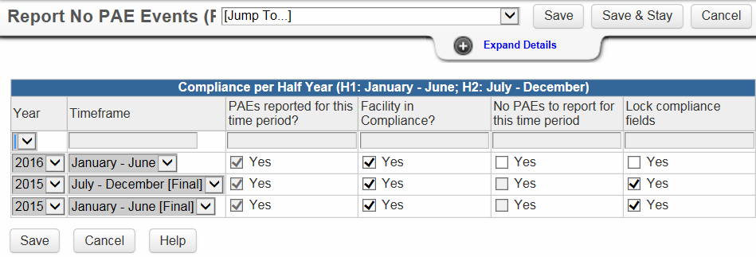
Report No PAE Event in TxHSN
Notes:
Here is an example of a Report No PAE Events question package that has reported a PAE for H1 2016.

Slide 51


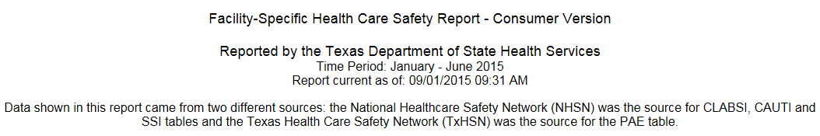
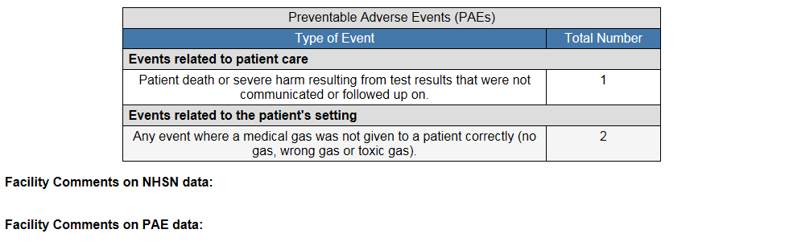
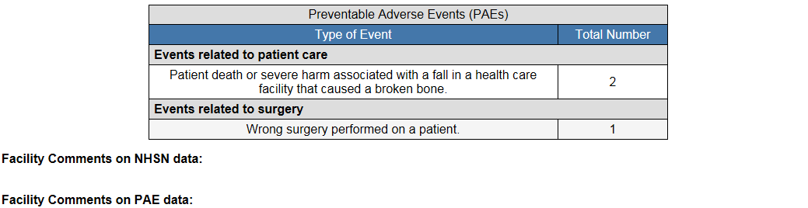
HCS Consumer Report
Notes:
This is a visual of the report that gets posted to the internet. All reported events are listed.

Slide 52
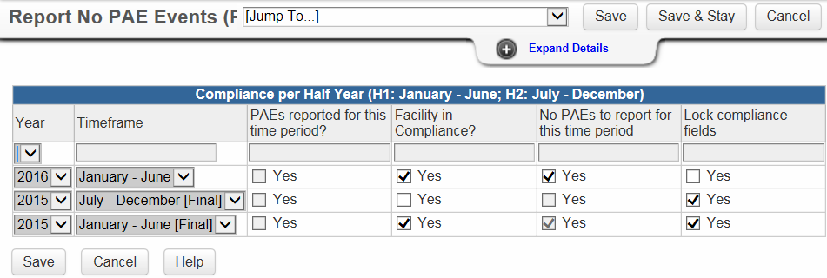
Report No PAE Event in TxHSN
Notes:
This is a visual of a facility that reported No PAEs for this time period.

Slide 53
HCS Consumer Report
Notes:
This is what the posted report will look like to the public. It will say that you reported zero events.
If you do not report any events and you miss the deadline to confirm that you had not PAEs to report, then the posted report to the public will say that you failed to report TxHSN events.

Slide 54
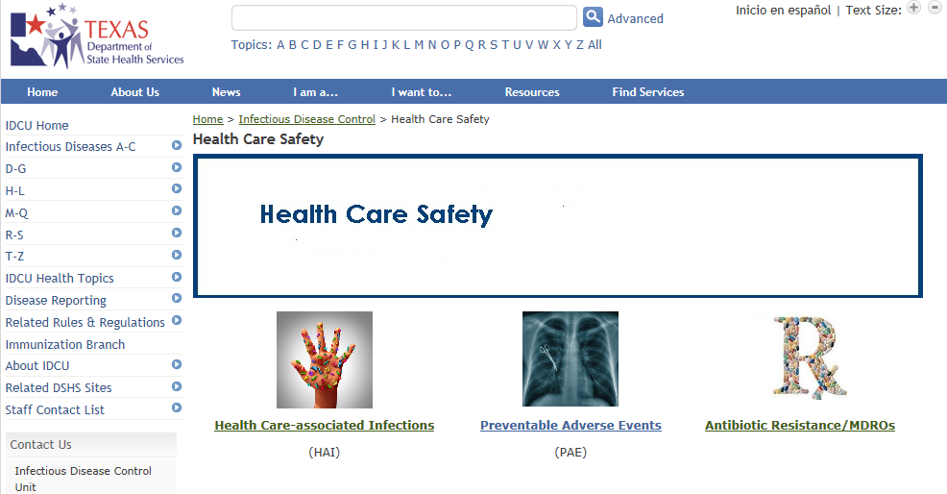
Health Care Safety
http://www.dshs.state.tx.us/idcu/health/Health-Care-Safety/
Notes:
This is the Health Care Safety webpage. On this page there is a link to the HAI, PAE and MDRO websites.

Slide 55
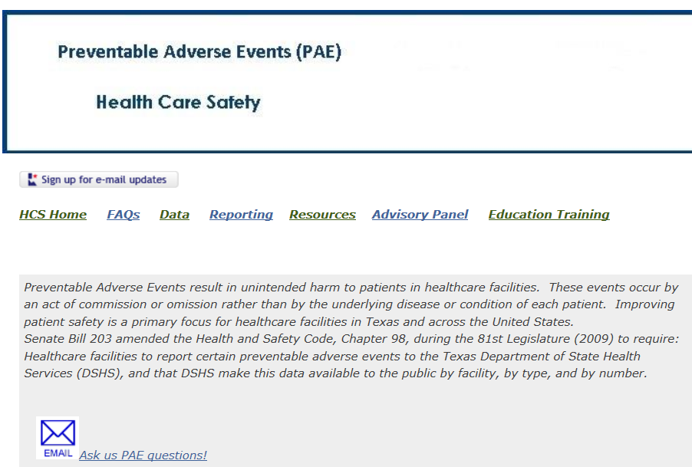
PAE Website--www.paetexas.org
Sign up for e-mail updates - ------------>
Email quick link
----------->
Notes:
This is a what the PAE website home page looks like.
First, you can see an icon for signing up for email updates. You are strongly encouraged to do this so that whenever anything is posted to the website you will received an email notice.
In the middle of the page, you will see headings for additional pages, such as Reporting, Resources etc.
The Reporting Page will give you more information about completing your reports.
There is a Data page which will take the user to a search menu to find reports by facility.
The Resources page has a PAE tool kit with a number of documents to assist you in the reporting process, as well as links to websites, and educational presentations.
There is a page with Advisory Panel information and then the Education/Training page which is where any upcoming educational presentations or webinars are posted and can be registered for.

Slide 56

Upcoming Education http://tdshshealthcaresafetyconference.com
Notes:
We are very pleased to bring you the 2nd Annual Healthcare Safety Conference to be held in San Antonio on August 18-19, 2016. More information is forthcoming. All designated contacts will receive notice when the website for registration is open. There will be limited travel reimbursements available and we will be having a poster display so watch for the Call for Poster Abstracts. The website for registration is http://tdshshealthcaresafetyconference.com

Slide 57
Contact Information
*Help Desk Email*
PAETexas@dshs.state.tx.us
HAITexas@dshs.state.tx.us
512-776-7676
Fax 512-776-7616
THE HELP DESK EMAIL is the FIRST and BEST PLACE TO CONTACT FOR QUESTIONS or ASSISTANCE.
Emily Engelhardt, TxHSN Administrator
Nesreen Gusbi, TxHSN Administrator
Vickie Gillespie, PAE Clinical Specialist
Notes:
The PAE Help Desk Email is the first and best place to contact us for questions or assistance. There are three staff that monitor this email account.

Slide 58
Take-A-Ways
Keep your email address in TxHSN updated—send to PAE helpdesk.
Pay attention to workflows and alerts.
If you have zero events don’t forget to confirm it.
Keep the reporting schedule, help-desk email and PAE resources handy.
Complete the Annual Survey.
Stay Alert for emails from TxHSN_Notifications_NO_REPLY@dshs.state.tx.us
or from the PAE helpdesk.
Notes:
Here are the Take-A-Ways from this presentation.

Slide 59

Questions?
Thank you!
Notes:
This concludes the presentation. If you have any questions please send them to the PAE Help Desk at paetexas@dshs.state.tx.us. Thankyou!

