Slide 1

Annual Survey of Hospitals
Hospital Survey Unit
March 2024
Notes:
Hello! Welcome to the training presentation for the Annual Survey of Hospitals. This content has been provided on behalf of the Hospital Survey Unit. The purpose of this presentation is to help guide hospital staff through the process of submitting the required information and improve their knowledge on reporting all necessary data.

Slide 2
Overview
Team Introduction
Brief Background
Reporting Deadlines
Validations Rules
Data Entry Reminders
Pre-populated Variables
Corresponding Variables
Specific and Complex Reporting
Summary
Notes:
Here’s a quick overview of today’s presentation and the various topics that will be discussed.

Slide 3





Meet the Team
Dwayne Collins – Team Lead
Role: Collaborate with stakeholders, oversee survey collection process, check compliance, screen surveys, supervise statutory and annual reports
Fun Fact: I like to fish & travel by motorcycle.
Survey Advice: It’s best to submit the survey early to reduce stress. Best practice is to stay current on all deadlines and info regarding the annual survey.
Andria Orbach – Data Analyst II
Role: Examine data from licensed hospitals, screen surveys, check for compliance, quality assurance, & create statutory reports
Fun Fact: I’m learning to belly dance on weekends.
Survey Advice: Prior to completing the survey, allow sufficient time to review each section’s criteria and read survey definitions. Doing so will reduce errors.
Lili Jones – Data Analyst II
Role: Update tracking system, screen survey for compliance & errors, manage data, quality assurance, create reports
Fun Fact: I love to binge watch Asian dramas when I can get the time.
Survey Advice: Prepare ahead of time by compiling the data and be sure to visit our website for all training materials.
Sergio Ochoa – Data Analyst I
Role: Screen survey for compliance & errors, manage data, quality assurance, create reports
Fun Fact: I eat at a new place every Saturday.
Survey Advice: Always double check corresponding variables. If you have any questions, please ask! We are happy to help!
Dallin Talbot – Data Analyst I
Role: Screen survey for compliance & errors, manage data, quality assurance, create reports
Fun Fact: I like board games.
Survey Advice: My advice would be to answer accurately and sufficiently.
Notes:
Let me introduce our team! I would like to share a little about each of our roles within the Hospital Survey Unit which will be done by tenure. First, we have our most valuable team member and leader Dwayne Collins. I’m sure his name is no surprise to many. He plays a major role with not only overseeing the survey data collection process but collaborates heavily with our survey partners and stakeholders regarding the annual survey. We have another front runner on our team Andria Orbach, a Data Analyst II and vital asset to our statute compliance, quality assurance, and author of our statutory reports. Then myself Lilibeth or Lili Jones, I am a Data Analyst II along with Ms. Orbach I maintain much of our tracking system for compliance and reference purposes. I screen surveys for errors and discrepancies, perform quality assurance, and create annual reports. Up next is Sergio Ochoa, our Data Analyst who serves as a screener of the survey with an amazing eye for detail and very thorough. His role features compliant status updates, quality assurance processes, as well as creating the annual reports. Finally, we have our newest and brightest Dallin Talbot who is also awesomely detail oriented and screens surveys for discrepancies or reporting issues. He performs quality assurance measures, compliant status updates, and creates annual reports as well.

Slide 4
Brief Background
The reporting of the data is mandated by statute
Collaborative data collection process between American Hospital Association (AHA), Texas Hospital Association (THA), & the Hospital Survey Unit (HSU) of the Texas Department of State Health Services (DSHS)
The Annual Survey of Hospitals is collected annually
Three compiled surveys – AHA, State Addendum, Annual Statement of Community Benefits survey (ASCBS)
Data is reported to the Attorney General and Comptroller’s Offices
Notes:
Let’s start with a little background history of the survey and why it is imperative that the data is submitted accurately every year. If not known to you already, the survey data is required by law through a mandated statute under Texas Health and Safety Code Chapter 311, subchapters C and D. The survey is collected through a collaborative collection process between the American Hospital Association, Texas Hospital Association, and the Texas Department of State Health Services specifically the with Hospital Survey Unit. For some who do not know, the Annual Survey of Hospitals is comprehensive and collected annually due it’s reporting criteria. It is not just one survey, but actually three compiled surveys consisting of the AHA or national survey, the Texas State Addendum, and the Annual Statement of Community Benefits survey. After each hospital has submitted, the data is reviewed, updated, and finalized for a special report that is sent over to the Attorney General and Comptroller’s offices for their purposes.

Slide 5
Reporting Deadlines
Verification process and finalizing data reporting begins
March or April
Survey is placed in active status for reporting season
May or June
Submission deadline is reached, and all surveys submitted
Late May or June
Compliance and deadline provided for survey changes and edit responses
July 1st
Attorney General and Comptroller’s report due
October 1st
December 31st
November 1st
Late November/Early December
Data is finalized and prepared for dissemination
Certification and Limited Liability report and Charity Care policy submitted
2nd Attorney General and Comptroller’s report due
Notes:
One of the most important aspects of completing the annual survey is knowing the deadlines for reporting and compliance purposes. Initially, March or April is the typical timeframe the survey is activated for hospitals to begin reporting. Consequently, May or June would be the final deadline for submitting the data which is 60 days from the active date (ex. March 5th active, May 5th deadline for submitting). In late May or early June, reporting compliance is required and specific deadlines are provided for survey changes as well as edit responses. July 1st is the legislative mandated deadline for the Attorney General and Comptroller’s report. October 1st usually begins the verification process and finalizing of data begins. November 1st is the other mandated deadline for the second Attorney General and Comptroller’s report. Late November to early December, the data is finalized and dataset files are prepared for dissemination to requestors. By December 31st the Certification and Limited Liability report is due and most often Charity Care Plans as well.

Slide 6
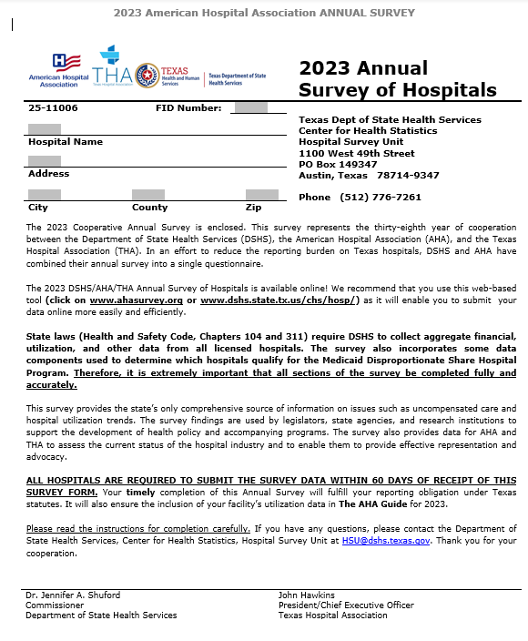
Preparing for Accuracy
Read survey definitions
Review blank survey
Prior year survey access
Required data compiled
Save and file survey
Informed of deadline
Contacting HSU staff
Notes:
When it comes to reporting and submitting the most accurate information, it’s a great idea to be prepared for the process ahead of time. It is advised that individuals designated to submit the survey read the included definitions that can be found in our blank copy on line. In addition, completing a thorough review of the survey beforehand helps with becoming familiar with the required data along with specific variables. Having an accessible copy of the prior year is a helpful method to build consistency and reduce errors. Another important step would be to either compile the required data beforehand and/or at the beginning of the reporting season to minimize the potential risk of missing the deadline or requesting longer extension times. We firmly advise survey coordinators, at the time of submission, to not only save, but also file a copy of the annual survey for safe keeping and future reference. If there are any issues along the way, it is important for staff to contact any member of the Hospital Survey Unit.

Slide 7

Annual Survey Rules
No blanks
No negative numbers
Save & Validate
Notification of Errors
Survey comments
Progress of completion
Special case/forced submission
Notes:
Now I’ll being sharing the best practices and pitfalls to avoid when reporting. More specifically, let’s discuss the AHA portion of the annual survey. The AHA survey can get a little tricky especially since the system does not allow for any blanks or non-reported fields. These occurrences are flagged as an error during the submission process. It is also important to mention here that negative numbers are allowed in both the AHA survey and State Addendum, but not in the Annual Statement of Community Benefits survey. When reporting, the survey provides different options for continuing through the data entry process. Meanwhile, using the save & validate function is extremely helpful when entering data and will display any errors or missed entries for the section that was recently completed; this aids in catching errors or missed information early before submitting. Once there is an error flagged, the notification of errors will prompt a message about how to proceed. If the data is correct or needs to be reported in a specific way, there is an option to input survey comments and mark as correct. Please note that once a comment is entered the comment cannot be changed in any way. The system will also display a percentage for each section to indicate the progress of completion. Special case hospitals and forced submissions are sometimes necessary and requires the survey coordinator to reach out to Dwayne Collins for assistance with this matter.

Slide 8
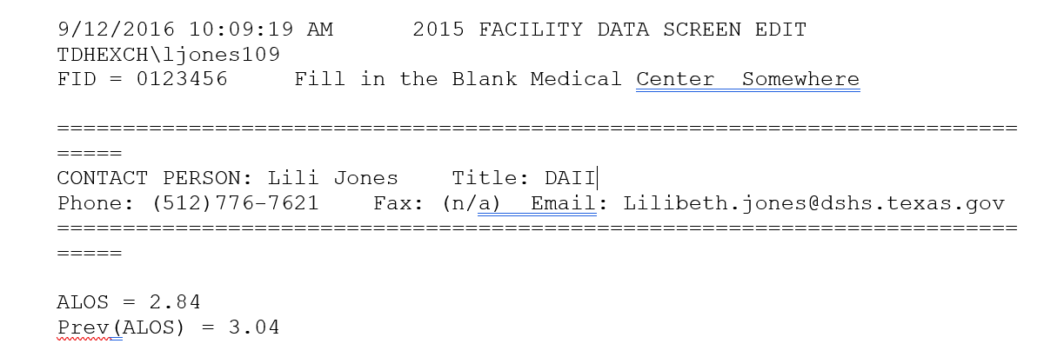
Validation Rules
Referred to as “Edits”
System checks
Accurate reporting
Incomplete entries
Consistency year to year
Prompt notice of changes
Notes:
Moving on to the State of Texas required reporting. Once, the survey has been submitted through the AHA online tool. HSU will use our in-house system to evaluate each hospital’s submission again. The picture here is an example of what the opens up as. There are specific validation rules embedded in our in-house system that allows us to identify any errors which will be detailed later. Whenever any errors or discrepancies are detected, the system compiles the validation rules along with the errors into a file which is also converted into a word document. The file contains what is referred to as “Edits.” These are the system checks that include several different areas that are common with the reporting process. One of the main focal points that the system flags is accuracy in the data reporting. For example, submitting a survey that has errors such as blanks or NAVs. The system inspects for consistent reporting and makes comparisons from year to year. There are also edits that prompt a notice of major changes that must be made to what was reported such transposed figures, data not matching correctly, or data reported the same or completely different from previous years.

Slide 9




Hospital Survey Edits
ACCURATE
Integrity of data
Prioritize details
Correct calculations
CONSISTENT
Major changes documented
No discrepancies
Year to year comparisons
COMPLETE
No missing variables
No insufficient responses
Necessary clarifications
TIMELY
Responses to HSU
Reporting deadline
Statute compliance (fines)
Notes:
Here are the major areas of concern for HSU and the data we collect from the hospitals. Beginning with accuracy, we monitor the integrity of data by ensuring the data sources are correct. We prioritize details like combing through data to ensure nothing was missed or reported incorrectly. Our system is meticulous for identifying areas where correct calculations are required. When it comes to consistency, we require all major changes be documented well and filed properly. It is our understanding that receiving reliable information and eliminating discrepancies creates improved reporting processes. The year-to-year comparisons provide insight into trends as well as inconsistencies. We ensure completeness by auditing for missing variables. Another aspect of our required documentation is to request justifications for insufficient responses which can also included any necessary clarifications either through emails or further explanations via a phone call. The final component of our process is maintaining a timely reporting period. Our recommendation is to be aware and provide all responses to HSU when designated information is requested. Acknowledging and adhering to the reporting deadline ensures smoother processes and minimizes any confusion. Lastly and most importantly, abiding by the statute rules and remaining compliant aids in avoiding fees for late or non-reporters which are set by the Attorney General and Comptroller’s offices.

Slide 10
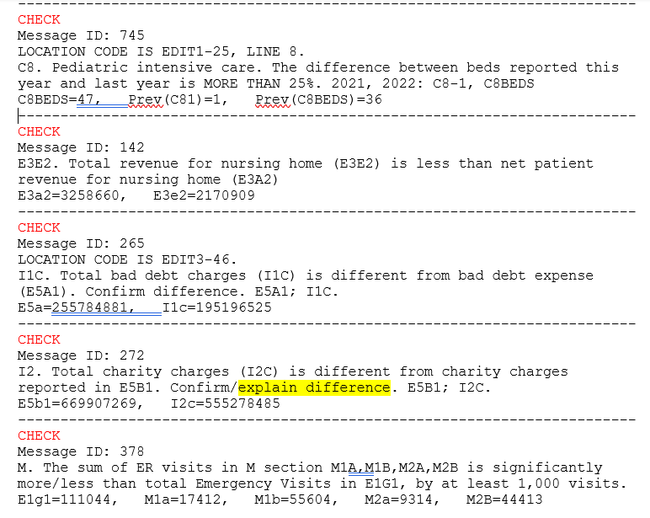
Example of Edits
Consistent yearly reporting
Calculations and totals
AHA vs. State Addendum Comparison
Clarification of special reporting
State Addendum vs. ASCBS comparison
Notes:
As you can see here, this is an example of some edits that we send to hospitals regarding validations for their initial submission. As stated previously there are confirmations needed for consistent yearly reporting. Another issue might be calculations and totals are being questioned. In addition, the AHA vs. State Addendum comparisons need more attention. Furthermore, clarification of special reporting will need to be documented and filed accordingly. Any changes to the data can only be made by our team which establishes our need for documentation. As for the State Addendum vs. ASCBS edits which are not depicted here, also require similar feedback when sent to each hospital’s point of contact.

Slide 11
Common Pre-Populated Variables
Totals for supplement page are based on worksheets’ totals and auto populate
Section J
J1a2d Other Govt total is populated from E6a31
WS 1-4B
Cost of charge ratio (calculated on WS 1 and populates on remaining worksheets)
WS 3
Calculations based on cost of charge ratio for W3B2, and payments totals W3C6
Total for W4BA3, calculations based on cost of charge ratio for W4BB2, and payments totals W4BC4
IIA1-IIE
WS 4B
1
2
3
4
5
Notes:
Here are some of the most common pre-populated fields throughout the entire annual survey. In section J, the variable J1a2d labeled Other Govt total is populated from E6a31. For hospitals required to report the ASCBS, the Cost of charge ratio is calculated on Worksheet 1 and populates on the remaining worksheets. Fields on Worksheet 3 that auto-populates based on the cost of charge ratio for W3B2, and payments total W3C6. Worksheet 4B populates a total for W4BA3. Similar to worksheet 3, cost of charge ratio for W4BB2, and payments total W4BC4 auto-populate. Totals for the supplemental page are based on worksheets 1-4B totals and auto populate as well.

Slide 12
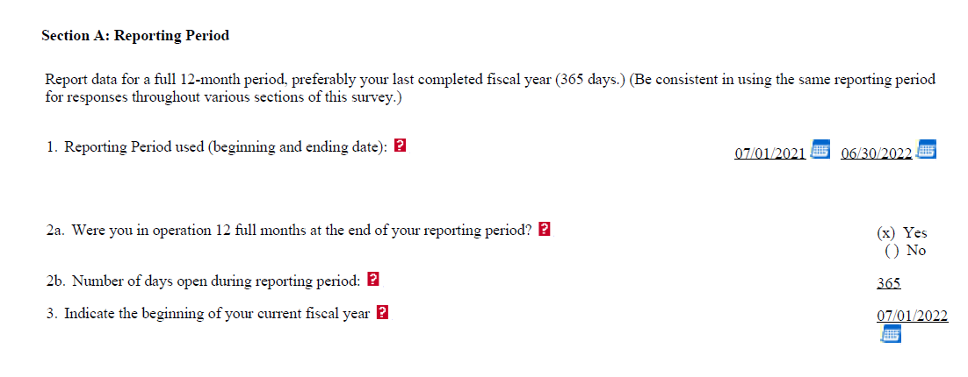
Data Entry Reminders
Review questions
Familiar with definitions & questions
Number vs. character
-9s or 0s
Negative numbers
Other variables impacted
Notes:
As stated earlier, there are some key practices that can help make the reporting process easier. So here are some reminders and areas to look out for during the data entry process. Remember to review and read each of the questions so there’s no mistake of what is entered in the system. Also, being familiar with definitions & questions in the blank survey is useful when entering information in the online tool. I would like to emphasize that knowing and understanding which variables are asking for actual numbers versus some that require a character or allows characters. Having greater understanding of the survey and what’s being entered allows for a much smoother submission process. Another key reminder is inputting negative numbers such as -9s or entering 0s when data is required will flag an error for the online tool as well as HSU’s in-house system. Negative numbers are acceptable unless the data directly relates to other fields where negative numbers are not allowed or data has been provided. This maybe getting redundant for me to say, but I’ll say it anyway, any changes made when entering data should be done carefully because it’s likely that other variables could be impacted by the changes.

Slide 13
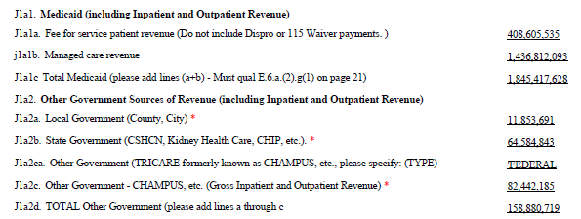
Data Entry Reminders (Continued)
Check boxes
“If yes” questions
Survey comments in AHA
Previous year data
Calculations and rounding
Notes:
Some other reminders when entering data is to not rely on the check boxes or using unjustifiable comments that allow you to pass through the survey questions since we do check the data thoroughly. Also, reviewing questions that require survey coordinator to select a check box(es) as an answer to a question is a good practice to ensure that nothing is missed or left unanswered; otherwise errors are prompted. Another important reminder is regarding the “If yes” questions which are sometimes left blank or ignored and should not be. Please be sure to look out for those as well. As mentioned earlier, survey comments are allowed in the AHA online tool and if there is a justification for data entered it can be done there. However, HSU you might ask for more information or request for an update if necessary. Our team has access to previous years’ data which we use to compare hospital’s reporting. Please be sure not to use same data that was reported in prior years. Double checking calculations and rounding maybe required due to data entry errors and/or the different systems’ methods.

Slide 14
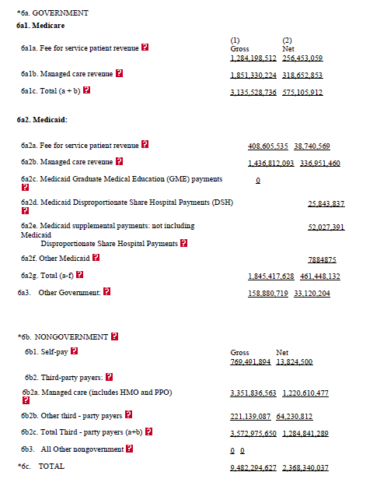
Revenue Data
Calculations
Easy mistakes
Multiple subtotals
Miss reporting
Rounding errors
Grand totals
Notes:
Revenue data in section E6 is specifically spotlighted for several reasons when discussing how to report. The first reason is that HSU staff find each year many errors in this particular section. One of the common issues with the data are the calculation errors in which totals do not properly add up. There are also recurring mistakes such as transposed numbers or a missing number within the figures. This section can be viewed as difficult due to the multiple subtotals which we understand. In addition, the classification is also challenging which can cause confusion and even lead to mistaken reporting or not reporting required data. Once again, rounding errors can become an issue here along with inaccuracies regarding grand totals. This section should be carefully reported and reviewed possibly several times before submitting. One other major imperative reminder for accurately reporting this section is the fact it is compared with other revenue in the survey such as section J and the ASCBS worksheets 3 and 4B. Therefore, it should be completed carefully.

Slide 15
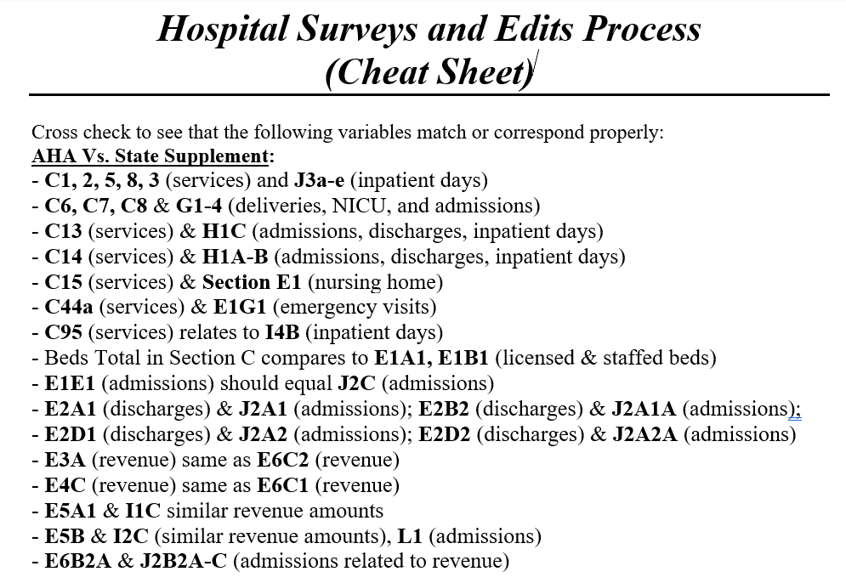
Examples of Corresponding Data
AHA vs. State Addendum (SA)
E1e1 and J2c
E3a and E6c2; E4c and E6c1
E5a and I1c; Eb5 and I2c
AHA vs. ASCBS
E3m and W1B2
E4C and W1B1
E3A and STDi1
State Addendum vs. ASCBS
I2A-C and W1A totals
J1a1c and W3A
J1a2a and W3a Local Govt
J1a2b and W3a State Govt
Notes:
As you can see on this slide, there many examples of corresponding data. What this means is that there are several variables throughout the survey that are directly related to one another. For example, in the AHA survey and State Addendum there are variables that ask for similar and even exact same information. There are also comparisons between the AHA and ASCBS as well as the State Addendum and ASCBS. We have created a cheat sheet that indicates what variables correspond in the survey along with the required data. For instance,
AHA vs. State Addendum (SA)
E1e1 and J2c admissions
AHA vs. ASCBS
E4C and W1B1 gross revenue
State Addendum vs. ASCBS
I2A-C and W1A totals charity revenue
We recommend this resource for learning the corresponding variables and can be useful when prioritizing accuracy.

Slide 16
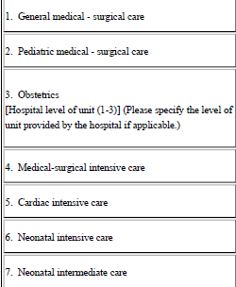
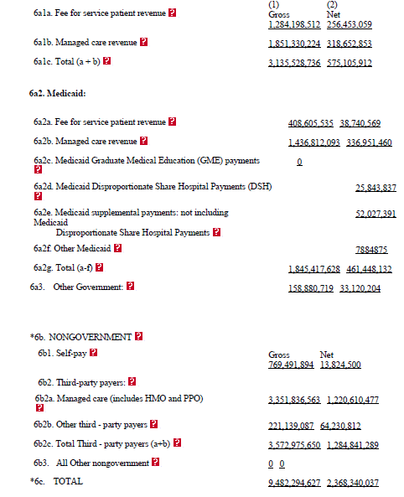
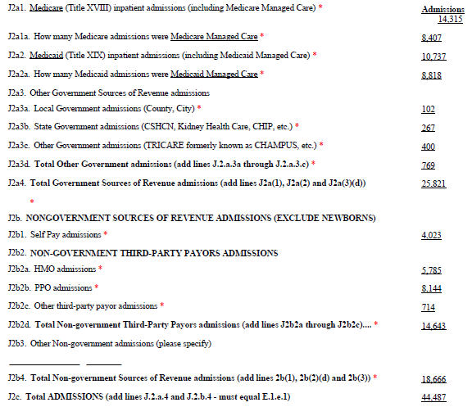
Specific and Complex Reporting
Revenue by Payor
Admissions
Beds and Services
Broken out differently in system
Incorrect calculations
Changes affect other data
Current vs previous year
Broken out different in system
Incorrect calculations
Changes impact other data
Based on end of reporting period
Multiple licenses/joint reporting
Impact utilization data
16
Notes:
This slide is particularly highlighting the most common areas of the survey that challenge hospitals’ reporting. The reason they are known to be difficult can be for a host of reasons. Beginning with the revenue by payor which is found in section E6 of the AHA portion, we often find that hospitals don’t have a system where the data can be broken out or the classification of the revenue is sometimes categorized differently in their system. Rounding or incorrect calculations are a challenge due to things like negative revenue numbers. Once again, when changes to the data are made, this can spark issues due to other data being affected in other parts of the survey. As mentioned before, the current data being compared to the previous year can be problematic if data appears inconsistent. One of the areas of the survey that we find is the most difficult for hospitals to complete and/or update is the admissions in section J. The specificity of the admissions causes issues because hospitals’ have a different break down or classification in their system. Most often, we when request changes or flag errors we wind up with more errors due to incorrect calculations. We believe that survey coordinators may not know or recognize that changes to many of the variables in this section impact other data, so this area takes time and patience. Particularly, J1a2ca should be reported as type or the name of the other gov’t source. Meanwhile, we often see figures or an additional breakout of revenue which creates an error for the entire other gov’t totals or breakout categories. We ask you remain vigilant in knowing these common mistakes to cut down on errors. Another complex area to report is the beds and services which are based on the end of reporting period and not the hospital’s general operations information. We’ve noticed countless challenges with reporting beds and services if hospitals share multiple licenses or complete joint reporting. These are special cases that may require more assistance from the HSU staff. Lastly, it is imperative that survey coordinators know that beds and services reported also impact the utilization data reported in the survey as well.

Slide 17
Be sure to ask questions or reach out whenever something is unclear. There’s no question too small or insignificant.
“
”
-Dwayne Collins
Notes:
The best piece of advice comes from our Team Lead, Dwayne Collins. He consistently shares this with us. “Be sure to ask questions or reach out whenever something is unclear. There’s no question too small or insignificant.” This is the same advice we would like to extend to each of you.

Slide 18
Summary
Meeting deadlines is critical.
Preparing and becoming familiar with the survey ahead of time makes reporting easier.
Being aware of data entry pitfalls and corresponding fields reduces errors.
Specific and complex data reporting is not uncommon so reaching out to HSU can be a major asset to ensuring accurate as well as timely submission.
Notes:
In closing, remember that meeting deadlines is the most critical aspect of reporting and complying with our mandated statute. Also, preparing and becoming familiar with the survey ahead of time makes reporting much easier. Moreover, being aware of data entry pitfalls and corresponding fields reduce errors. Lastly, specific and complex data reporting is not uncommon for many hospitals, so reaching out to HSU can be a major asset to ensure accurate as well as timely submission.

Slide 19
Thank you!
Hospital Survey Unit
512-776-7261
HSU@dshs.texas.gov
Hospital Survey Unit Hospital Data Collection and Reporting | Texas DSHS
Notes:
On behalf of the Hospital Survey Unit, we would like to thank you for your time. If you have any further questions regarding the presentation or concerns about the annual survey, please feel free to contact any of us at the information listed here as we are happy to help. Once again, thank you!

