Slide 1
Consumer Safety
FOOD & DRUG COMPLIANCE

Slide 2

DRUGS AND MEDICAL DEVICES
(DMD)
COMPLIANCE
2023 CALENDAR YEAR END REPORT

Slide 3
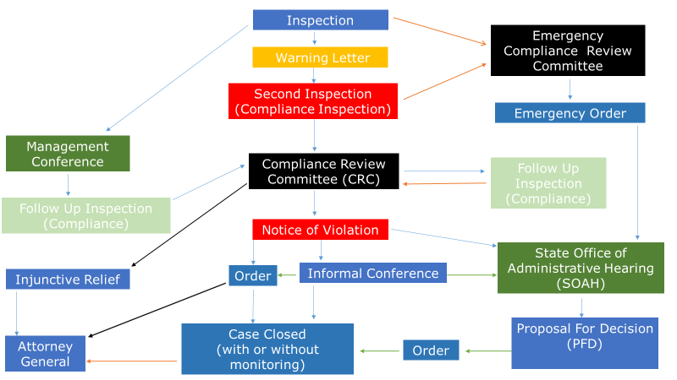
Food & Drug Compliance Flowchart

Slide 4
Cases referred to Compliance
Ten (10) cases were referred in total:
  All ten (10) cases were triaged through Compliance Review Committee (CRC)
CRC | 10
Total | 10

Slide 5
Outcomes
After triage at CRC:
Nine (9) Notice of Violation (NOV) letters were cleared to be issued
Four (4) case were referred to the Attorney General
One (1) case was closed without pursuit

Slide 6
Informal Conference (IC)
Four (4) cases were heard at an IC:
All four (4) cases were settled after the IC

Slide 7
Orders & Agreements Processed
7 Agreed Orders/ Acceptance Orders (AO)
  An Agreed Order is issued after an informal conference, to document and memorialize the settlement agreement reached between a Respondent and the Department.
  An Acceptance Order is issued when a Respondent accepts the proposed disciplinary action in the Department’s Notice.
4 Attorney General (AG) Referrals
  4 cases were referred to the AG for further administrative and/or judicial remedies on Respondents who failed to and/or refuse to comply with a final order.

Slide 8
Cases Closed With or Without Monitoring
Cases that have a finalized Order or an Agreement are either:
Closed with monitoring
  Terms and conditions to be met are still pending
Closed without monitoring
  All terms and conditions are met

Slide 9
Cases Closed With or
Without Monitoring Continued
5 cases were closed with monitoring
5 cases were closed without monitoring

Slide 11
Ongoing trends

Slide 12
For more information regarding Compliance Consumer Safety policies and protocols, please click on the link below:
Consumer_Safety_Unit_Procedure_Manual_122123.pdf

Slide 13
Thank You
and
Happy New Year!

