Slide 1
Program Income Spending & Allocation Monitoring Tool
Presenters:
Courtlin Burke, HIV Technical Advisor
Savannah Hedge, Auditor

Slide 2
Overview
- What is Program Income?
Program Income Criteria
What is 340B Program Income Revenue
Program Income Requirements
Why are you here?
Using the Program Income Tool​

Slide 3
What is Program income?
Program income means gross income earned by the non-Federal entity that is directly generated by a supported activity or earned as a result of the Federal award during the period of performance except as provided in 45 CFR §75.307(f). Program income includes but is not limited to:
Income from fees for services performed
The use or rental of real or personal property acquired under Federal awards
The sale of commodities or items fabricated under a Federal award
License fees and royalties on patents and copyrights
​

Slide 4
Flow of the Funds
Health Resources and Services Administration
Starting from the top of the hierarchy
Texas Department of State Health Services (DSHS)
Administrative Agencies
Sub-recipients

Slide 5
Program Income Specific Criteria
Federal Criteria:
45 CFR 75
2 CFR 200
State Criteria:
UGMS. 40
UGMS. Subpart A. (5) “Program Income”
UGMS. 21. I.
UGMS. 25
UGMS. 41. (b)
DSHS contract
​

Slide 6
340B: How does it work
A drug manufacturer enters into a Pharmaceutical Pricing Agreement with the Health Resources and Services Administration (HRSA)
A covered entity registers to participate in the 340B program with HRSA’s Office of Pharmacy Affairs at https://340bopais.hrsa.gov/
The covered entity purchases drugs at the 340B price from a distributor, which receives drugs from the manufacturer
The covered entity enters into a contract with a third party, usually a retail pharmacy
The distributor ships the covered entity’s drugs to the contract pharmacy
The patient receives the 340B drug at the contract pharmacy

Slide 7
340B Program Income
All 340B generated revenue IS program income.
Covered entities are able to generate savings on each drug by purchasing these drugs at a discounted 340B rate and yet receive normal payments from insurers. Covered entities are able to provide drugs to low-income patients at free or significantly reduced costs and also use savings to provide other health care services under the scope of work for the contract in which made them eligible to receive 340B certification.
Insurance Reimbursement
- 340B Drug Pricing from Manufacturer
340B Generated Program Income
​

Slide 8
Program Income Requirements
1
2
3
4
Program income must be spent during the contract term it is earned and not allowed to be carried over to next term, except with approved spending plan (45 CFR 75).
All program income must be disbursed before requesting additional grant payments (UGMS and 45 CFR §75.307).
Program income must be used for the purposes of the Federal award. ​(45 CFR §75.307)
Per DSHS contract, the contractor must use the additive method, as provided in UGMS, for the use of Program Income to further the program in which it was earned.

Slide 9
Further Requirements
Program income should have a separate cost center established in the grantee’s General Ledger.
Program income should be able to be identified by the grant in which it was generated
Multiple funding streams where grantee is unable to fully identify the grant = appropriate allocation methodology and allocation work to be shown when monitored
Retain invoices and payments for billing
Readily available for third party reviewers
** This is currently a requirement and will continue to be so in future renewals. **

Slide 10
Why are you here?
Because your agency is an Eligible Entity to receive 340B program income revenue!
Your agency is a covered entity:
Under the Part B grant ID by entering the DSHS Notice of Funding Opportunity (NOFO) and the Part B grant number.
Your agency enrolls yearly into the HRSA Office of Pharmacy Affairs Information System (OPAIS)
OPA then sends DSHS Part B an email for us to certify that entity is in fact funded by Part B

Slide 11
The Program Income Spending and Allocation Monitoring Tool
How to fill out the tool

Slide 12
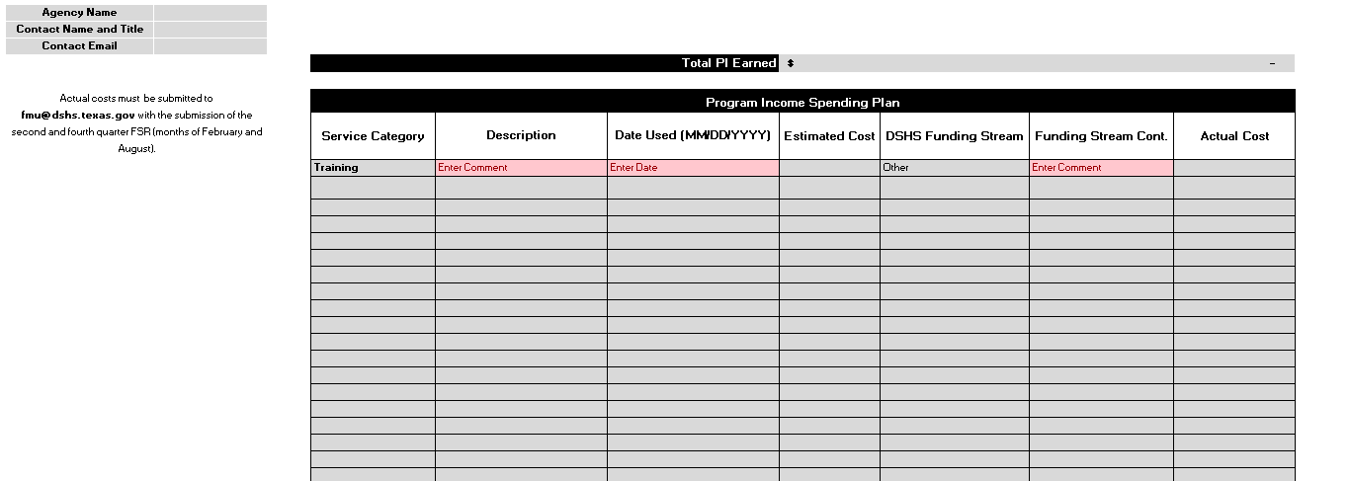
Spending Plan
Service Category
Accounting Services
Communication Costs
Salaries
Office Supplies
Meeting/Conferences
Professional Services Costs
Training
Advertising Costs
Travel
Equipment
Other
Notes:
is helpful for audits as well as internal reviews.

Slide 13
Spending Plan, cont.

Slide 14
Program Income Revenue Allocation
Service Category Options
Co-Pay
Sold Item
Sub-recipient
Medication Difference
Registration Fees
Fees for Services Performed
Revenue from the Use or Rental of Property
Other

Slide 15
Program Income Revenue Allocation, cont.

Slide 16
Key Takeaways!
Spending Plan is due within 30 days after the start of the contract.
Allocation Tool is due the end of February and August.

Slide 17
Instructions

Slide 18
Instructions cont.

Slide 19
Questions / Comments

Slide 20
Thank you
Ann Duncan, FMU Director
April Marek, HIV Grants Branch Audit Manager
Contact us at: fmu@dshs.texas.gov
dshs.state.tx.us/fiscal-monitoring

