Slide 1
STD Epidemiology in Texas, 2018
Prepared by the Epidemiology and Supplemental Projects Group
HIV/STD Epidemiology and Surveillance Branch
Texas Department of State Health Services

Slide 2
Chlamydia Diagnoses in Texas, 1992-2018
Year
Notes:
Chlamydia diagnoses in Texas have been steadily increasing from around 80,000 cases in 2007 to over 140,000 in 2018

Slide 3
Chlamydia Diagnoses by Year in Texas, 2009-2018
Year
Notes:
About half of new chlamydia diagnoses are among females between the ages of 15-24 from 2009-2018.

Slide 4
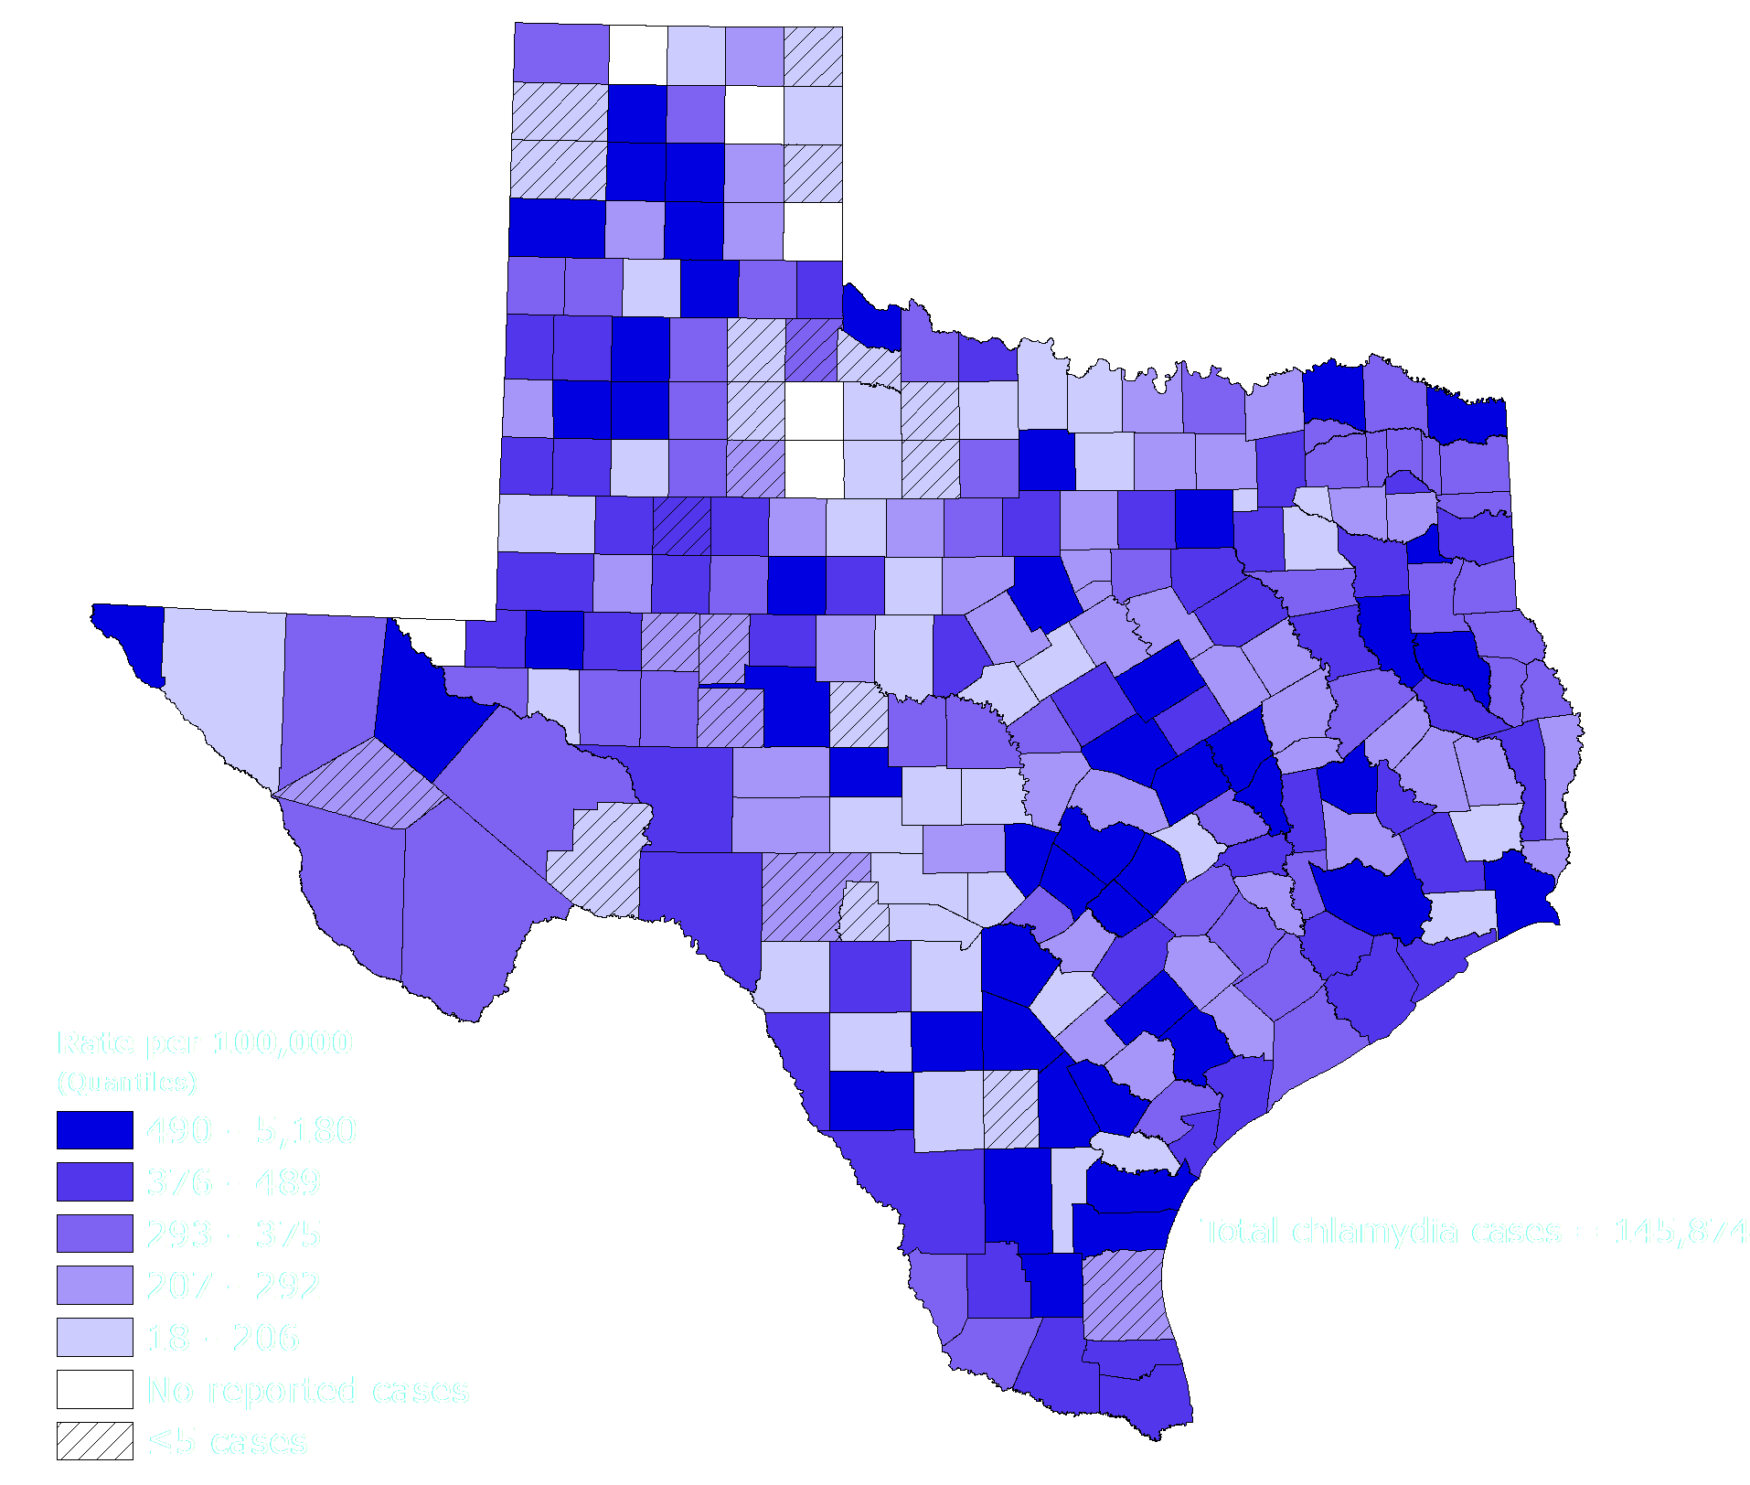
Chlamydia Incidence Rates by County in Texas, 2018
Notes:
Incidence rates of chlamydia are the highest among densely populated counties such as Harris and Dallas Counties

Slide 5
Chlamydia Diagnoses Among Women by Race/Ethnicity in Texas, 2009-2018*
Year
**Native Hawaiian/Pacific Islander #American Indian/Alaskan Native
*A delay in updating the race/ethnicity field in the surveillance data has resulted in a large number of cases with race/ethnicity as unknown for 2018. Ongoing data quality improvement will address this for 2019 reporting. Numbers should be interpreted with caution.
Notes:
In Texas from 2009-2018, the most chlamydia diagnoses were in Hispanic women.. It should be noted that a delay in updating the race/ethnicity field in the surveillance data has resulted in a large number of cases with race/ethnicity as unknown for 2018. Ongoing data quality improvement will address this for 2019 reporting. Numbers should be interpreted with caution.

Slide 6
Gonorrhea Diagnoses in Texas, 1992-2018
Year
Notes:
Gonorrhea diagnoses in Texas has been steadily increasing from about 30,000 cases in 2009 to over 45,000 in 2018.

Slide 7
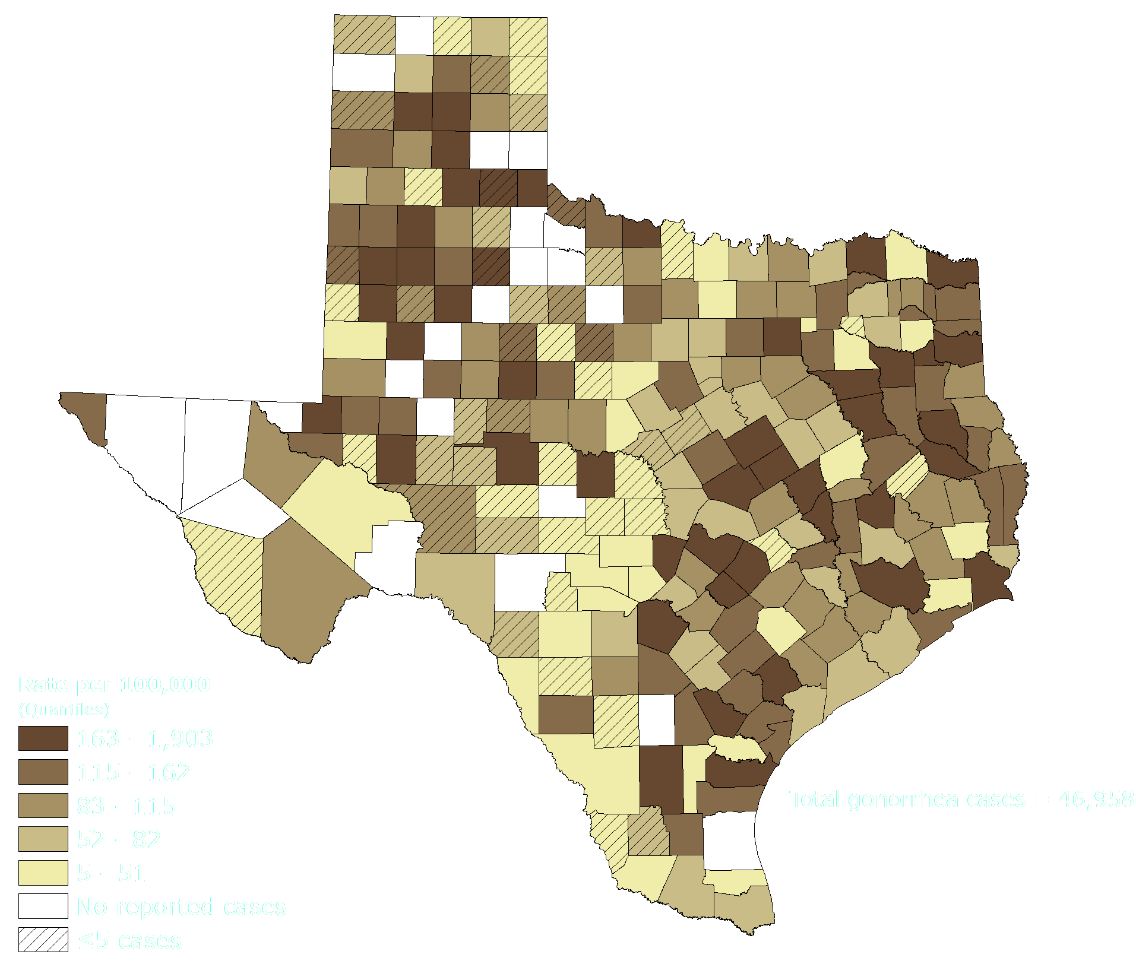
Gonorrhea Incidence Rates by County in Texas, 2018
Notes:
Similar with chlamydia, the highest gonorrhea incidence rates by county in 2018 is in densely populated counties such as Harris, Bexar, and Dallas.

Slide 8
Gonorrhea Diagnoses by Race/Ethnicity in Texas, 2009-2018*
Year
**Native Hawaiian/Pacific Islander #American Indian/Alaskan Native
*A delay in updating the race/ethnicity field in the surveillance data has resulted in a large number of cases with race/ethnicity as unknown for 2018. Ongoing data quality improvement will address this for 2019 reporting. Numbers should be interpreted with caution.
Notes:
Black and Hispanic Texans make up most of the gonorrhea cases in Texas, but it should be noted that a delay in updating the race/ethnicity field in the surveillance data has resulted in a large number of cases with race/ethnicity as unknown for 2018. Ongoing data quality improvement will address this for 2019 reporting. Numbers should be interpreted with caution.

Slide 9
Gonorrhea Diagnoses by Age Group & Race/Ethnicity in Texas, 2018*
*A delay in updating the race/ethnicity field in the surveillance data has resulted in a large number of cases with race/ethnicity as unknown for 2018. Ongoing data quality improvement will address this for 2019 reporting. Numbers should be interpreted with caution.
**Other race includes: Native Hawaiian/Pacific Islander, American Indian/Alaskan Native, Asian, Multi-race, and other/unspecified
Notes:
In 2018, Black and Hispanic Texans ages 15-24 make up about a third of all the gonorrhea cases in the state. However, a delay in updating the race/ethnicity field in the surveillance data has resulted in a large number of cases with race/ethnicity as unknown for 2018. Ongoing data quality improvement will address this for 2019 reporting. Numbers should be interpreted with caution.

Slide 10
Primary & Secondary Syphilis Diagnoses in Texas, 1992-2018
Year
Notes:
Primary and secondary syphilis cases in TX have been slowly increasing from 1,500 in 2013 to about 2,500 in 2018.

Slide 11
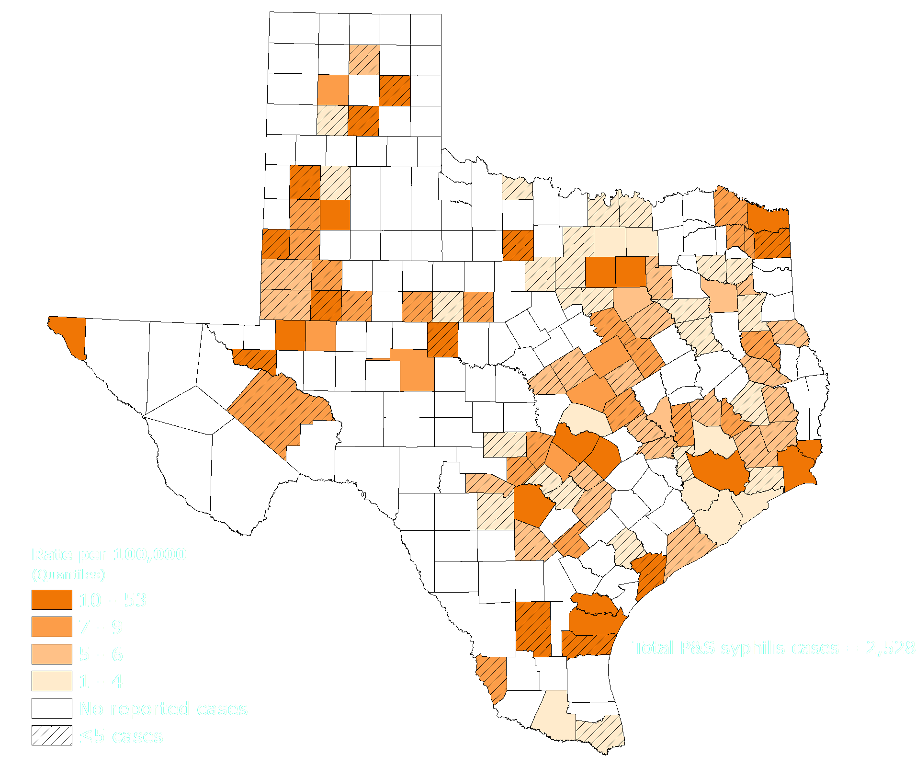
Primary and Secondary Syphilis Incidence Rates by County in Texas, 2018
Notes:
Incidence rates of primary and secondary vary in TX – some urban counties such as Dallas and Nueces as well as more rural counties such as Lamb and Orange have the highest rates in 2018.

Slide 12
Primary & Secondary Syphilis Diagnoses by Race/Ethnicity in Texas, 2009-2018*
Year
**Native Hawaiian/Pacific Islander #American Indian/Alaskan Native
*A delay in updating the race/ethnicity field in the surveillance data has resulted in a large number of cases with race/ethnicity as unknown for 2018. Ongoing data quality improvement will address this for 2019 reporting. Numbers should be interpreted with caution.
Notes:
The number of primary and secondary syphilis diagnoses has been steadily increasing among Hispanic Texans between 2009-2018, with the highest number of cases in 2018 (936). Black Texans had the second most new diagnoses with 840 in 2018.

Slide 13
Primary & Secondary Syphilis Diagnosis Rates by Year of Diagnosis and Sex in Texas, 2009-2018
Year
Notes:
Males have always had a higher rate of primary & secondary syphilis diagnosis compared to females in TX. In 2018, males had a 5-fold increased rate (14.8 per 100,000) compared to females (2.9 per 100,000).

Slide 14
Primary & Secondary Syphilis Diagnoses by Sex and MSM* in Texas, 2009-2018
Diagnoses
Year
Notes:
Men who have sex with men (MSM) comprise the largest proportion of primary and secondary syphilis cases in 2018 (55%), whereas females only comprise 17% of new diagnoses in 2018.

Slide 15
Congenital Syphilis Diagnoses in Texas, 1998-2018
Year
Notes:
Nationally, the congenital syphilis rate has been increasing since 2013. TX Congenital syphilis cases increased from 164 in 2017 to 367 in 2018.

Slide 16
Congenital Syphilis Diagnosis Rates in Texas, 2009-2018
Year
Notes:
Black Texans experienced the highest congenital syphilis diagnosis rate in 2018 (343 per 10,000 live births), with Hispanic Texans having the next highest with 86.9 per 10,000 live births.

Slide 17
Diagnoses and Rates of Primary & Secondary and Early Latent Syphilis among MSM* in Texas, 2010-2018
Notes:
Both early latent and primary/secondary syphilis cases and rates have been increasing among men who have sex with men (MSM) between 2010 and 2018.

Slide 18
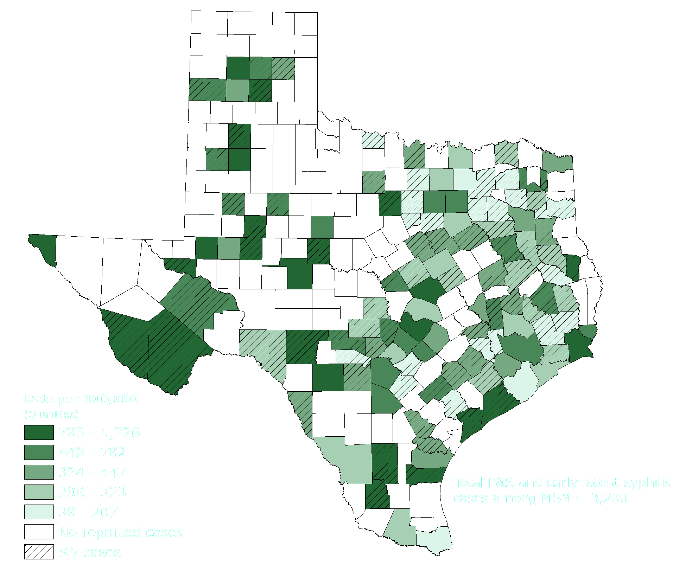
Primary & Secondary and Early Latent Syphilis Incidence Rates Among MSM* by County in Texas, 2018
*MSM– men who have sex with men
Notes:
More densely populated counties such as Harris, Dallas, and Travis have the highest primary/secondary and early latent syphilis incidence rates in Texas in 2018.

