Slide 1
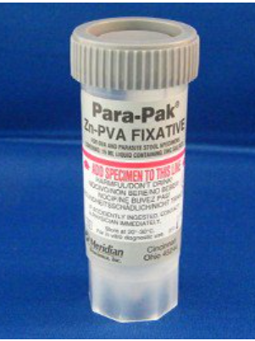
Specimen Collection and Submission Guidance for Molecular Analysis of Confirmed and Suspected Human Cases of Cryptosporidiosis
CryptoNet: Molecular Tracking of Cryptosporidium to Understand Transmission
Cryptosporidium Stool Specimen Collection
Use: Formalin-Free Stool Specimen Collection and Transport Kit.
Fixed Stool Specimens with Zn-PVA, Cu-PVA or Ecofix (or other parasitology fixative without formalin).
Raw Stool and Unfixed Specimens collected in Cary-Blair or other transport media for bacteriologic testing.
Required Volume: Minimum of 500 µl
Required Storage and Shipping Temperature:
Fixed Stool Specimens: Room/Ambient Temperature
Raw Stool and Unfixed Specimens (including Cary-Blair): Store at 2°C–8°C. Ship overnight in insulated containers with cold packs.
Follow the manufacturer’s specimen collection instructions.
Avoid kits containing formalin as it interferes with testing.
Do not use dry ice as it will freeze the specimen.
Non- sterile Para-Pak® Zn-PVA 1-Vial Transport 15 mL (0.5 oz)
Ship Cary-Blair Specimens Cold!
Cryptosporidium Shipping and Labeling Requirements
Ship as: Category B Biological Substance, UN3373. Specimen must be:
Triple Packaged to withstand shock, pressure changes, leaks, and other ordinary handling conditions while in transit.
Packaged with Enough Absorbent Material such as cellulose wadding or paper towels to soak up the entire contents of the specimen container.
Ensure all containers are securely closed to prevent leaks.
Visit DSHS’ online Specimen Shipping and Mailing Guidance for more details on shipping Category B substances to the Laboratory.
dshs.texas.gov

Slide 2
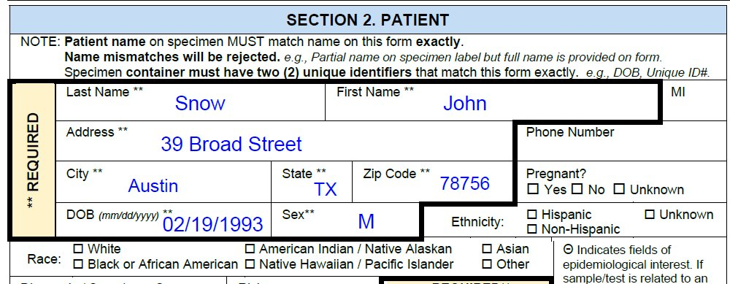
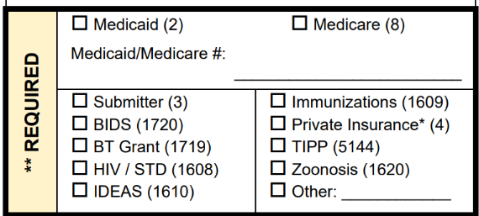
Specimen Collection and Submission Guidance for Molecular Analysis of Confirmed and Suspected Human Cases of Cryptosporidiosis
Label Specimen With Unique Identifiers
Every specimen must have at least two unique patient identifiers on its label.
Three patient identifiers provided on this label
Name
Date of Birth
Medical Record Number
1
Snow, John
DOB: 02/19/1993
06161858
2
3
Provide Patient Identifiers in Sections 2 and 3 of Form G-2B
Patient identifiers on specimen label and G-2B submission form must match.
Date of Collection must be provided in Section 3.
Select Test Type in Section 4.3
Check “Cryptosporidium spp. Exam” under Parasitology.
Select Crypto in Section 4.4
Check “Cryptosporidium subtyping” under Molecular Studies.
Select “IDEAS (1610)” in Section 6
Check the IDEAS (1610) box as the Payor.
12/21/2023
06161858
Select Specimen Type in Section 3
Check “Feces/ stool” as the specimen type.
Questions About . . .
Specimen Collection/Suitability: (512) 776-7560 or Medical.parasitology@dshs.texas.gov
Specimen Shipping: (512) 776-7598 or 1-888-963-7111 ext. 7578 (toll free)
Submitter Accounts, Submission Forms, or Result Reports: (512) 776-7578 or LabInfo@dshs.texas.gov
dshs.texas.gov

