Slide 1

Worksite Lactation Support and the Texas Mother-Friendly Worksite Program
[Presenter Title and Organization]

Slide 2
[insert poll]
T/F – Texas has a law that allows employees returning to work to express breast milk in the workplace.

Slide 3
The Public Health Case for Supporting Breastfeeding
How we move the needle to improve breastfeeding outcomes.

Slide 4
Improved Maternal Health
Breastfeeding reduces mothers’ risk of:
  Breast cancer;
  Ovarian cancer;
  High blood pressure;
  High cholesterol;
  Heart disease; and
  Type 2 diabetes.
Breastfeeding supports:
  Improved return to pre-pregnancy weight;
  Improved birth spacing;
  Increased bonding between mother and infant; and
  Less time off from work due to lower rates of common childhood infections.
Notes:
Note for Presenter: Breastfeeding has both short and long-term health benefits for women. Consider the audience that you are providing this information to and if possible, tie this message to align goals. For instance, if talking with an organization that also works to build awareness for heart disease, highlight that this and other contributors to heart disease are reduced for women who breastfeed.​
Barriers to Breastfeeding: Supporting Initiation and Continuation of Breastfeeding: American Congress of Obstetricians and Gynecologists (ACOG) Committee Opinion, Number 821. (2021). Obstetrics and gynecology, 137(2), e54–e62. ​

Slide 5
According to medical recommendations, breastfeeding could prevent an estimated…
8,487 heart attacks and 986 resulting deaths* (strong evidence-more studies needed). ​
5,023 cases of breast cancer and 838 resulting deaths​.
12,302 cases of Type 2 diabetes and 473 resulting deaths.​
35,982 cases of hypertension and 322 resulting deaths​ among U.S. women per year​.
Notes:
Bartick MC, Schwarz EB, et al.. Suboptimal breastfeeding in the United States: Maternal and pediatric health outcomes and costs. Matern Child Nutr. 2016​.

Slide 6
Improved Infant and Child Health
Breastfeeding reduces baby’s risk of:
  Ear infections;
  Respiratory infections/pneumonia;
  Diarrhea/stomach infections;
  Allergic reactions and asthma;
  Intestinal disease (inflammatory bowel disease, celiac disease);
  Obesity and diabetes;
  Childhood leukemia;
  Necrotizing enterocolitis; and
  Sudden infant death syndrome (SIDS).
Notes:
Notes for Presenter: ​
Most parents can relate to frequent trips to the Pediatrician for ear, respiratory, and stomach infections when caring for an infant or young child, so emphasis here on reducing time spent caring for an ill child is important.​
​
Meek, J. Y., Noble, L., & Section on Breastfeeding (2022). Policy Statement: Breastfeeding and the Use of Human Milk. Pediatrics, 150(1), e2022057988. ​

Slide 7


Breastfeeding according to medical recommendations could prevent an estimated…
700 child deaths per year in the U.S., mostly from sudden infant death syndrome (SIDS) and necrotizing enterocolitis (NEC).
Notes:
Note for presenter: SIDS is the third leading cause of death for Texas infants.
L Bartick MC, Schwarz EB, et al.. Suboptimal breastfeeding in the United States: Maternal and pediatric health outcomes and costs. Matern Child Nutr. 2016.

Slide 8
Estimated Economic Impact
For every 597 women who breastfeed according to medical recommendations, one maternal or child death is prevented.
More than $17 billion saved annually in health care costs and lost productivity.
Notes:
Bartick MC, Schwarz EB, et al.. Suboptimal breastfeeding in the United States: Maternal and pediatric health outcomes and costs. Matern Child Nutr. 2016​.

Slide 9
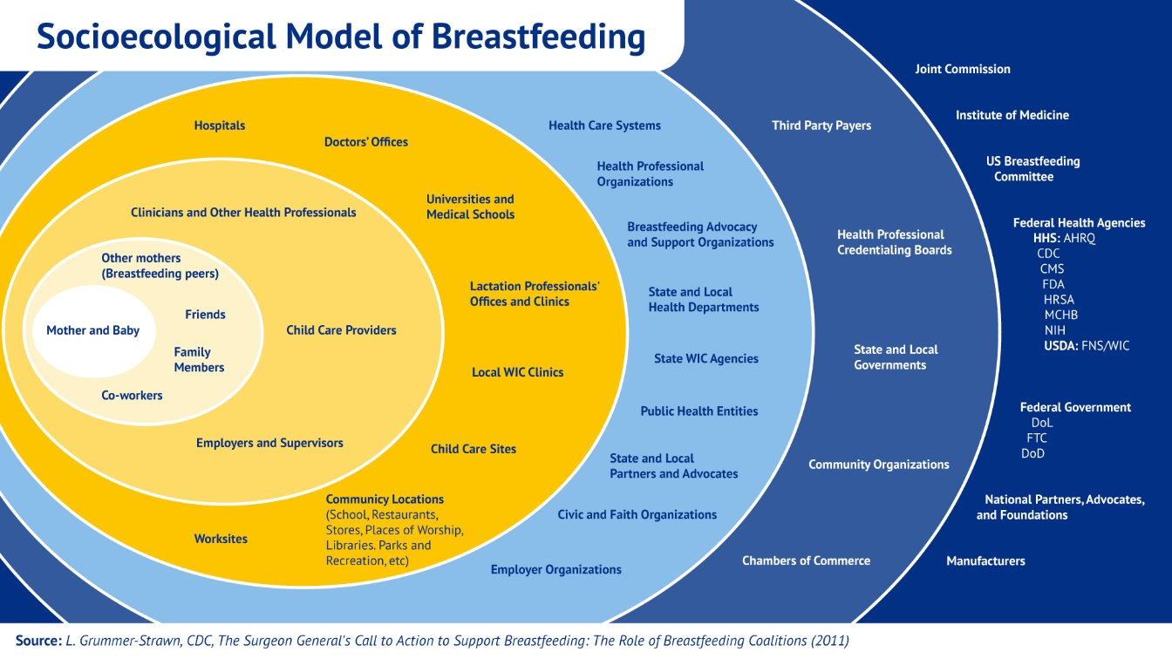
We All Have a Role in Supporting Breastfeeding
Notes:
When we think about everything that has the potential to impact a mother's decision to breastfeed, we realize that for her to truly be successful and meet her intended goal, she not only has to be offered the opportunity and information to make an informed feeding choice, but she must also live, work and thrive in environments that fully support her choice once it’s been made. ​
​
Support in the workplace is just one piece of the puzzle in creating an environment of breastfeeding support.

Slide 10

Texas Women Want to Breastfeed
Breastfeeding Among Texas Infants Born in 2021
CDC National Immunization Survey
Opportunity Gap
*Any breastfeeding includes the feeding of any amount of breast milk.
Notes:
CDC NIS survey, 2021 https://www.cdc.gov/breastfeeding/data/nis_data/rates-any-exclusive-bf-state-2021.htm

Slide 11
Legal Case for Supporting Breastfeeding

Slide 12

Legal Case
Texas Worksite Lactation Laws​
Texas Health and Safety Code Chapter 165 ​
  A mother can breastfeed or express breast milk for her baby anywhere she is otherwise allowed to be​.
  Established the Texas Mother-Friendly Worksite business designation​.
Texas Government Code Chapter 619​
  Public employers must have lactation support policies​.
Notes:
There are several state policies that that are related to employer provisions for breastfeeding mothers. ​
​
Texas Statutes include:​
Chapter 165. Breast-feeding Subchapter A. Breast-feeding rights and policies​
Includes: “mother is entitled to breast-feed her baby or express breastmilk in any location in which the mother-s presence is otherwise authorized.”​
Also established the Texas Mother-Friendly Worksite Business designation​
​
Chapter 619: Right to express breastmilk in the workplace​
https://statutes.capitol.texas.gov/Docs/GV/htm/GV.619.htm#:~:text=GOVERNMENT%20CODE%20CHAPTER%20619.,EXPRESS%20BREAST%20MILKIN%20THE%20WORKPLACE&text=(2)%20a%20board%2C%20a,an%20institution%20of%20higher%20education.​
​
Texas Admin Code, Rule §31.1 ​
Register of Mother-Friendly Business​
​
Important to note: The TMFW program implements the Business “Mother-Friendly” designation and can educate and inform about the other components. We can answer common questions and connect employers with the appropriate resources while building their programs. We do not have oversite or enforcement responsibilities related to GC 619. ​

Slide 13
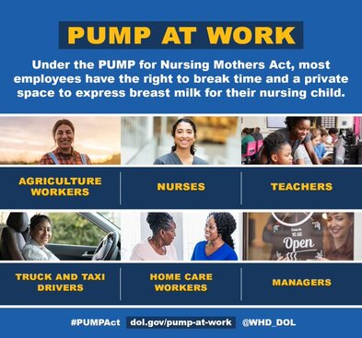
Legal Case
Federal Worksite Lactation Laws​
Fair Labor Standards Act (FLSA)
  Most nursing employees have the right to reasonable break time and a place other than a bathroom that is shielded from view to express breast milk while at work.
  This right is available for up to one year after the child’s birth.
PUMP Act, 2022
  Extended protections for additional employees not previously covered.
Notes:
As you may or may not be aware, the FLSA was amended in December 2022 by the Providing Urgent Maternal Protections for Nursing Mothers Act (or “PUMP Act” for short). The PUMP Act extends the rights to receive break time and a private space to pump at work to nearly all employees, including FLSA exempt employees, who were previously not covered by the Break Time for Nursing Mothers provision of the FLSA. This includes:​
Agriculture workers​
Nurses​
Teachers​
Truck and taxi drivers​
Home care workers​
Managers ​

Slide 14
Business Case for Supporting Breastfeeding

Slide 15
The Business Case
Employee Impact
Increased engagement
Increase morale and productivity
Retention of experienced employees
Healthier employees
Business Impact
Three to one return on investment¹
Lower recruitment and training costs
Lower medical insurance claims
State Health Impact
Reduced health care costs
Investment in community of future employees and managers
Worksite Support for Breastfeeding Mothers
Notes:
1. The Business Case for Breastfeeding, United States Department of Health and Human Services, Health Resources and Services Administration, Maternal Child Health Bureau, 2008

Slide 16
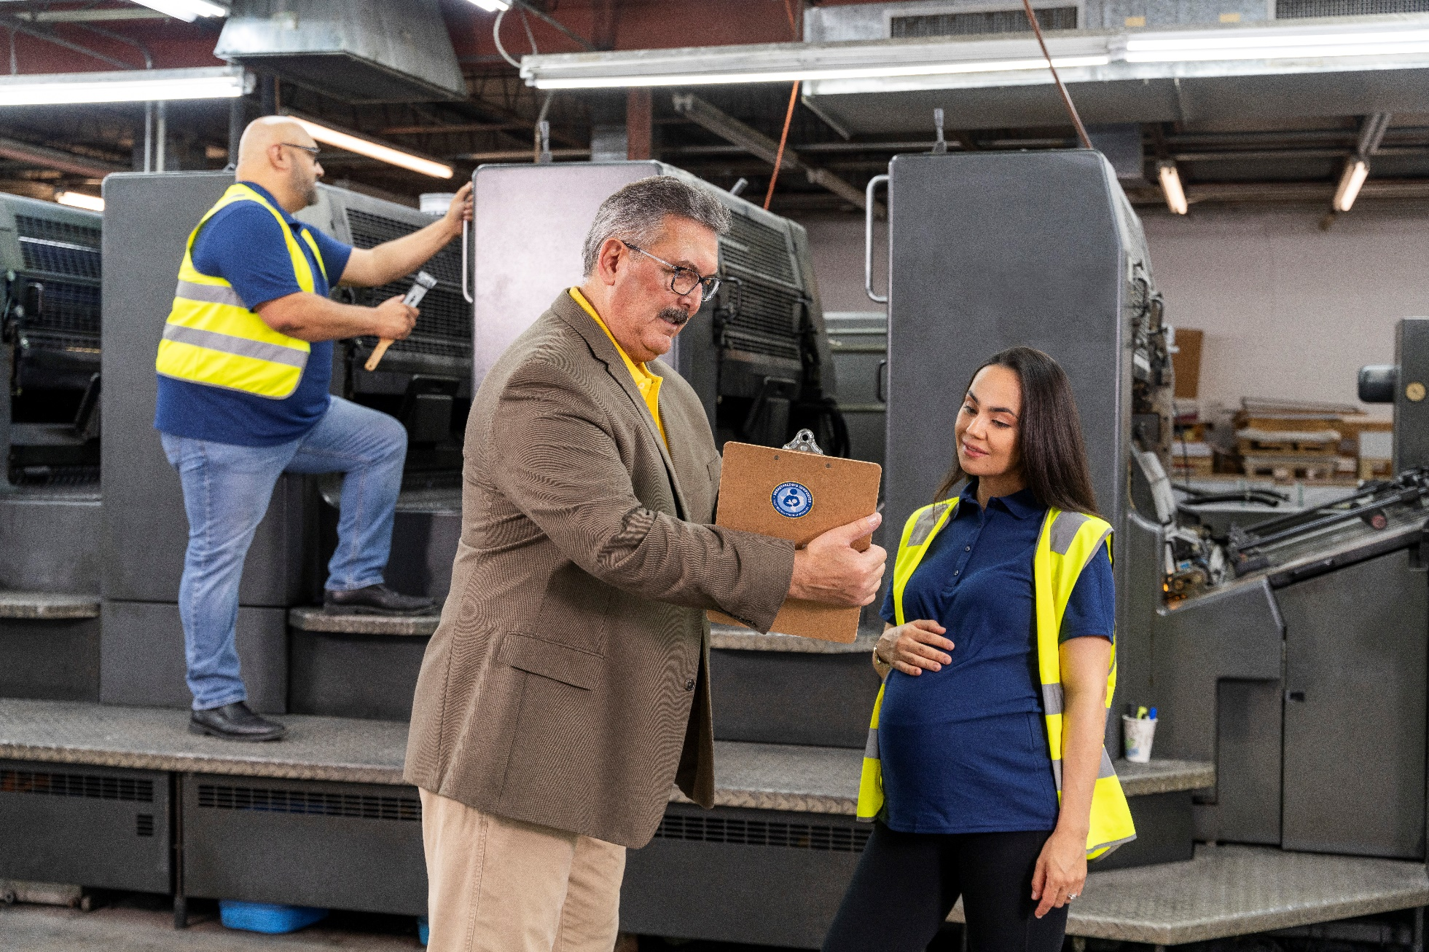
The Issue: Employers often don’t recognize there is a need for lactation support.
Women are often uncomfortable talking to their employers about lactation breaks.
Employers often do not realize there is a need.
Notes:
Through Texas DSHS’s qualitative research with both employers and employees, we have learned that women are often uncomfortable talking to their employers about lactation breaks, and employers often don’t realize there is a need.​
​
Information Source: DSHS Qualitative Research (FY23 Infant Health and Safety Campaign, 2011 SUMA Focus Groups)

Slide 17

The Issue: Return to work is the leading barrier to breastfeeding among working mothers.
62% of women with births in the last 12 months are in the US labor force.
56% of Texas WIC working mothers’ main reason for early weaning was related to work.
63% of Texas WIC working mothers who did not breastfeed reported that the main reason why was their need to return to work.
58% of Texas WIC working mothers report not meeting their own breastfeeding goals.
Notes:
U.S. Census Bureau, 2018 American Community Survey 1-year estimates chart by the Women’s Bureau, U.S.. Department of Labor. Available: tinyurl.com/census-timeseries; Texas Department of State Health Services 2018 Texas WIC Infant Feeding Practices Survey

Slide 18

The Solution: Worksite Lactation Support
Work-Life Benefits​
More postpartum employees who return to work;​
Reduced turnover​;
Increased ability to focus on job responsibilities​;
Greater sense of work-life balance​; and
Higher job satisfaction and increased loyalty​.
Health Benefits​
Fewer severe childhood illnesses and reduced costs and​
Fewer absences of mothers and fathers​.
Notes:
Note to Presenter: 62% of women with births in the last 12 months are in the US labor force, which further establishes the need to develop worksite lactation support programs. ​
Data source: U.S. Census Bureau, 2018 American Community Survey 1-year estimates chart by the Women’s Bureau, U.S.. Department of Labor. Available: tinyurl.com/census-timeseries​
​
To stay competitive and retain top talent, employers across Texas are intensifying their focus on compensation, morale, and wellness initiatives. Many are enhancing benefits packages, encompassing comprehensive health insurance, dental and vision coverage, and expanded paid time off. ​
​
U.S. Department of Health and Human Services, Health Resources and Services Administration (HRSA), Maternal and Child Health Bureau, Business Case for Breastfeeding, 2008.

Slide 19

The Solution in Texas: Texas Mother-Friendly Worksite Program
There are currently over 3,500 worksites designated in sectors such as education, manufacturing, public administration, and more!
Notes:
TMFW is a unique solution available only to Texas employers. TMFW can help Texas employers meet the law by providing policy guidance. While the TMFW Program does not assure compliance with the law or enforce the law, following TMFW policy guidance can help employers meet the requirements of federal and state law.​
​
The Texas Mother-Friendly Worksite Program got its start in 1995 under Texas Health & Safety Code 165 which authorized the Texas “Mother-Friendly” Business Designation and established the program at Texas Department of State Health Services.​
​

Slide 20

What are Texas employers saying?
Employers across Texas have been impacted by significant factors affecting the United States and Texas economy – the pandemic, economic inflation, and disruptions to supply chains. Impacts have varied by industry, and each has had to adapt practices to meet changing demands.
Notes:
Employers recognize the need to support their employees, especially if they want to retain experienced and valued staff. They recognize the need to think outside traditional boxes and offer their employees more substantial supports. ​
​
Source: DSHS Qualitative Research (2023 Infant Health and Safety Campaign)​

Slide 21
Lactation Policy Requirements

Slide 22
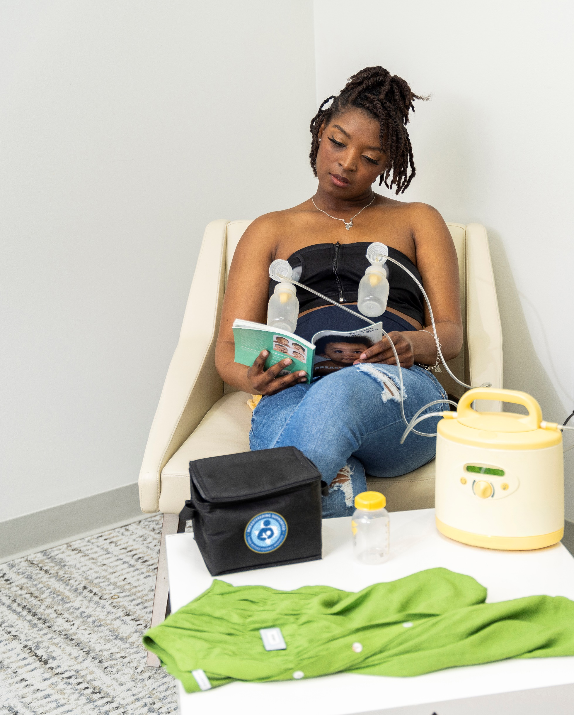
What Are Lactation Breaks?
Basic arrangements that allow mothers to comfortably express and store breast milk and maintain lactation when separated from their babies during the workday.

Slide 23
Why Are Lactation Breaks Important?
Breaks for lactation are like other work breaks to attend to physical needs.
  If lactating employees do not express milk as often as they need, they might:
    Suffer with pain and discomfort;
    Feel embarrassed due to leaking milk;
    Not be able to produce enough milk to feed their baby; or
    Get sick and need medical treatment.
  Missing even one needed pumping session can lead to lowered milk production and other undesirable consequences.

Slide 24






Texas Mother-Friendly Worksite Designation Requirements
Routine policy communication and active breastfeeding promotion and support are foundations of the TMFW designation.
1
2
Time
Work pattern ﬂexibility and break time
Space
Accessible, private non-bathroom location(s)
Water
Access to a nearby clean and safe water source
Storage
Access to hygienic storage options to safely store breast milk
3
4

Slide 25

Break Time and Work Pattern
Flexibility
Basic Needs​
Varies, but often two to three 15–20-minute breaks during a typical 8-hour work period (plus time to go to and from the site and set up equipment)​.
Flexible Options​
Use regular allotted breaks and lunch period​.
Excess time that may be needed can be made up before or after work, as part of lunch period, or at other times negotiated with supervisors​.

Slide 26
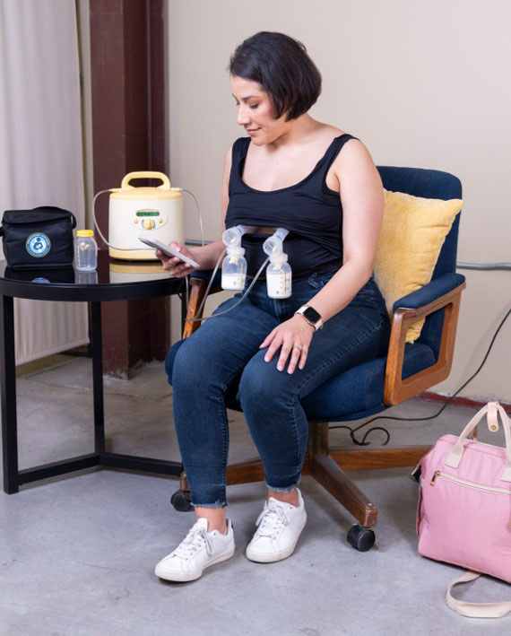
Accessible, Private Space
(Not a Bathroom)
Minimum Requirements for Space​
A place, other than a bathroom, that is shielded from view and free from intrusions by co-workers and the public to allow employees to express milk. ​
  A temporary space that has been set up to meet privacy requirements will work. ​Employers are not obligated to maintain a permanent, dedicated space for nursing mothers.
The space provided must contain a place for the nursing mother to sit, and a flat surface, other than the floor, on which to place the pump.
Notes:
Minimum requirements for designation are outlined in the Texas Health and Safety Code Chapter 165.

Slide 27
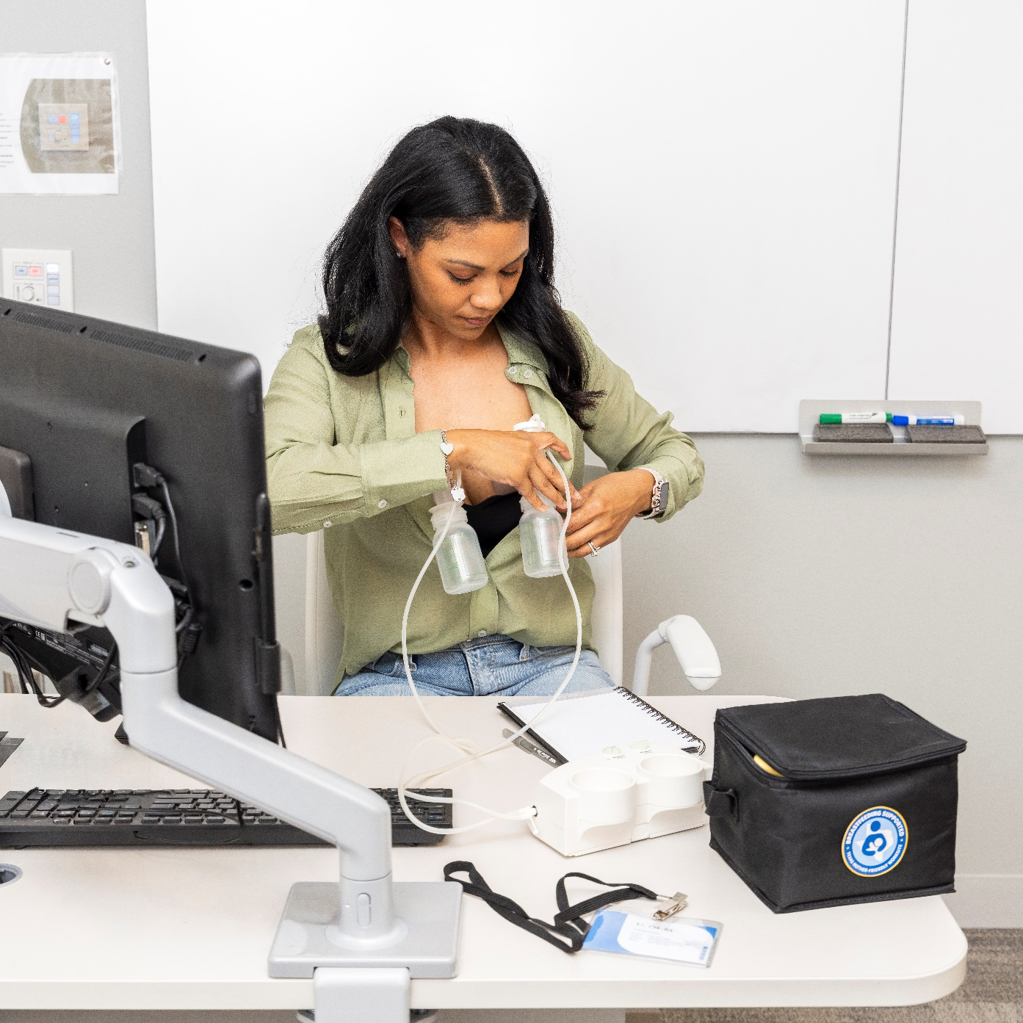
Common Question
Is my organization required to have a lactation room to become designated as a Texas Mother-Friendly Worksite?
Notes:
No, a lactation room is NOT required to obtain the Mother-Friendly designation. For many businesses, building out a lactation room simply isn’t feasible. AND…​
​
As a Mother-Friendly worksite, your policy acts as the foundation of support you provide your employees and ensures your employees will be provided proper space for expressing breastmilk, when that need arises. Creating a culture of support, communicating your policy regularly to your employees, and ensuring supervisors and employees are aware and educated about the need for lactation support is often more essential than a lactation room. Conversations between supervisor and employee before and after the birth of a child to make a plan for returning to work and pumping at work, can make all the difference to an employee. ​

Slide 28
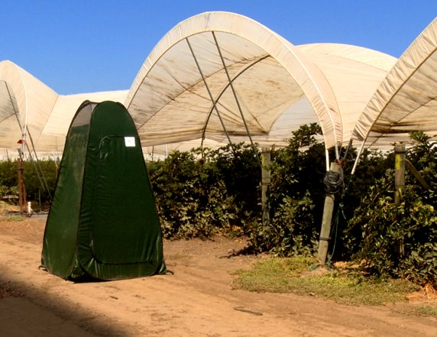

Creative Space Solutions
Small office or storage area spaces;​
Flexible space in a manager’s office or employee break area;​
Pop-up tent with chair, table, and battery pack for breast pump;​
Private vehicle with privacy window coverings;​
Indoor office space at a main office, fire stations, police stations, etc.;​
A manager’s office; or​
Vacant conference rooms (with a locking door and/or appropriate signage).​
Photo credit: OWH Employer Solutions

Slide 29

Access to Hygienic Storage
Hygienic storage may be:
A personal cooler​;
A small college dorm room sized refrigerator located in the lactation room​; or
A public shared refrigerator like in a break room​.
OSHA regulations state breast milk is not an “occupational exposure”​.

Slide 30
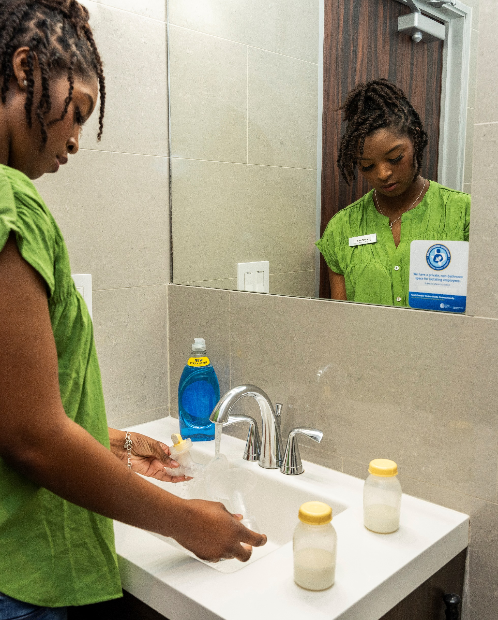
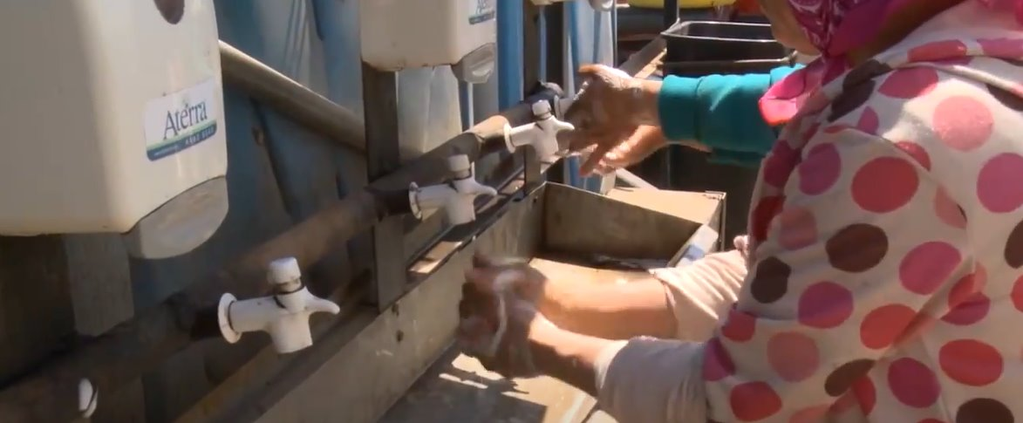
Access to a Clean, Safe Water
Source
For hand washing and pump equipment hygiene. ​
Depending on the industry, creative solutions could be necessary​. Example: agriculture workers​.
Photo credit: OWH Employer Solutions

Slide 31
Foundational Texas Mother-Friendly
Worksite Elements
Supportive Environment​
Best practice- policy language​
"In recognition of the well-documented health advantages of breastfeeding for infants and mothers, [Organization Name] provides a supportive environment to enable breastfeeding employees to express their milk during work hours."​
Routine Communication of Policy​
Best practice- policy language​
“[Organization Name] will disseminate the Texas Mother-Friendly Worksite policy to every incoming and current employee in the Organization Name on an annual basis."​
Notes:
Additional policy language option for environment: [Organization Name] recognizes that breastmilk is the optimal food for growth and development of infants.​
​
Additional policy language option for communication: Supervisors are responsible for notifying all employees of this policy and for alerting pregnant and breastfeeding employees about this policy for breastfeeding support on an annual basis.

Slide 32
Texas Mother-Friendly Worksite Program Benefits
Access to technical assistance and support from State Program Staff in the Maternal and Infant Health Branch​.
Access to relevant information and resources to support your TMFW program.​
TexasMotherFriendlyWorksite@dshs.texas.gov ​
Notes:
If you have any question about the Texas Mother-Friendly designation and its requirements, feel free to reach out to DSHS program staff at the email address listed on the slide​

Slide 33
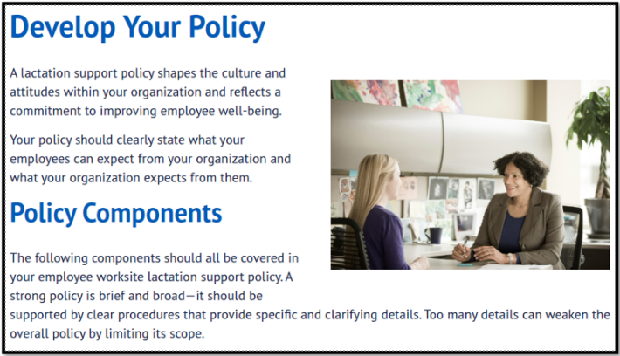

Resources for Employers
Step-by-step lactation support policy development resources;​
Information on worksite lactation laws​; and
Details on how to apply and application and policy FAQs.​
dshs.texas.gov/TexasMotherFriendly​
Notes:
Familiarize yourself with why lactation support policies and a culture of support matter for your breastfeeding employees!​
​
Previous version of our site was a microsite (TexasMotherFriendly.org).​
Visit our new site at dshs.texas.gov/TexasMotherFriendly for more information, and to bookmark. We will be adding additional content and resources in the coming year!

Slide 34
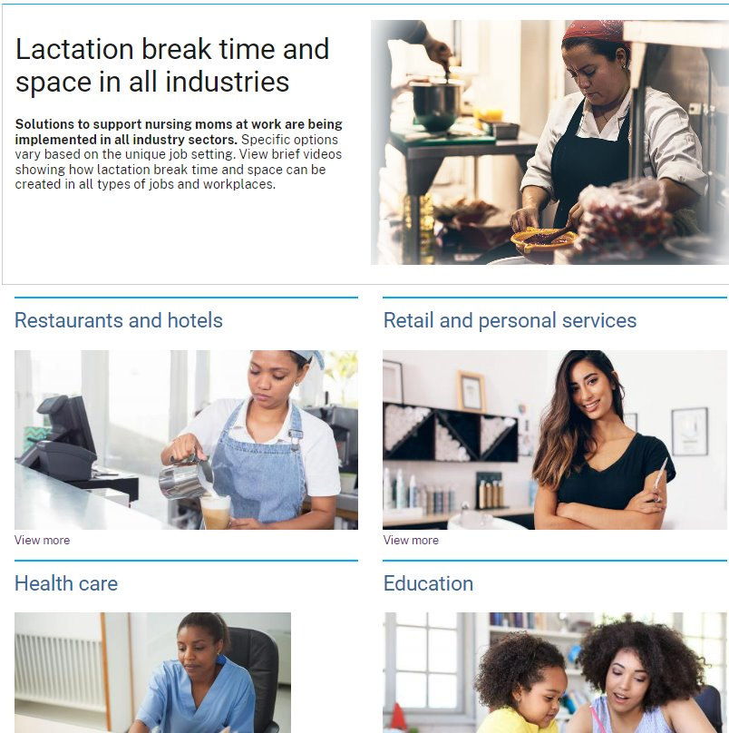
Other Online Resources
US Office on Women’s Health​
    Lactation break time and space in all industries.​
    Has fact sheets and brief videos about how lactation break time and space can be created in all types of jobs and workplaces​.
US Department of Labor – Pump at Work​
Office on Women’s Health – It’s Only Natural​
Notes:
Fact sheets: https://www.womenshealth.gov/supporting-nursing-moms-work/lactation-break-time-and-space-all-industries​
Videos: https://www.womenshealth.gov/supporting-nursing-moms-work/resources#2​
DOL Pump at Work: https://www.dol.gov/agencies/whd/pump-at-work​
It’s Only Natural:​
Get involved: Reaching Our Sisters Everywhere – Health Equity Action for Lactation Initiative (HEAL): http://breastfeedingrose.org/heal-initiative/​
-Strategy 1: Develop and facilitate a national community of practice to use and disseminate It’s Only Natural materials, support evidence-based breastfeeding practices in maternity care, and enhance training for medical and lay support of African-American mothers and infants.​
-Strategy 2: Expand the Perinatal Community Health Worker Collaborative that incorporates It’s Only Natural material into direct service support to pregnant and parenting women and their families.​
-Strategy 3: Develop and execute a national digital media campaign to promote It’s Only Natural and other breastfeeding support materials.​
​

Slide 35
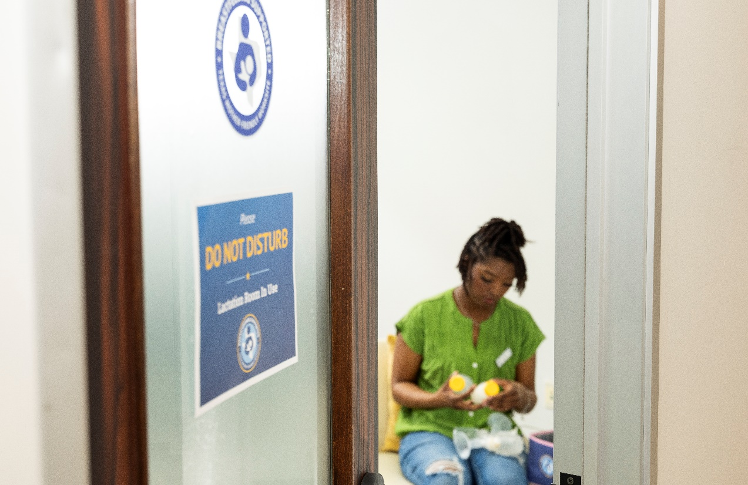

Common Questions
What if I own a small business- do I still need to provide worksite lactation support?
Is the TMFW designation still important if my business has a male-dominated work force?
Notes:
Note to Presenter: Increase engagement by pairing employer with another employer that has overcome similar concern.​
From the DOL site: Employers with fewer than 50 employees are not subject to the FLSA break time and space requirements if compliance with the provision would impose an undue hardship. Whether compliance would be an undue hardship is determined by looking at the difficulty or expense of compliance for a specific employer in comparison to the size, financial resources, nature, and structure of the employer’s business. All employees who work for the covered employer, regardless of work site, are counted when determining whether this exemption may apply. Undue hardship should not be assumed.
Yes- the decision to provide breast milk is largely dependent on having a circle of support. Fathers play a significant role in successful breastfeeding. Having a comprehensive lactation support program can include offering breastfeeding prenatal education classes and health plan or other coverage for lactation supplies and services.

Slide 36
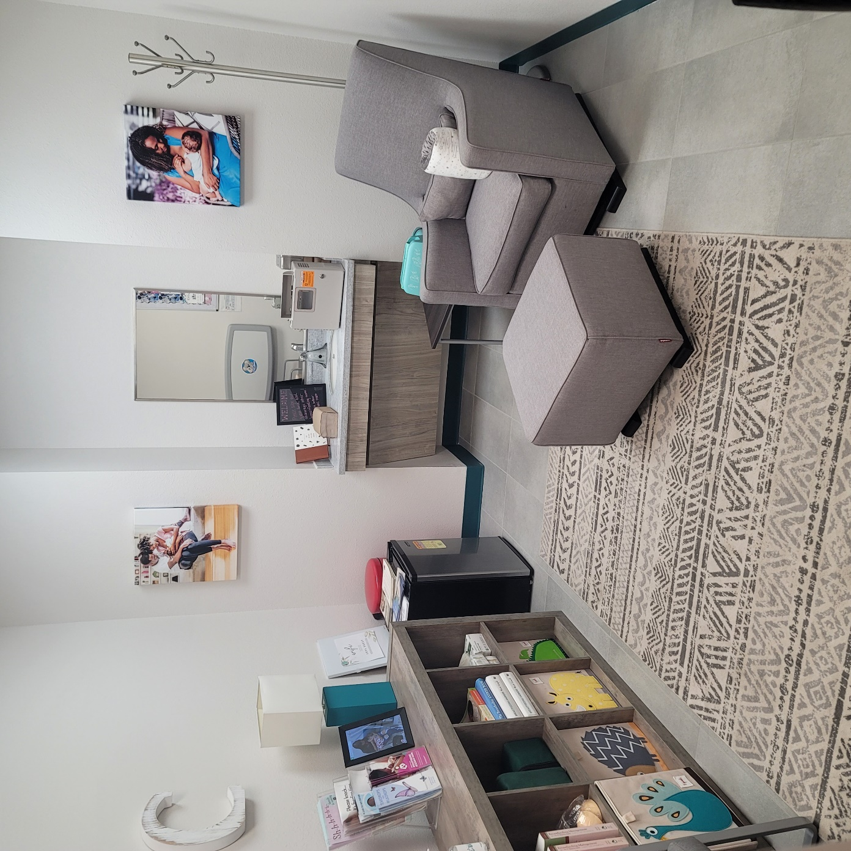
Texas Mother-Friendly Worksite Success Story
Photo credit: City of Port Arthur

Slide 37

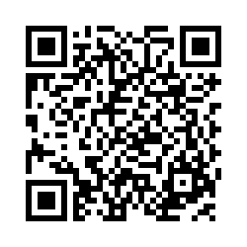
What can you do by next week?
Take the TMFW Readiness Survey!

Slide 38
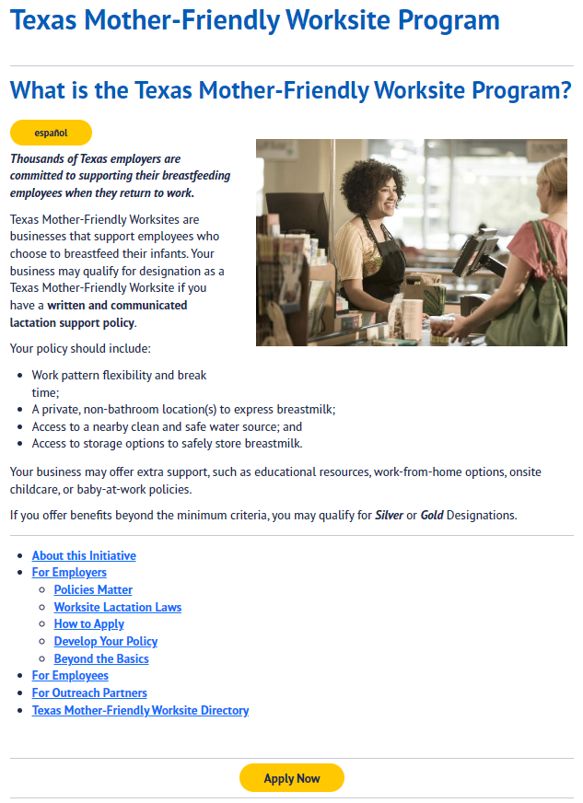

Apply for Designation
Apply on the Texas Mother-Friendly Worksite Program Website!​
dshs.texas.gov/TexasMotherFriendly​

Slide 39
Contact us to learn more!
[Your Organization Name]​
  Your Name​
  Phone​
  Email​
​
Texas Mother-Friendly Worksite Program Coordinator
  Tina Castellanos, MPA, IBCLC
  Email: TexasMotherFriendlyWorksite@dshs.texas.gov ​

Slide 40

Thank You!
Tina Castellanos – Perinatal and Infant Health and Safety Coordinator
TexasMotherFriendlyWorksite@dshs.texas.gov

Slide 41
References
Barriers to Breastfeeding: Supporting Initiation and Continuation of Breastfeeding: American Congress of Obstetricians and Gynecologists (ACOG) Committee Opinion, Number 821. (2021). Obstetrics and gynecology, 137(2), e54–e62. ​
Bartick MC, Schwarz EB, et al.. Suboptimal breastfeeding in the United States: Maternal and pediatric health outcomes and costs. Maternal Child Nutrition, 2016​.
Meek, J. Y., Noble, L., & Section on Breastfeeding (2022). Policy Statement: Breastfeeding and the Use of Human Milk. Pediatrics, 150(1), e2022057988. ​
U.S. Census Bureau, 2018 American Community Survey 1-year estimates chart by the Women’s Bureau, U.S.. Department of Labor. Available: tinyurl.com/census-timeseries; Texas Department of State Health Services 2018 Texas WIC Infant Feeding Practices Survey
U.S. Department of Health and Human Services, Health Resources and Services Administration (HRSA), Maternal and Child Health Bureau, Business Case for Breastfeeding, 2008.

