Slide 1


Slide 2
COVID-19 Vaccine & Monkeypox PHFPC Debriefing
The information presented today is based on CDC’s recent guidance and MAY change.
Imelda Garcia, MPH
Associate Commissioner| Laboratory & Infectious Disease Services Division
August 31, 2022

Slide 3
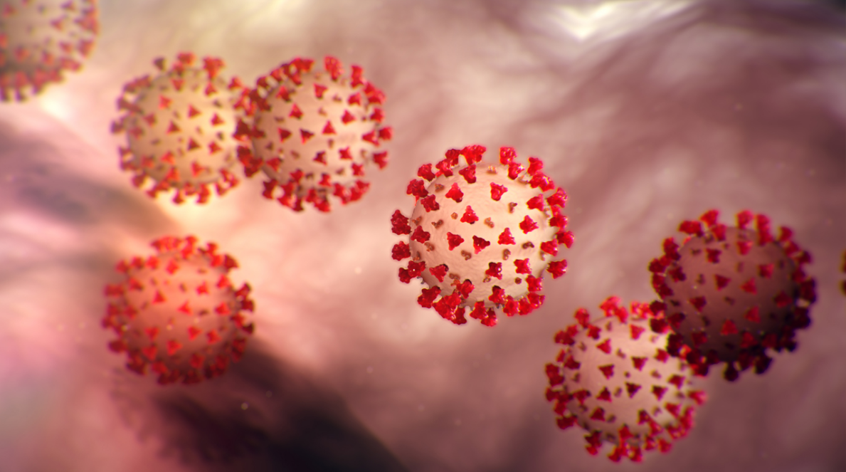
COVID-19 Vaccine Updates
The information presented today is based on CDC’s recent guidance and MAY change.
August 31, 2022

Slide 4
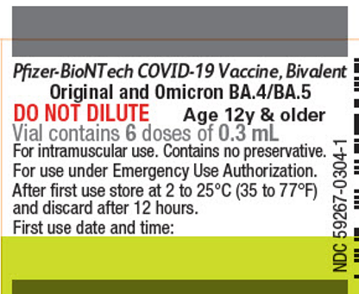
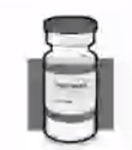
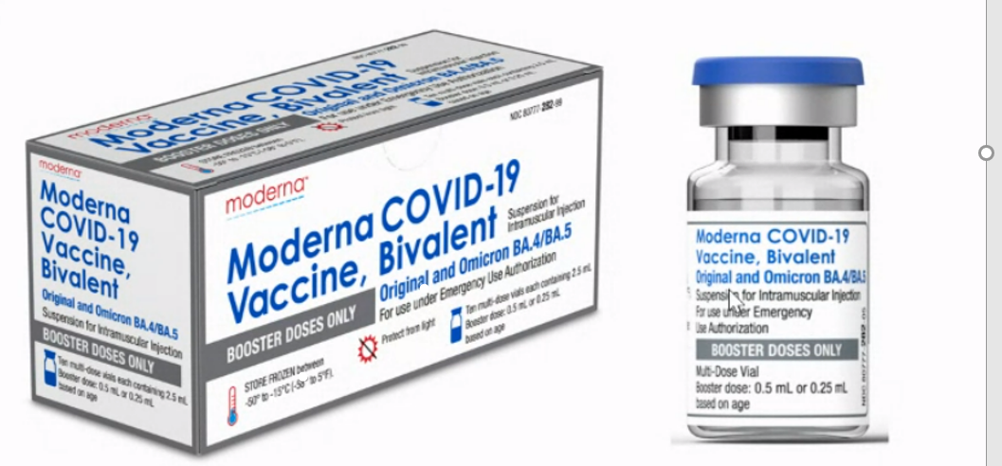
New Bivalent COVID-19 Booster Vaccines
(Original + Omicron BA.4/5)
Pfizer Bivalent COVID-19
Booster Vaccine
Single booster dose (30 mcg)
12 years and older
Grey cap with grey border vial
  No dilution
  6 doses/vial
  Storage and handling identical to the current grey cap vaccine product
Moderna Bivalent COVID-19 Booster Vaccine
Single booster dose (50 mcg)
18 years and older
Blue cap with grey border vial
  5 doses/vial
  Storage and handling identical to all current Moderna COVID-19 vaccine products

Slide 5
Path to New Bivalent COVID-19 Booster Vaccine
FDA Advisory
Manufacturers Complete EUA Submission
FDA Issuance of EUA
VRBPAC Meeting
CDC (ACIP) Recommendations
CDC Director’s Sign-Off
Begin Vaccination
4/6/2022
6/28/2022
  Strain selection
  Bivalent (Original + Omicron-BA.4/5 )
Begin manufacturing
Pfizer (8/22/2022)
Moderna (8/23/2022)
8/31/2022?
Begin shipment of bivalent vaccines on 9/1/2022?
ACIP meeting scheduled for 9/1/2022 & 9/2/2022
Possible recommendations by 9/2/2022?
9/2/2022?
9/6/2022?
FDA: Food and Drug Administration
VRBPAC: Vaccine and Related Biological Products Committee
ACIP: Advisory Committee on Immunization Practices
EUA: Emergency Use Authorization
All forwarding looking dates subject to change

Slide 6
New Bivalent COVID-19 Booster Vaccines
Pre-Orders
Texas has received the following as a part of waves 1 & 2 pre-order allocation:
  Pfizer Bivalent COVID-19 booster vaccine (502,500 doses)
  Moderna Bivalent COVID-19 booster vaccine (192,800 doses)
All provider pre-orders have been ordered.
Shipment to begin immediately following issuance of the EUAs by the FDA. Delivery date unknown as of now.

Slide 7
Eligible Population Projection for Bivalent COVID-19 Vaccine Booster
Month Projected to be Eligible* | Number of Eligible Individuals >12 Yrs
Sep-22 | 18,959,672
Oct-22 | 482,128
Nov-22 | 565,611
Dec-22 | 285,680
*Eligible population includes all individuals 12 years and older who have received any dose of COVID-19 vaccine four months prior.
Data as of 8/29/2022

Slide 8
COVID-19 Vaccine
Texas Overall Summary

Slide 9
People Vaccinated by Age Group
Age Group | People Completed Primary Series | Total Doses Administered | 2019 Statewide Population Estimate by Age Group | % of Population Completed Primary Series
6m-4 years | 13,486 | 128,118 | 1,814,387 | 0.74%
5-11 years | 818,968 | 2,100,484 | 2,898,962 | 28.25%
12-15 years | 998,291 | 2,472,173 | 1,647,446 | 60.60%
16-17 years | 512,669 | 1,298,925 | 825,107 | 62.13%
18-29 years | 2,931,146 | 7,055,325 | 4,985,597 | 58.79%
30-39 years | 2,750,111 | 6,713,642 | 4,169,318 | 65.96%
40-49 years | 2,734,511 | 6,827,059 | 3,730,994 | 73.29%
50-64 years | 3,979,386 | 10,676,745 | 4,975,933 | 79.97%
65-74 years | 1,997,116 | 5,908,923 | 2,245,028 | 88.96%
75+ years | 1,234,795 | 3,746,672 | 1,489,201 | 82.92%
Unknown | 691 | 4,487 | -- | --
Total | 17,971,170 | 46,932,553 | 28,781,973 | 62.44%
Data as of 8/29/22

Slide 10
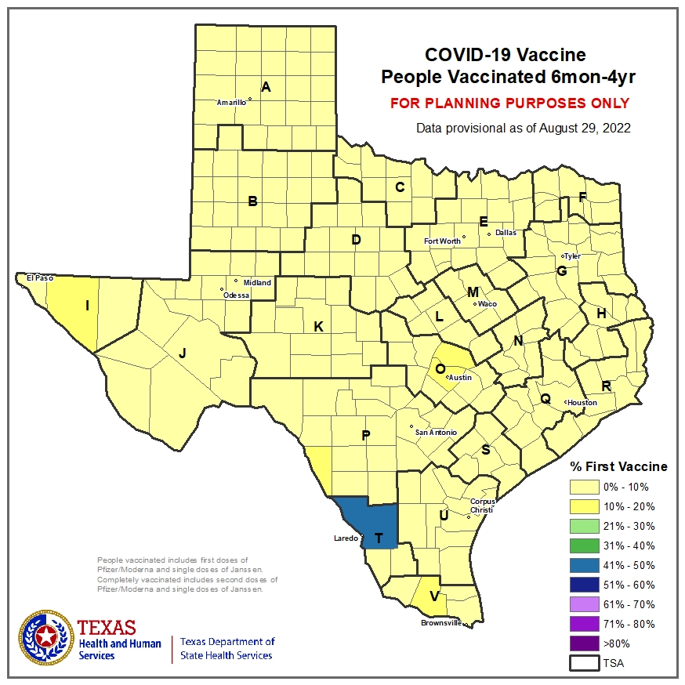
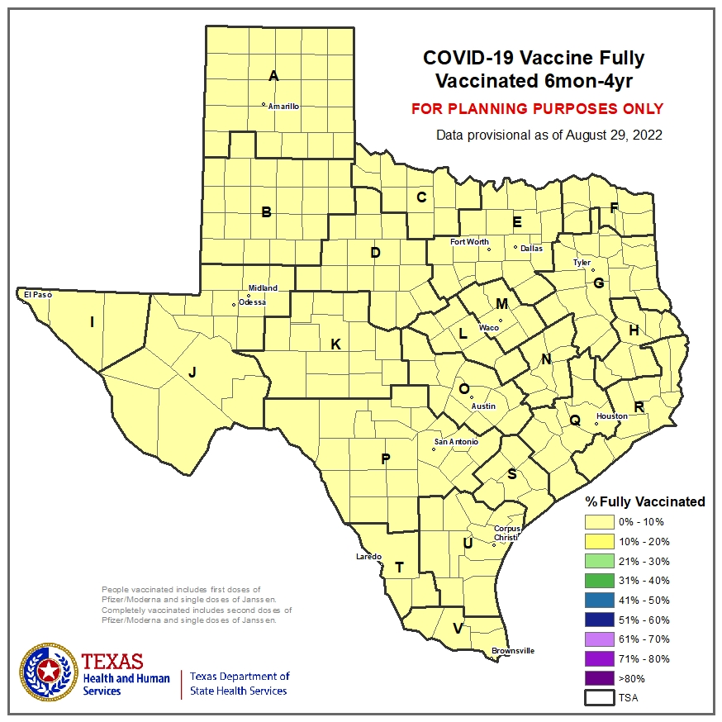

Slide 11
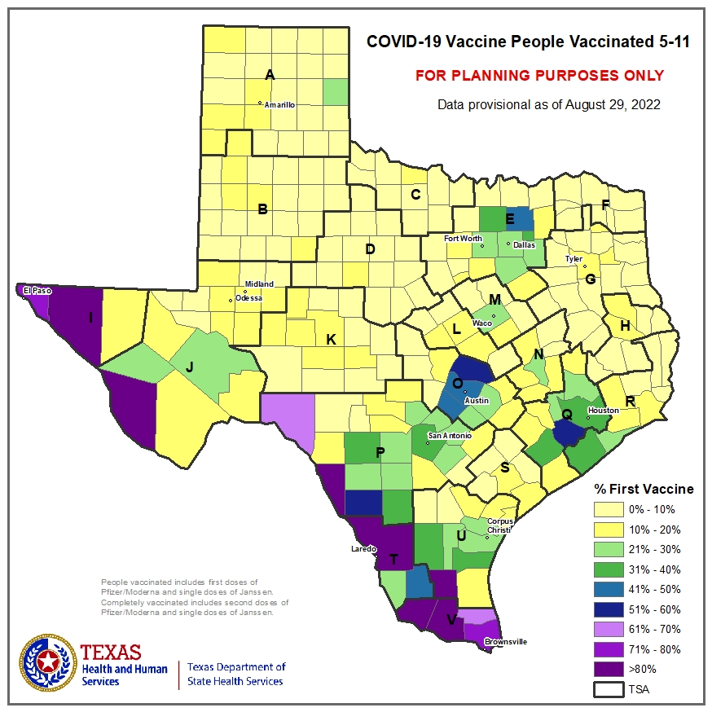
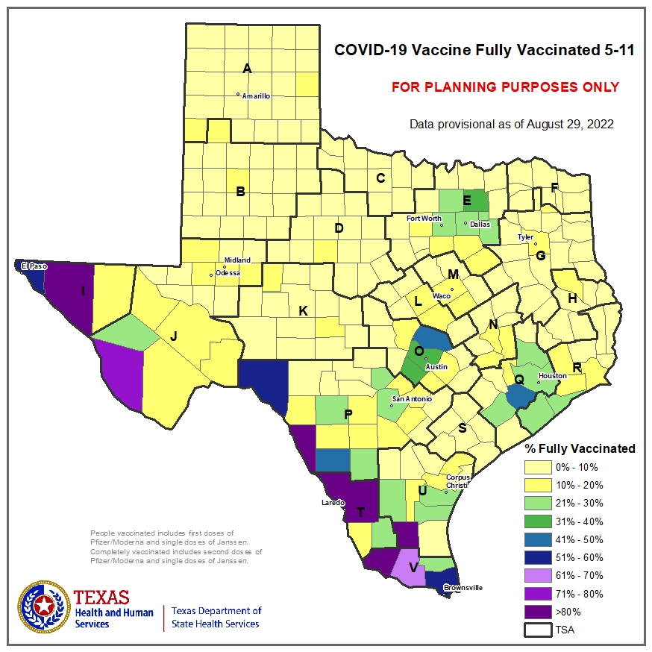

Slide 12
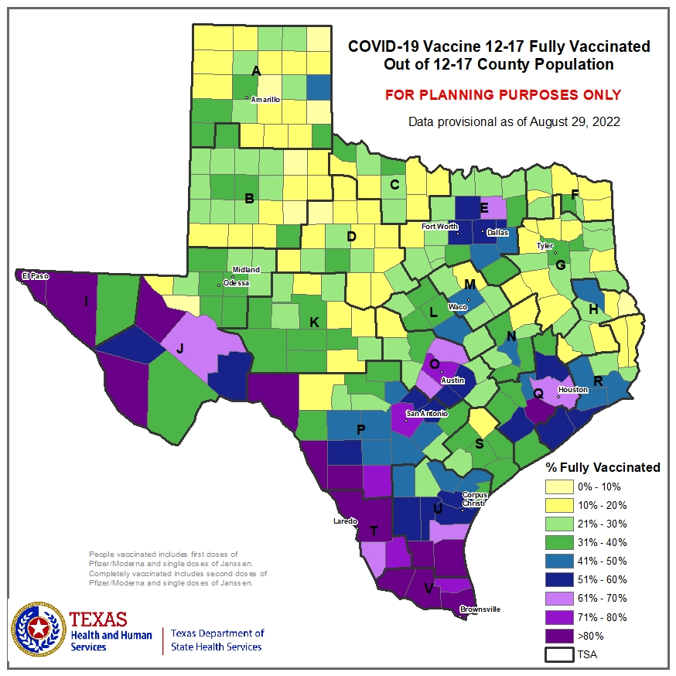
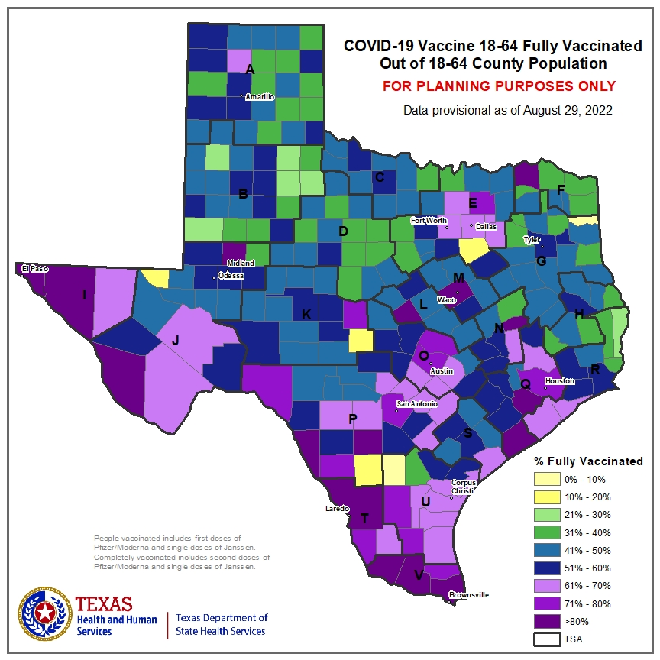
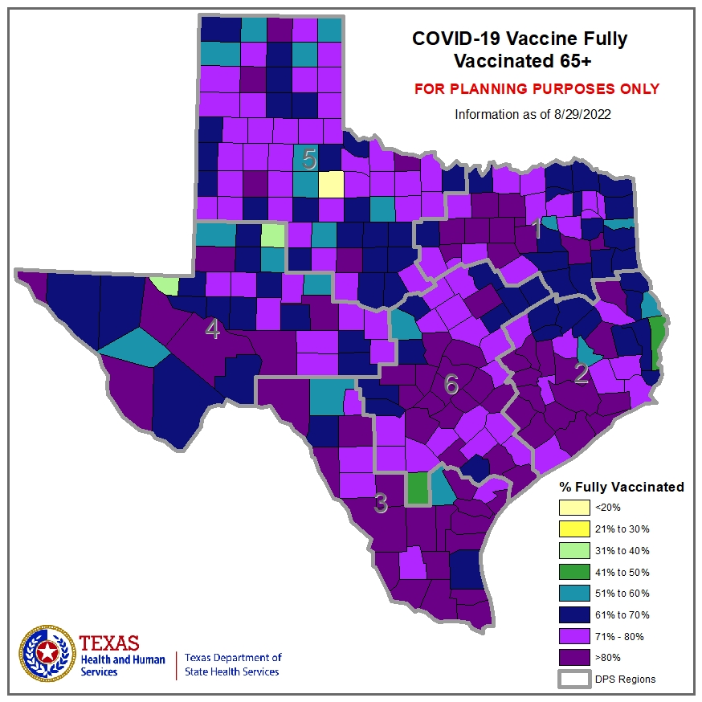

Slide 13

Monkeypox Updates
The information presented today is based on CDC’s recent guidance and MAY change.
August 31, 2022

Slide 14
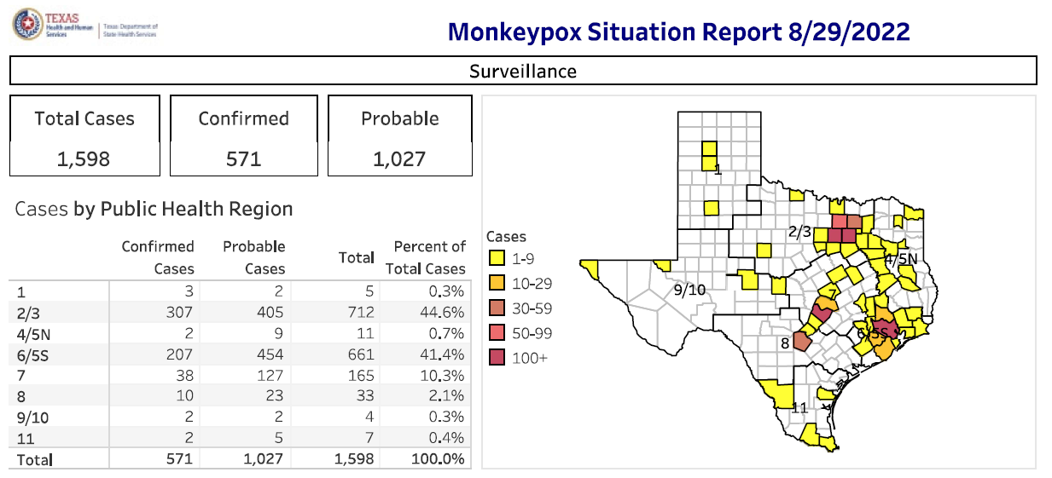

Slide 15
Case Demographics
Age Category | # of Cases | % of Cases
<18 Years | 9 | 0.56%
18-29 Years | 460 | 28.79%
30-39 Years | 675 | 42.24%
40-49 Years | 293 | 18.34
50-59 Years | 135 | 8.45%
60+ Years | 26 | 1.63%
Total | 1,598 | 100%
Race | # of Cases | % of Cases
Hispanic | 224 | 14%
Asian | 21 | 1.30%
Black | 472 | 29.50%
White | 302 | 18.90%
Other | 85 | 5.30%
Unknown | 494 | 30.90%
Total | 1,598 | 100%
Sex | # of Cases | % of Cases
Male | 1556 | 97.40%
Female | 41 | 2.60%
Unknown | 1 | 0.10%
Total | 1,598 | 100%
DSHS INTERNAL USE ONLY: NOT FOR DISTRIBUTION

Slide 16
As of August 29, 2022, there are a total of 1,598 monkeypox cases in Texas

Slide 17
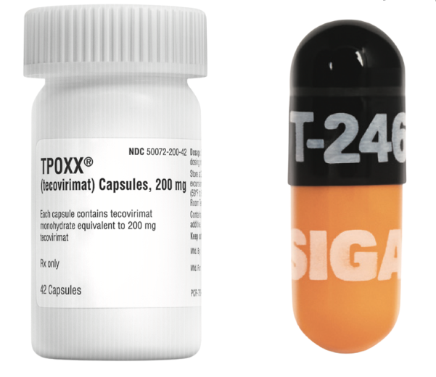
Monkeypox Therapeutic
Tecovirimat (TPOXX)

Slide 18
Jurisdictions With Prepositioned Tecovirimat (TPOXX) Oral
Austin Public Health
Dallas County Health and Human Services
Houston Heath Department
San Antonio Metropolitan Health District
Tarrant County Public Health Services
Lubbock Health Department
All 8 PHRs

Slide 19
Texas TPOXX Thresholds
ASPR is making 50,000 courses of TPOXX (100,000 bottles) available to jurisdictions for prepositioning to facilitate timely access to TPOXX for eligible patients.
Jurisdictions’ thresholds are calculated based on a formula based on cases (75%) and number of individuals at the highest risk (25%), including who have HIV or other immunocompromising conditions.
Jurisdictions can receive additional TPOXX supplies to meet the threshold
  only when they have reported use of 80% of their current supply through HPOP and
  have documented submission to the CDC of required regulatory forms (Patient Intake Form, at a minimum) for 90% of the used supply​.
Jurisdiction | Total Courses Threshold as of August 18, 202​​2
Texas - Houston | 1,219
Texas - Other | 2,810
1 Course = Oral form 2 bottles (14 days) for a person with a body weight of 40 kg to less than 120 kg

Slide 20
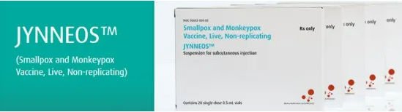
Monkeypox Vaccination

Slide 21
JYNNEOS Schedule and Dosing Regimens
 | Route of Administration | Injection Volume | Recommended Doses | Recommended Interval between 1st and 2nd dose
People age >18 yrs | ID | 0.1 mL | 2 | 28 days
People age < 18 yrs | Subcut | 0.5 mL | 2 | 28 days
People of any age who have a history of developing keloid scars | Subcut | 0.5 mL | 2 | 28 days
Intradermal (ID)
Subcutaneous (Subcut)
JYNNEOS FDA EUA Fact Sheet HCP
CDC Monkeypox Vaccine Interim Clinical Recommendations

Slide 22
Texas JYNNEOS Vaccine Expanded Eligibility Option
People with a known or possible exposure to the monkeypox virus remain the highest priority for vaccination.
Local health entities may also expand vaccination to include pre-exposure prophylaxis (PrEP) for people who are at an increased risk of monkeypox, such as people 18 years of age and older who
  are men who have sex with men, and
  have had multiple or anonymous sex partners within the previous 21 days.
DSHS further recommends prioritizing eligible people who
  have a sex partner who is showing symptoms of monkeypox, such as a rash or sores;
  have had a diagnosis of HIV, chlamydia, gonorrhea, or early syphilis, within the previous 12 months;
  are on HIV pre-exposure prophylaxis; or
  have a condition that may increase their risk for severe disease if infected with monkeypox virus, such as HIV, atopic dermatitis, or eczema.

Slide 23
JYNNEOS Dose Availability Summary
Texas JYNNEOS Allocations
 | Phase 1 & 2 | Phase 3 |  |  | Phase 4** (33:33:33) August 22 – September 30, 2022
 |  | Wave 1 (July 29, 2022) | Wave 2* (August 15, 2022) | Wave 3 (August 15, 2022) | Tranche 1 | Tranche 2 | Tranche 3
Texas Available Doses (not including COH/Harris) | 14,780 vials | 16,720 vials | 2,510 vials | 2,510 vials | 4,499 vials | 4,499 vials | 4,499 vials
Texas Doses Shipped | 20,104 vials | 16,340 vials (39 providers) | 2,310 vials (33 providers) | Wk Aug 30th | TBD
Houston/Harris | 5,324 vials | 6,712 vials | 1,007 vials | 1,007 vials | 4,291 vials | 4,291 vials | 4,291 vials
*CDC/ASPER changed vials to doses ** Available in three tranches with an attestation via HPOP to having utilized at least 85% of vials received to date

Slide 24
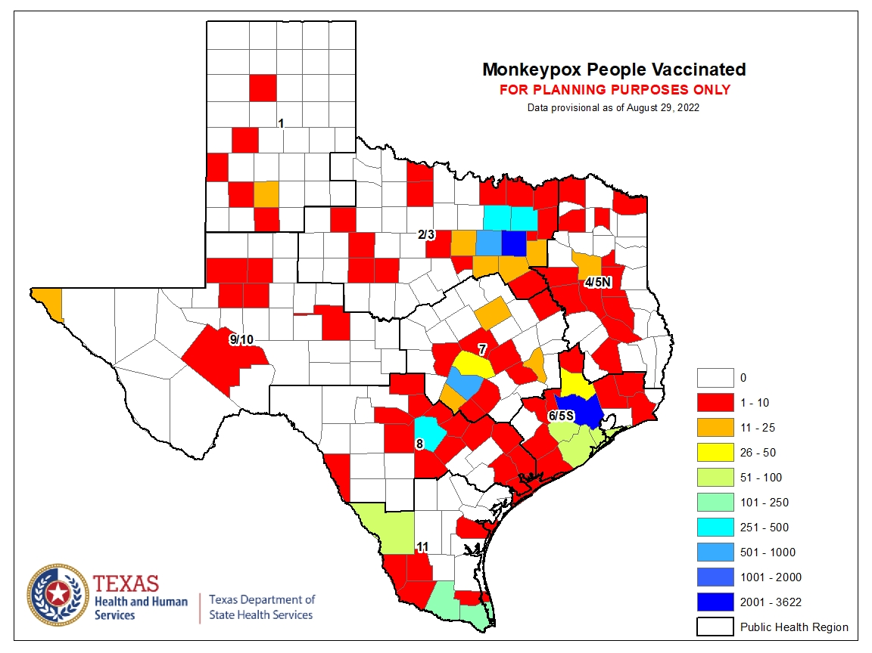

Slide 25
Support & Resources

Slide 26
Expanded Access and Emergency Use Authorization
Sometimes called “compassionate use”, Expanded Access (EA) is a potential pathway for a patient with an immediately life-threatening condition or serious disease or condition to gain access to an investigational medical product (drug, biologic, or medical device) for treatment outside of clinical trials when no comparable or satisfactory alternative therapy options are available.
  Different types of EA
Required documentation for EA-IND Intermediate size patient group (TPOXX EA-IND):
  Informed Consent
  FDA 1572
  Patient Intake
  Serious Adverse Events (MedWatch)
An Emergency Use Authorization (EUA) is a mechanism to facilitate the availability and use of medical countermeasures, including vaccines, during public health emergencies. Under an EUA, FDA may allow the use of unapproved medical products, or unapproved uses of approved medical products in an emergency to diagnose, treat, or prevent serious or life-threatening diseases or conditions when certain statutory criteria have been met, including that there are no adequate, approved, and available alternatives.
Required documentation for an EUA (JYNNEOS):
  Fact Sheet to recipients
  Required adverse event reporting
    Vaccine Adverse Event Reporting System (VAERS)
Expanded Access Categories for Drugs (Including Biologics) | FDA
https://www.fda.gov/vaccines-blood-biologics/vaccines/emergency-use-authorization-vaccines-explained

Slide 27
TPOXX EA-IND Protocol
CDC held TPOXX EA-IND provides umbrella regulatory coverage to clinicians, so that facilities do not need to request and obtain their own INDs.
Informed Consent Form English and Spanish Short Form Consent Written Summary | Treating physician or designee should complete this form prior to tecovirimat initiation. | Return to CDC within 7 calendar days of initiation of therapy by: email (regaffairs@cdc.gov) or upload to secure ShareFile at: https://centersfordiseasecontrol.sharefile.com/r-r3941801ebcbd4002b4dfe98e314ec697
2) Patient Intake Form | Provide baseline assessment information
3) FDA Form 1572 | STATEMENT OF INVESTIGATOR [This only needs to be signed once per facility.]
 | Once submitted it can be used for all future TPOXX treatment administer under the EA-IND.
Clinical Outcome Form | No longer “required” and is now optional
4) Serious Adverse Events [MedWatch Form] | Report life-threatening or serious adverse events associated with TPOXX by completing a PDF MedWatch Form (or downloaded from the FDA website). | Return to the CDC within 72 hours of awareness or sooner, if possible, by: email (regaffairs@cdc.gov) or upload to secure ShareFile at: https://centersfordiseasecontrol.sharefile.com/r-r3941801ebcbd4002b4dfe98e314ec697 The MedWatch form states to submit the completed form to the FDA. However, please submit to CDC at regaffairs@cdc.gov.

Slide 28
Components of JYNNEOS Vaccine
JYNNEOS is a live vaccine produced from the strain Modified Vaccinia Ankara-Bavarian Nordic (MVA-BN), an attenuated, non-replicating orthopoxvirus.
MVA-BN is grown in primary Chicken Embryo Fibroblast cells.
Each 0.5 mL dose is formulated to contain:
  0.5 x 10⁸ to 3.95 x 10⁸ infectious units of MVA-BN live virus in 10 mM Tris (tromethamine)
  140 mM sodium chloride at pH 7.7.
  Residual amounts of host-cell DNA (≤ 20 mcg)
  Protein (≤ 500 mcg)
  Benzonase (≤ 0.0025 mcg)
  Gentamicin (≤ 0.1 mcg)
JYNNEOS is a sterile vaccine formulated without preservatives.
The vial stoppers are not made with natural rubber latex.
https://www.rxlist.com/jynneos-drug.htm#description

Slide 29

JYNNEOS Resources
FDA EUA Fact Sheet for Providers: https://www.fda.gov/media/160774/download
FDA EUA Fact Sheet for Patients and Caregivers: https://www.fda.gov/media/160773/download
FDA EUA Fact Sheet for Patients and Caregivers in other languages: https://www.fda.gov/emergency-preparedness-and-response/mcm-legal-regulatory-and-policy-framework/emergency-use-authorization#monkeypox
FDA: JYNNEOS Package Insert: https://www.fda.gov/media/131078/download
Use of JYNNEOS (ACIP Recommendations)
Vaccine Information Statement: Smallpox/Monkeypox Vaccine (JYNNEOS™): https://www.cdc.gov/vaccines/hcp/vis/vis-statements/smallpox-monkeypox.pdf
JYNNEOS Expiration Look-up: Monkeypox (hhs.gov)
Vaccine Adverse Events Reporting System https://vaers.hhs.gov/
JYNNEOS Storage and Handling Summary: https://www.cdc.gov/poxvirus/monkeypox/pdf/Storage-and-Handling-Summary.pdf
FDA Fast Facts: JYNNEOS: Final Fact Sheet Monkeypox Jynneos 07292022 (fda.gov)
FDA granted an EUA amendment for preparation and storage for JYNNEOS vaccine: Letter granting EUA amendment for 8-week storage - Jynneos (fda.gov)
Requests for JYNNEOS Medical Information
• medical.information_US@bavarian-nordic.com
• US Telephone Number: 1-844-4BAVARIAN (844-422-8274)
• US Fax Number: 1-833-4BAVARIAN

Slide 30
DSHS Resources
EAIDU Monitoring: EAIDUMonitoring@dshs.texas.gov
TPOXX requests: dshsmpxconsult@dshs.texas.gov
Vaccine questions: DSHSPMXVax@dshs.texa.gov

Slide 31
DISCLAIMER
The information presented today is based on CDC’s recent guidance and MAY change.
August 31, 2022

