Slide 1
Community Conversations on Health
REDUCING HEALTH DISPARITIES | BUILDING HEALTHIER COMMUNITIES
ESTABLISHING STRONGER PARTNERSHIPS
Update to PHFPC
Office of Public Health Policy
Center for Public Health Policy and Practice
August 31, 2022

Slide 2
Grant Activities
Current funding from 6/1/2021 – 5/31/2023
Activities focus on 3 key CDC strategies:
DSHS Central and Regional Offices
Local Health Departments
Increase and improve data collection and reporting
Grant Partners
Build, leverage, and expand infrastructure and support
Mobilize and support partners and collaborators
State Agency Partners

Slide 3
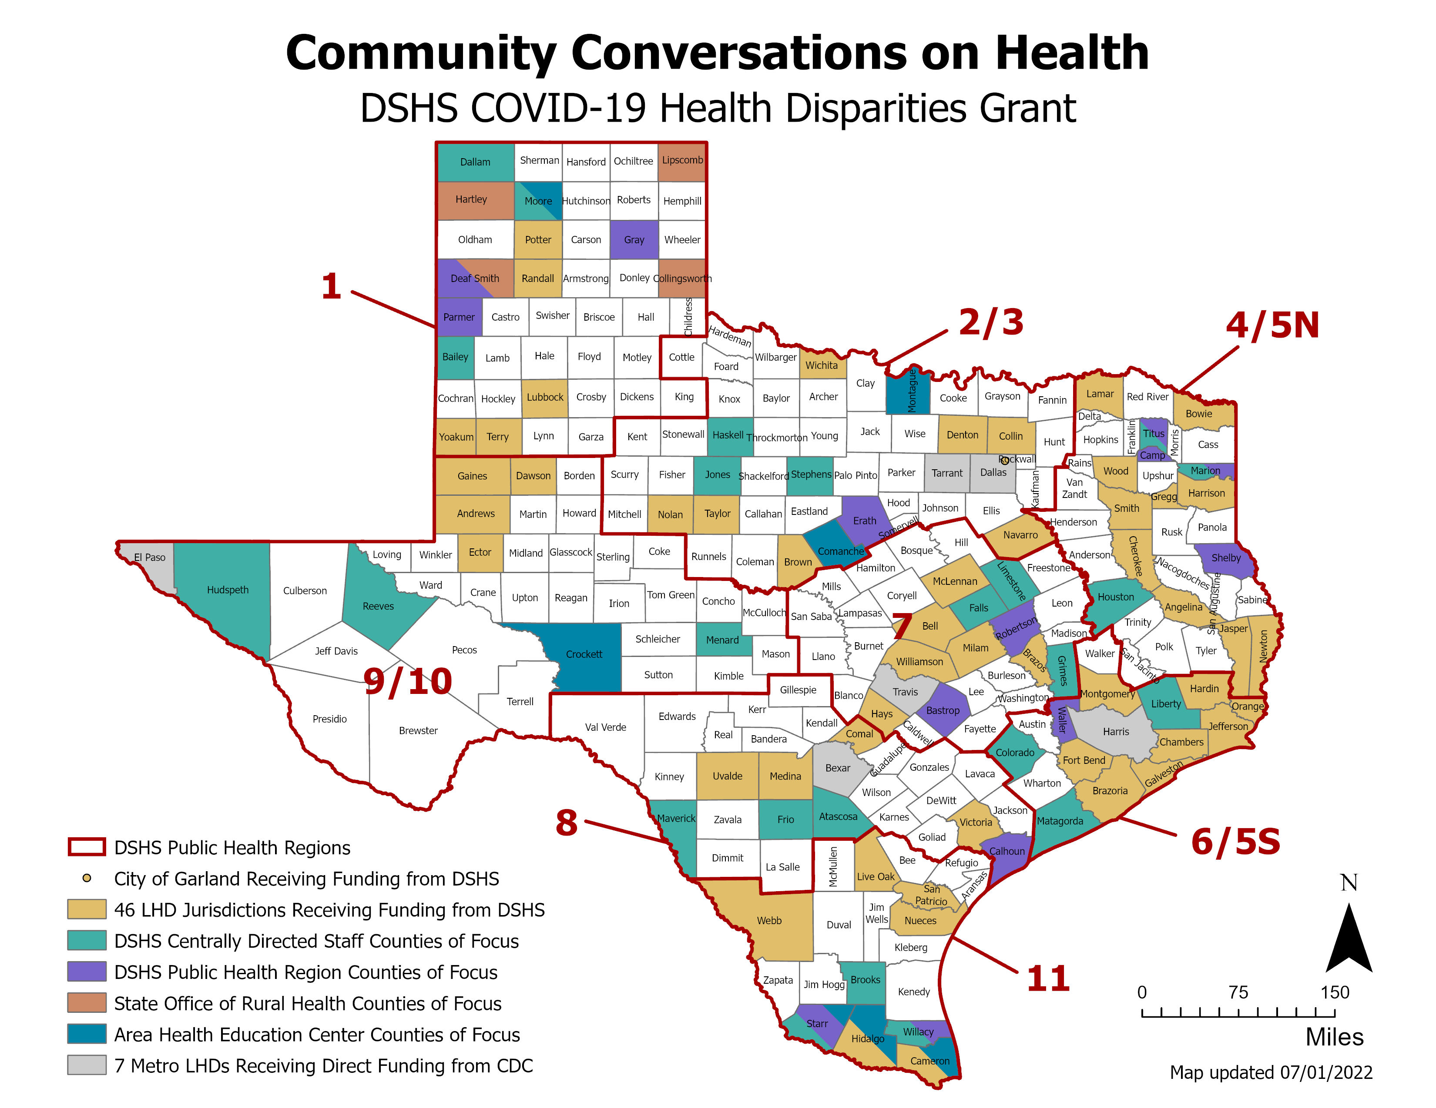

Slide 4
DSHS Activities
Regional activities to date:
Met regional DSHS staff and regional grant partners
Conducted windshield assessments in focus counties and reviewing available data
Met with county judges to introduce the grant
Ongoing meetings with potential partners and community organizations
Developing community engagement strategy workplans with regional guidance
Top Priorities from County Judges
Mental Health
Access to healthcare
Food insecurity
Transportation needs
Chronic disease prevention
Access to affordable housing

Slide 5
Grant Coordination
Monthly sharing sessions with all grant partners
Highlight grant partner successes
Discuss grant partner needs and challenges
Invite speakers from service providers and potential partners
Routine regional coordination meetings

Slide 6
Texas Public Health Fellowship
Overview:
One-year, paid training program
Hands-on, real-world experience
Early career public health professionals
Professional development and mentorship

Slide 7
2022-23 Fellowship Host Sites
Local Health Departments
DSHS Programs and Regional Offices
36 Fellowship Positions:
13 positions with 9 LHDs
23 positions with 19 DSHS programs

Slide 8
Fellowship Details
2022-23 Positions provide experience in:
Professional development opportunities:
Community engagement
Data collection
Data analysis and data visualization
Strategic planning and project management
Disease surveillance and outbreak investigation
Public health preparedness and emergency response
Program evaluation and quality improvement
Health education and communication
Report and manuscript writing
Monthly skill building workshops hosted by Office of Practice and Learning (OPL)
Fellows matched to an OPL coach to receive 1:1 mentoring
Fellows will complete a personal professional development plan identifying:
Public health competency focus areas of interest
Training and development plan
Networking opportunities with DSHS staff
HHS Jobs presentations
Culminating experience

Slide 9
2022-23 Fellowship: Professional Development
Soft Skill Development
&
Public Health Systems Education

Slide 10
2023-24 Fellowship Timeline
HOST SITE
SELECTION
FELLOW INTERVIEWS AND SELECTION
FELLOWSHIPS
BEGIN
PROMOTION
September
October
November
December
January
February
March
April
May
June
HOST SITE APPLICATION OPENS
FELLOW
APPLICATIONS DUE
HIRE FELLOWS

Slide 11
Grant Successes

Slide 12
Building Community Relationships
Wichita Falls-Wichita County Public Health Department:
The grant has allowed the LHD to meaningfully engage the Hispanic and African American communities in the county.
Launched the “Barber Talk” community outreach and education initiative to provide health education alongside barber services.
The first event “Men’s Health-Mind, Body, Spirit” was held at the Wichita Barber Academy located in a Black neighborhood with high rates of chronic disease.

Slide 13
Addressing Community Needs
Victoria County Public Health Department:
Financial literacy was identified as a need in the community.
Partnered with a local federal credit union to host a “Personal Finance Workshop” for health department staff and residents.
Topics included creating a budget, saving, and repairing credit history.
The health department staff will share the information learned with residents.

Slide 14
Addressing Service Gaps
Texas Area Health Education Center (AHEC) East:
The AHEC serves 100 counties in East Texas.
Developed the Community Health Integrated Response Portal (CHIRP) to help CHWs identify areas of high risk and low vaccination.
Used to make data-informed decisions on resource allocation and targeted community outreach.
Can be used to monitor effectiveness of outreach efforts in an integrated, seamless, and automated way.

Slide 15
Addressing Service Gaps
Texas Parks & Wildlife Department and Texas Children in Nature Network:
Hosted a workshop with regional grant partners and community organizations to discuss barriers and needs for increasing park utilization.
Brainstorming pilot programs to expand access and utilization of parks and greenspaces.
Ideas include an equipment library for residents to check out outdoor equipment, park pass “library cards” to provide sustained support for covering park fees, and park prescriptions.

Slide 16
Providing Health Education
Medina County Health Unit:
Partnering with public schools and summer programs to provide health education and training.
Trainings include CPR classes and mental health first aid for school staff and community members.

