Slide 1
Infectious Disease Prevention
Joshua Hutchison, MBA
Deputy Commissioner, Infectious Disease Prevention Division

Slide 2
Program Updates
Immunizations Dashboard and Snowflake
Texas Insurance Assistance Program – PLUS (TIAP-PLUS)
Preliminary TB Case Counts for 2024

Slide 3
Immunizations

Slide 4
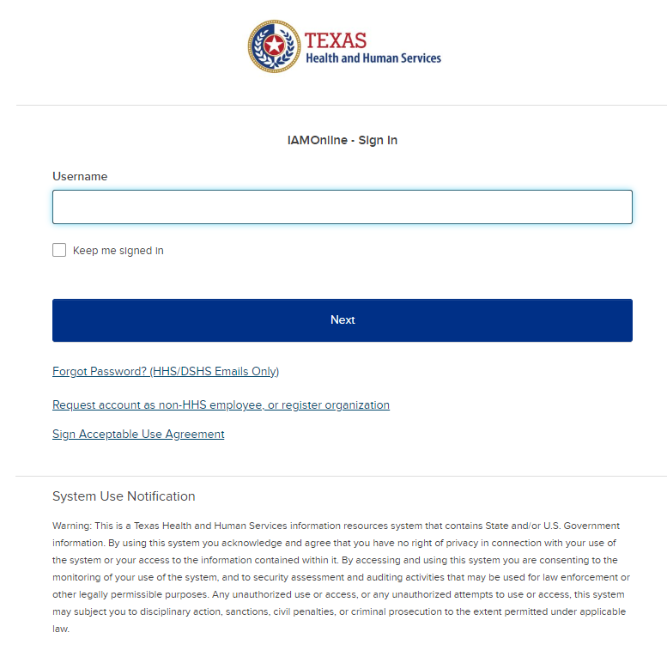
Requesting Access to Snowflake/Tableau Roles - External Staff without IAMOnline Accounts
To access Snowflake/Tableau, you will need to use IAMOnline, the main platform for accessing HHS applications.
Access the IAMOnline sign-in page and click the “Request account as a non-HHS employee or register organization”. Follow the steps to preregister and complete the “Partner User Registration Form”.
Once your account is approved, an email will be sent with a link to activate your account.
After your IAMOnline account is activated, refer to the steps on the next slide (Requesting Access to Snowflakes Roles – External Staff with existing IAMOnline Accounts) to request Snowflake/Tableau data view access.
Need help? If you are having trouble logging into or using IAMOnline, please call the Consolidated Help Desk at 855-435-7181 (7 a.m.-7 p.m. CST, Monday through Friday). Select option 1 for the consolidated help desk and then follow the remaining prompts. Inform the support staff of the issue you are having with IAMOnline and they will assist with resolving the issue or providing a ticket to the appropriate team.

Slide 5
Requesting Access to Snowflake Roles – External Staff with existing IAMOnline Accounts
To access Snowflake, you will need to use IAMOnline, the main platform for accessing HHS applications.
Access the IAMOnline sign-in page and use your DSHS or employee email to sign in.
  First-time users: You will be prompted to sign the Acceptable Use Agreement before you can proceed
Click "Manage My Access". Click “Next”.
Type “Snowflake” in the search bar, click the magnifying glass icon, and then select the role for data for your LHE.
Click “Next” to provide a business justification for your data access needs.
Review and understand the data use stipulations for the dataset.
Submit the request.
Please refer to the Access to Snowflake through IAMOnline – External User guide on detailed access request steps.
Need help? If you are having trouble logging into or using IAMOnline, please call the Consolidated Help Desk at 855-435-7181 (7 a.m.-7 p.m. CST, Monday through Friday). Select option 1 for the consolidated help desk and then follow the remaining prompts. Inform the support staff of the issue you are having with IAMOnline and they will assist with resolving the issue or providing a ticket to the appropriate team.

Slide 6
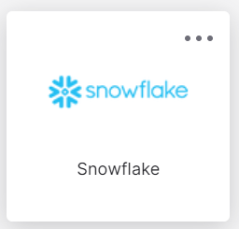
Viewing Snowflake Data Views
Once you have been approved to access data views in Snowflake, follow the steps below to access the Snowflake views through IAMOnline.
Log into IAMOnline.
Click on the Snowflake tile.
From the Snowflake home page, click on your account name to configure your role to the dataset that you want to access.
Open a workbook to begin running queries on your data set.

Slide 7
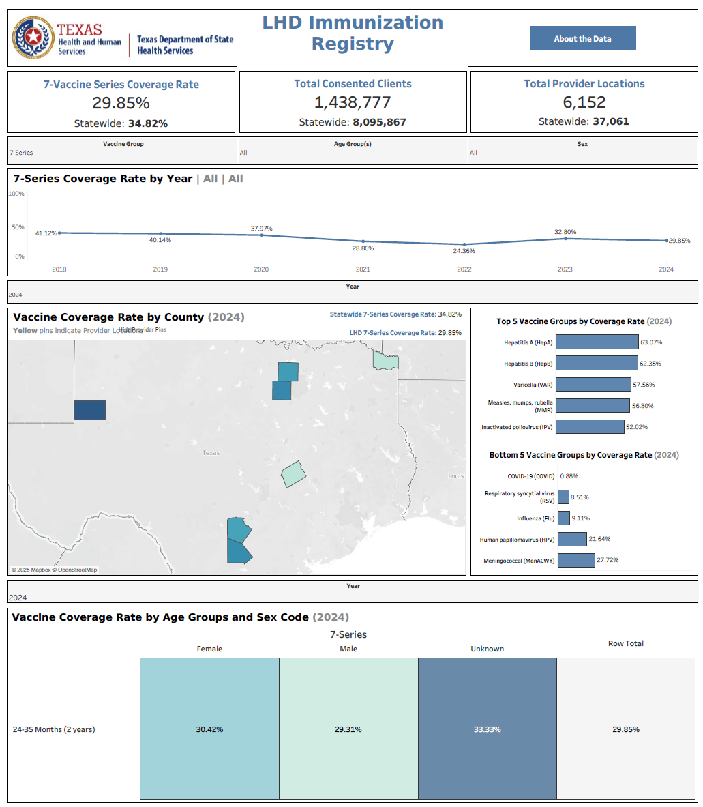
LHD Immunization Registry
Tableau Dashboard
PURPOSE:
The LHD Immunization Registry Dashboard showcases key metrics for an LHD’s contracted service area including the following:
LHD-specific and Statewide Key Performance Indicators, including the 7 Vaccine Series Coverage Rate, Total Consented Clients, and Total Provider Locations.
7-Series Coverage Rate by Year
Vaccine Coverage Rate by County, with the option to add/hide pins with the provider locations
Top 5/Bottom 5 Vaccine Groups by Coverage Rate
Vaccine Coverage Rate by Age Groups and Sex Code
IMPACT:
The dashboard provides LHDs with insights into how their service area is performing in terms of immunization coverage rates. This includes understanding which immunizations are most received, how vaccinations are trending over time, and which geographic areas need the most focus to update their coverage rates.
This data will ultimately enable LHDs to conduct the appropriate outreach to providers and clients to ensure optimal vaccination coverage.
SCREEN PRINT ONLY
The data and KPIs displayed in this dashboard may not reflect actual values.

Slide 8
Requesting Access to Tableau Roles – External Staff with existing IAMOnline Accounts
To access Tableau, you will need to use IAMOnline, the main platform for accessing HHS applications.
Access the IAMOnline sign-in page and use your employee email to sign in.
  First-time logging in? You will be prompted to sign the Acceptable Use Agreement before you can proceed
Click the "Access Request" tile.
Click the three dots in the top left corner to open a dropdown menu, select "Manage Identity", then click the link titled "Tableau SHARP Data Sharing Site Access Request".
Fill out the Tableau Access Request form, by selecting the dashboard(s) that you would like to request access for and providing the business justification.
Review and understand the data use stipulations for the dataset.
Submit the request.
Please refer to the Access to Tableau through IAMOnline – External Staff user guide on detailed access request steps.
Need help? If you are having trouble logging into or using IAMOnline, please call the Consolidated Help Desk at 855-435-7181 (7 a.m.-7 p.m. CST, Monday through Friday). Select option 1 for the consolidated help desk and then follow the remaining prompts. Inform the support staff of the issue you are having with IAMOnline and they will assist with resolving the issue or providing a ticket to the appropriate team.
Notes:
Now, that everyone has an IAMOnline Account, please log in and click the "Access Request" tile. Then click the three dots in the top left corner to open a dropdown menu, select "Manage Identity", then click the link titled "Tableau SHARP Data Sharing Site Access Request". You’ll see the Tableau Access Request form, fill it out and select the dashboard(s) that you would like to request access for and providing the business justification. After you review and understand the data use stipulations for the dataset, you can submit the request. There is an approval process that takes time but for the sake of the training, I’d still like to show you all how to access the dashboard.

Slide 9

Viewing Tableau Dashboards
Once you have been approved to access dashboards in Tableau, follow the steps below to access the Tableau dashboards through IAMOnline.
Log into IAMOnline.
Click on the Tableau tile.
From the Tableau home page, click the dashboard you want to access.
The dashboard will open.
Notes:
Once you’ve been approved

Slide 10
Texas Insurance Assistance Program-PLUS (TIAP-PLUS)
10

Slide 11
TIAP-PLUS Outreach
TIAP-PLUS has 578 active enrollments.
Open enrollment: November 1, 2024 – January 15, 2025
KFF Campaign
  English:
    2,915,000+ impressions
    43,800+ clicks
    35,900+ web sessions
  Spanish:
    947,000+ impressions
    16,800+ clicks
    12,800+ web sessions
Other efforts:
  26,000+ phone calls
  27,500+ emails
  12,000+ mailouts
  14,000+ printed flyers and posters
  40 events and meetings
11
Information as of January 15, 2024
Notes:
Impressions for digital ads are the number of times a sponsored post is displayed.
An individual can be shown an ad multiple times.
A session is a visit to a website.
A single session can contain multiple pageviews.
Pageviews are the total number of pages viewed during a session (or visit).
Notes: TIAP-PLUS has 578 active enrollments.
565 enrolled during open enrollment.
Two enrolled during the special enrollment period.
23 transferred from local subcontracted agencies after open enrollment ended.
17 have disenrolled.

Slide 12


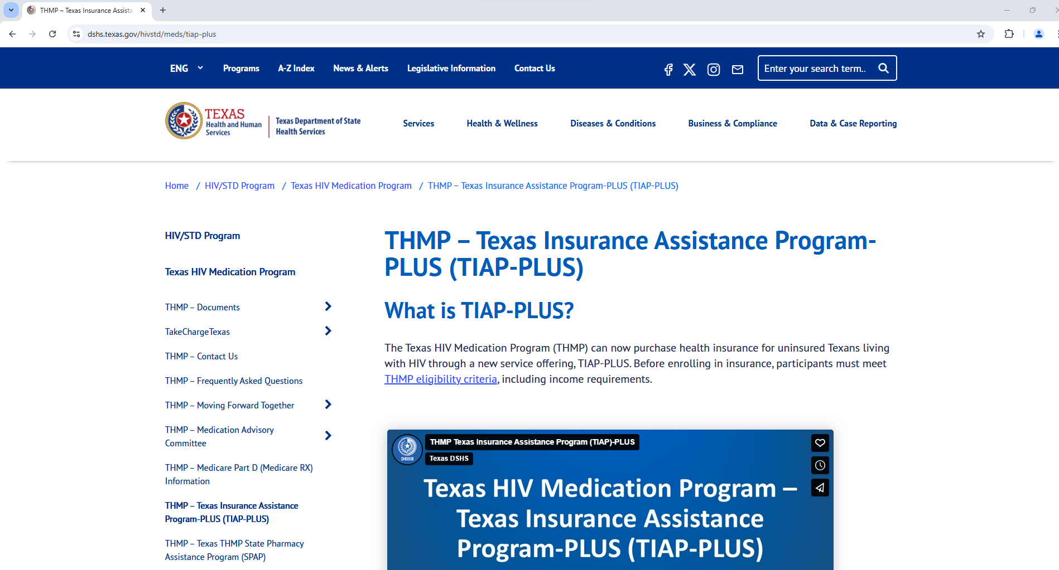
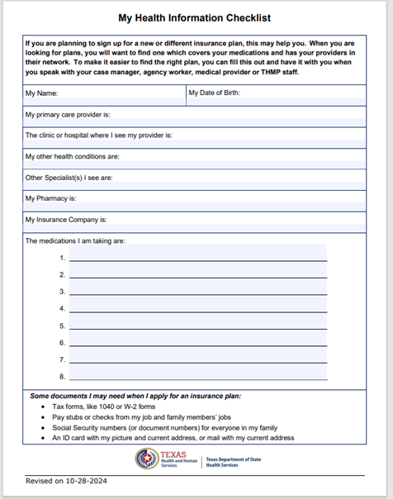
TIAP-PLUS Resources
THMP Insurance Expansion Notice
THMP Insurance Expansion Notice Poster
Visit our TIAP-PLUS page for updates and resources
12
MyInsuranceinformation.pdf
Notes:
TIAP-PLUS resources are on the DSHS HIV/STD website.
Items of note include flyers and posters with information designed to provide agencies with information to share with clients regarding TIAP-PLUS, an insurance information tool that allows subrecipient agency workers and clients to pull together medical provider and medications information before identifying an appropriate health care plan.
The website also includes videos and information on pre-approved plans under TIAP-PLUS.
This webpage was designed to provide all needed information on TIAP-PLUS in one place.

Slide 13
Tuberculosis and Hansen’s Disease

Slide 14
TB Case Counts and Rates in Texas,
2018–2024*
*2023/2024 data is provisional and subject to change.
Notes:
The CDC tuberculosis cooperative agreement has been renewed for the new project period, 2025 – 2029.
The preliminary TB case count for 2024 is 1,241 which is subject to change.

Slide 15
Thank you!

