Slide 1
Community Conversations on Health
REDUCING HEALTH DISPARITIES | BUILDING HEALTHIER COMMUNITIES
ESTABLISHING STRONGER PARTNERSHIPS
Public Health Finance & Policy Committee Meeting
Center for Public Health Policy and Practice
June 12, 2024

Slide 2
Grant Funding & Activity Phase
Community Feedback & Data Collection
Coalition Building & Program Development
Program Implementation
Sustainability Planning
2021
2022
2023
2024
2025
2026
Original Budget Period
1st No Cost Extension
2nd No Cost Extension
All no cost extension amendments have been executed up to May 31, 2026.

Slide 3
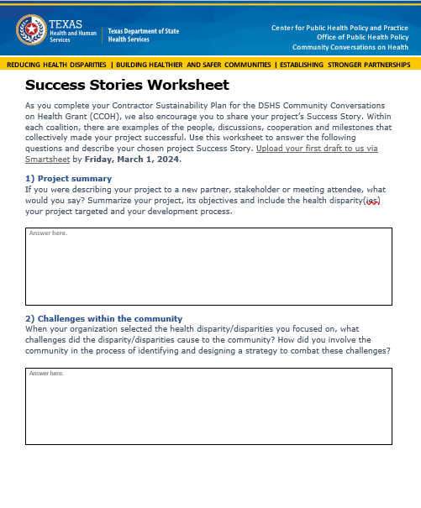

Capturing Grant Successes
Overall
Message or Takeaway
Key Message
Key Message
Key Message
Data, Evidence, or Support

Slide 4
Project & Partnership Highlights

Slide 5
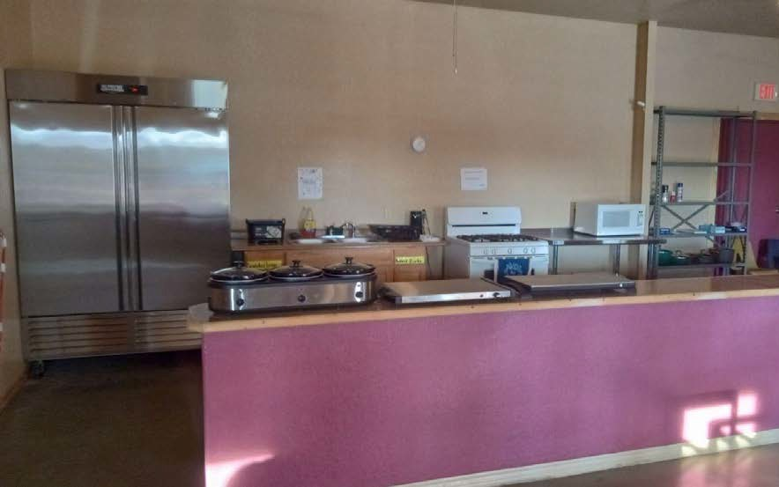
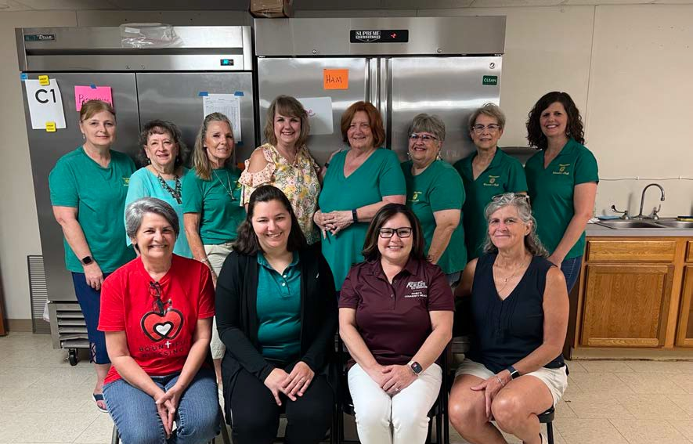

Texas A&M AgriLife Extension
With support from DSHS, AgriLife collaborated with 34 rural communities in 20 counties across Texas:
  Collected community feedback
  Established coalitions with faith-based organizations and churches
  Implemented Health Improvement Projects (HIPs) to address community needs
16 Fruit & Vegetable Access HIPs
3 Community Garden HIPs
3 Physical Activity HIPs
2 AED Access HIPs

Slide 6
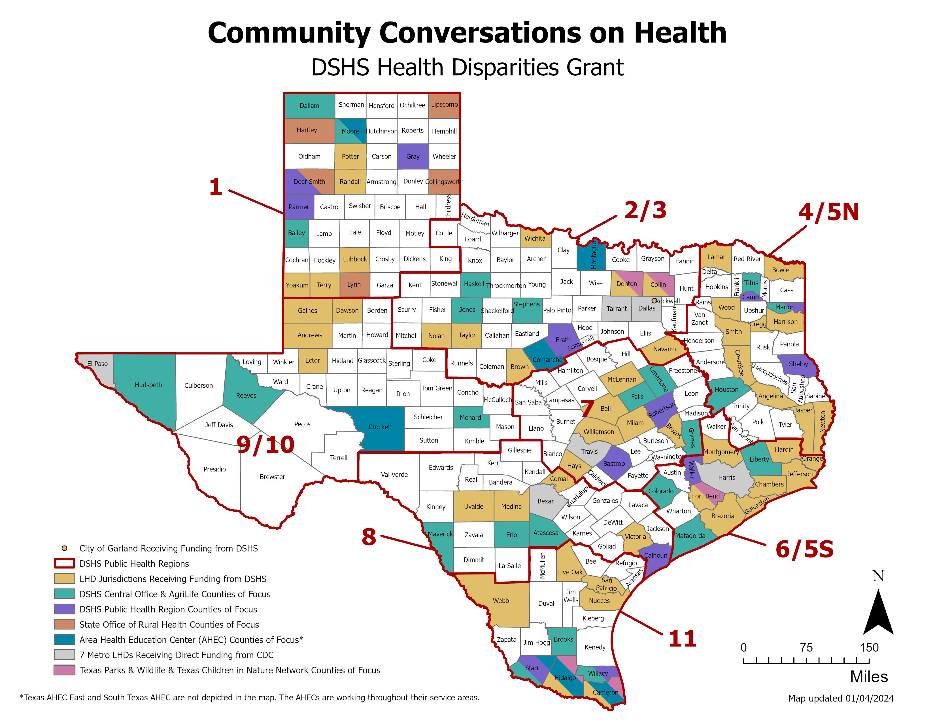
Healthcare Quality & Access Programs
Houston County Health and Wellness Coalition:
In March, regional staff worked with community leaders to establish the multi-sector coalition to address community needs.
The coalition identified a lack of access to health care services as their main priority.
TLL Temple Foundation, a member of the coalition, agreed to provide grant funding for programs to expand health care access.
Regional staff were key in connecting TLL Temple Foundation with partners to expand telemedicine and mobile clinic programs.

Slide 7
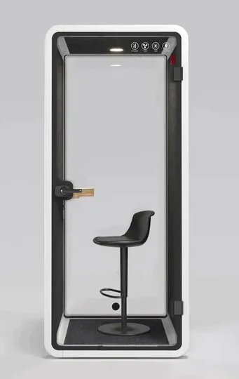
Houston County Coalition Projects
Telemedicine Expansion at the Crockett Public Library:
Regional staff supported the Crockett Public Library in securing grant funding from TLL Temple Foundation for 3 soundproof pods.
Pods will be equipped with a laptop and will be available for general use, including telemedicine appointments, proctored exams, and internet access.
Program roll out is expected June 2024.
The library will provide regular program updates to the coalition (e.g., number of telemedicine visits, % telemedicine visits vs. proctored exams, etc.).

Slide 8
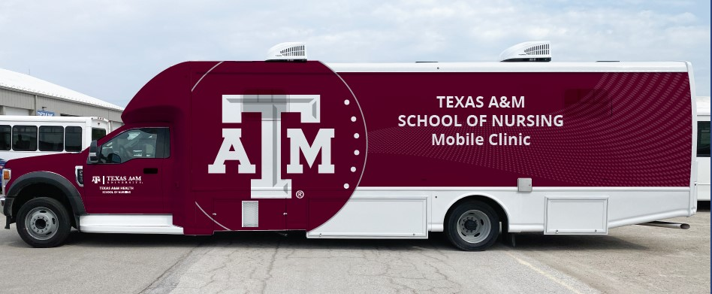
Houston County Coalition Projects
PHR 4/5N CCOH Regional Staff
Texas A&M School of Nursing
TLL Temple Foundation
Region 6 Education Service Center
Texas A&M East Texas Mobile Clinic Project:
Regional staff connected partners to expand the Texas A&M School of Nursing East Texas Mobile Clinic project.
TAMU was awarded a $1.2M grant from TLL Temple to purchase a new mobile clinic.
Program will provide:
  Access to telemedicine with a TAMU nurse practitioner for schools in Houston County.
  Mobile clinic will visit schools and provide primary care services for students, staff, and the public.
  Nursing students will gain clinical experience with supervision from a nurse practitioner.
Goal is to start the program by January 2025.

Slide 9
Texas Children in Nature Network
TCiNN Program Expansion:
TCiNN, in collaboration with Education Service Center 1, received a $14M grant from Texas A&M Forest Service to build green schoolyards in the Rio Grande Valley.
Funds will be used to construct 38 green schoolyards in the region over the next 3 years.
Project development and planning is being led by the Health & Nature Liaisons funded by the CCOH grant.
TCiNN is creating an advisory group to provide technical assistance and plan trainings for staff working on the project.

Slide 10
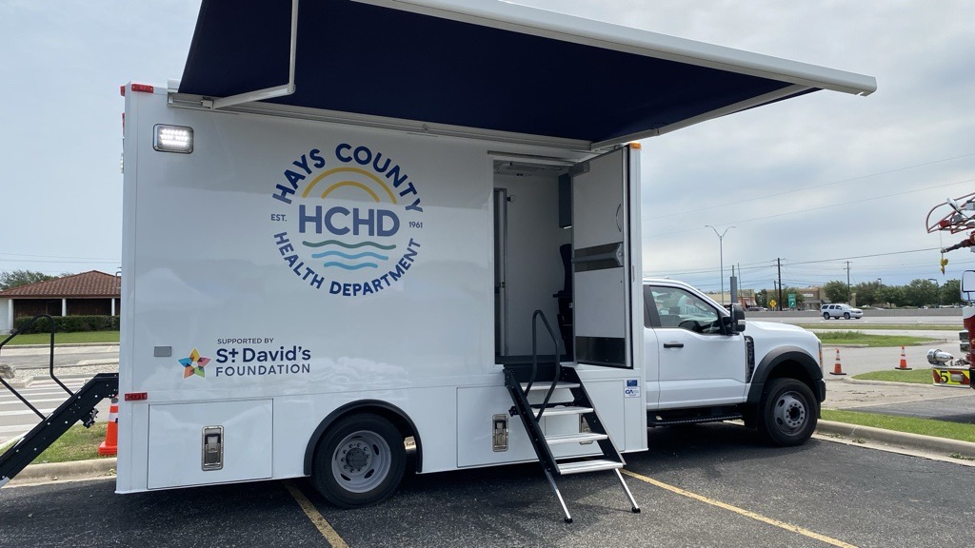
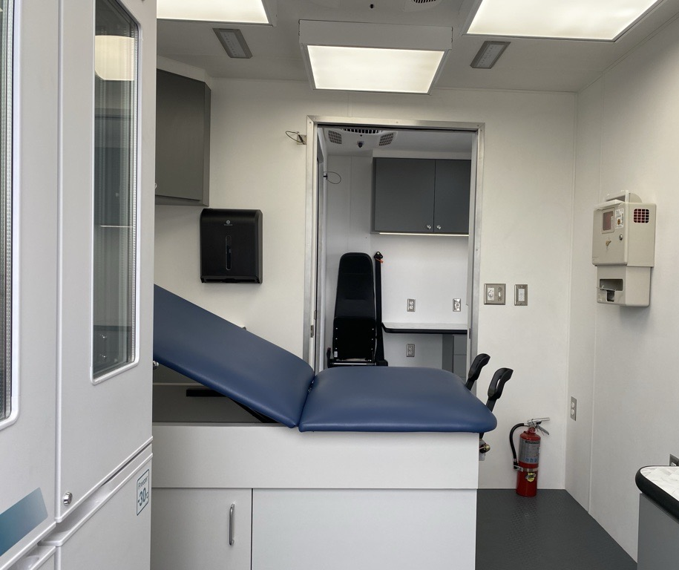
Hays County Health Department
HCHD used grant funds to hire engagement and outreach staff that conducted a Community Health Assessment (CHA).
The CHA was used in priority setting and building support from county leadership and philanthropy for additional funding.
  Purchased a mobile medical unit with additional funding from St. David’s and the county.
  County health department funding supported maintaining grant funded staff.
  Redesigned the health department logo to be more welcoming to communities.

Slide 11
For more information on the grant email:
healthdisparities@dshs.texas.gov

