Slide 1
Community Conversations on Health
REDUCING HEALTH DISPARITIES | BUILDING HEALTHIER COMMUNITIES
ESTABLISHING STRONGER PARTNERSHIPS
Update to PHFPC
Office of Public Health Policy
Center for Public Health Policy and Practice
April 12, 2023

Slide 2
Grant Activities Overview
Current funding from 6/1/2021 – 5/31/2024
Activities focus on 3 key CDC strategies:
DSHS Central and Regional Offices
Local Health Departments
Increase and improve data collection and reporting
Grant Partners
Build, leverage, and expand infrastructure and support
Mobilize and support partners and collaborators
State Agency Partners

Slide 3
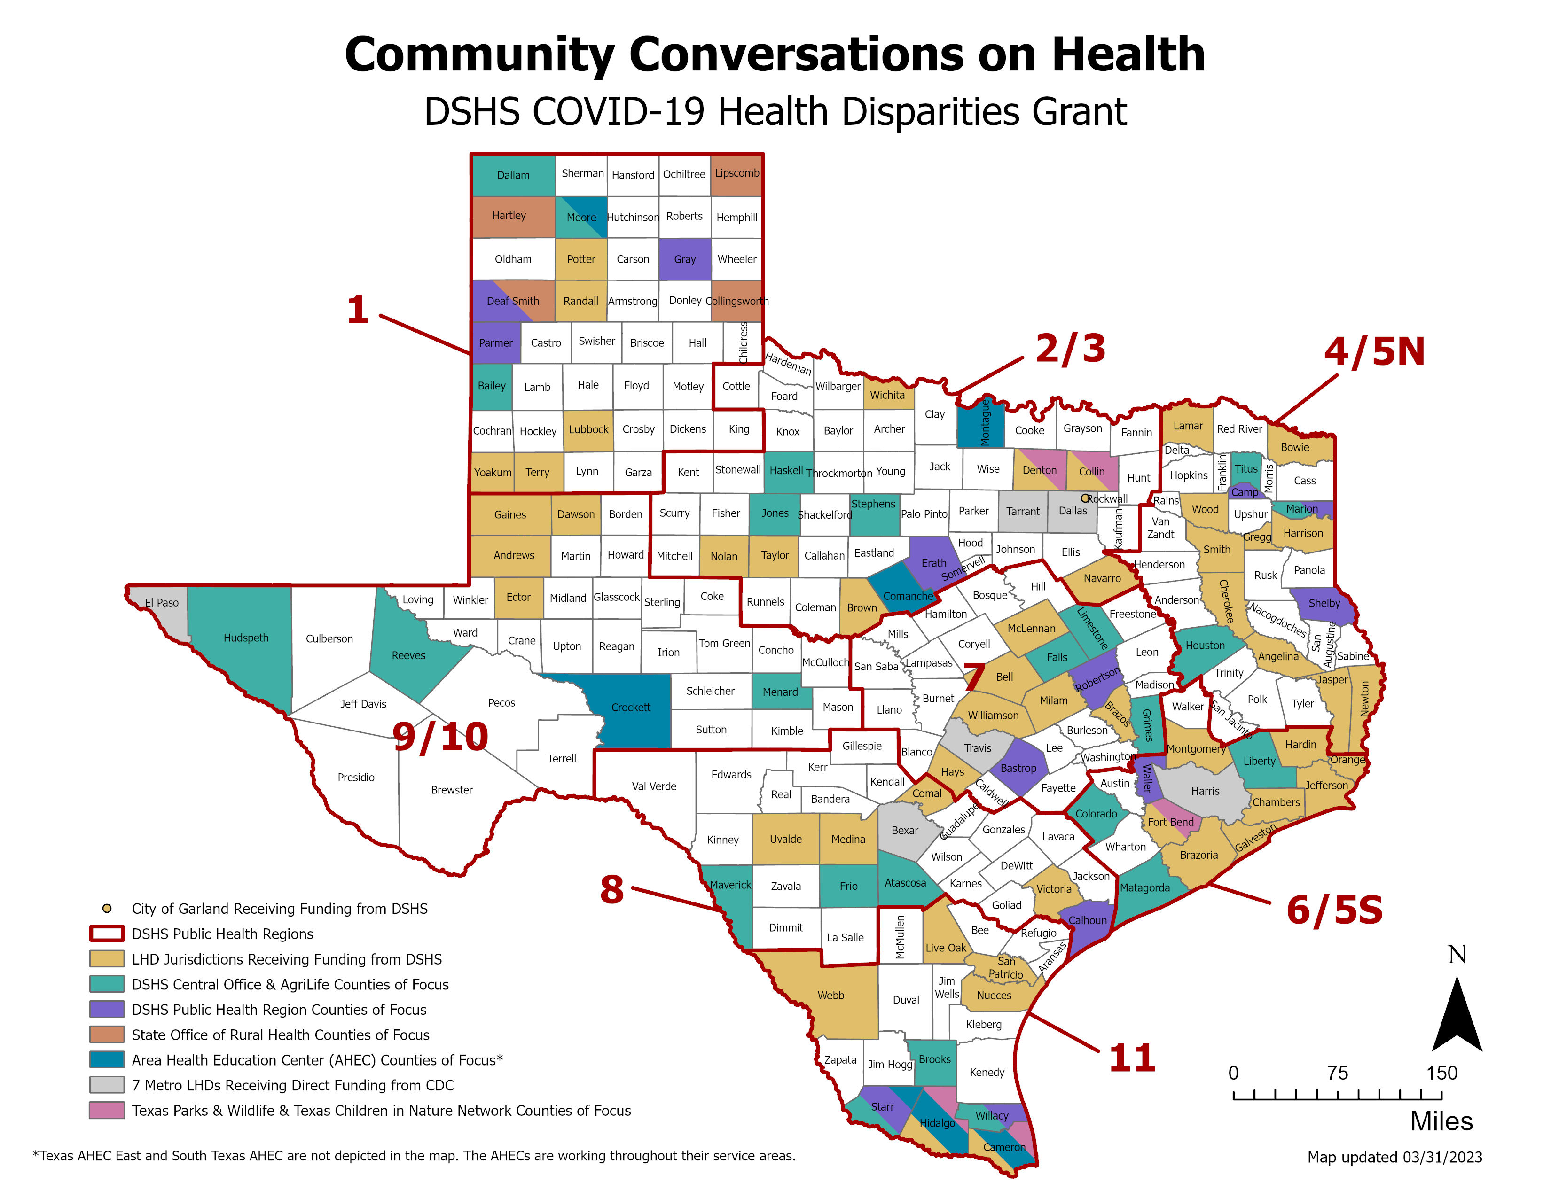
3

Slide 4
DSHS Activities Update
No cost extension amendments are in process
External grant presentations
National CDC Spring Symposium for all health disparities grantees
Texas Rural Funders
LHD presentations and posters at the TACCHO conference
Ongoing DSHS 24-county activities
Community-level data collection in partnership with local partners and coalitions
Community coalition building
Developing projects to address community needs

Slide 5
2023-24 Fellowship Progress
FELLOW INTERVIEWS AND SELECTION
Conducted 97 interviews with host sites and the fellowship team.
HOST SITE SELECTION
44 fellowship positions selected (20 positions with 13 LHDs and 24 positions with 24 DSHS programs/offices).
FELLOWSHIPS
BEGIN
PROMOTION
September
October
November
December
January
February
March
April
May
June
HOST SITE APPLICATION DUE
60 host applications received from 25 LHDs and 35 DSHS programs/ offices.
FELLOW
APPLICATIONS DUE
Received 420 eligible applications. Fellowship team screened applications to select top candidates for hosts.
HIRE FELLOWS
39 fellows matched to host sites. Interviews pending for 2 host sites.

Slide 6
Grant Successes

Slide 7
Health Data Dissemination
City of Laredo Health Department (CLHD):
Collaborated with the Texas Health Institute to do a digital community survey to collect zip code level community data.
Identified areas with higher levels of chronic disease, lower health literacy, and less access to health insurance to target outreach efforts and community initiatives.
Working on a dashboard with over 80 metrics to share survey findings and other relevant data. CLHD convened a Community Leadership Committee to assist in dashboard development.

Slide 8
Building Community Relationships
DSHS PHR 1 & Texas Tech University (TTU):
PHR 1 and TTU partnered with Family Support Services Sembrando el Sue$\text{ñ}$o to engage the Guatemalan community in Parmer County.
Efforts to meet the community where they are at has resulted in stronger relationships between DSHS and the community, increased utilization of available DSHS services, and improved knowledge of different health topics.
PHR 1 and Sembrando el Sueño hope to replicate this collaboration in another county in the region.

Slide 9
Coalition Building
DSHS Regional Team in PHR 4/5N:
Grant team facilitated the development of the Houston County Health and Wellness Coalition bringing together law enforcement, Crockett ISD, Texas A&M AgriLife, the local mental health authority, HHSC, DSHS social work staff, and philanthropies.
At the first meeting in March, members identified additional partners to bring in and identified a lack of access to mental health services as the main concern.
The participating philanthropy wants to help fund programs to expand the FQHC, telemedicine, and youth tele-psychiatry services.

Slide 10
Texas Children in Nature Network
Library Explorer Adventure Pack (LEAP) Backpack Program
Outdoor gear, entry fee waivers to area nature centers or state parks
Each backpack has 10 different nature themes with activities, journals, books, field guides, tools, and equipment
Eight library locations in Hidalgo and Cameron Counties
Program will include monthly health and nature education programs to promote physical activity, healthy living, and connection to nature
Received $10,000 from Driscoll Health Plan

