Slide 1
Community Conversations on Health
REDUCING HEALTH DISPARITIES | BUILDING HEALTHIER COMMUNITIES
ESTABLISHING STRONGER PARTNERSHIPS
Update to PHFPC
Office of Public Health Policy
Center for Public Health Policy and Practice
December 7, 2022

Slide 2
Grant Activities Overview
Current funding from 6/1/2021 – 5/31/2024
Activities focus on 3 key CDC strategies:
DSHS Central and Regional Offices
Local Health Departments
Increase and improve data collection and reporting
Grant Partners
Build, leverage, and expand infrastructure and support
Mobilize and support partners and collaborators
State Agency Partners

Slide 3
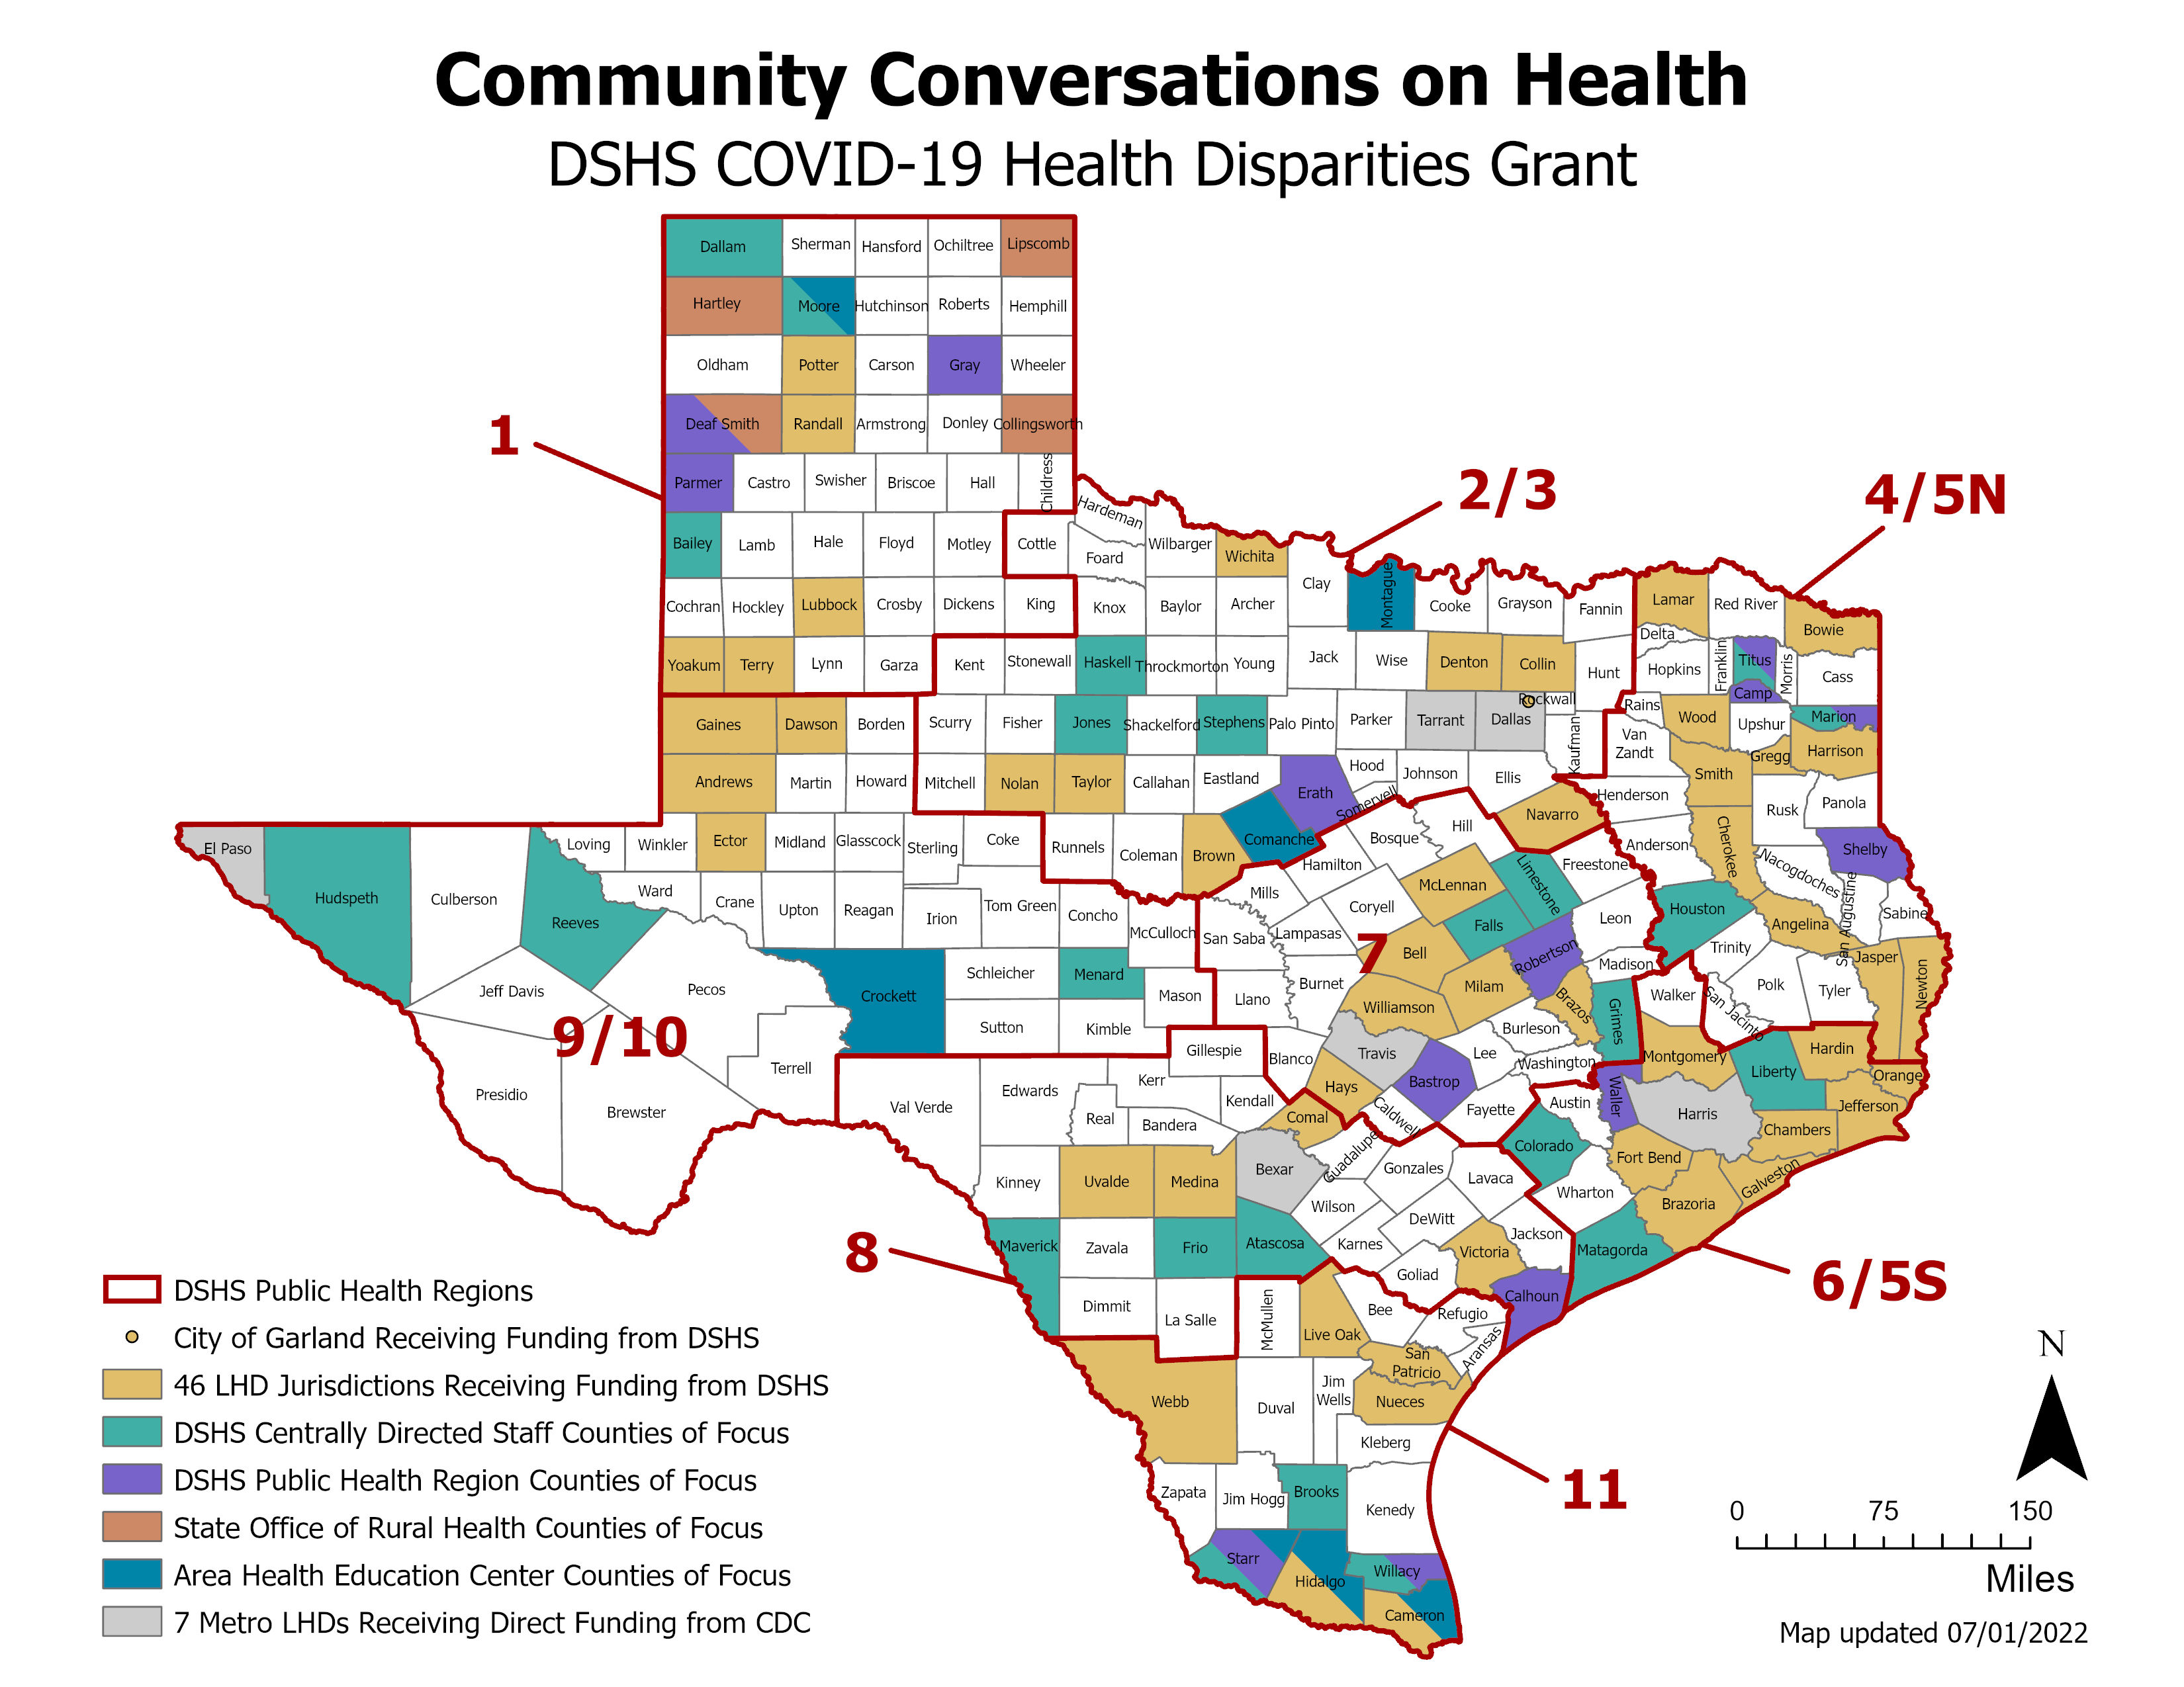

Slide 4
No Cost Extension
51 of 54 LHD and state agency contractors chose to extend through May 2024
Execution of all contract amendments expected by early 2023
Contract amendments include additional deliverables:
Complete an updated work plan to forecast activities through May 2024
Submit a success story deliverable at the conclusion of the grant
Participate in brief grant evaluation activities, such as surveys or short interviews

Slide 5
2023-24 Fellowship Timeline
HOST SITE
SELECTION
FELLOW INTERVIEWS AND SELECTION
FELLOWSHIPS
BEGIN
PROMOTION
September
October
November
December
January
February
March
April
May
June
HOST SITE APPLICATION DUE
FELLOW
APPLICATIONS DUE
HIRE FELLOWS

Slide 6
2023-24 Fellowship Host Sites
Received 60 host applications from 25 LHDs and 35 DSHS programs/offices
All 8 current LHD hosts and 7 new LHDs applied
26 unique DSHS programs/offices applied (10 current hosts)
44 fellowship positions selected:
20 positions with 15 LHDs
24 positions with 22 DSHS programs/offices

Slide 7
2023-24 Fellowship Positions

Slide 8
Grant Successes

Slide 9
Data & Information Sharing
Abilene-Taylor County Public Health District:
Launched “Rebuild Health,” an online hub of resources, information, and data for the Abilene community.
Rebuild Health provides community data and information on chronic disease causes, diagnosis, treatment, and prevention.
Also provides free online and local resources to address nutrition, physical activity, accountability, and wellbeing.
Future plans to add online courses, health literacy education materials, and more community resources and events.

Slide 10
Pilot Community Programs
UTRGV Area Health Education Center (AHEC):
Piloting an intervention to provide health education and connect families to health and social services at clinics in Starr, Hidalgo, and Cameron Counties (~7,000 total population).
Built community resource directories with organizations and eligibility criteria for:
Indigent care
Health education
Mental health and substance abuse services
Housing and food assistance
Transportation services
Workforce training
Cultural and arts education
Program has connected hundreds of clinic patients to needed resources.

Slide 11
Pilot Community Programs
Texas Parks & Wildlife Department (TPWD) and Texas Children in Nature Network (TCiNN):
TCiNN is planning to launch the Nature Smart Libraries and nature backpacks programs at local libraries in the Rio Grande Valley.
Nature Smart Libraries maximize local resources and partnerships to activate libraries as community spaces for nature connection and getting children and families active outdoors.
TCiNN secured additional funding from the Driscoll Children's Hospital to help launch the program at 8 libraries across the Rio Grande Valley.

Slide 12
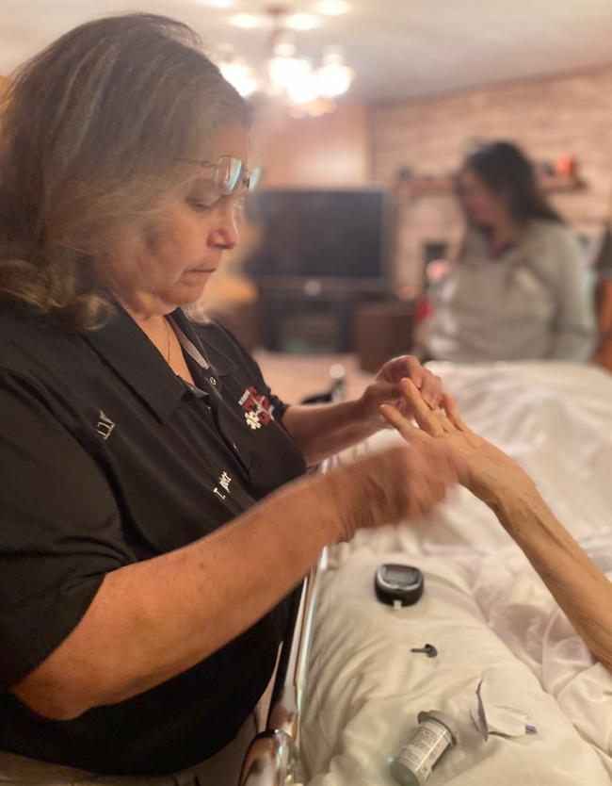
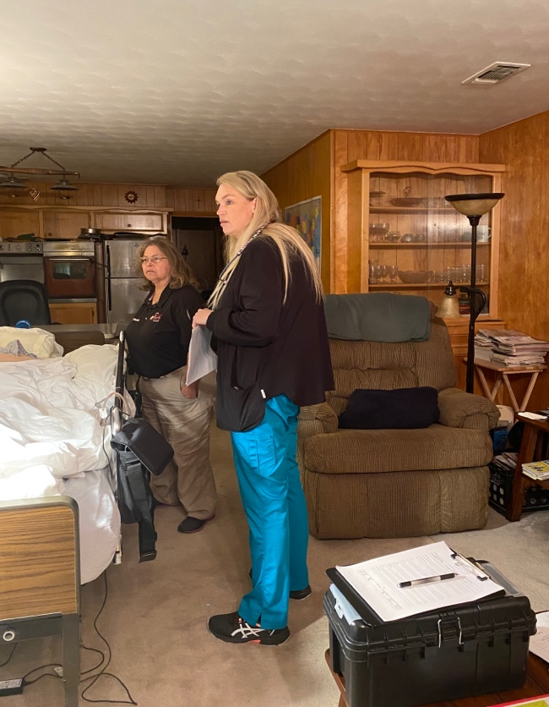
Rural Community Health Program
The State Office of Rural Health pilot community paramedicine program aims to improve preventive care services and health education in rural communities.
Training paramedicine teams is nearly complete and home visits are underway.
Impact on Individual Texans
The Deaf Smith community paramedicine team provided in-home follow up to a client that recently suffered an untreated hip fracture and severe sepsis secondary infection. The client opposed home health services due to a negative experience.
The community paramedicine team established a trusting relationship, helped set up home health services for the client, and continues to visit the client and assist in coordinating care and connecting to social services.
Photos and stories have been obtained with verbal consent from the participants and are the property of Amy S Jarosek, LP CHW.

