Slide 1
Community Conversations on Health
Public Health Funding & Policy Committee Meeting
Center for Public Health Policy and Practice
December 11, 2024

Slide 2
Grant Funding & Activity Phase
Community Feedback & Data Collection
Coalition Building & Program Development
Program Implementation
Sustainability Planning
2021
2022
2023
2024
2025
2026
Original Budget Period
1st No Cost Extension
2nd No Cost Extension

Slide 3





Sustainability Phase
Provide Support to Contractors and New Coalitions
Evaluate and Highlight CCOH Successes
Public Health Research and Partnership Advancement
Texas Public Health Fellowship
Academic Public Health Partnership Initiatives

Slide 4
Ongoing Support and Successes

Slide 5
Local Health Department Funding
Additional CCOH funding was available to all LHDs that:
  Had an active CCOH contract.
  Expended 50% or more of their contract value.
Additional funding amounts were based on the same LHD jurisdiction populations used to determine the original contract value.
$2.5 million was distributed to 31 LHDs that accepted additional funding.
Jurisdiction Pop Size | Additional Funding Amount
<100,000 | $50,000
100,00 – 249,999 | $80,000
≥250,000 | $110,000

Slide 6





Ongoing Support
Share lessons learned with CDC
highlight success stories
Evaluate pilot programs
Continue coalition support
Connect partners to funding opportunities

Slide 7
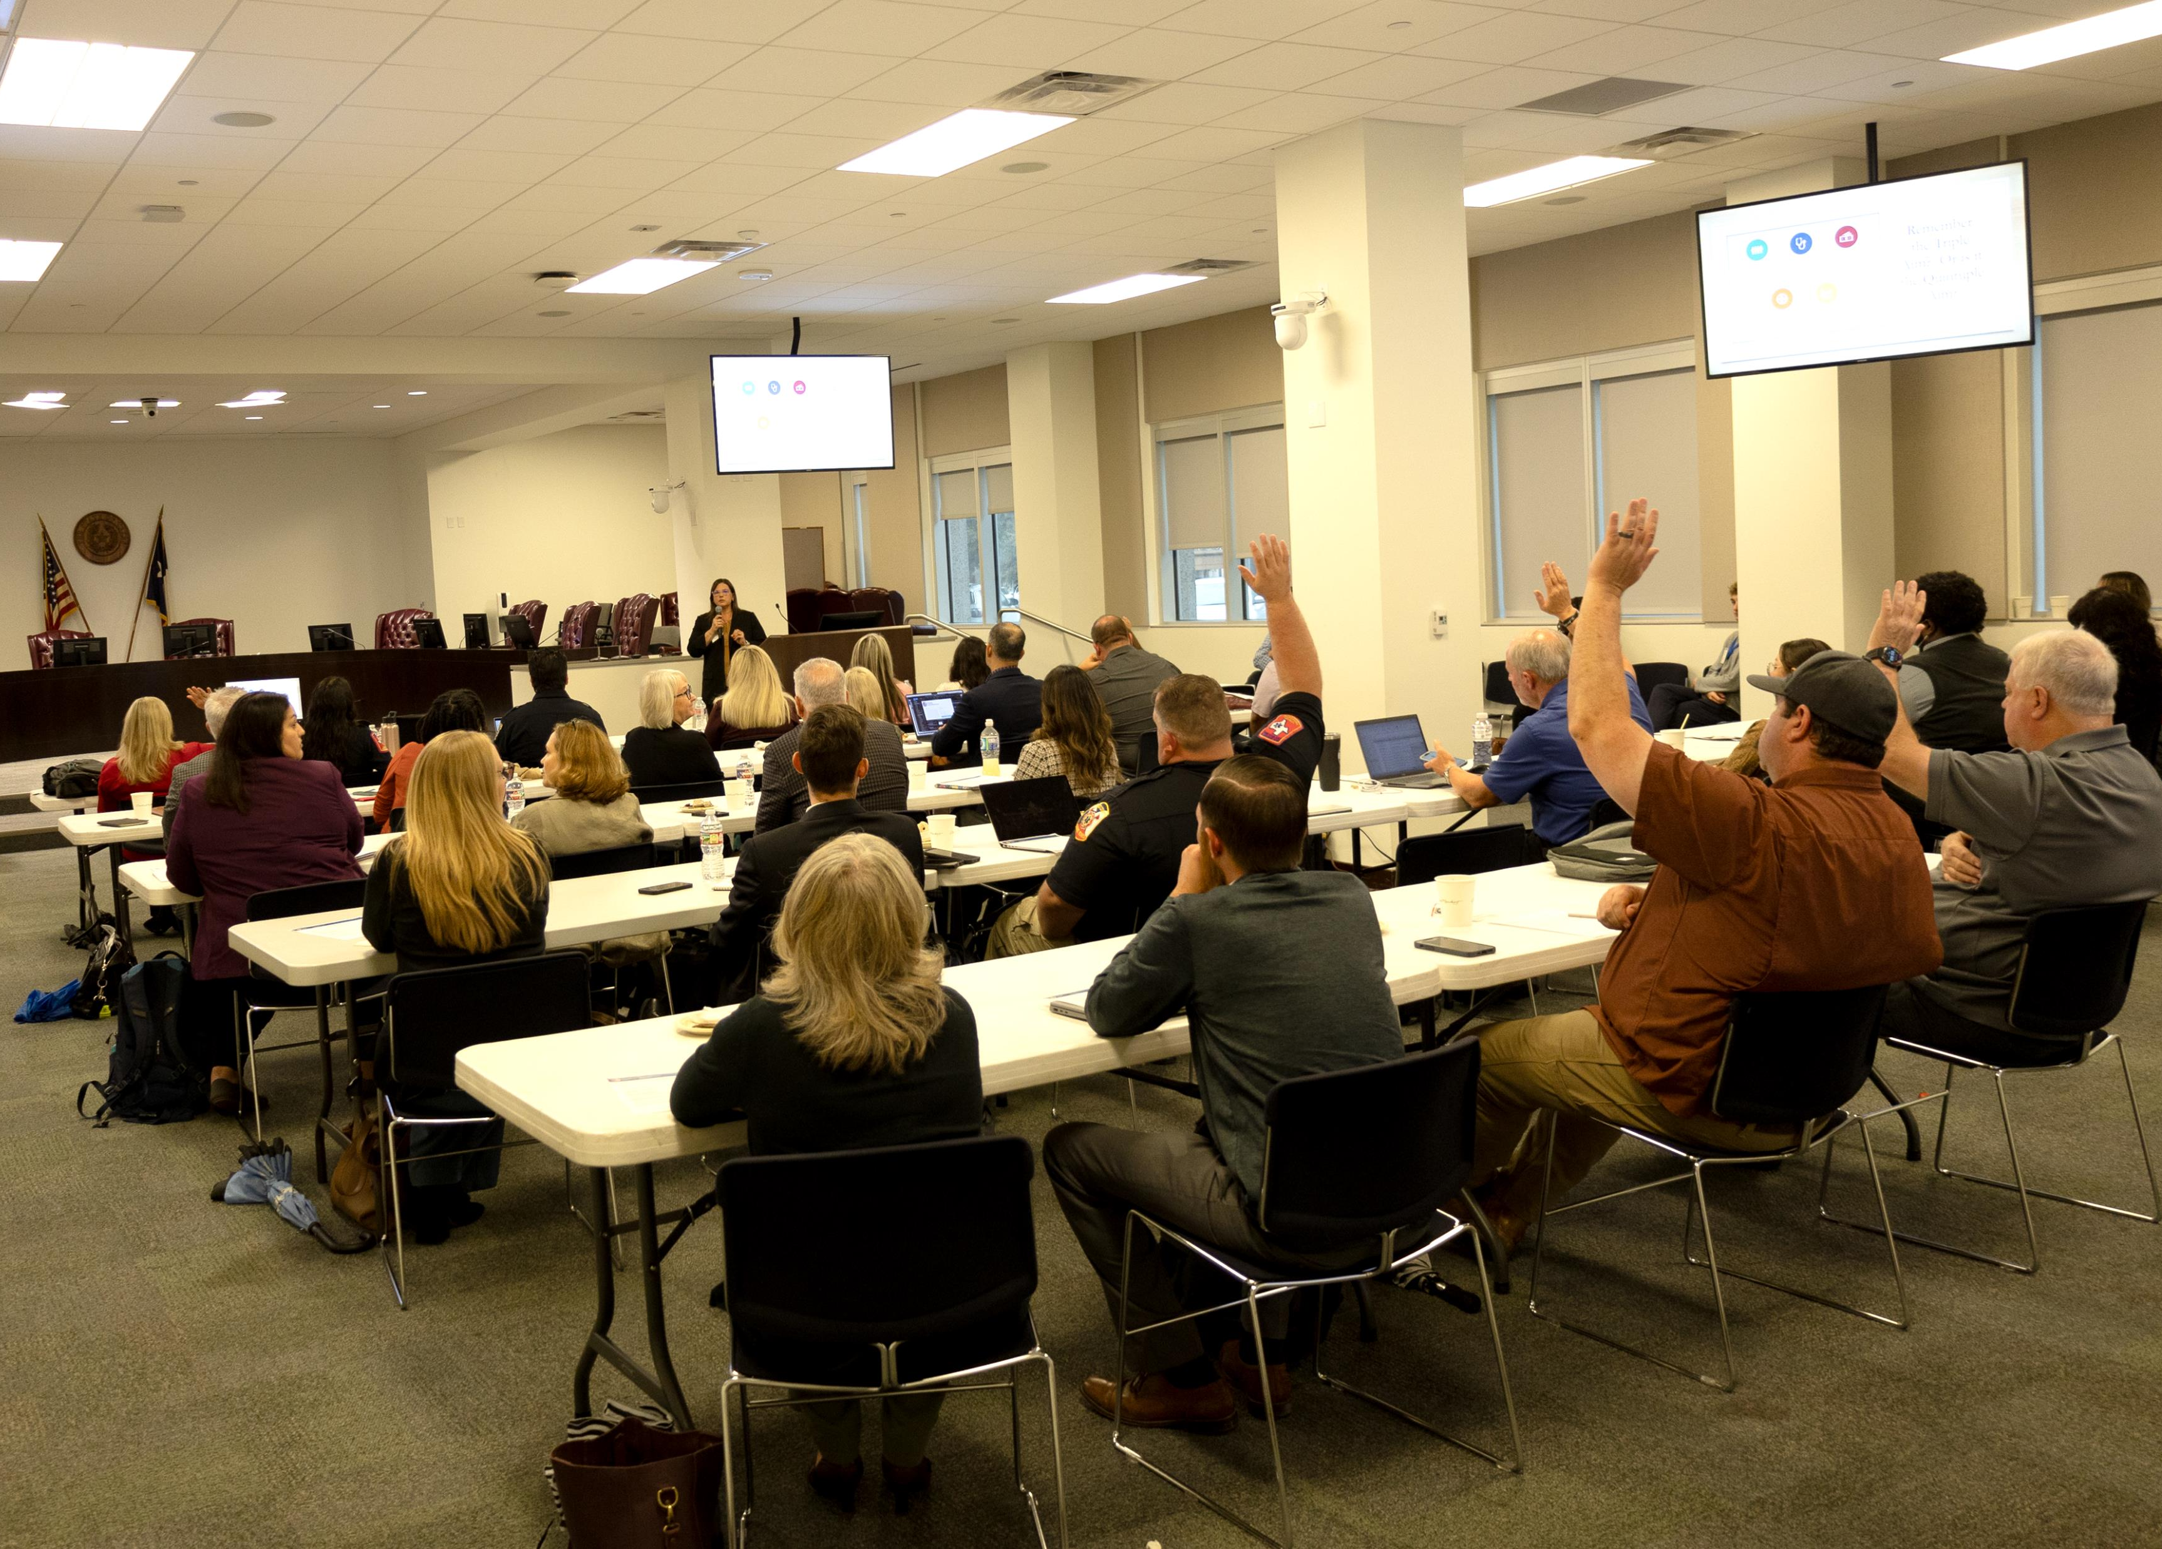
Community Paramedicine Roundtable
Co-sponsored event with Episcopal Health Foundation and Texas Department of Agriculture’s State Office of Rural Health on November 18th
~60 multidisciplinary partners in attendance
  EMS providers
  Philanthropy
  Health plans
  Hospital administrators
Next steps
  Compile notes, synthesize themes to distribute
  Coordinate topical workgroups to continue discussion

Slide 8
Public Health Partnership Advancement

Slide 9

Our Mission: To improve the health, safety, and well-being of all Texans.
Our job is to promote and protect the health of people and the communities where they live, learn, work, worship, and play. No single entity working by itself can improve health for all Texans. We must all work together to create a better system that includes prevention, intervention, and effective partnerships.

Slide 10
Public Health Partnership
Advancement Section
Proactive outreach to foundations, nonprofits, other state agencies
Identify opportunities for resource sharing or mission alignment with DSHS programs, other partners
Since the team’s official formation in June 2024, we have engaged with 72 unique programs or organizations, including:
  18 foundations
  28 Texas HHS programs
  4 non-HHS state agencies

Slide 11






Grant Development Center
Grants Education
Data Resources
Private and Public Funding Announcements
Grant Searches
GDC Email Updates
dshs.texas.gov/grant-applications-funding/grant-development-center

Slide 12
Office of Practice and Learning
Updates

Slide 13
Academic Public Health Partnership
Academic Public Health Partnership:
-Formal relationship between a public health department and an academic institution
Why Formalize?
Accountability
Show collective value and impact
Potential funding
Benefits:
Improve the relevance of education to public health practice
Create innovative public health practices and research
Facilitate connections, communication, and trust
Share and replicate evidence-based projects, initiatives, and interventions
Pooling resources, expertise, and funding
Provide opportunities to meet strategic goals
Build up the future public health workforce and retain and train the current workforce

Slide 14
Academic Public Health Consortium
A collaborative whose purpose is to strengthen, support, and enhance activities between public health practice and academic institutions to improve health in Texas.
Applied learning & practical experiences
Curriculum development
Workforce training & continuing education
Statewide Goals:
1. Prepare, educate, and train the public health workforce.
Early Career Workforce Pipeline
Joint Appointments
Emerging Public Health Roles & SKILLS
2. Support public health careers.
3. Speed the translation of research to practice, share best practices, and pilot projects in communities.
Joint grants
Joint research
accreditation

Slide 15








Funding Opportunity

Slide 16
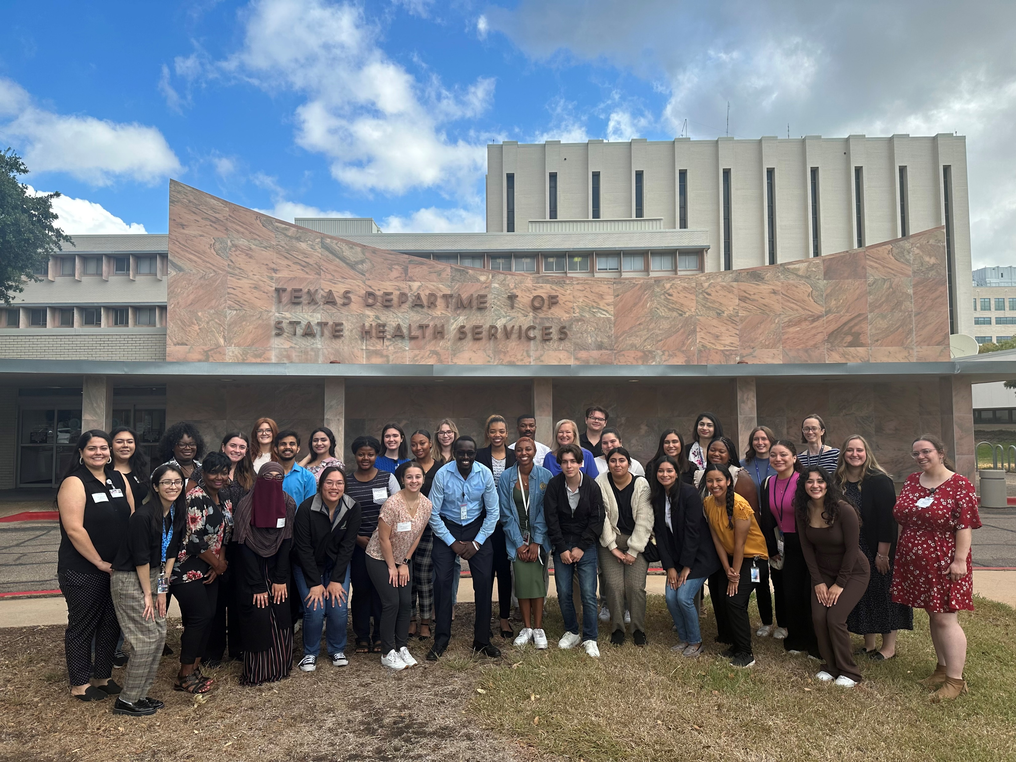
Texas Public Health Fellowship
One-year, paid training program + professional development
Building a public health workforce pipeline
Currently in our 3rd cohort
Selected 10 Local Health Department host sites for the 4th year (June 1, 2025-May 31, 2026)
Fellowship Applications open December 9th
https://www.dshs.texas.gov/texas-public-health-fellowship

Slide 17
For more information email:
Texas Public Health Fellowship
TXPHFellowship@dshs.texas.gov
Office of Practice and Learning
Courtney.Dezendorf@dshs.texas.gov
CCOH Grant
healthdisparities@dshs.texas.gov
Academic Public Health Partnerships
APHP@dshs.texas.gov

