Slide 1
PHFPC Briefing
Texas Department of State Health Services
April 10, 2024

Slide 2
Emerging & Infectious Diseases Update
Varun Shetty, MD, MBA, MS
Chief State Epidemiologist
Office of the Chief State Epidemiologist
Texas Department of State Health Services

Slide 3
DISCLAIMER
The information presented today is based current preliminary data and on CDC’s recent guidance. Information is subject to change.
April 10, 2024

Slide 4
Avian Influenza A(H5N1)

Slide 5
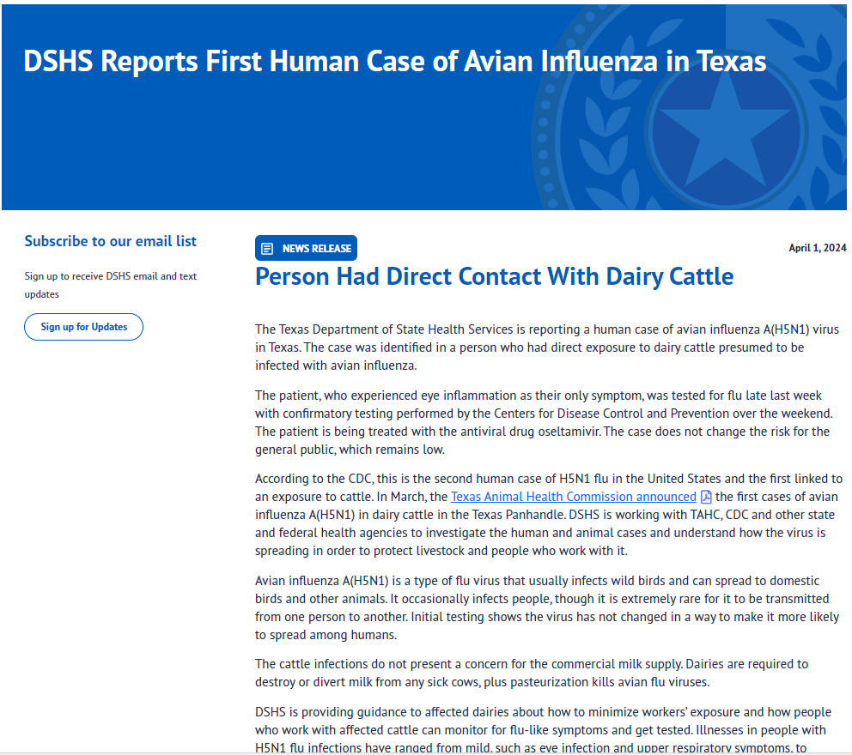
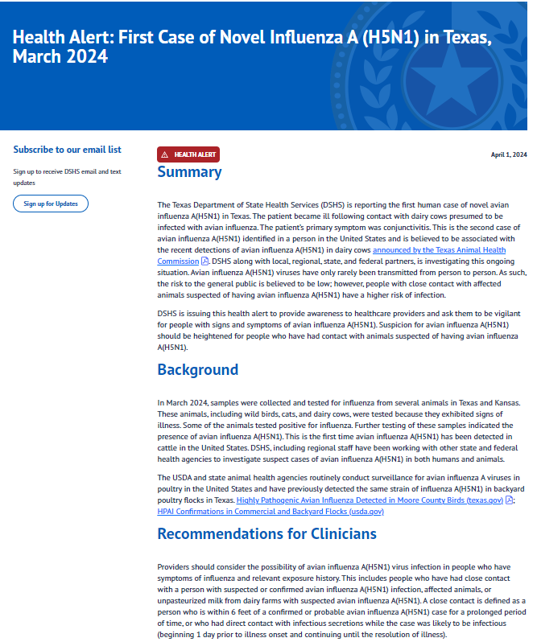
DSHS Reports First Human Case of Avian Influenza in Texas | Texas DSHS
DSHS Reports First Human Case of Avian Influenza in Texas | Texas DSHS

Slide 6
Health Alert: First Case of Novel Influenza A(H5N1) in Texas
The first case of avian influenza A(H5N1) in Texas.
The patient became ill following contact with dairy cows.
This follows recent detection of influenza A(H5N1) virus in dairy cattle, wild birds, feral cats in the area.
The patient experienced eye inflammation (conjunctivitis) as the only symptom, was tested for flu late last week with confirmatory testing performed by the Centers for Disease Control and Prevention.
The patient was treated with the antiviral drug oseltamivir.

Slide 7
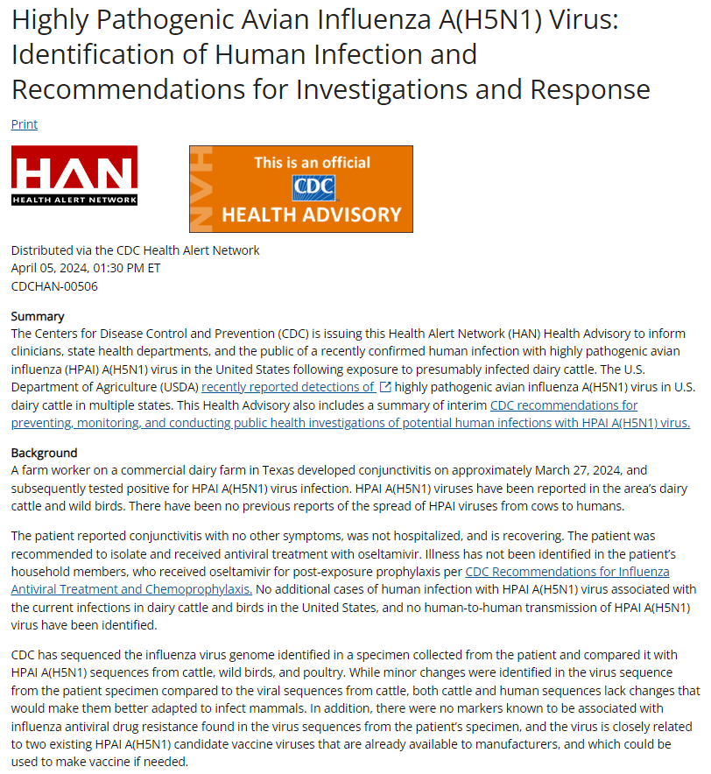
On April 5, 2024 @ 1:30 PM ET CDC issued a Health Advisory on Highly Pathogenic Avian Influenza A(H5N1) Virus: Identification of Human Infection and Recommendations for Investigations and Response (cdc.gov)
Recommendations include instructions for
  infection prevention and control measures,
  using personal protective equipment (PPE),
  testing, antiviral treatment,
  patient investigations,
  monitoring of exposed persons (including persons exposed to sick or dead wild and domesticated animals and livestock with suspected or confirmed infection with HPAI A(H5N1) viruses), and
  antiviral chemoprophylaxis of exposed persons.
Recommendations for Clinicians
Recommendations for State Health Departments
Recommendations for Farmers; Poultry, Backyard Bird Flock, and Livestock Owners; and Worker Protection
Recommendations for the Public

Slide 8
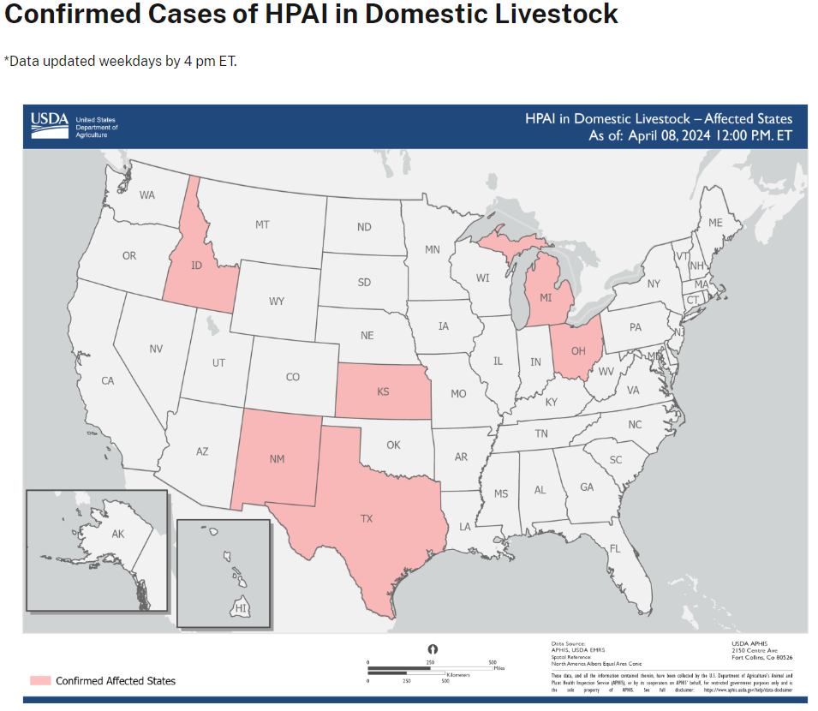
  Available at: Highly Pathogenic Avian Influenza (HPAI) Detections in Livestock | Animal and Plant Health Inspection Service (usda.gov), accessed 4/9/2024

Slide 9
Measles and Meningococcus Updates

Slide 10
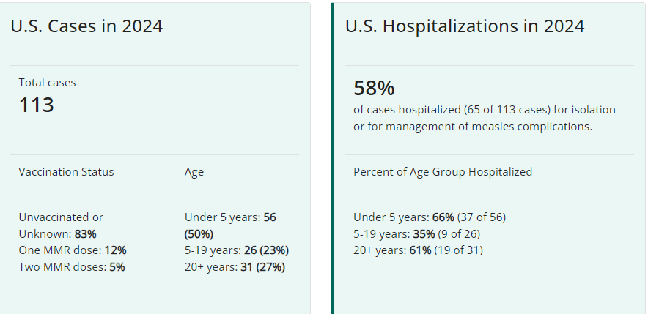
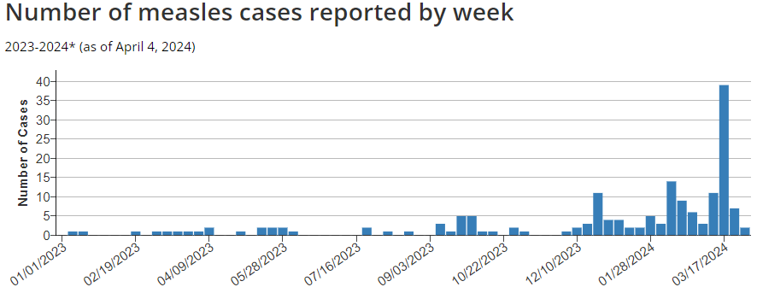
Measles Cases in the United States
January 25, 2024: Due to increases in measles cases, CDC issued the Stay Alert for Measles Cases via COCA Now emergency.cdc.gov/newsletters/coca/2024/012524.html
2024: As of April 4, 2024, a total of 113 measles cases from 18 jurisdictions.
  No cases reported in Texas
  Arizona, California, Florida, Georgia, Illinois, Indiana, Louisiana, Maryland, Michigan, Minnesota, Missouri, New Jersey, New York City, New York State, Ohio, Pennsylvania, Virginia, and Washington
2023: A total of 58 measles cases in the entire year from 20 jurisdictions.
Available at: Measles Cases and Outbreaks | CDC), accessed on 4/9/2024
Notes:
Why measles cases are climbing - Not enough kids are getting vaccinated.
For herd immunity, about 95% or more of a population needs to be vaccinated, but most countries around the world have been below that threshold for years.
By 2019, 86% of kids worldwide had been vaccinated with a dose by their second birthday, but that number dropped even further to 81% in 2021. (The measles vaccine is given in two doses: one at a year, the next at age 4-6.)
Vaccination rates in the U.S. are declining, too, and vaccination exemption rates are creeping up.
CDC data show that 93% of kindergarteners were vaccinated against measles during the 2021-22 school year. Texas (including Houston) is at 94.2% vaccination rate for this time period.
Measles is one of the most contagious diseases on the planet. It spreads through the air, by infectious droplets, and on surfaces.
If a person has not been exposed or vaccinated, then they generally get infected if they are exposed 90% of the time.
Vaccinating more children is the best way to prevent new outbreaks.
One dose is 93% effective against measles, and two doses are 97% effective.
Cases pose a particular threat to people who can’t get vaccinated, such as babies less than a year old, people who have weakened immune systems due to medical conditions or transplant surgeries, and pregnant women—even if they've been vaccinated—since their immune systems are more susceptible while they are expecting.

Slide 11
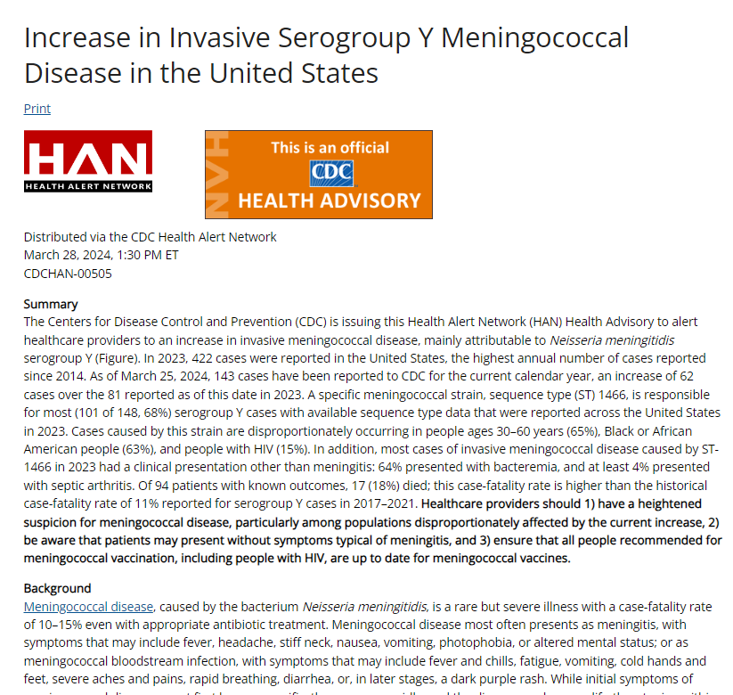
March 28, 2024 – CDC issued a Health Advisory - Increase in Invasive Serogroup Y Meningococcal Disease in the United States (cdc.gov).

Slide 12
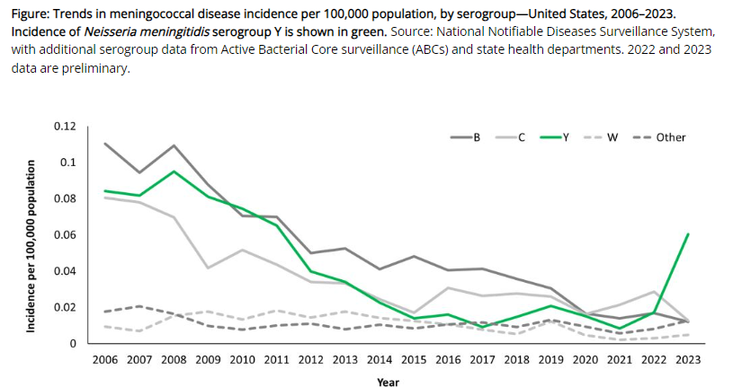
CDC Health Advisory – Increase in Invasive Serogroup Y Meningococcal Disease
An increase in invasive meningococcal disease, mainly attributable to Neisseria meningitidis serogroup Y .
In 2023, 422 cases were reported in the United States, the highest annual number of cases reported since 2014.
As of March 25, 2024, 143 cases have been reported to CDC for the current calendar year, an increase of 62 cases over the 81 reported as of this date in 2023.
A specific meningococcal strain, sequence type (ST) 1466, is responsible for most (101 of 148, 68%) serogroup Y cases with available sequence type data that were reported across the United States in 2023.
  Cases caused by this strain are disproportionately occurring in people ages 30–60 years (65%), Black or African American people (63%), and people with HIV (15%).
  In addition, most cases of invasive meningococcal disease caused by ST-1466 in 2023 had a clinical presentation other than meningitis: 64% presented with bacteremia, and at least 4% presented with septic arthritis.
  Of 94 patients with known outcomes, 17 (18%) died; this case-fatality rate is higher than the historical case-fatality rate of 11% reported for serogroup Y cases in 2017–2021.
Healthcare providers should
  have a heightened suspicion for meningococcal disease, particularly among populations disproportionately affected by the current increase,
  be aware that patients may present without symptoms typical of meningitis, and
  ensure that all people recommended for meningococcal vaccination, including people with HIV, are up to date for meningococcal vaccines.
Available at: Health Advisory - Increase in Invasive Serogroup Y Meningococcal Disease in the United States (cdc.gov), accessed on April 4, 2024

Slide 13
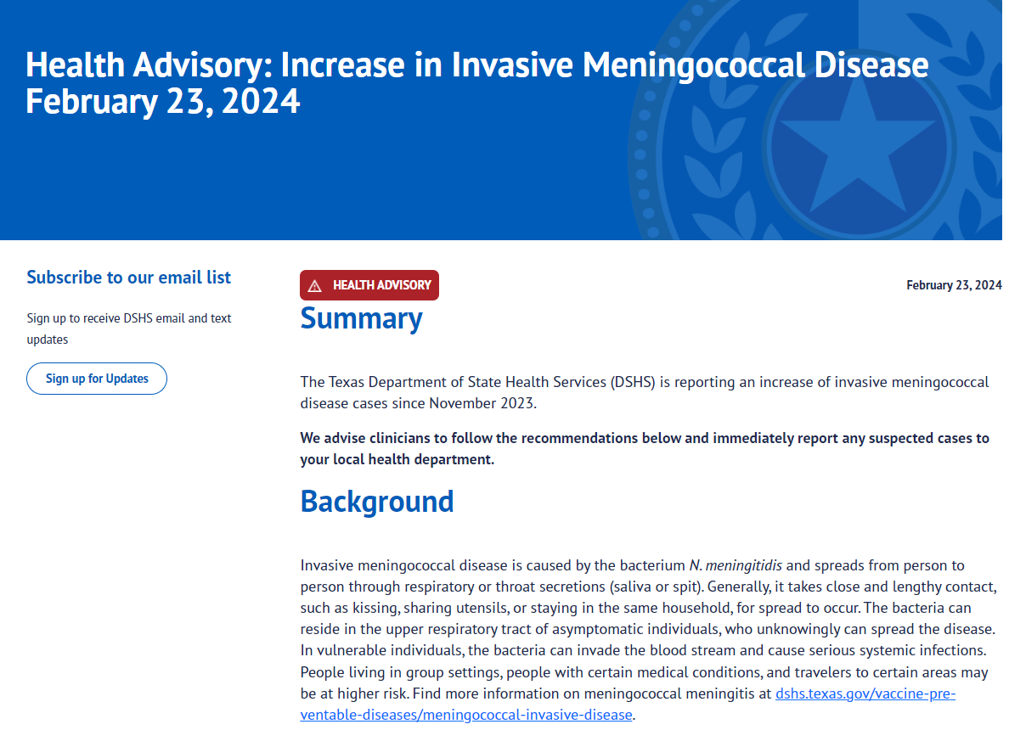
February 23, 2024 – DSHS issued a Health Advisory: Increase in Invasive Meningococcal Disease.
Texas has seen an increase in cases since November 2023:
  TX 2024 cases - as of April 4, 2024, there are a total of 17 cases.
  TX 2023 cases – a total of 31 cases
Thus far, none of the cases have been closely related.
DSHS continues to work to test and serogroup all meningococcal cases that are submitted.
Notes:
2023: 31 cases
B (2), C (4), W136 (1), Y (17), nongroupable (2), unknown (4)
2024: 14 cases
B (2), Y (10), nongroupable (1), unkn (1)

Slide 14
Thank you

