Slide 1
Public Health Data Sharing in Texas​
Office of Public Health Data Strategy & Modernization
Texas Department of State Health Services
February 12, 2025

Slide 2
Agenda
Vital Event Data Sharing
THCIC Data Sharing
Immunizations Data Sharing
Data Sharing Training and Feedback
NEDSS Provisional Data Sharing
LHE Enablement

Slide 3
Vital Event Data Sharing

Slide 4
Vital Event Data Sharing
Line-level data via Snowflake
Aggregate data via Tableau dashboards
42 total LHEs
Launch completed for 29 LHEs
November 4, 2024 – 11 LHEs
December 2, 2024 – 11 LHEs
January 22, 2025 – 7 LHEs
Tentative remaining launches pending MOU signature
February 26, 2025 – LHEs included dependent on MOUs being signed by February 10th
Additional launch dates to be added as needed
Tentatively March/April

Slide 5
THCIC Data Sharing

Slide 6
THCIC Data Sharing
Line-level data via Snowflake
No new dashboards were created for data sharing. Users are referred to dashboards on Texas Health Data.
41 total LHEs
Launch completed for 31 LHEs
October 21, 2023 – 9 LHEs
November 4, 2024 – 17 LHEs
January 22, 2025 – 6 LHEs
Tentative remaining launches pending MOU signature
February 26, 2025 (tentative) – LHEs included dependent on MOUs being signed by February 10th
Additional launch dates to be added as needed
Tentatively March/April

Slide 7
Immunizations Data Sharing

Slide 8
Immunizations Data Sharing
Line-level data via Snowflake
Aggregate data via Tableau dashboards
Deployed to production on January 31, 2025.
Rollout is occurring at LHEs request access via IAMonline.

Slide 9
Data Sharing Training and Feedback

Slide 10
Data Sharing Training
3 general webinars
Introduction to Data Sharing, Tableau, and Snowflake Training Webinar #1
Snowflake Training Webinar #2
Snowflake Training Webinar #3
5 “Beyond Basics: Q&A and Advanced Training Sessions”
Data set specific – apply training concepts to data set
Training content in HHS Learning Portal
Aligns with live training sessions
Allows users to refresh on training concepts
Community of Practice
Monthly sessions by each data set – launched January 2025
Encourage discussion among LHE peers on use of the shared data

Slide 11
Data Sharing Feedback Survey
To be sent to authorized users after completion of training and Beyond Basics series
Obtain feedback on:
Comfort level using IAMOnline, Snowflake, and Tableau
Training needs across IAMOnline, Snowflake, and Tableau
Examples of how the shared data are being used for job duties
Training and support provided during data sharing rollouts
Use feedback provided to enhance training and communications

Slide 12
NEDSS Provisional Data Sharing

Slide 13
NEDSS Provisional Data Sharing​
Sharing NEDSS basic case data via SHARP to LHEs to enhance public health surveillance and situational awareness
Includes aggregate data through a Tableau dashboard for all NEDSS users
Line-level data through Snowflake for two users per LHE

Slide 14
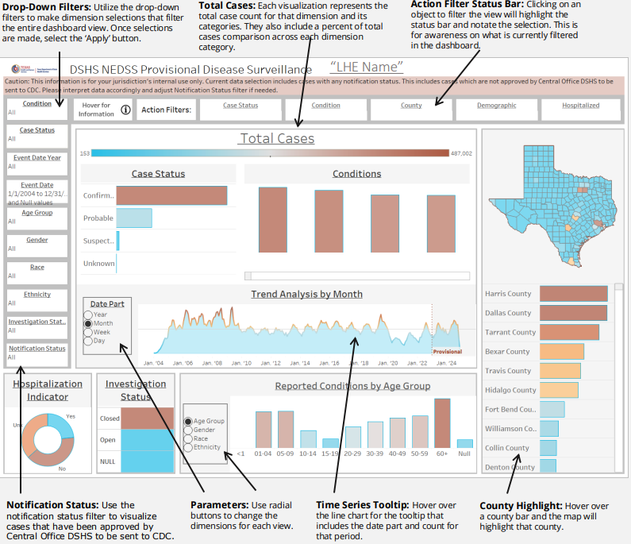
NEDSS Provisional Data Sharing: Phase 1
Tableau dashboard launched December 13, 2024
57 LHEs included in rollout
Training and Support​
2 live webinar trainings conducted
3 office hour sessions
Training resources include job aid and training slides
Utilization
Dashboard has ~1,300 views

Slide 15
NEDSS Provisional Data Sharing: Phase 2
Will provide line-level basic case data to two users per LHE
Snowflake data views scheduled to launch February 20, 2025 (tentative)
Additional Training and Support​
Two live webinar training sessions scheduled for February 2025
Three office hours scheduled for February and March 2025
Training resources will include job aids and data dictionaries

Slide 16
LHD Enablement Project

Slide 17
LHE Enablement Project
The goal of the project is to support building more effective partnerships and enhance collaboration with LHEs around public health data sharing
DSHS will solicit feedback from LHEs through interviews and surveys to identify gaps and opportunities to enhance data sharing
LHE surveys are tentatively scheduled for late February or early March 2025

Slide 18
Thank you

