Slide 1
Update on COVID-19 Vaccine Administration & Current Status Regarding Mpox
Imelda Garcia, MPH
Associate Commissioner
Laboratory & Infectious Disease Services Division
February 8, 2023

Slide 2
DISCLAIMER
The information presented today is based current preliminary data and on CDC’s recent guidance. Information is subject to change.
February 8, 2023

Slide 3
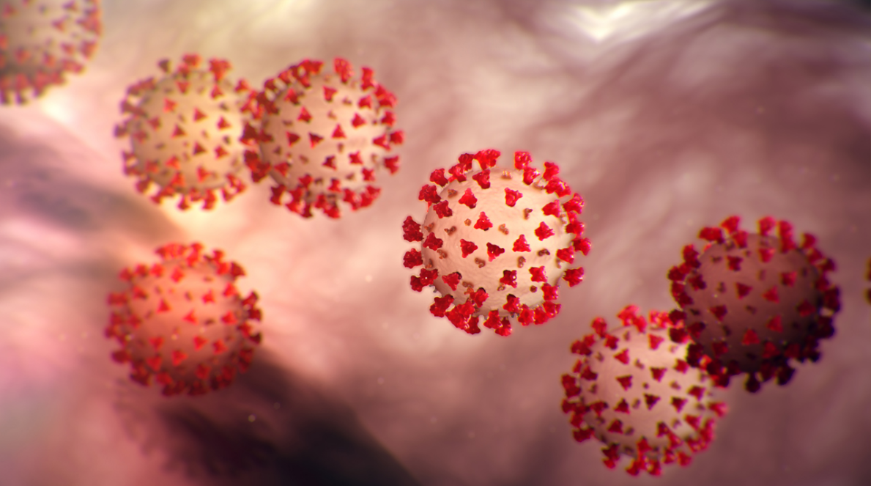
COVID-19 Vaccine Update

Slide 4
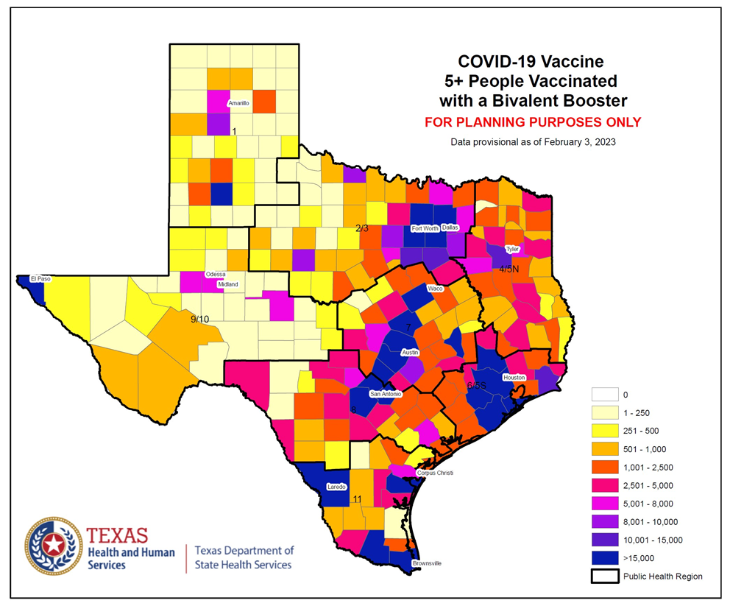
Bivalent COVID-19 Vaccine Booster Doses Administered, Texas (February 3, 2023)
Age Group | Population | Number of Bivalent Boosters
5-11 years | 2,898,962 | 52,710 (1.8%)
12-17 years | 2,472,553 | 88,741 (3.6%)
18-49 years | 12,885,909 | 636,946 (4.9%)
50-64 years | 4,975,933 | 676,139 (13.6%)
65+ years | 3,734,229 | 1,054,713 (28.2%)
Total | 26,967,586 | 2,509,249 (9.3%)

Slide 5
Future COVID-19 Vaccines

Slide 6
Future COVID-19 Vaccines
The Food and Drug Administration (FDA) advisory committee on Vaccine Related Biologics and Product (VRBPAC) met on January 26, 2023. They discussed 3 specific issues:
Harmonizing vaccine strain composition for primary series and booster doses.
Simplifying the immunization schedule for a multi-dose series in some population(s), but one dose (possibly annually) for many individuals.
Future strain selection and vaccine composition.

Slide 7
Future COVID-19 Vaccines
Harmonizing vaccine strain composition for primary series and booster doses:
VRBPAC voted YES (21:0)
Thus, the composition of all vaccines administered currently would be a bivalent vaccine (original + Omicron BA.4/BA.5).
Implementation feasibility is an important consideration.
Next Steps
The FDA will authorize and update/revise the fact sheets/labels for all current monovalent and bivalent COVID-19 vaccines – TBD.
CDC Advisory Committee on Immunization Practices (ACIP) to review and update clinical recommendations (meeting scheduled - 2/24/2023).
The CDC Director approves the clinical recommendations.

Slide 8
Future COVID-19 Vaccines
Simplifying the immunization schedule for a multi-dose series in some population(s), but one dose (possibly annually) for many individuals.
Future strain selection and vaccine composition.
A proposal is to utilize the current influenza vaccine approach.
An evidence-driven approach, similar in many ways to the process used for influenza vaccines, to monitor and update, as needed, the composition used in all COVID-19 vaccines to induce or restore protective immunity through periodic vaccination campaigns.
Any change in vaccine composition, when appropriate, would be implemented broadly and would be coordinated by the World Health Organization and national regulatory authorities.

Slide 9
Mpox Update

Slide 10
Mpox Situation Report 2/2/2023
Surveillance

Slide 11
Case Demographics
Age Category | # of Cases | % of Cases
<18 Years | 18 | 0.6%
18-29 Years | 848 | 29.1%
30-39 Years | 11213 | 41.7%
40-49 Years | 552 | 19.0%
50-59 Years | 231 | 7.9%
60+ Years | 48 | 1.7%
Total | 2,910 | 100%
Race | # of Cases | % of Cases
Hispanic | 890 | 30.6%
Asian | 48 | 1.6%
Black | 9996 | 34.2%
White | 668 | 23.0%
Other | 135 | 4.6%
Unknown | 173 | 5.9%
Total | 2,910 | 100%
Sex | # of Cases | % of Cases
Male | 2814 | 96.7%
Female | 96 | 3.3%
Total | 2,910 | 100%
As of 2/6/2023

Slide 12
As of 2/6/2023

Slide 13
As of 2/6/2023

Slide 14
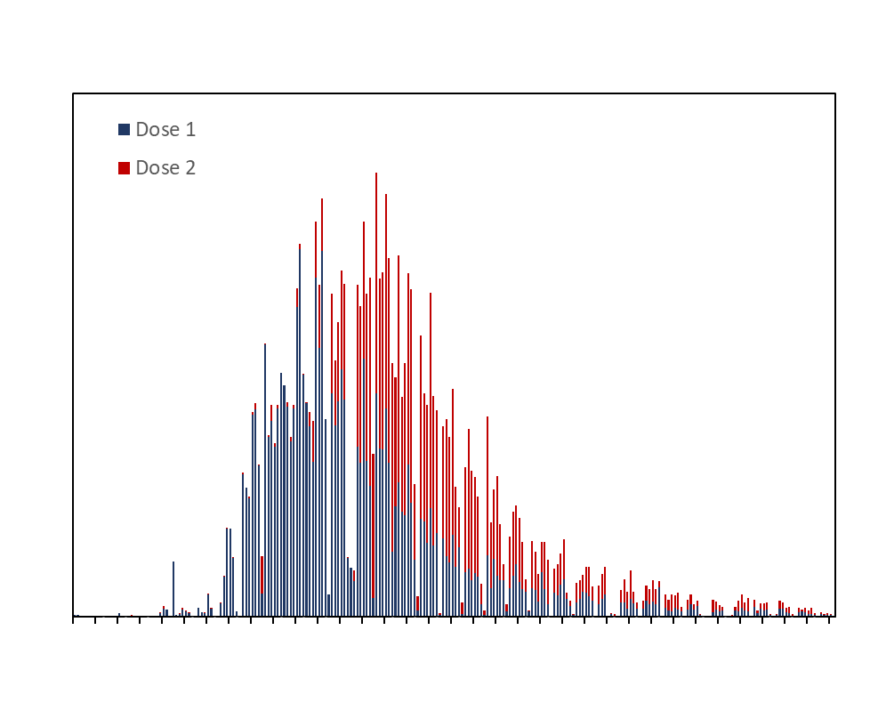
As of February 3, 2023, a total of 28,949 People Vaccinated
(47,336 Doses) with JYNNEOS (ImmTrac2 data) in Texas
JYNNEOS Administration (ImmTrac2) by PHR |  |  |  |  | Cases
PHR | One Dose | People Fully Vaccinated | Total Doses Administered | % | Total Cases | %
1 | 137 | 105 | 242 | 0.5% | 10 | 0.3%
2/3 | 8,035 | 4,840 | 12,889 | 27.2% | 1,192 | 41.0%
4/5N | 116 | 72 | 188 | 0.4% | 15 | 0.5%
6/5S | 10,580 | 7,040 | 17,635 | 37.3% | 1,066 | 36.7%
7 | 5,715 | 3,473 | 9,197 | 19.4% | 393 | 13.5%
8 | 1,763 | 1,184 | 2,951 | 6.2% | 199 | 6.8%
9/10 | 574 | 297 | 871 | 1.8% | 11 | 0.4%
11 | 1,009 | 775 | 1,785 | 3.8% | 22 | 0.8%
Unknown | 1,020 | 557 | 1,578 | 3.3% | 0 | 0.0%
Total | 28,949 | 18,343 | 47,336 | 100.0% | 2,908 | 100.0%
As of February 3, 2023, there are 10,308 individuals overdue (day 43) for their second dose of JYNNEOS to complete the primary series.

Slide 15
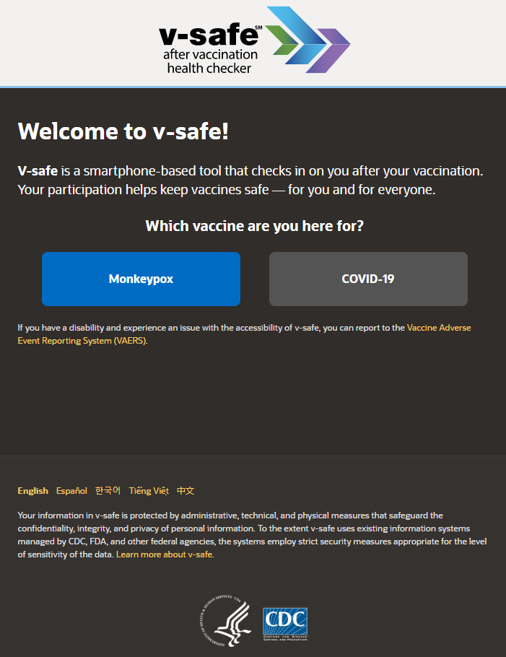
NEW: V-safe after MPOX Vaccination
V-safe is a safety monitoring system that lets you share with CDC how you, or your dependent, feel after getting a MPOX vaccine.
After you enroll, v-safe will send you personalized and confidential health check-ins via text messages and web surveys to ask how you feel, including if you experience any side effects after vaccination.
Completing health check-ins and sharing how you feel, even if you don’t experience side effects after vaccination, helps CDC monitor vaccine safety.
How to Enroll or Access Your V-safe for Monkeypox Vaccine Account | Monkeypox | Poxvirus | CDC
V-safe After Vaccination Health Checker for Monkeypox Vaccine | Monkeypox | Poxvirus | CDC
v-safe (cdc.gov)

Slide 16
Thank you!

