Slide 1
Texas Department of State Health Services Updates
Texas Department of State Health Services
October 16, 2024

Slide 2
Agenda
Infectious Disease Prevention
  Congenital Syphilis (CS)
  Vaccine Updates – Respiratory Infectious Disease
  Public Health Data Sharing
Data Modernization and Public Health Data Sharing
  NEDSS Provisional Data Sharing
  NIFI 4 Enhancements
  HTI-2 Proposed Rule Comment
  Data Visualization

Slide 3
Infectious Disease Prevention
Josh Hutchison, MBA
Deputy Commissioner, Infectious Disease Prevention Division

Slide 4
Congenital Syphilis

Slide 5
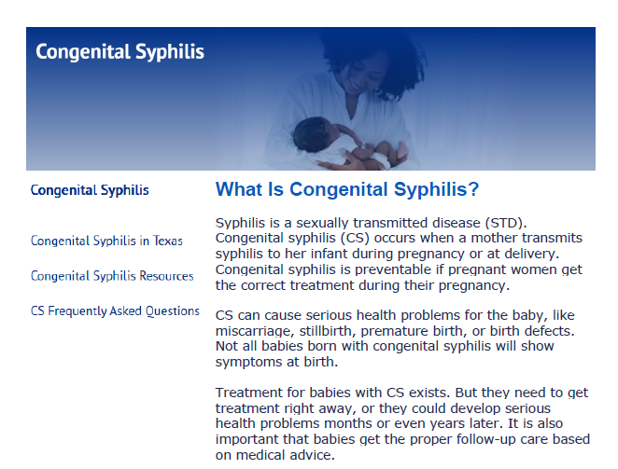
Congenital Syphilis Website

Slide 6
Respiratory Infectious Disease Vaccine Updates

Slide 7
Respiratory Infectious Diseases
Respiratory Syncytial Virus (RSV)
Updated (2024-2025) COVID-19 Vaccines

Slide 8
RSV Updates

Slide 9
RSV Vaccine Supply
AbrysvoTM (RSVpreF) RSV vaccine for maternal patients:
    Ordering made available on August 1, 2024.
    Administration for 2024–2025 RSV season began in September 2024, through January 2025.
    Unused inventory can be stored for use the the following RSV season.
BeyfortusTM (Nirsevimab) Immunization for newborns and infants:
Ordering made available on September 1, 2024.
Administration for 2024–2025 RSV season began on October 1, 2024, through March 31, 2025.
Beyfortus supply constraints impacted availability last season, but supply has significantly increased this year.

Slide 10
Updated (2024-2025) COVID-19 Vaccines

Slide 11
Bridge Access Program
The CDC created the Bridge Access Program to provide COVID-19 Vaccines at no cost to uninsured and underinsured adults which DSHS implemented as part of the Adult Safety Net Program in September 2023.
After Bridge Access Program ended August 2024, the CDC awarded supplemental 317 funding for limited COVID-19 vaccine, which are a part of the ASN program to uninsured adults.
  Providers may charge an administration fee.

Slide 12
Updated (2024-2025) COVID-19 Vaccines Under EUA
  HHSC notified DSHS that beginning October 1, 2024, Texas Medicaid and CHIP will no longer reimburse administration fees for COVID-19 vaccines under emergency use authorization (EUA), regardless of whether it is a Texas Vaccines for Children program-supplied vaccine.
  COVID-19 vaccines currently under EUA include Novavax (>12 years), Moderna (6m-11yrs), and Pfizer (6m-5yrs, 5y-11yrs).
  Updated (2024-2025) Pfizer and Moderna COVID-19 vaccines for individuals 12 years of age and older are fully U.S. Food and Drug Administration (FDA) approved.
  Texas Medicaid reimburses TVFC providers up to $13.75 for vaccine administration for Medicaid and CHIP beneficiary birth through 18 years of age. HHSC set the administration fee on September 1, 2022.

Slide 13
Updated (2024-2025) COVID-19 Vaccine Supply
  Updated (2024-2025) COVID-19 vaccines received FDA approval/authorization and became available for ordering in late August.
  DSHS does not anticipate any supply concerns for these updated (2024–2025) COVID-19 vaccines.
  Last season (2023-2024) COVID-19 vaccines should NO LONGER be administered and all remaining inventory must be disposed.

Slide 14
Public Health Data Sharing
DSHS Immunizations Program

Slide 15
Public Health Data Sharing
Record-level data sharing to all 50 LHDs since mid-July 2024.
Efforts are still ongoing to transition to the State Health Analytical and Reporting Platform (SHARP) by October 2024 for record level data sharing.
Communication and training for accessing data in SHARP forthcoming.
A data use stipulation document has been created to help guide LHDs on how to utilize the data provided.
Client data does not include address and phone number since this data is not meant to be used in individual recall/reminder efforts.

Slide 16
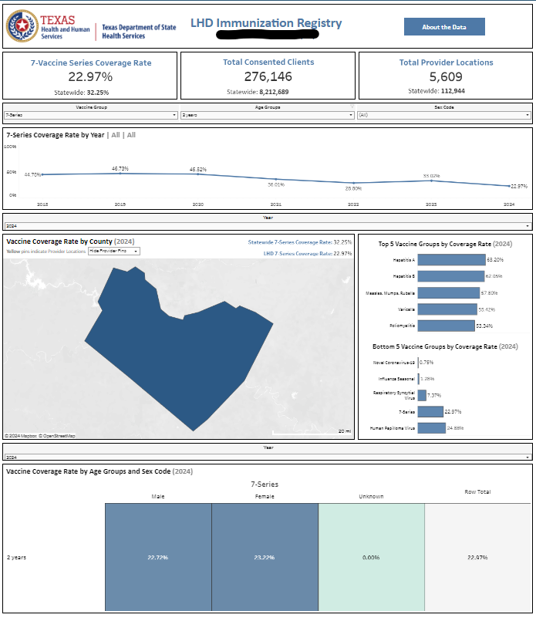
Public Health Data Sharing
Every contracted LHD with the Immunization Section will have their own Tableau dashboard that includes coverage rate estimates based upon the data reported for their jurisdiction.
Statewide coverage rates will be included on the individual LHD dashboards for reference.
Example

Slide 17
Data Modernization and Public Health Data Sharing
Dr. Sai Balasubramanian, M.D., J.D.
Director, Public Health Informatics Data & Exchange Unit (PHID)

Slide 18
NEDSS Provisional Data Sharing

Slide 19


NEDSS Provisional Data Sharing
The PHID Unit will leverage data to enhance public health surveillance at Local Health Departments (LHEs) by sharing NEDSS data via SHARP
The NEDSS project rollout will occur in two phases:
    Phase 1 delivers aggregate-level disease surveillance dashboards to each LHE
    Phase 2 provides LHEs line-level NEDSS provisional data in Snowflake

Slide 20
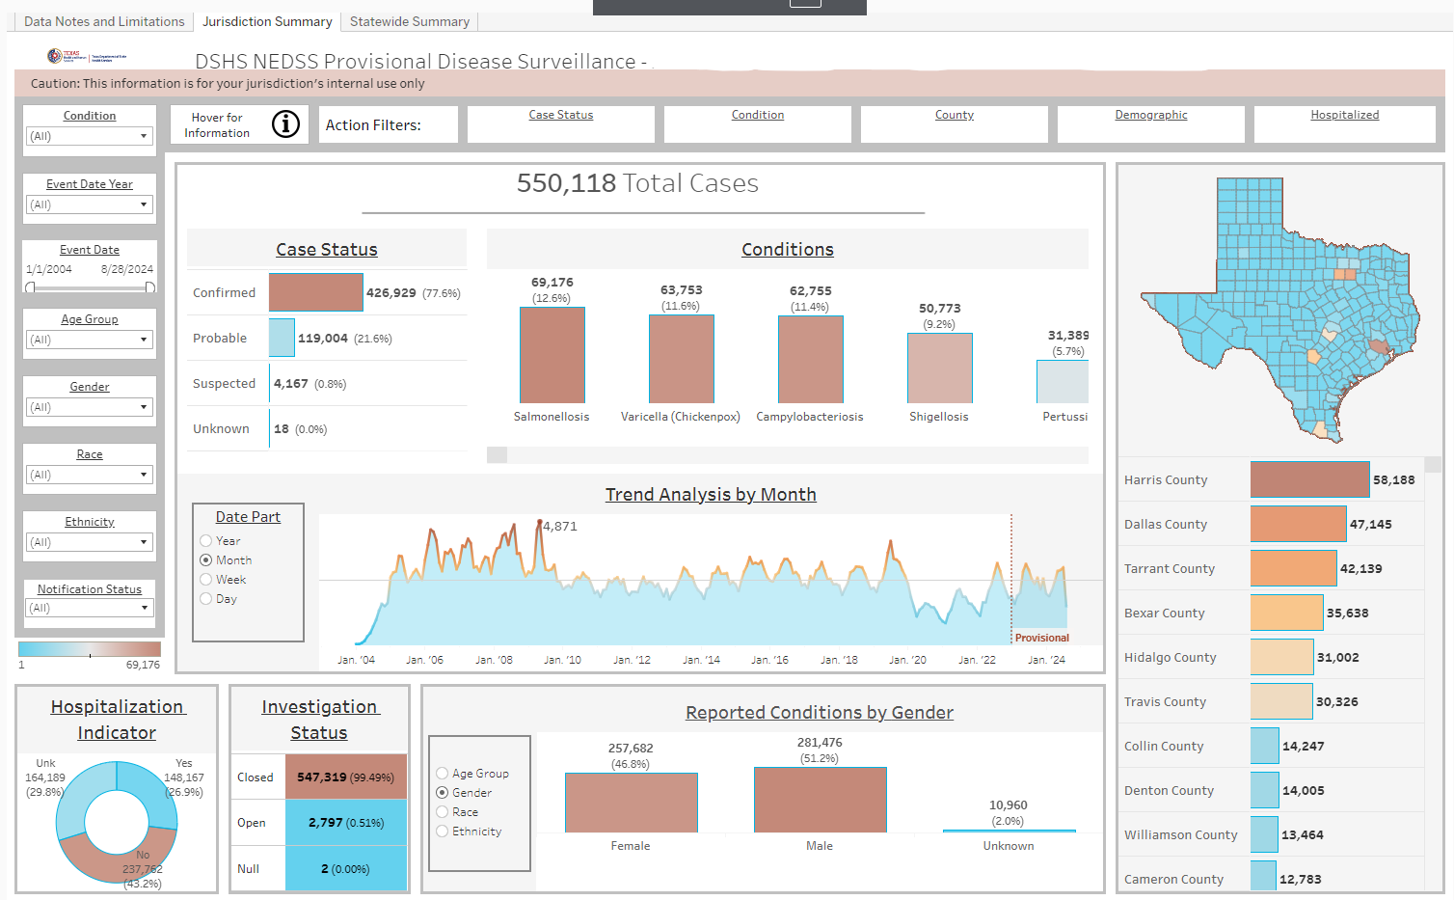
NEDSS Provisional Data Sharing Roll-Out
Initial communication was sent out to LHEs 8/22
PHID distributed a survey to LHEs on 8/26 to identify staff who should receive access to line-level data for Phase 2
  As of 10/9, the response rate is 70%
Training and Support
  Training sessions and office hours are scheduled for October and November

Slide 21
NIFI 4 Enhancements

Slide 22
NIFI 4 & STHARRS Epics & Timeline-- Preliminary
NIFI 4 & STHARRS Enhancement Projects are comprised of 13 epics.
The projects kick just kicked off this month and run through Summer 2026.
Epic # | Epic Title/Description | Duration (in months)
30 | Add Bulk Case Investigation from UI | 8
31 | Map Jurisdictions Using Program Area/Conditions | 7
32 | Add Ability to Update Test Code to Condition Mapping Through NEDSS UI | 8
33 | Add Organization/Facility Management Module | 17
34 | Enhance Workflow Decision Support (WDS) Functionality | 5
35 | Upgrade Texas NEDSS UI Design | 23
36 | Implement Electronic Initial Case Reports (eICR) Reportability Response (RR) | 5
37/38 | Rewrite ETL into SQL Server | 22
39 | Support for Interoperability Improvements in NEDSS | 23
40 | High Priority Enhancements for STD, HIV, and TB Programs in NEDSS | 22
41 | STD/HIV Data Migration | 23
42 | HIV Implementation in NEDSS | 23
NIFI 4
STHARRS

Slide 23
HTI-2 Proposed Rule Comments

Slide 24
HTI-2 Proposed Rule
ASTP/ONC recently proposed the HTI-2 rule that stipulates requirements by which healthcare organizations must conform. HTI-2 has several impactful and long-lasting implications to public health programs.
There are 4 major sections that impact public health
  Updated naming convention and standards of the "f-criteria" (reference to the f-criteria in the rule): Includes two new criteria for birth reporting and bi-directional exchange with a prescription drug monitoring program (PDMP);
  New certification criteria for Health IT for Public Health: Health IT for Public Health certified systems must be able to receive, validate, parse, and filter standardized data
  USCDI V4 adoption: Update the USCDI standard with new data elements and data class included in version 4;
  FHIR-based API exchange: Adopting a new criterion for a standardized FHIR-based API for public health data exchange for data senders.

Slide 25
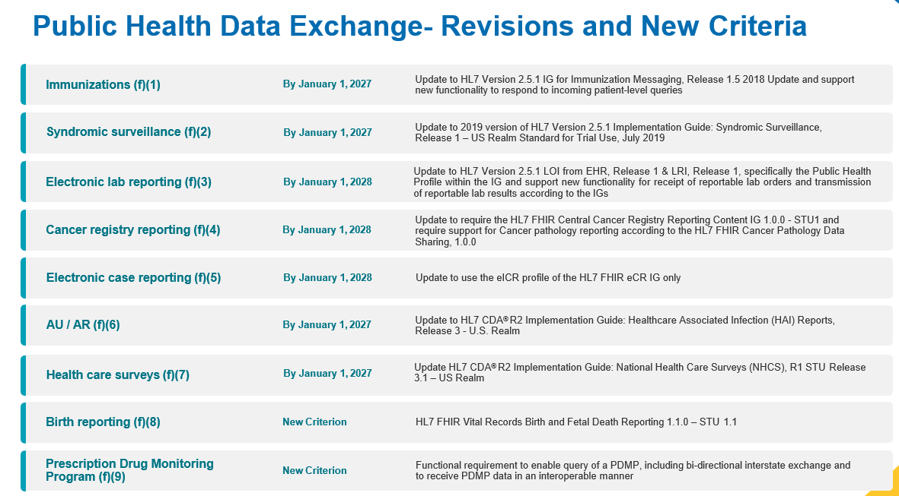
Public Health Data Exchange – HTI-2 Proposed Rule

Slide 26
Texas DSHS Comment Summary
January 1, 2028 is not a feasible deadline to comply with proposed ELR and eCR changes.
Funding is not offered to assist with these large-scale proposed efforts which presents time, workforce, and resource challenges for the public health workforce.
The proposed Public Health Certification process is worrisome as we do not know how requirements will be set which may further impact the timeline. We believe public health needs to have an important designated role in defining these criteria. TX DSHS continues to work with healthcare organizations to improve data intake when onboarding. It is important to clarify a certification does not negate state and local reporting requirements.

Slide 27
Data Visualization

Slide 28
Dashboards Timeline
January 2024
Respiratory Virus
June 2024
Maternal and Child Health (MCH)
Maternal Health
Infant Mortality and Morbidity
September 2024
Congenital Syphilis (CS)
August 2024
MCH
Severe Maternal Morbidity
Pregnancy-Related Mortality Ratio
Texas AIM Quality Improvement Analysis and Outcomes
Infant Health Practices
November 2024*
MCH
Prenatal, Delivery, and Postpartum Care
December 2024*
CS
About the Babies
About the Moms
Testing and Treatment
MCH
MMRC Cohort Summary and Status
Birth Demographics
MCH
January 2025*
MCH
Perinatal Periods of Risk
*Tentative Go-Live Dates

Slide 29
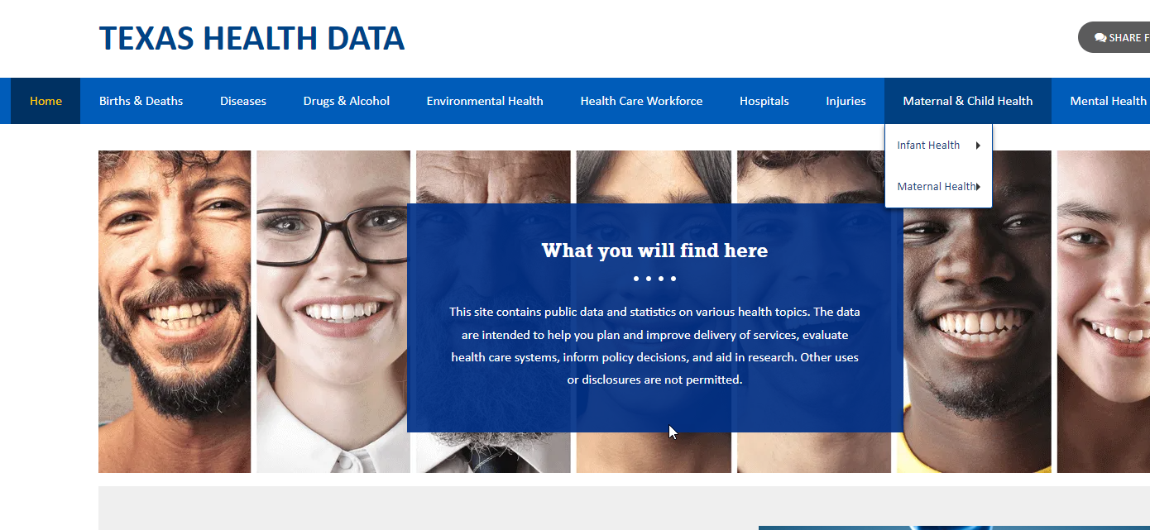
Texas Health Data
Multiple data sets in a single area
Visualization
Customization
Downloading in formats that meet users needs
https://healthdata.dshs.texas.gov/
Notes:
DSHS is committed to continuous improvement of our public facing data portal at DSHS known as Texas Health Data.
Texas Health Data provides a one stop shop for people interested in data that is housed at DSHS and we’re continuing to work every day to make more datasets available through this site.
We have released several maternal and child health dashboards this year, and we are excited to share that we have recently gone live with our Congenital Syphilis Dashboards on Texas Health Data. I am excited to share with you some of the information that you can see on these dashboards now, and encourage you to go to the dashboards after this session to explore them further.

Slide 30
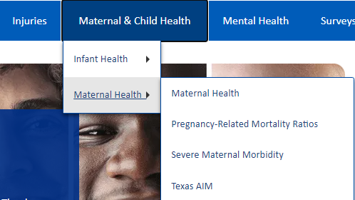
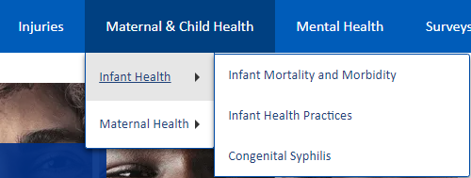
Maternal and Child Health Dashboards
August 30, 2024 release included:
Infant Mortality and Morbidity
  Infant Health Practices
Maternal Health
  Severe Maternal Morbidity
  Pregnancy-Related Mortality Ratio
  Texas AIM

Slide 31
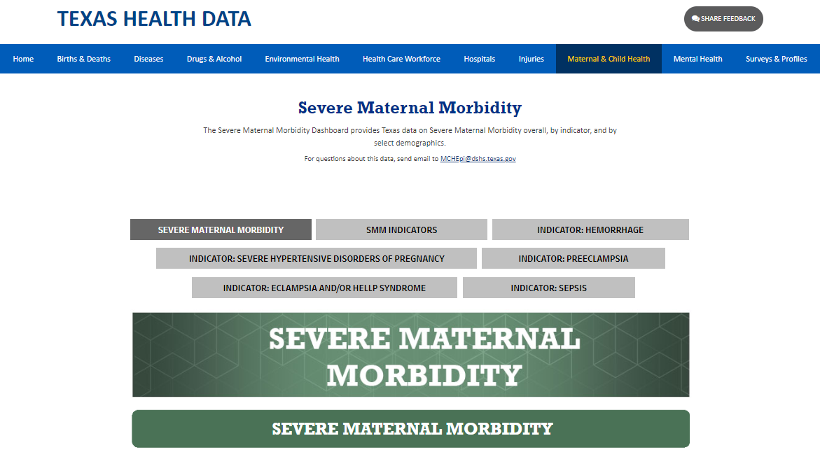
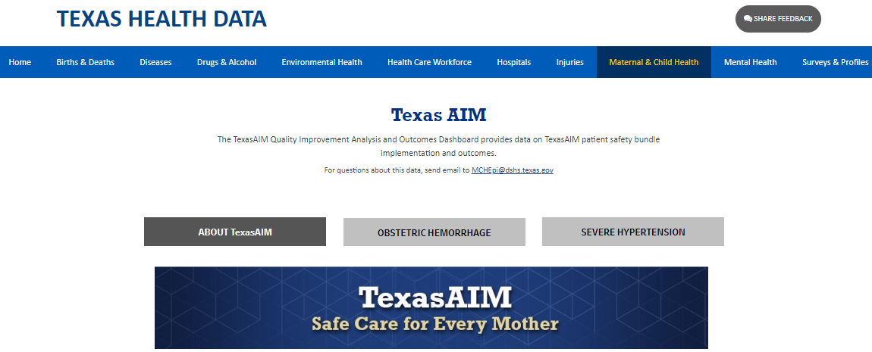
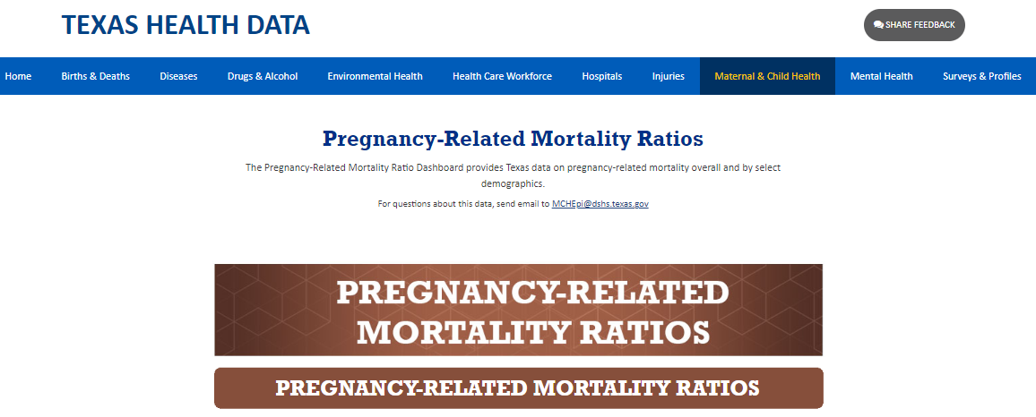
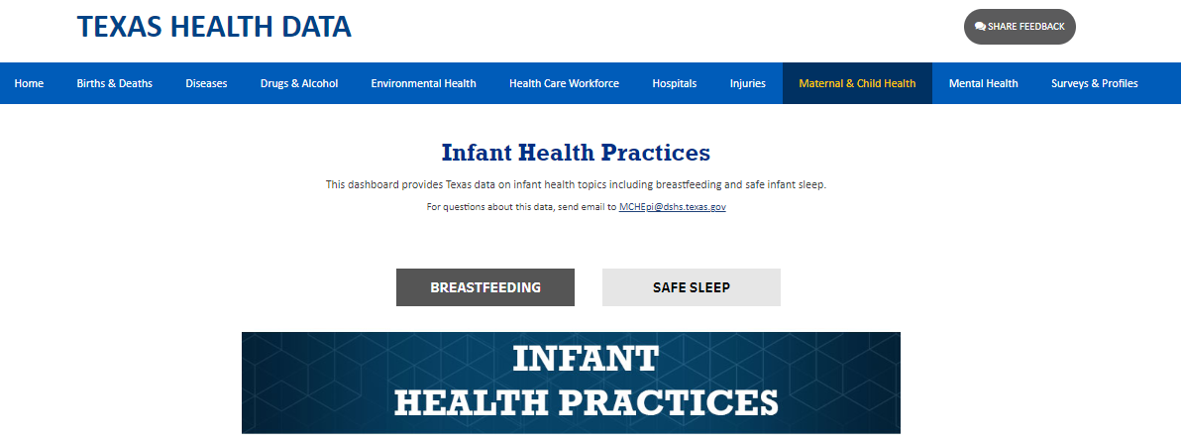
Texas Health Data - Infant Health
Texas Health Data - Maternal Health

Slide 32
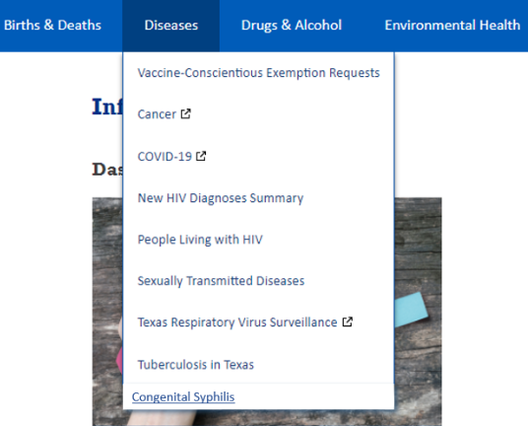
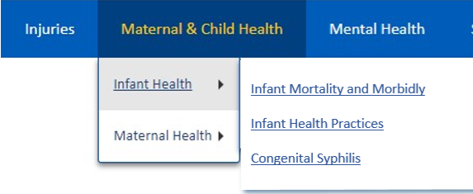
Congenital Syphilis Dashboard
https://healthdata.dshs.texas.gov/dashboard/diseases/congenital-syphilis
September 16, 2024 release included:
Understanding syphilis
Overview of Congenial Syphilis and Syphilis in Women of Childbearing Age in Texas
  CS cases and Rate by County
Maternal Demographics for Women Delivering Infants with CS
  Race/ethnicity
  Maternal Risk
  Prenatal Care
Notes:
I am very excited to be able to share with you today that we have launched a new series of Congenital Syphilis dashboards on our Texas Health Data Site which are available now and provide the latest information on Congenital Syphilis in our state. We are so excited to share this information with you and for you to be able to use it to make a difference in your community. And this is just the start. We will be releasing additional data through these dashboards in the winter and into early next year.
You can access the CS dashboard in two different places on THD – Under Diseases – added a new menu for Congenital Syphilis. Secondly, under Maternal & Child Health -> Infant Health → new menu for CS

Slide 33
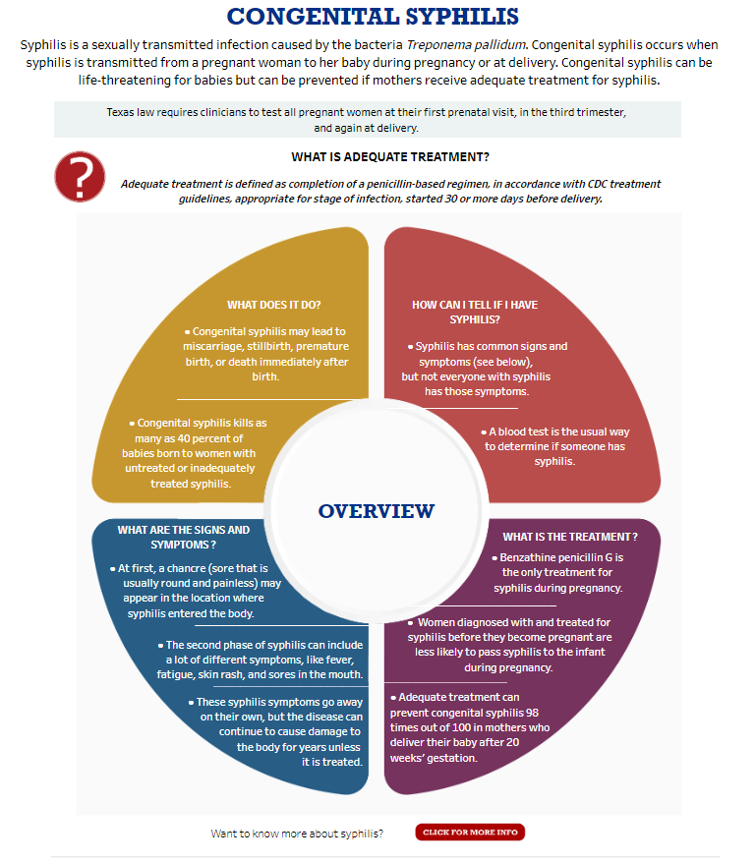
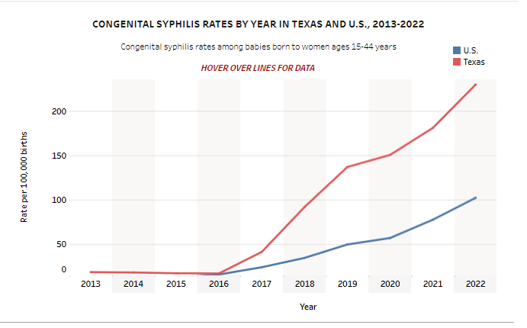
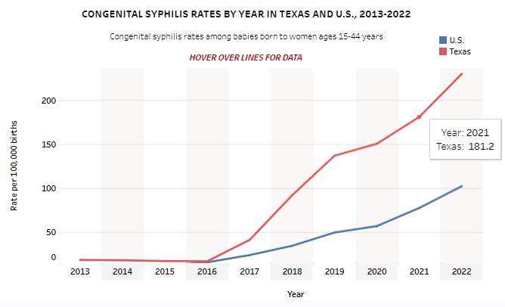
Congenital Syphilis Data Dashboard
https://healthdata.dshs.texas.gov/dashboard/diseases/congenital-syphilis
Notes:
I would like to point out a feature of the dashboard that you might find useful.
Each of the data maps, figures, and charts have this ‘hover over’ feature. So, far example here, if you move the cursor over a particular year, you can see the specific data for that year. In this example, you see Texas data for 2021.

Slide 34
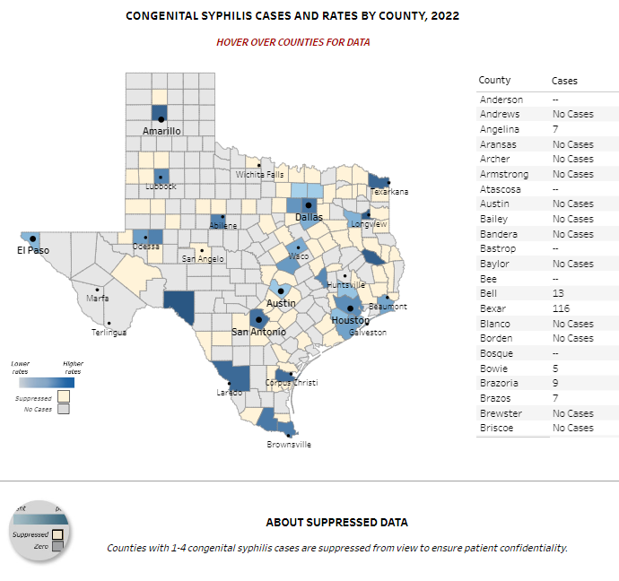
Congenital Syphilis Data Dashboard
https://healthdata.dshs.texas.gov/dashboard/diseases/congenital-syphilis
Notes:
Here we see data on CS cases and rates by county. This is 2022 data, the most current year of data available,
Another feature of the dashboard is for the maps with the counties, we also have a table of the counties in alphabetical order that you can scroll to find the data for the county of interest.

Slide 35
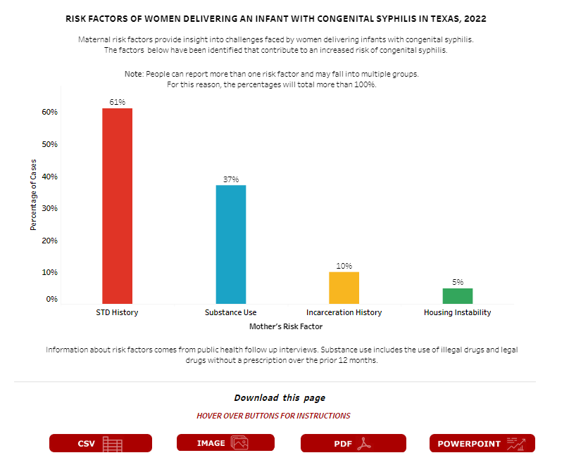
Congenital Syphilis Data Dashboard
Download the data in the desired format
https://healthdata.dshs.texas.gov/dashboard/diseases/congenital-syphilis
Notes:
Here we are looking at the various risk factors of women delivering an infant with CS in Texas. This is from 2022 data again.
Another feature to point out is that all the data you see on the dashboard are downloadable in the format of your choice as shown on the slide

Slide 36
Thank you!

