Slide 1
Emerging Infectious Diseases
PHFPC Briefing
Varun Shetty, MD, MBA, MS
Chief State Epidemiologist
Office of the Chief State Epidemiologist
Texas Department of State Health Services
December 11, 2024

Slide 2
DISCLAIMER
The information presented today is based current preliminary data and on CDC’s recent guidance. Information is subject to change.
December 11, 2024

Slide 3
Discussion Topics
Respiratory Virus Illness Dashboard
Pertussis
Marburg Virus
Mpox
H5N1
Enhanced Influenza Surveillance

Slide 4
Respiratory Virus Illness Interactive Dashboard

Slide 5
Texas Respiratory Illness Interactive Dashboard
Effective December 6, 2024, two key enhancements have been made to the Texas Respiratory Illness Interactive Dashboard
  Landing page updated with new features
  Hospitalization reporting resumes for COVID-19 and influenza and starts for respiratory syncytial virus (RSV)
Available: Health officials update features and content on respiratory illness dashboard | Texas DSHS, accessed 12/10/2024

Slide 6
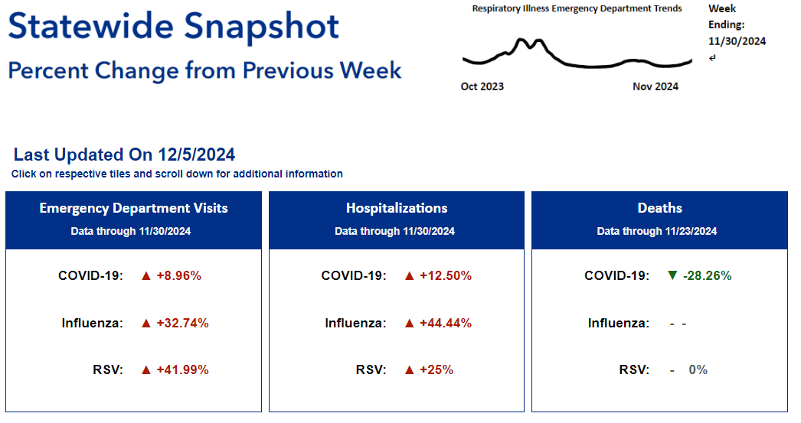
Texas Respiratory Illness Interactive Dashboard
Landing page updated with new features
  Statewide snapshots of weekly changes in emergency room visits, hospitalization, and death
  Tiles added for each interactive visualizations
    Emergency room visits
    Hospitalizations
    Deaths
Available: Texas Respiratory Illnesses Dashboard, accessed 12/10/2024

Slide 7
TX Respiratory Illness Statewide Hospitalization Data
Since December 2022, hospitals were required to report weekly hospitalization and bed occupancy counts of confirmed COVID-19 and influenza infections directly to the Federal government using the Centers for Disease Control and Prevention (CDC)’s National Healthcare Safety Network (NHSN).
Since May 1, 2024, the weekly hospitalization and bed occupancy counts reporting became optional.
Effective November 1, 2024, a new reporting requirement from CMS has begun for weekly hospitalizations and bed occupancy of patients with confirmed COVID-19, influenza, and newly added Respiratory Syncytial Virus (RSV) infections.​
Available: NHSN Hospital Respiratory Data (HRD) Reporting, accessed 12/06/2024
Notes:
* (ON THIRD BULLET) ARE WE SURE THAT IT WILL BE WEEKLY REPORTING? I SEE THAT THE HHS SECRETARY IS SUPPOSED TO NAME THE INTERVAL, BUT I DON’T SEE WHERE HE HAS SAID IT WILL BE WEEKLY.” -
CMS is requiring that, beginning on November 1, 2024, hospitals and CAHs electronically report information about flu, COVID-19, and RSV on a schedule specified by the Secretary of Health and Human Services (HHS). These include:
- Beginning on November 1, 2024, CMS specified the required reporting to include the following to NHSN on a weekly basis: 2 1. Hospital bed capacity and occupancy information, overall and by bed type (inpatient, ICU) and designation (adult, pediatric) 2. Number of patients hospitalized with laboratory-confirmed COVID-19, influenza, and RSV, by age group 3. Number of new hospital admissions of patients with laboratory-confirmed COVID-19, influenza, and RSV, by age group Additionally, hospital personal protective equipment (PPE) and supply data are available for voluntary reporting to NHSN in conjunction with the required data with hospitals to provide training and technical assistance to ensure they are ready and able to meet these updated reporting requirements this fall.

Slide 8
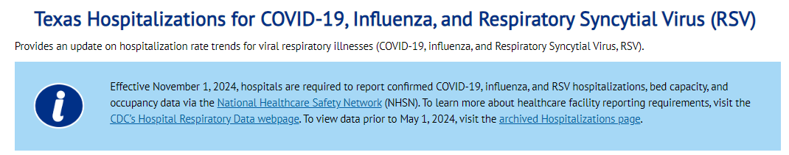
Texas Respiratory Illness Interactive Dashboard
Hospitalization
Available: Current Hospitalizations Data | Texas Respiratory Illnesses Dashboard, accessed 12/10/2024

Slide 9
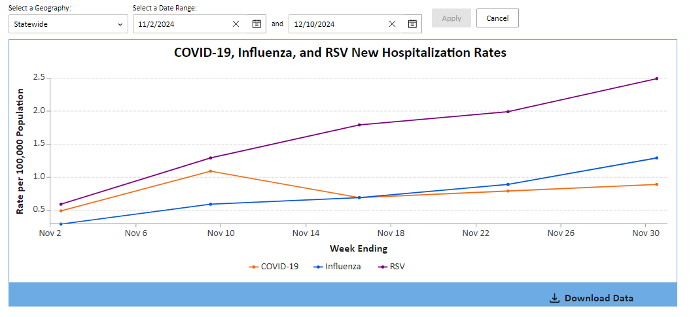
Texas Respiratory Illness Interactive Dashboard
COVID-19, Flu, and RSV Hospitalization Rates
Available: Current Hospitalizations Data | Texas Respiratory Illnesses Dashboard, accessed 12/10/2024

Slide 10
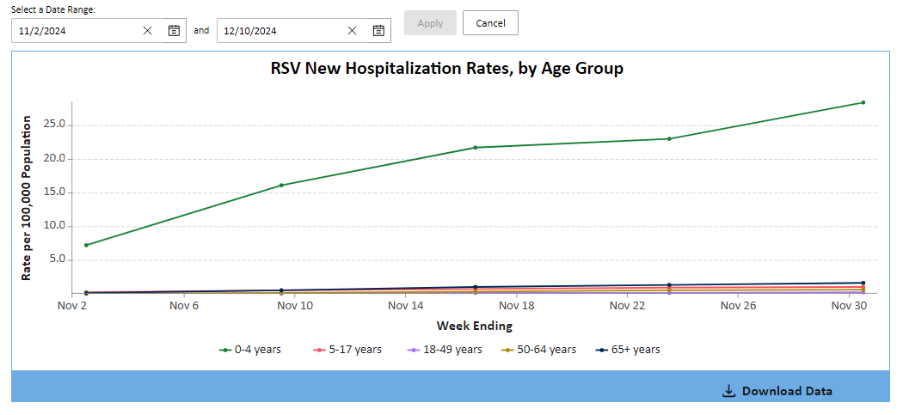
Texas Respiratory Illness Interactive Dashboard
New: RSV-Associated Hospitalizations
Available: Current Hospitalizations Data | Texas Respiratory Illnesses Dashboard, accessed 12/10/2024

Slide 11
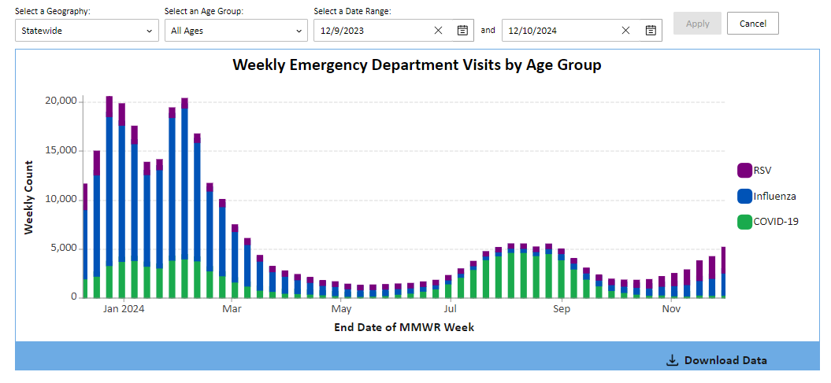
Texas Respiratory Illness Interactive Dashboard
Emergency Department Visits
Available: Current Hospitalizations Data | Texas Respiratory Illnesses Dashboard, accessed 12/10/2024

Slide 12
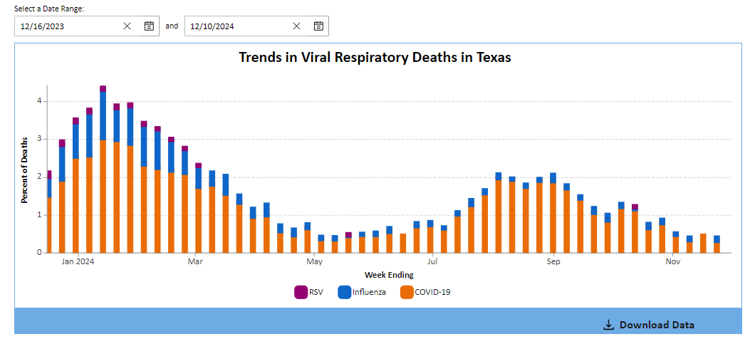
Texas Respiratory Illness Interactive Dashboard
Viral Respiratory Deaths
Available: Current Hospitalizations Data | Texas Respiratory Illnesses Dashboard, accessed 12/10/2024

Slide 13
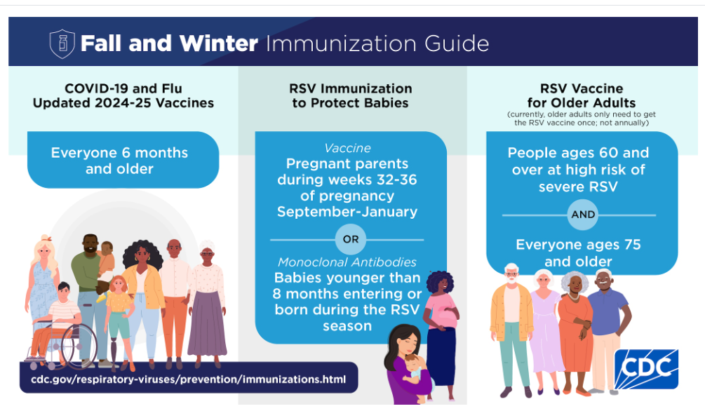
Available: Immunizations for Respiratory Viruses Prevention | Respiratory Illnesses | CDC, accessed 12/10/2024

Slide 14
Pertussis

Slide 15
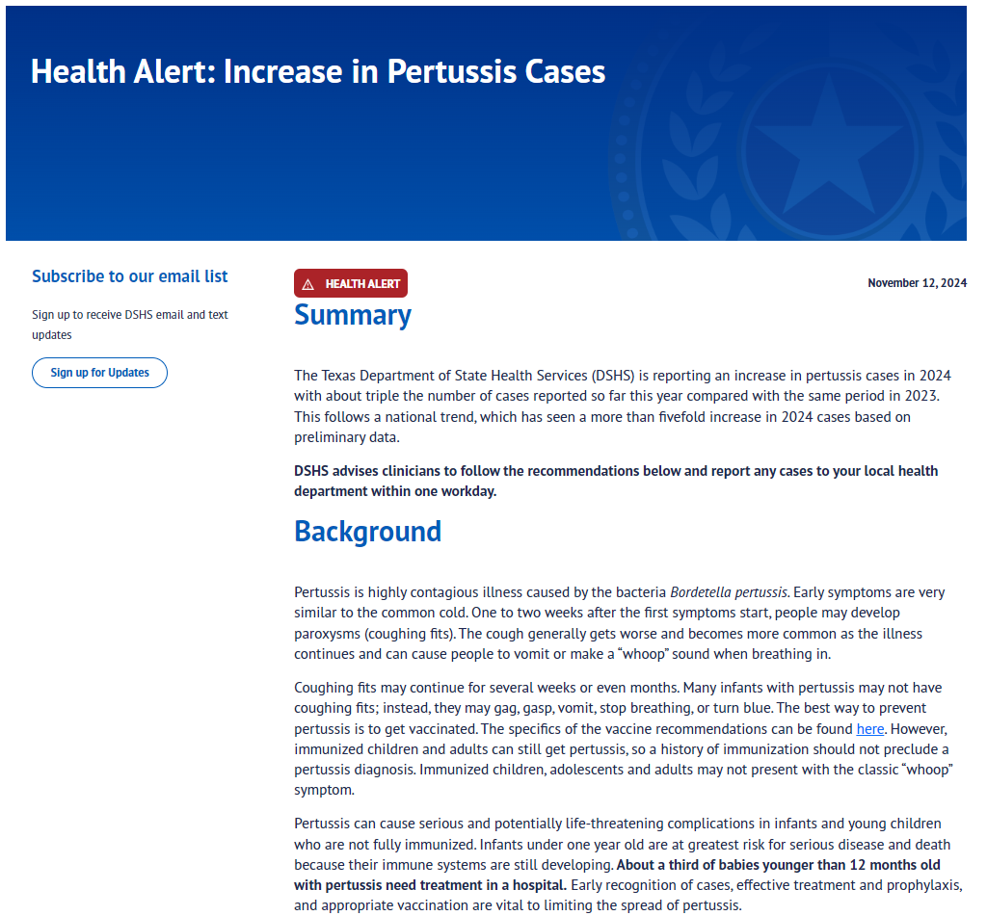
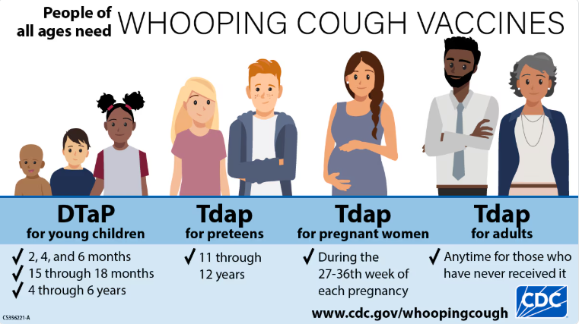
DSHS Health Alert:
Increase in Pertussis Cases
On Nov. 12, 2024, Texas Department of Health Services (DSHS) issued a Health Alert: Increase in Pertussis Cases | Texas DSHS
  Texas pertussis cases in 2024 with about triple the number of cases reported so far this year compared with the same period in 2023.
  This follows a national trend, which has seen a more than fivefold increase in 2024 cases based on preliminary data.
  The best way to protect against pertussis is vaccination. Centers for Disease Control and Prevention recommends pertussis vaccines for people of all ages.

Slide 16
Marburg Virus

Slide 17
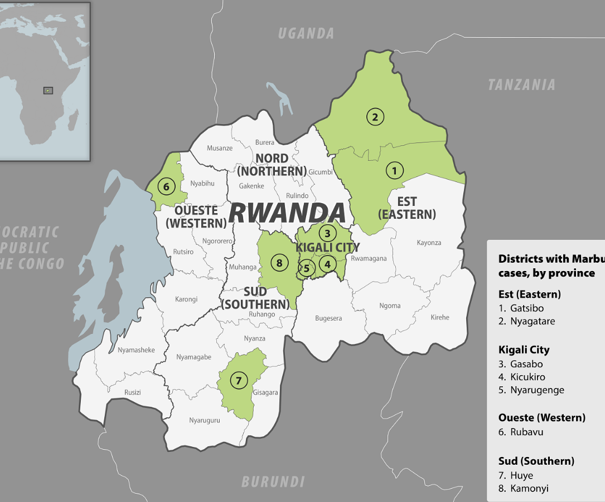
Republic of Rwanda
On September 27, 2024, the Ministry of Health in Rwanda reported cases of Marburg virus disease.
As of Nov. 29, 2024, Rwanda has reported :
  66 cases
  15 deaths
  ~75% of patients have recovered.
  No new cases identified since October 30, 2024.
  Rwanda Ministry of Health has begun the 42-day countdown. If no new cases occur, WHO and Rwandan health authorities could declare the outbreak officially over on December 22, 2024.
There were no reported cases outside of Rwanda, including the United States.
On December 4, 2024, CDC ended the U.S. airports and public health entry screening of travelers to the U.S. who have been in Rwanda.
Available at: https://www.cdc.gov/marburg/situation-summary/index.html, accessed 12/10/2024.
Available at: https://wwwnc.cdc.gov/travel/images/marburg-rwanda.png ; accessed 12/10/2024.
Notes:
As of last week, there have been 28 days without a new Marburg virus disease case reported in Rwanda and 22 days since the last patient was discharged from the hospital.

Slide 18
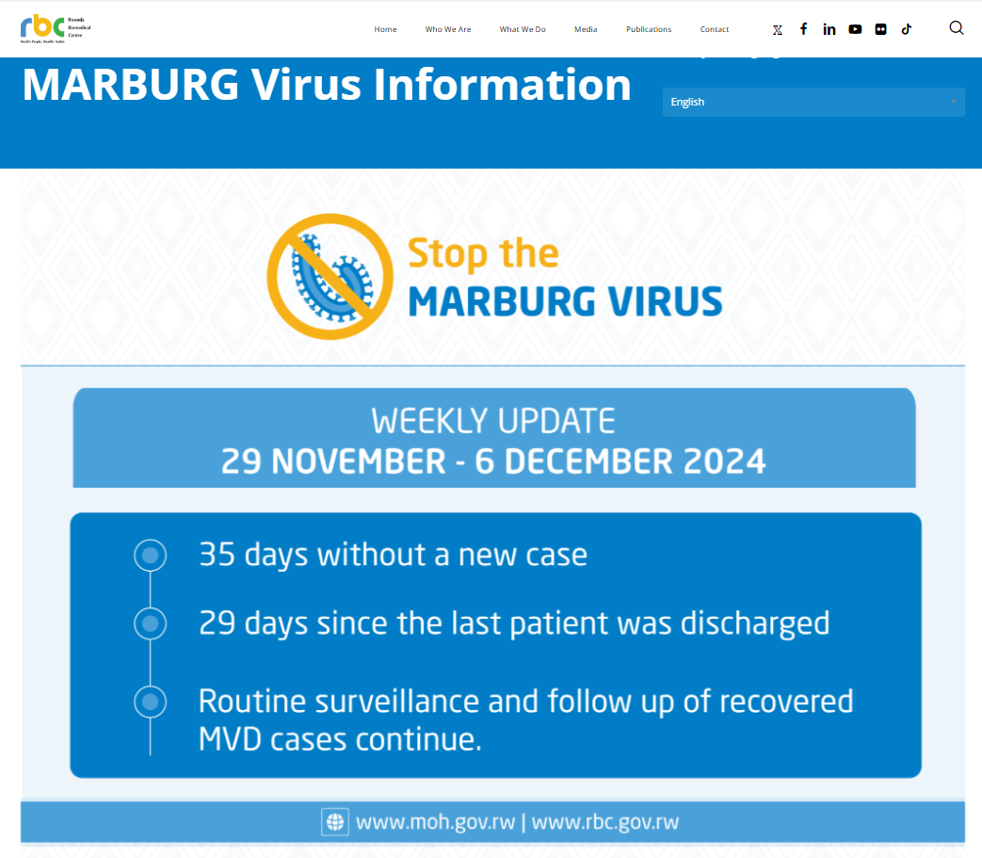
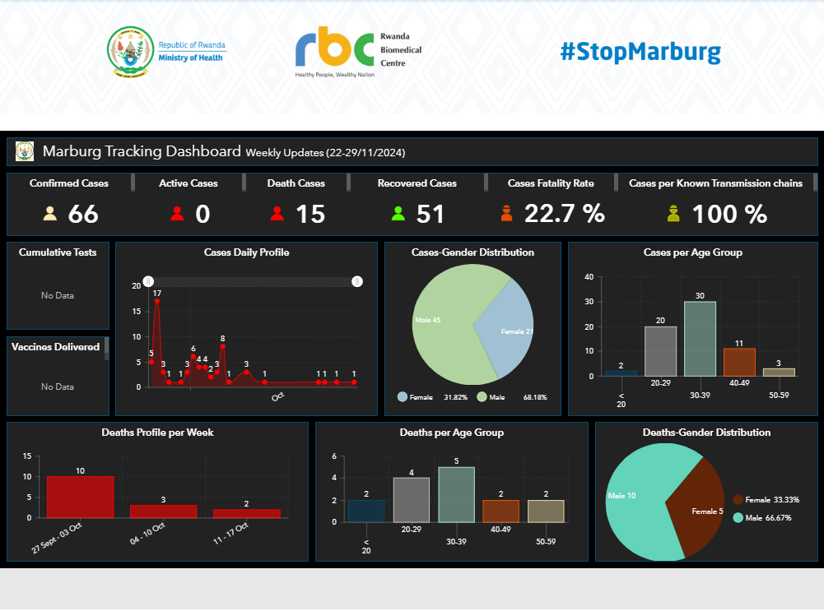
Available at: MARBURG Virus Information - Rwanda Biomedical Centre, accessed 12/10/2024.

Slide 19
Mpox

Slide 20
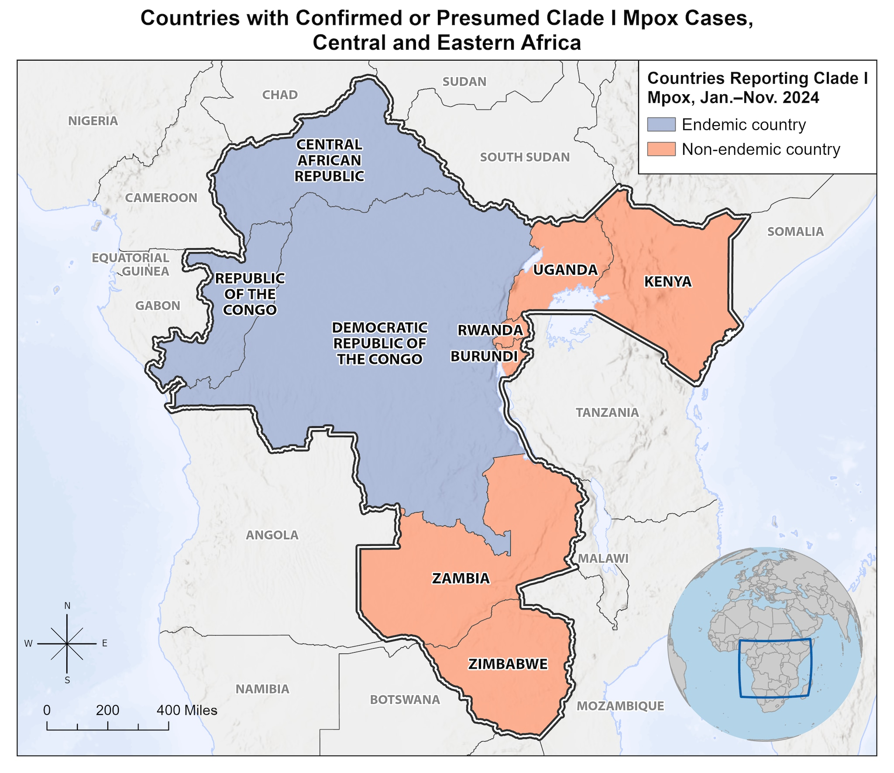
Mpox Situational Update - Global
August 14, 2024, the World Health Organization (WHO) declared the outbreak of clade I mpox in Central and Eastern Africa as a Public Health Emergency of International Concern (PHEIC).
  This is the WHO’s highest level of global alert.
  November 28, 2024, WHO released a report that the outbreak continues to meet the criteria of PHEIC.
Person-to-person transmission has occurred during this outbreak, including through sexual contact, household contacts, and within healthcare settings, when person protective equipment was not available.
Available at Clade I Mpox Outbreak Originating in Central Africa | Mpox | CDC, accessed 12/10/2024
Notes:
The disease has spread to neighboring countries, including Burundi, Central Africa Republic, Republic of Control, Rwanda, and Uganda, that are not known to be endemic for the virus.
On November 29, 2024, the UK Health Security Agency has confirmed 5 cases of clade 1b mpox in the UK.
The first case was reported on 30 October 2024 with 3 further household contact cases confirmed. The latest confirmed case is a new and unrelated case.
Nov 28 note from Saroj-Flagging this as WHO is continuing with this as a PHEIC

Slide 21
Mpox Situational Update - Global
Cases Reported in 2024 After Travel to Areas with Clade I Outbreaks
  Kenya (July 2024)
  Sweden (August 2024
    First clade I mpox case to be reported outside of African Continent
  Thailand (August 2024)
  India (September 2024)
  Germany (October 2024)
  United Kingdom (October 2024)
    Three additional cases from the same household contact
    November 30, 2024 - A new case reported which is unrelated to the case in October.
    A total of 5 cases
  Zambia (October 2024)
  United States (November 2024)
  Canada (November 2024)
Available at Clade I Mpox Outbreak Originating in Central Africa | Mpox | CDC, accessed 12/10/2024

Slide 22
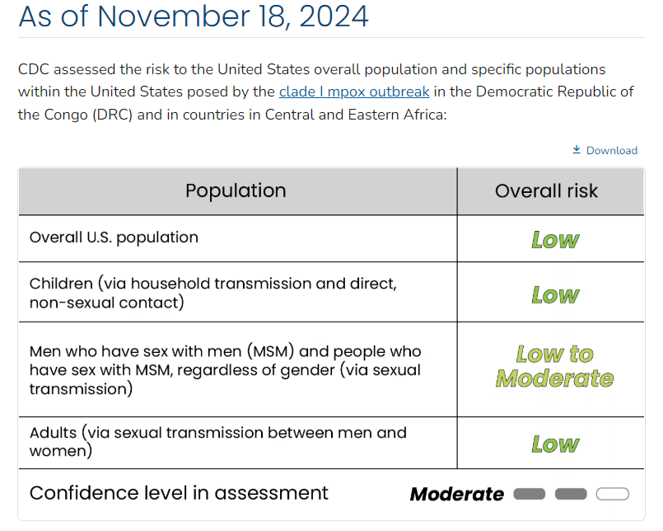
Mpox Situational Update – United States
On November 15, 2024, California Department of Public Health confirmed the first known case of clade I mpox in the United States.
  The patient returned from travel to an affected area and is recovering after seeking medical care.
  No additional cases have been reported at this time.
Clade II mpox is still circulating at low levels in the U.S.
As of November 18, 2024, CDC assessed the risk to the United States overall population and specific populations within the United States posed by the clade I mpox outbreak in DRC and in countries in Central and Eastern Africa:
Available at: Mpox in the United States and Around the World: Current Situation | Mpox | CDC, accessed 12/10/2024
Available at: Risk to United States from clade I mpox outbreak in Central and Eastern Africa | CFA: Qualitative Assessments | CDC, accessed 12/06/2024

Slide 23
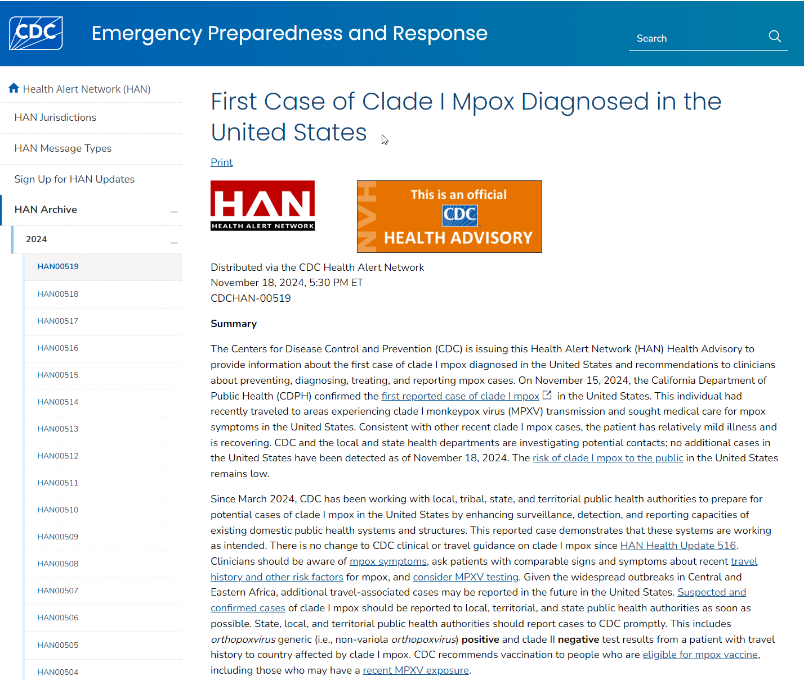
Mpox Situational Update -
United States
On November 18, 2024, CDC issued a Health Advisory | First Case of Clade I Mpox Diagnosed in the United States
On July 19, 2024, DSHS Health Advisory: Health Advisory: Ongoing Transmission of Mpox in Texas and Recommendations for Preparedness | Texas DSHS
Notes:
On November 18, CDC issued a Health Alert advising about the first case of clade I Mpox case diagnosed in the United States.
To provide context, most Mpox cases in Texas were reported in 2022, with 2,970 cases reported. Since then Texas continues to experience ongoing transmission of monkeypox virus clade II. With less then 200 cases reported in 2023 and about 295 cases reported so far this year.
We saw a slight increase in cases this past summer compared to the previous year and released a Health Alert in July to remind providers of the availability of vaccine, recommend continued community outreach efforts and remind Texans to take precautions to protect themselves from the disease.

Slide 24
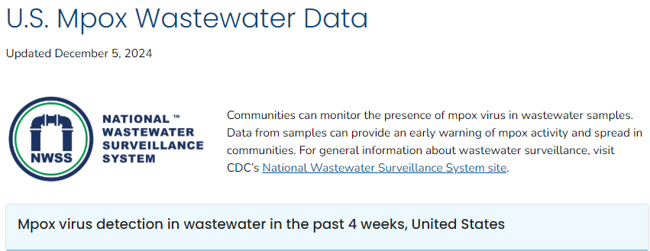



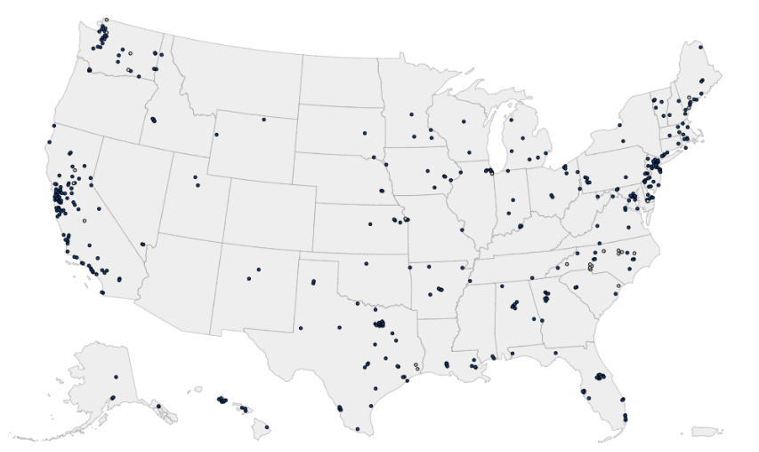



Mpox Wastewater Data – United Sates
Time Period: 11/08/2024 – 12/05/2024
Available at: U.S. Mpox Wastewater Data | National Wastewater Surveillance System | CDC, accessed 12/10/2024.
Detection Categories
Consistent detection: Mpox virus was detected in more than 80% of samples in the past 4 weeks AND the most recent detection was within the past 2 weeks.
Intermittent detection: Mpox virus was detected in 1% to 80% of samples in the past 4 weeks AND the most recent detection was within the past 2 weeks.
No detection: Mpox virus was not detected in any samples from the site in the past 4 weeks OR the most recent detection was more than 2 weeks ago.
No recent data: Too few samples were submitted (fewer than 3) in the past 4 weeks.

Slide 25
Mpox Situational Update – United States
CDC issued level 2 travel notice (Practice Enhanced Precautions) for travel to affected countries in Central and Eastern Africa.
CDC recommends vaccination with two doses of JYNNEOS for people in the United States at risk of mpox.
  The vaccine is FDA approved for and expected to protect against both clades and all subclades of mpox.
  CDC has updated vaccination recommendations for people traveling to countries with clade I outbreaks.
Currently there is no treatment approved specifically for monkeypox virus (MPXV) infections.
  To facilitate access to tecovirimat, CDC holds an expanded access IND (EA-IND) protocol for the treatment of non-variola orthopoxvirus infections, including mpox, in adults and children who meet the eligibility criteria.
    The compassionate use of tecovirimat is for patients with laboratory-confirmed or suspected mpox must meet the eligibility criteria as outlined in the protocol.
Notes:
EA-IND (Expanded Access – Investigational New Drug)
TPOXX eligibility criteria
Severely Immunocompromised
Patients with protracted or life-threatening manifestations of mpox at presentations
- lesions affecting 25% or more of the body surface
- airway compromised or affecting nervous system
- amonth others

Slide 26
Avian Influenza A(H5N1)

Slide 27
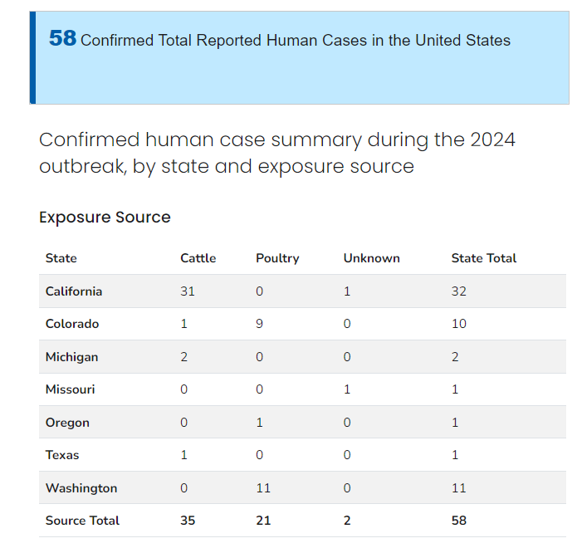
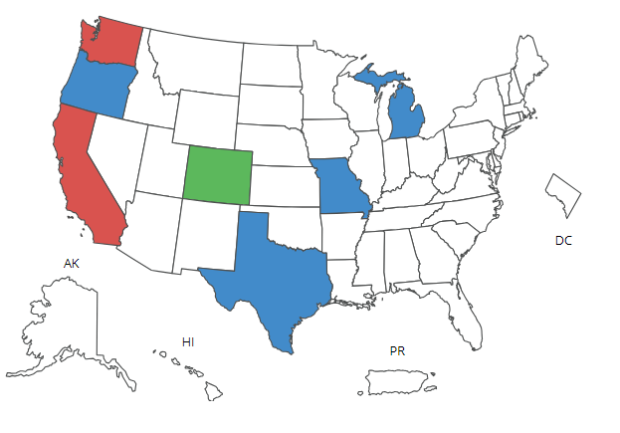
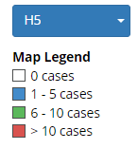
H5N1 (Bird Flu) Human: At-A-Glance
United States
Available at: H5 Bird Flu: Current Situation | Bird Flu | CDC, accessed on: 12/11/24
Available at: Novel Influenza A Virus Infections, accessed on: 12/11/24
Notes:
Additional cases meeting the Council of State and Territorial Epidemiologists (CSTE) probable case definition have been reported by states:
1 case with dairy cow exposure (CA),
3 cases with poultry exposure (WA), and
2 cases with poultry exposure (AZ).
Confirmatory testing at CDC for these cases was negative.

Slide 28
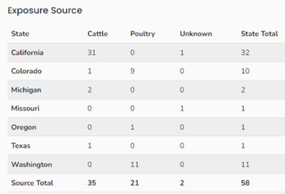

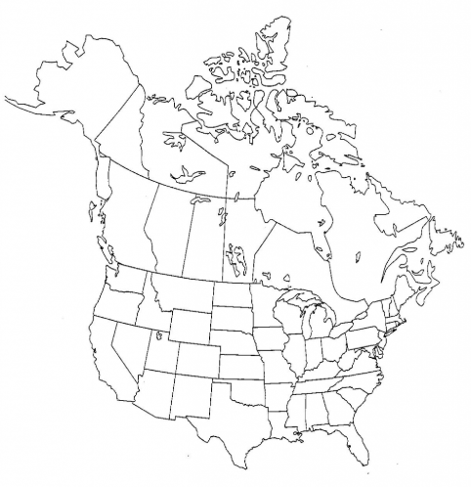



H5 Genetic Sequencing – At-A-Glance
Human Cases
Oregon Swine case: clade 2.3.4.4b (genotype D1.2)
Human Cases with Poultry Exposure:
Some with NA-S247N & PA-138M mutations ( antivirals): clade 2.3.4.4b
BC, Canada teen case (exposure unknow) : HPAI Clade 2.3.4.4b (genotype D1.1)
Human cases with Dairy Cows Exposure: HPAI A(H5N1): clade 2.3.4.4b
California Teen case (exposure unknown): clade 2.3.4.4b
Missouri case (exposure unknown): Clade 2.3.4.4b

Slide 29
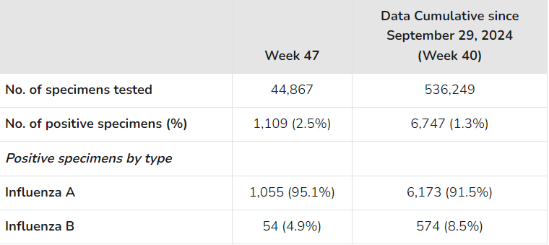
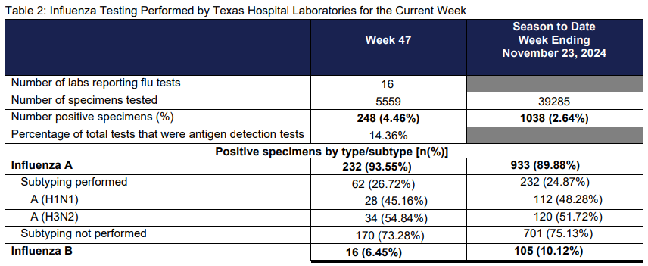
United States
Clinical Laboratories
Texas
Available: Weekly US Influenza Surveillance Report: Key Updates for Week 47, ending November 23, 2024 | FluView | CDC; accessed December 4, 2024
Available: Texas DSHS | Respiratory Virus Surveillance Report | 12.03.24 | Week 47; accessed December 4, 2024

Slide 30
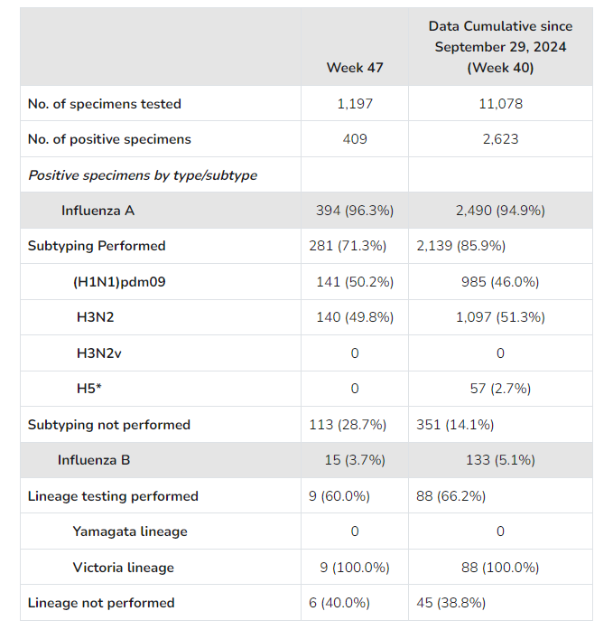
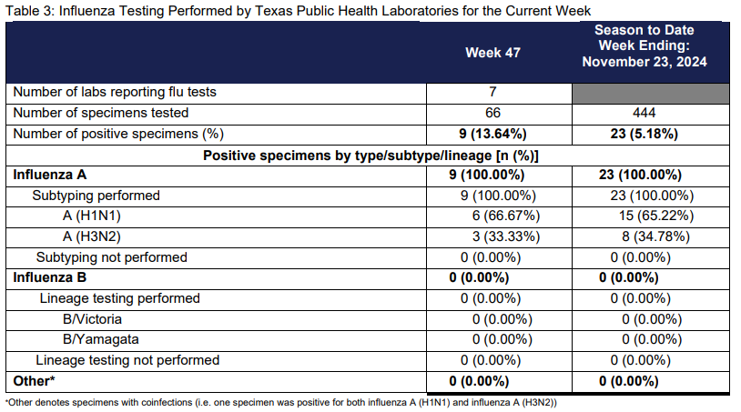
United States
Public Health Laboratories
Texas
Available: Texas DSHS | Respiratory Virus Surveillance Report | 12.03.24 | Week 47; accessed December 4, 2024
Available: Weekly US Influenza Surveillance Report: Key Updates for Week 47, ending November 23, 2024 | FluView | CDC; accessed December 4, 2024

Slide 31
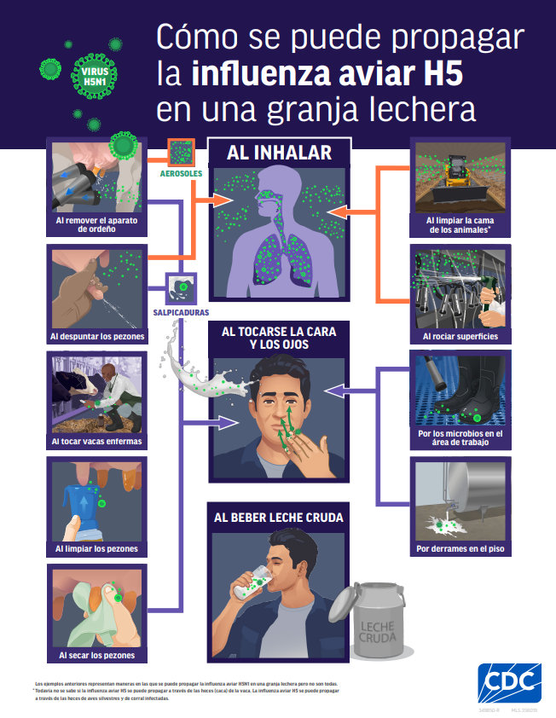
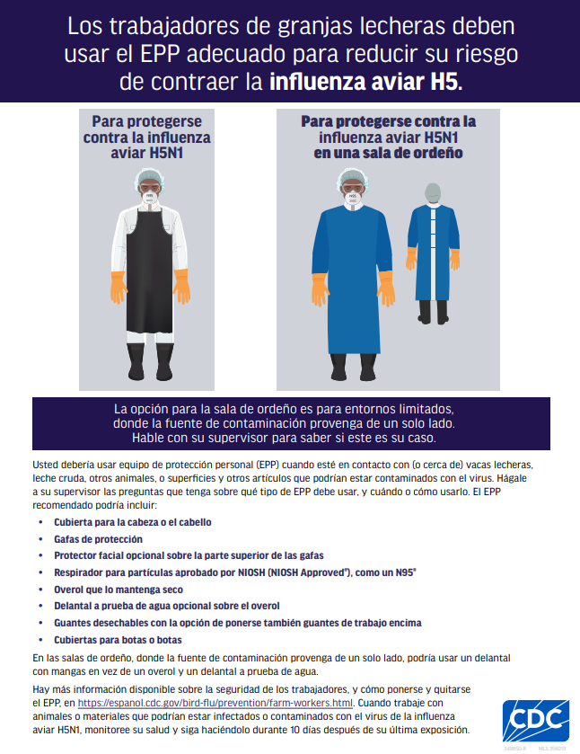
Update: CDC adds new Spanish resources to increase understanding of how H5 bird flu can spread on a dairy farm
Source: Cómo se puede propagar la influenza aviar H5 en una granja lechera, Accessed on: 12/4/24

Slide 32
Enhanced Influenza A & COVID-19 Surveillance

Slide 33
DSHS Enhanced Influenza A(H5N1) & COVID-19 Surveillance
Texas Department of State Health Services (DSHS) is requesting healthcare providers assistance with increasing the submission of influenza A specimens for subtyping as well as submitting “un-subtypeable” specimens to public health laboratories for further identification.
The goal for DSHS is to enhance current influenza surveillance to monitor for any increases in influenza A activity and determine if this increase is due to H5N1 by increasing the submission of respiratory samples to public health laboratories statewide.
Collaborating with health care providers and healthcare systems to increase awareness and encourage participation in this effort is crucial to meet the public health goal.

Slide 34
DSHS Enhanced Influenza A(H5N1) & COVID-19
Co-Surveillance
Overarching question: How can we improve what is currently being tested and subtyped to avoid missing any potential H5N1 cases identified through routine surveillance?
Potential ways in which you can help enhance current surveillance efforts:
  For providers who get influenza A specimens tested but not subtyped-consider getting the specimens subtyped
  Consider sending “un-subtypeable” influenza A specimens to public health laboratories for testing and subtyping
  For healthcare providers who engage in point of care testing-consider partnering with public health to collect an additional specimen for PCR testing at a public health laboratory
For any additional questions, or, if you are interested in participating in this effort, please contact Dr. Carolyn Crisp at Carolyn.Crisp@dshs.texas.gov.

Slide 35
Thank you

