Slide 1
Policy Update on LHD Topics of Interest
Public Health Funding and Policy Committee
December 7, 2022

Slide 2
Overview
Introduction
Texas Medicaid policy
Topics of noted interest by LHDs

Slide 3
Introduction
HHSC looks forward to additional provider participation in the Texas Medicaid program.
HHSC encourages providers and members to voice policy ideas and opportunities for improvement.
HHSC has created a dedicated mailbox for submissions related to local health entities:
LHDinquiry@hhs.texas.gov

Slide 4
Sources governing Texas Medicaid policy
Federal law
Federal regulations
Federal agency policy guidance
Centers for Medicare & Medicaid Services (CMS)
Texas Constitution
Texas statute (laws)
State agency regulations (rulemaking)

Slide 5
Texas Medicaid policy references
Texas Medicaid State Plan www.hhs.texas.gov/services/health/medicaid-chip/about-medicaid-chip/state-plan
Texas Medicaid Waivers www.hhs.texas.gov/regulations/policies-rules/waivers
Covered services and delivery requirements:
Texas Medicaid Provider Procedures Manual (TMPPM) www.tmhp.com/resources/provider-manuals/tmppm
Notes:
Texas’ Medicaid program has:
state-level components,
program-level components, and
service-level components.
Within these, there are population-level components as well.

Slide 6
Texas Medicaid Managed Care policy references
Uniform Managed Care Contract (UMCC)
Program-specific contracts and handbooks
(Ex: STAR Kids, STAR+PLUS, STAR Health, CHIP)
Uniform Managed Care Manual (UMCM)
www.hhs.texas.gov/services/health/medicaid-chip/managed-care-contract-management
Notes:
Contracts are updated yearly.
The policy development process can take months to years.

Slide 7
Topics Raised by LHDs
Professional Liability Insurance
Indemnification Clause
Arbitration and Dispute Resolution
Provision of Services
Primary Care Provider Requirements

Slide 8
Professional Liability Insurance
Resolved
The Uniform Managed Care Contract (UMCC) was updated in September 2022.
Section 17.01(c)(1)(i) Insurance Coverage:
An MCO is prohibited from requiring a Network Provider to obtain the insurance coverage described in Section 17.01 if the Network Provider qualifies as a state governmental unit or municipality under the Texas Tort Claims Act, and is required to comply with, and subject to the provisions of, the Texas Tort Claims Act.

Slide 9
Indemnification Clause
Resolved
The Uniform Managed Care Contract (UMCC) was updated in September 2022.
Section 7.02(a)(19) MCO responsibility for compliance with laws and regulations:
An MCO is prohibited from requiring a Network Provider who is a governmental entity to agree to indemnify the MCO if such indemnification by the governmental entity is prohibited by law.

Slide 10
Arbitration and Dispute Resolution
Not an HHSC requirement for providers
HHSC does not require a managed care organization (MCO) to include arbitration or dispute resolution clauses in its contracts with providers.
The dispute resolution provision in the UMCC applies to the contract between HHSC and MCOs.

Slide 11
Medicaid Covered Services
No change
Texas Medicaid benefits and requirements for coverage will continue as published in the Texas Medicaid Provider Procedures Manual (TMPPM).

Slide 12
Texas Medicaid Provider Procedures Manual (TMPPM)
The TMPPM is the official source for policies on member benefits and services.
The TMPPM is updated monthly.
Volume 1 provides general information applicable to all providers.

Slide 13
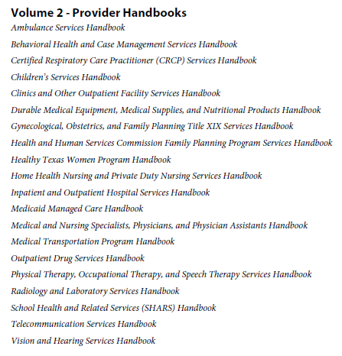
Texas Medicaid Provider Procedures Manual (TMPPM)
Volume 2 covers Medicaid policies, procedures, and claims filing requirements for specific services.
Services are identified by Current Procedural Terminology (CPT) code or Healthcare Common Procedure Coding System (HCPCS) code.
A procedure code may appear in more than one handbook.
Notes:
Coverage may be specific to age, gender, diagnosis,

Slide 14
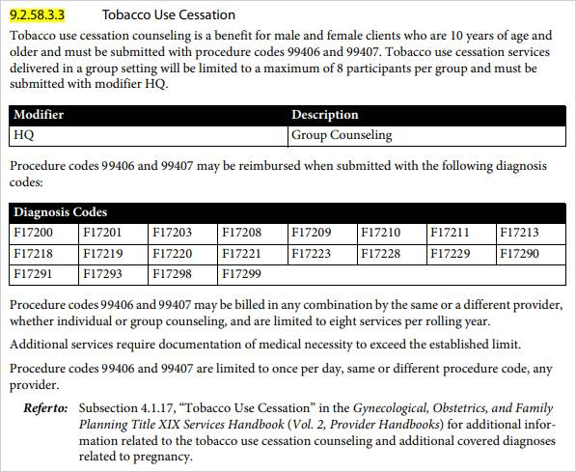
Example: Tobacco Use Cessation
Medical and Nursing Specialists, Physicians, and Physician Assistants Handbook

Slide 15
Managed Care
Primary Care Physician or Provider (PCP)
Specific to managed care contracts
UMCC definition:
Primary Care Physician or Primary Care Provider (PCP) means a physician or provider who has agreed with the MCO to provide a Medical Home to Members and who is responsible for providing initial and primary care to Members, maintaining the continuity of Member care, and initiating referral for care.

Slide 16
Managed Care
Primary Care Physician or Provider (PCP)
Citations:
UMCC Section 8.1.4 Provider Network
UMCC Section 8.1.4.2 Primary Care Providers

Slide 17
Mailbox for policy questions and proposals
LHDinquiry@hhs.texas.gov

Slide 18
Texas Medicaid Resources
Texas Medicaid Reference Guide
www.hhs.texas.gov/services/health/medicaid-chip/about-medicaid-chip/reference-guide
Provider enrollment
www.tmhp.com/topics/provider-enrollment
www.hhs.texas.gov/services/health/medicaid-chip/provider-information/texas-medicaid-chip-claims-enrollment
Managed care service areas
www.hhs.texas.gov/sites/default/files/documents/services/health/medicaid-chip/programs/managed-care-service-areas-map.pdf

Slide 19
Texas Medicaid benefit requests
HHS uses the Topic Nomination Process for requests for Texas Medicaid coverage of a service, technology, or benefit.
Any member of the public can submit a request.
Instructions are available on the Texas Medicaid Medical & Dental Policies website: www.hhs.texas.gov/services/health/medicaid-chip/about-medicaid-chip/medicaid-medical-dental-policies

Slide 20
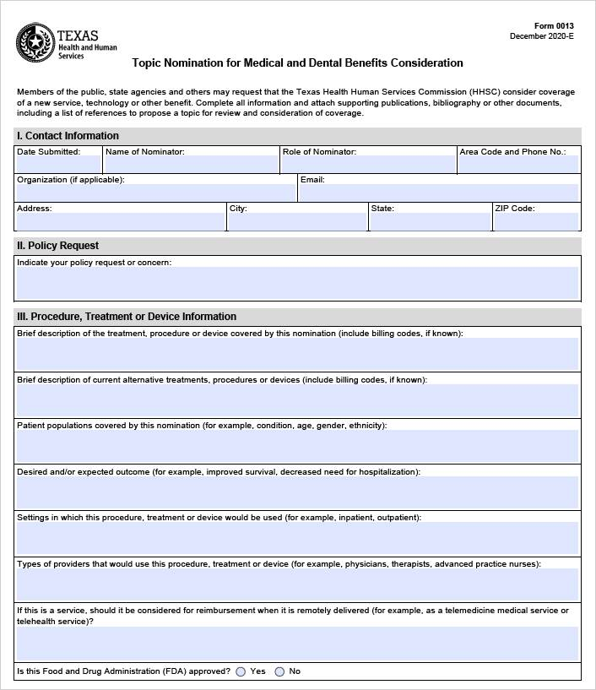

Slide 21
