Slide 1
Public Health Data Sharing in Texas​
Texas Department of State Health Services
August 7, 2025

Slide 2
Immunizations Data Sharing

Slide 3
Immunizations Data Sharing
As of January 31, 2025, data sharing has been live for contracted local health departments. The following local health departments have approved users as of August 7, 2025:
Snowflake Local Health Departments:
Angelina County and Cities Health Department
Austin Public Health
Cherokee County Public Health
City of Houston Health Department
Lubbock Public Health
San Antonio Metropolitan Health District
Comal County Public Health
Corsicana-Navarro County Public Health District
Dallas County Human and Health Services
Galveston County Health District
Gregg County Health Department
Harris County Public Health
Hidalgo County Health Department
Marshall Harris County Health District
Northeast Texas Public Health District
South Plains Public Health District
Tarrant County Public Health
Medina County Health Unit
Williamson County and Cities Health District
Users: 25

Slide 4
Immunizations Data Sharing
Tableau Local Health Departments:
Andrews County Health Department
Angelina County and Cities Health Department
Austin Public Health
Cherokee County Public Health
City of Houston Health Department
San Antonio Metropolitan Health District
Collin County Health Care Services
Comal County Public Health
Dallas County Health and Human Services
Gregg County Health Department
Hidalgo County Health Department
Marshall Harrison County Health District
Northeast Texas Public Health District
Tarrant County Public Health
Medina County Health Unit
Williamson County and Cities Health District
Users: 28

Slide 5
Immunizations Data Sharing
As of August 7, 2025, there are no users pending approval by DSHS Central Office staff.
DSHS Central Office staff continues to support local health departments with any challenges requesting access or issues with IAMOnline.

Slide 6
Immunizations Data Sharing Updates
On July 14, 2025, an expanded public health dataset became available for download through GlobalScape for contracted local health departments for their jurisdiction.
  This dataset will be updated monthly on the second Monday of the month.
A communication was sent to all local health department immunization managers and public health data sharing immunization partner admins on July 22, 2025.
Aggregate and line-level data for your jurisdiction will still be shared through Snowflake and Tableau dashboards on a monthly cadence.
The expanded dataset will transition to the State Health Analytics and Reporting Platform (SHARP) in the future.

Slide 7
Immunizations Data Sharing Updates
Accessing the data through GlobalScape needs to be completed in IAMOnline.
  Once signed in, select ‘Manage My Access/Manage User Access’ tile
  Once here, select the three lines in the top left corner of the screen

Slide 8
Immunizations Data Sharing Updates
This will pull out a tab where users will choose ‘Application Access’.
  From here, select ‘EFT Access Request form’

Slide 9
Immunizations Data Sharing Updates
Users will fill out the access request form and then submit it for the following three levels of approval.
When filling out the form:
  Choose to make a request on behalf of someone or for yourself.
  On the drop-down for ‘Add New GlobalScape Group’, select “/Usr/ImmTrac2_Data/”
  For the folder name, please select your local health department name
Once all required fields are completed, select the submit button

Slide 10
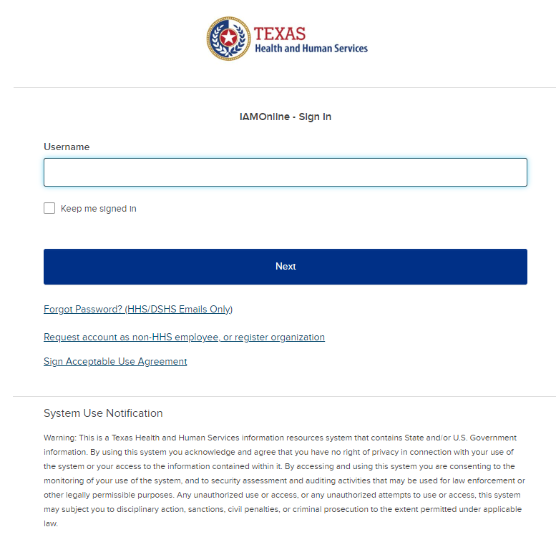
Requesting Access to Snowflake/Tableau Roles - External Staff without IAMOnline Accounts
To access Snowflake/Tableau, you will need to use IAMOnline, the main platform for accessing HHS applications.
Access the IAMOnline sign-in page and click the “Request account as a non-HHS employee or register organization”. Follow the steps to preregister and complete the “Partner User Registration Form”.
Once your account is approved, an email will be sent with a link to activate your account.
After your IAMOnline account is activated, refer to the steps on the next slide (Requesting Access to Snowflakes Roles – External Staff with existing IAMOnline Accounts) to request Snowflake/Tableau data view access.
Need help? If you are having trouble logging into or using IAMOnline, please call the Consolidated Help Desk at 855-435-7181 (7 a.m.-7 p.m. CST, Monday through Friday). Select option 1 for the consolidated help desk and then follow the remaining prompts. Inform the support staff of the issue you are having with IAMOnline and they will assist with resolving the issue or providing a ticket to the appropriate team.

Slide 11
Requesting Access to Snowflake Roles – External Staff with existing IAMOnline Accounts
To access Snowflake, you will need to use IAMOnline, the main platform for accessing HHS applications.
Access the IAMOnline sign-in page and use your DSHS or employee email to sign in.
  First-time users: You will be prompted to sign the Acceptable Use Agreement before you can proceed
Click "Manage My Access". Click “Next”.
Type “Snowflake” in the search bar, click the magnifying glass icon, and then select the role for data for your LHE.
Click “Next” to provide a business justification for your data access needs.
Review and understand the data use stipulations for the dataset.
Submit the request.
Please refer to the Access to Snowflake through IAMOnline – External User guide on detailed access request steps.
Need help? If you are having trouble logging into or using IAMOnline, please call the Consolidated Help Desk at 855-435-7181 (7 a.m.-7 p.m. CST, Monday through Friday). Select option 1 for the consolidated help desk and then follow the remaining prompts. Inform the support staff of the issue you are having with IAMOnline and they will assist with resolving the issue or providing a ticket to the appropriate team.

Slide 12
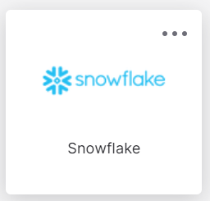
Viewing Snowflake Data Views
Once you have been approved to access data views in Snowflake, follow the steps below to access the Snowflake views through IAMOnline.
Log into IAMOnline.
Click on the Snowflake tile.
From the Snowflake home page, click on your account name to configure your role to the dataset that you want to access.
Open a workbook to begin running queries on your data set.

Slide 13
Requesting Access to Tableau Roles – External Staff with existing IAMOnline Accounts
To access Tableau, you will need to use IAMOnline, the main platform for accessing HHS applications.
Access the IAMOnline sign-in page and use your employee email to sign in.
  First-time logging in? You will be prompted to sign the Acceptable Use Agreement before you can proceed
Click the "Access Request" tile.
Click the three dots in the top left corner to open a dropdown menu, select "Manage Identity", then click the link titled "Tableau SHARP Data Sharing Site Access Request".
Fill out the Tableau Access Request form, by selecting the dashboard(s) that you would like to request access for and providing the business justification.
Review and understand the data use stipulations for the dataset.
Submit the request.
Please refer to the Access to Tableau through IAMOnline – External Staff user guide on detailed access request steps.
Need help? If you are having trouble logging into or using IAMOnline, please call the Consolidated Help Desk at 855-435-7181 (7 a.m.-7 p.m. CST, Monday through Friday). Select option 1 for the consolidated help desk and then follow the remaining prompts. Inform the support staff of the issue you are having with IAMOnline and they will assist with resolving the issue or providing a ticket to the appropriate team.
Notes:
Now, that everyone has an IAMOnline Account, please log in and click the "Access Request" tile. Then click the three dots in the top left corner to open a dropdown menu, select "Manage Identity", then click the link titled "Tableau SHARP Data Sharing Site Access Request". You’ll see the Tableau Access Request form, fill it out and select the dashboard(s) that you would like to request access for and providing the business justification. After you review and understand the data use stipulations for the dataset, you can submit the request. There is an approval process that takes time but for the sake of the training, I’d still like to show you all how to access the dashboard.

Slide 14
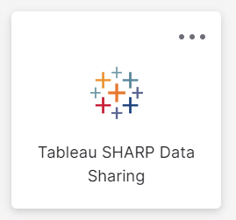
Viewing Tableau Dashboards
Once you have been approved to access dashboards in Tableau, follow the steps below to access the Tableau dashboards through IAMOnline.
Log into IAMOnline.
Click on the Tableau tile.
From the Tableau home page, click the dashboard you want to access.
The dashboard will open.
Notes:
Once you’ve been approved

Slide 15
Thank you

