Slide 1
PHFPC Updates​
Office of Public Health Data Strategy & Modernization
Texas Department of State Health Services
June 11, 2025

Slide 2
Public Health Data Sharing in Texas

Slide 3
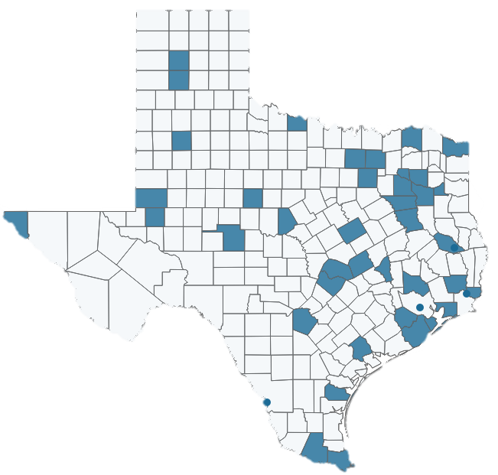
Vital Event Data As of 6/9/25
40
Target LHEs
Covered Area
Rollouts
Texas covered area based on the LHEs with signed agreements
Pilot
May 2022-July 2022
Frozen death data
Phase 1 – LHEs with Existing Agreements
December 2022
Frozen birth, death, fetal death, and birth infant death data
Phase 2 – LHEs with Existing Agreements
November 2023
Provisional birth and death data
Expansion – Additional LHEs with New Agreements
November 2024 – Ongoing (as additional agreements are signed)
Frozen and provisional birth, death, fetal death, and birth infant death data
35
Signed Agreements
36 (14)
Snowflake LHE Users (LHEs)
17 (9)
Tableau LHE Users (LHEs)
Shared Data Includes:
Line-level data through Snowflake views
Aggregate data through Tableau dashboards
20
LHEs with No Users

Slide 4
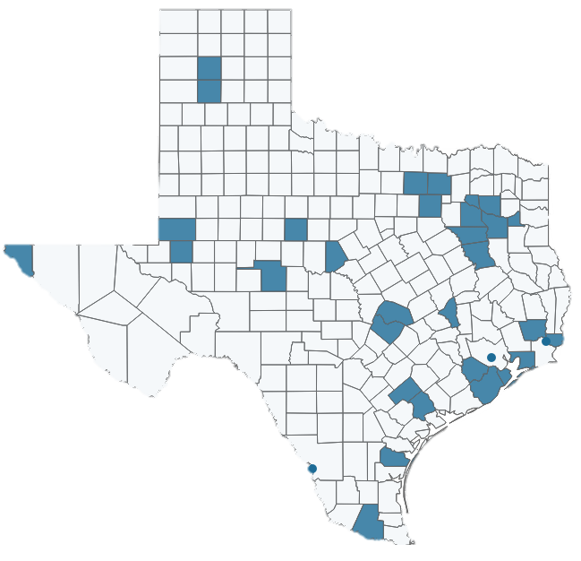
Hospital Discharge Data As of 6/9/25
39
Target LHEs
Covered Area
Rollouts
Texas covered area based on the LHEs with signed agreements
Phase 1 – LHEs Previously Requesting Data
October 2023
Expansion – Additional LHEs with New Agreements
November 2024 – Ongoing (as additional agreements are signed)
Emergency department, inpatient, and outpatient data
Emergency department, inpatient, and outpatient data
33
Signed Agreements
15 (11)
Snowflake LHE Users (LHEs)
22
LHEs with No Users
Shared Data Includes:
Statewide data
Line-level data through Snowflake views
Aggregate data through Tableau dashboards published on Texas Health Data

Slide 5
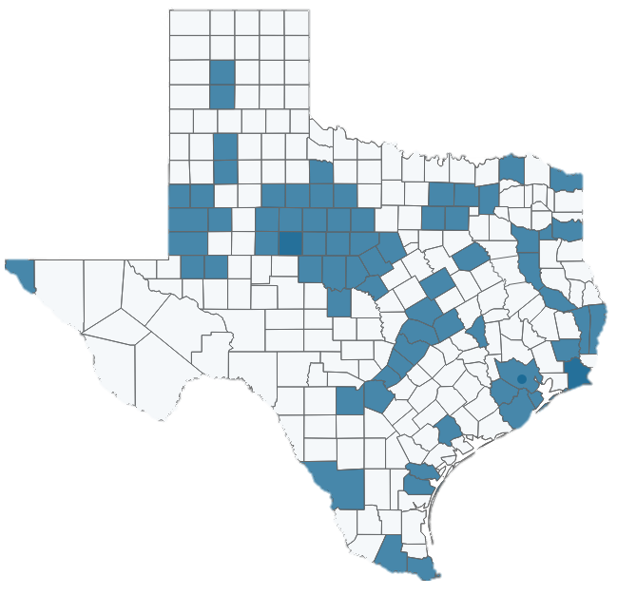
Immunizations Data As of 6/9/25
50
Target LHEs
Covered Area
Rollouts
Texas covered area based on the LHEs with signed agreements
Contract LHEs
January 2025
Non-disaster, consent only data
50
Signed Agreements
20 (16)
Snowflake LHE Users (LHEs)
21 (15)
Tableau LHE Users (LHEs)
Shared Data Includes:
Data based on LHEs contract service area
Line-level data through Snowflake views, limited to 2 users per LHE
Aggregate data through Tableau dashboards, limited to 5 users per LHE
31
LHEs with No Users

Slide 6
NEDSS Provisional Data As of 6/9/25
57
Target LHEs
Covered Area
Rollouts
Texas covered area based on the LHEs with signed agreements
Tableau Dashboard
December 2024
Snowflake Views
February 2025
Disease surveillance dashboards
Basic case investigation data, includes all conditions in NEDSS except COVID
35
Signed Agreements
59 (33)
Snowflake LHE Users (LHEs)
888 (57)
Tableau LHE Users (LHEs)
Shared Data Includes:
Data based on LHEs service area
Line-level data through Snowflake views, limited to 2 users per LHE
Aggregate data through Tableau dashboards
0
LHE with No Users

Slide 7
Data Sharing Through SHARP Training May 2025 Training Series
Introduction to Data Sharing, Tableau, and Snowflake Webinar 1
May 13, 2025 - 82 total attendees
22 LHE staff from 11 LHEs
60 DSHS staff
Snowflake Webinar 2
May 20, 2025 - 63 total attendees
19 LHE staff from 10 LHEs
44 DSHS staff
Snowflake Webinar 3
May 22, 2025 - 51 total attendees
15 LHE staff from 9 LHEs
36 DSHS staff
Conducted outreach in May to LHEs authorized to access data but have no users, and for users that have access to Snowflake but not Tableau. Outreach included invitation to register and attend training.

Slide 8
Data Sharing Through SHARP Training HHS Learning Portal Training
Data Sharing with SHARP Overview
October 2024 through May 2025 – 45 total participants
35 LHE staff from 20 LHEs
10 DSHS staff
Accessing Data through Tableau
November 2024 through May 2025 – 19 total participants
14 LHE staff from 9 LHEs
5 DSHS staff
Accessing Data through Snowflake
November 2024 through May 2025 – 17 total participants
13 LHE staff from 9 LHEs
4 DSHS staff
Using SQL to Analyze Data in Snowflake
October 2024 through May 2025 – 20 total participants
15 LHE staff from 9 LHEs
5 DSHS staff

Slide 9
Data Sharing Through SHARP Feedback
Survey to gather information on:
Comfort level using Snowflake and/or Tableau
Additional training or support needs
How shared data is being used
The next feedback survey will be sent in June

Slide 10
SHARP IT Projects Update and Funding Impacts

Slide 11
Canceled or Paused SHARP Projects
LHD Assessment - canceled
Some survey responses collected for analysis
LHEs are encouraged to share additional feedback and data sharing needs through datasharingsupport@dshs.texas.gov.
SHARP Portal - canceled
Create a centralized storefront for data access
Simplify process to request, approve, and deliver data
Analytical Tools – canceled
Provide analytical tools (Tableau, SAS Viya, ArcGIS) to approved LHEs
THISIS to NEDSS Migration (STHARRS) – canceled
Migrate users from THISIS to NEDSS
TB migrated, HIV/STD to remain on THISIS for now
NEDSS Enhancements (NIFI Phase IV) – paused
Enhance workflow decision support
Upgrade UI
ETL upgrade and extension of data marts
Interoperability improvements

Slide 12
Thank you
Contact Us:
datasharingsupport@dshs.texas.gov

