Slide 1
PHFPC Meeting
February 11, 2026

Slide 2
Agenda
Interoperability Updates
Added Enhancements to NEDSS
CSV bulk upload function via NEDSS UI
New functionality added to NEDSS to help with case uploads
THISIS Updates
Upcoming NEDSS Enhancements
NEDSS UI redesign
Legacy pages converted to pagebuilders
ETL enhancements
Condition page conversions
Other new functionality
PHDCs and RPA updates

Slide 3
Interoperability Updates

Slide 4
NEDSS Interoperability Updates
New functionality that will allow cases to be uploaded via CSV through the NEDSS UI was added last month.
We estimate by summer that LHDs will be able to use this functionality to import cases.
All conditions will be available to use by the end of the summer.
PHDCs will still be available for now
RPA (Robotic Processing Automation) will soon be available and best uses for it will be communicated soon.

Slide 5
THISIS Interoperability Updates
Currently, THISIS is in the middle of core updates to the system. Any enhancements will occur after this work is completed.

Slide 6
Completed NEDSS Enhancements

Slide 7
NEW Bulk New Case Upload and Update Function via NEDSS UI
Bulk upload of cases by condition is available in NEDSS via the NEDSS User interface (UI).
All pages will be converted to page builder format by the summer.
Templates, data dictionaries and guidelines will be completed over the next several months
Demos will be scheduled soon for those from the LHDs that will be getting this permission to upload.
No globalscape folders are necessary since this will all be done via the NEDSS UI
Notes:
New functionality to improve the interoperability in NEDSS between other local health departments is the bulk upload of new case and updates via the UI. This is brand new functionality that allows users with permission to create templates and upload new cases or updates existing cases. PHID is in the process of working on an implementation guide for locals that will have all of the templates and data dictionaries available to be sure there is standardization among all conditions and jurisdictions. A demo will be scheduled and guidance sent out soon once all templates have been confirmed.

Slide 8
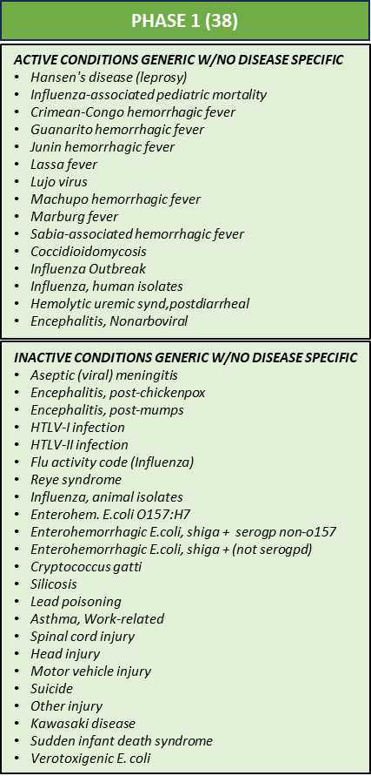
New Pages Added in NEDSS
Phase 1 lift and shift (part of NIFI) was added back in February 2025. These are the first batch of conditions moved from legacy to a generic page builder.
Measles, Avian Influenza and Melioidosis disease specific pages were all added over the last several months.
Cronobacter, Cyclosporosis and STEC disease specific pages will be added in the next month.
Notes:
Phase 1 out of 3 was deployed last February 2025 that included this list of conditions. Many included in that first phase were inactive conditions, but we still had to move them over to the new format and out of legacy formats before upgrading the UI. Measles, Avian Influenza and Melioidosis disease specific pages were all added over the last several months. Cronobacter, Cyclosporosis and STEC disease specific pages will be added in the next month to NEDSS.

Slide 9
Upcoming NEDSS Enhancements

Slide 10
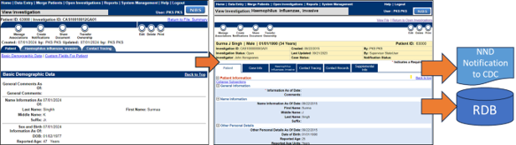
Lift & Shift of Pages (Part of UI Re-Design)
Bulk converting ALL the legacy investigation pages to new page builder format so that they can be ‘reskinned’ with the other Page Builder investigations.
Move all existing questions and value sets (as-is) in bulk to Page Builder. This means:​
No alignment with draft/final CDC MMGs​
No changing page order​
No [planned] question standardization​
No adding/changing questions
*Customizations of these pages will be prioritized after the conversion is done.
Notes:
We are continuing the page conversion and have 2 more phases to get through over the next few months. ALL pages need to be moved to the new page builder formats (as you can see here), so they can all be reskinned with the investigation pages. These are all moving to just a generic page just to get them out of that legacy format. Any customizations of the pages will be planned after the conversion is completed.

Slide 11
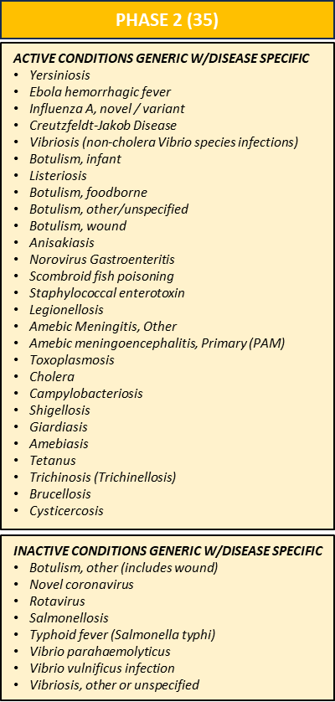
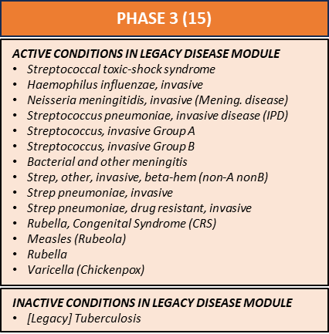
Legacy Conditions/pages to Page Builder
Phase 1 was added to production on February 2025!
Custom Disease Specific Pages added by March 2026:
Cyclosporiasis
STEC
Phase 2 will be deployed this month!
Notes:
In order to upload cases in the new bulk upload functionality and complete the redesign, the pages need to be in the new page builder formats. They also have to all be in this format by May 2026 so the first phases of the UI redesign can be deployed. The phase 1 in green was added last February 2025 before the project pause. Phase 2 in yellow will be added this month and includes all of the foodborne and waterborne conditions. This month the custom disease specific pages will be added, as well. That included Cyclosporiasis and STEC. Phase 3 will then be added end of April that includes many of the respiratory diseases.

Slide 12
NEDSS UI Reskin: Roadmap
10/1/2024-03/25/2025
11/20/2025-8/31/2026
9/1/2026-8/31/2027
Project Start - COMPLETE
Discovery and Requirements Phase
Created UI Templates and Style Guide
Project Planning Phase
Updated Project Plan
Proof of Concept Phase
Presentation Layer Architecture
Legacy NEDSS & Modern UI Coexisting
Phase 1 Development
Reskinning End-User Facing Screens
2025 Part 1 - End-User Screens
Core Pages (Dashboard, Login, Error)
Patient Screens
Investigation (including Page Builder)
Lab Report
Queues
Vaccination & Treatment
Provider, Organization & Place
Bulk Processing Functionality
Outbreak, Contact & Interview
Reports
2026 Part 2 - Sys Mgt Screens
Patient Merge
Workflow Decision Support
Epi-Link Management
Case and Lab Management
Messaging Management
Page Management
Security Management
Report Management
Summary/Aggregate Reports
Morbidity Report & STD/STI Screens
Notes:
The NEDSS UI redesign is the largest epic of the NIFI project. This was started months prior to the pause back in March 2025. There are two main parts left with the first deployment scheduled in the summer. That will include all new designs on end user screens that are listed in the middle card. Part 2 will follow that will focus on more of the admin pages that most users don’t see and that will be completed by next summer 2027.

Slide 13
Resolve and/or Improve Many Items
Upgrade the NEDSS architecture with more modern technologies
Reskin NEDSS User Interface (UI) to a more modern look and feel
Adhere to compliance and accessibility guidelines
Better handle special characters entered in the UI
Allow users to use the back button when using the NEDSS UI
Allow users to open multiple tabs in the same browser while entering data into NEDSS under the same user login.
Notes:
The UI redesign will include 1) Upgrade the NEDSS architecture with more modern technologies, 2) reskin NEDSS User Interface to a more modern look and feel, 3) Adhere to compliance and accessibility guidelines, 4) better handle special characters entered in the UI, 5) Allow users to use the back button when using NEDSS UI and 6) Allow users to open multiple tabs in the same browser while entering data into NEDSS under the same user login.

Slide 14
New NEDSS Designs

Slide 15
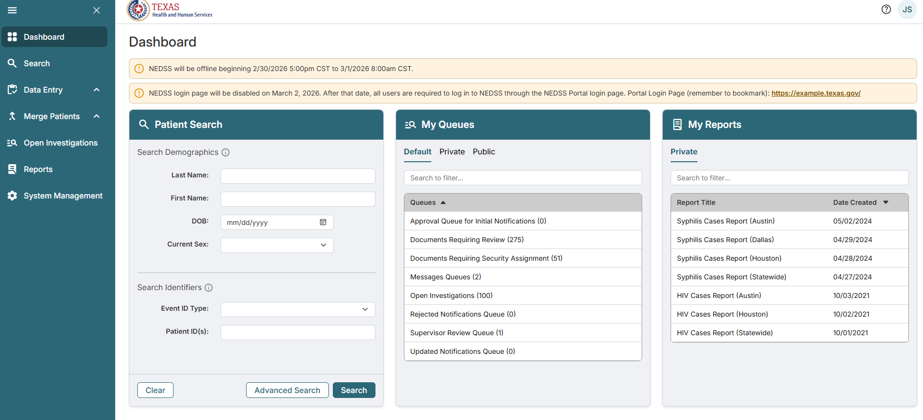
NEDSS Home Page Design

Slide 16
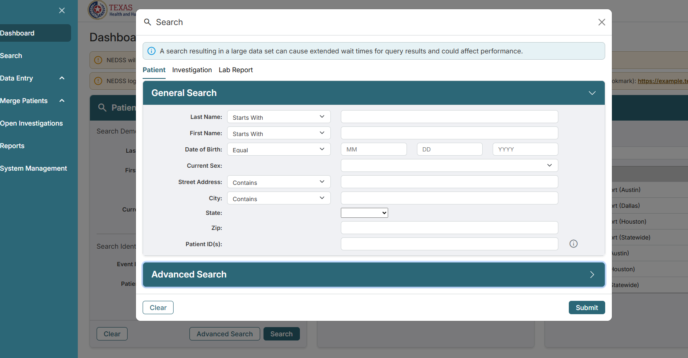
Search Floating Window

Slide 17
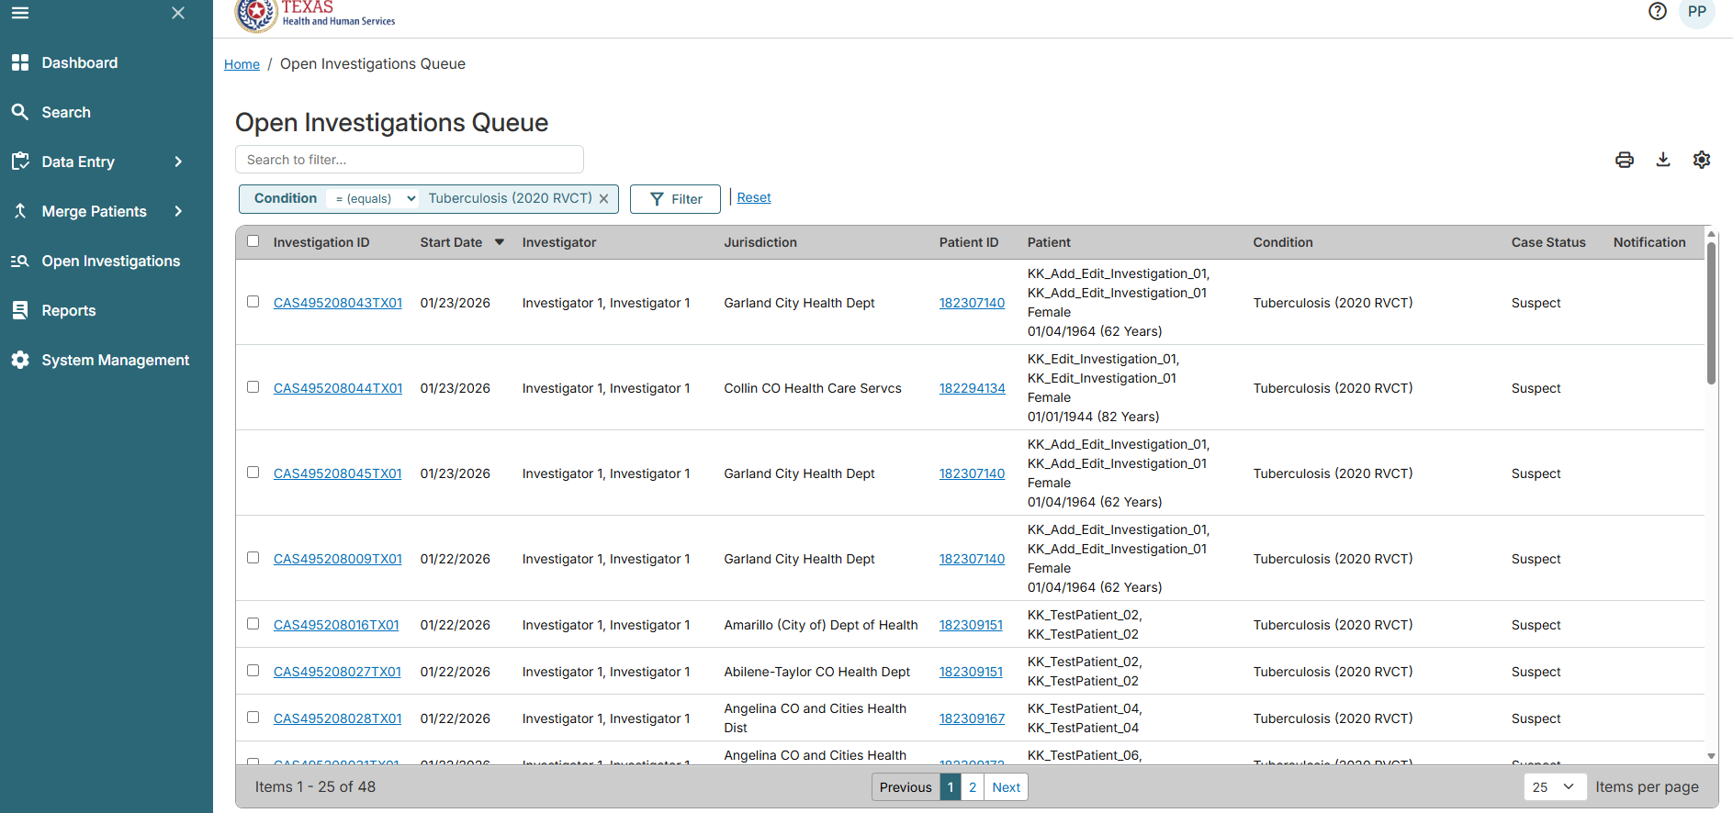
Open Investigation Queue Page

Slide 18
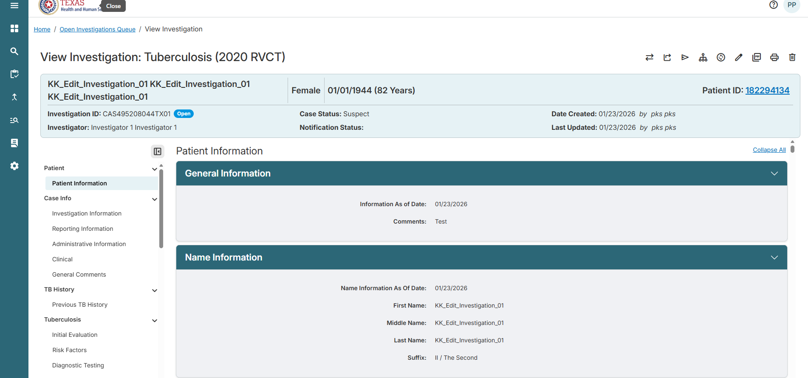
Investigation Page

Slide 19
Other Enhancement Items
NEDSS Database cleanup activities
Upgrading eICR version and mappings
Developing more efficient mapping tables via the UI in NEDSS
Enhancing the performance of queues
Improving the patient matching logic in NEDSS
Notes:
There are other enhancements that are being worked on in this project that include cleaning up data in NEDSS database, Upgrading the eICR version and mappings to 3.1, developing more efficient mapping tables within the UI, enhancing the performance of the NEDSS queues, and improving the patient matching logic in NEDSS

