Slide 1
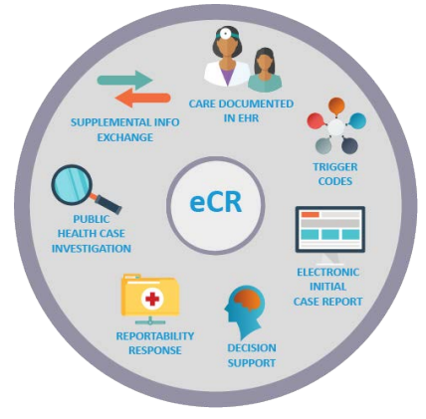
eCR (Electronic Case Reporting)
The automated generation and transmission of electronic case reports (eCR) from electronic health record (EHR) systems to public health agencies for review and further action
Meant to replace the initial report (e.g. Epi-1 manual form) from a provider to public health
Provides a single interface for health care organizations to provide electronic Initial Case Reports (eICRs) in support of over 200 conditions
Health Level 7 (HL7) consensus-based standards

Slide 2
eCR Updates
Texas DSHS started onboarding healthcare organizations (HCOs) for transmission of electronic case reports (eCRs) in 2022.
Conditions reported by eCR to Texas DSHS (129 active conditions in eCR production)
HCOs onboarded for reporting eCRs continue to be required to parallel report.
69 conditions in Texas National Electronic Disease Surveillance System (NEDSS)
70 conditions in State Health Analytics Reporting Platform (SHARP)
Notes:
~139 active RCKMS conditions
~79 conditions active in NEDSS
1,400 to 1,500 facilities onboarded with DSHS
eICR content and format is standardized and universal - it is not tailored for any specific condition being reported.
The report content has bee predetermined at the federal/national-level and requirements are established in the federal registrar.
Data found
An agencywide workgroup is currently being established to develop consensus on criteria, policy, legislation, potential barriers, and solutions essential for release of these HCOs from parallel reporting.

Slide 3
Reportable Conditions Knowledge Management System (RCKMS) Content Release 15
New updates just released last week
Updated specs available for 50 existing conditions
Total of 262 conditions now available in RCKMS (94 nationally notifiable and 168 non-notifiable conditions)
2 new conditions added:
COVID-19 Associated Pediatric Mortality
Soil-transmitted Helminths
Total of 129 conditions in TX production
69 conditions in NEDSS
60 conditions in SHARP

Slide 4
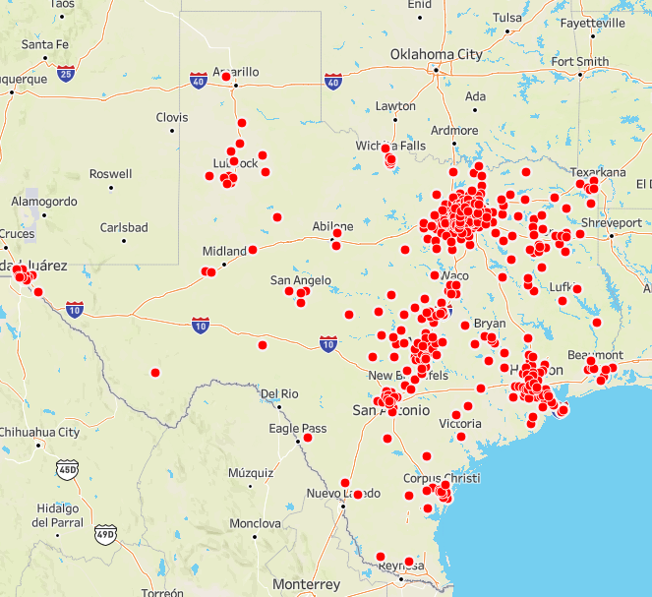
Health Care Facilities in eCR Production
Over 1600 facilities in production
Continuing to expand eCR across Texas

