Slide 1
Emerging and Infectious Disease Update
Varun Shetty, MD, MBA, MS
Chief State Epidemiologist
Texas Department of State Health Services
June 10, 2026

Slide 2
Discussion Topics
Ebola Bundibugyo Virus Outbreak
New World Screwworm

Slide 3
DISCLAIMER
The information presented today is based current preliminary data and on CDC’s recent guidance. Information is subject to change.
June 9, 2026

Slide 4
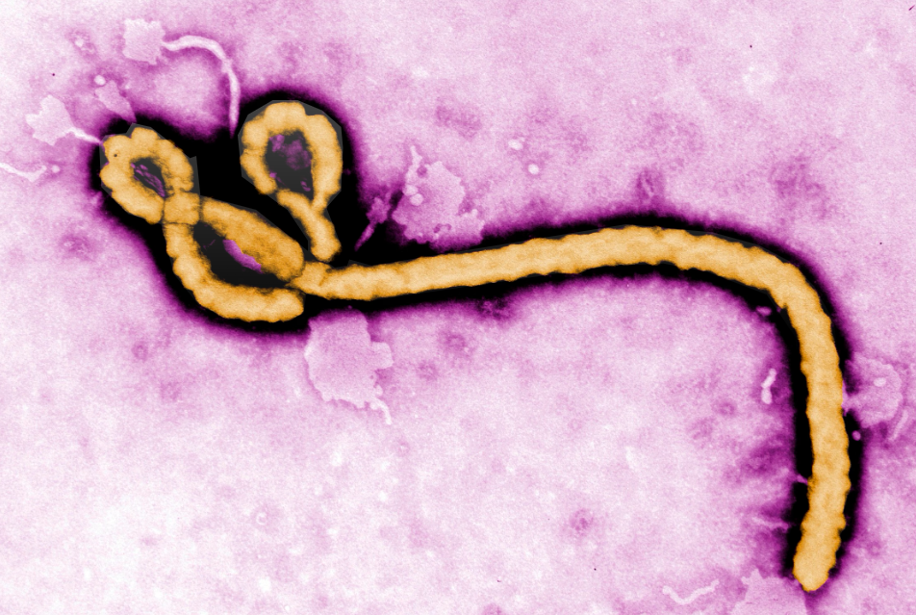
Ebola Bundibugyo Virus Outbreak

Slide 5
Ebola Disease
Ebola disease: Umbrella term to describe clinical disease due to infection with any of the 4 viruses within the genus Orthoebolavirus that cause disease in humans:
  Ebola virus (species Orthoebolavirus zairense)
  Sudan virus (species Orthoebolavirus sudanense)
  Bundibugyo virus (species Orthoebolavirus bundibugyoense)
  Taï Forest virus (species Orthoebolavirus taiense)
Illnesses caused by infection with these viruses are clinically indistinguishable
Bundibugyo virus disease (BVD): Term used to describe clinical disease due to infection with Bundibugyo virus
Vast majority of data on Ebola disease in humans come from Ebola virus (Orthoebolavirus zairense) cases and are considered applicable to all human-disease-causing orthoebolaviruses.
Serious, highly transmissible, often rapidly fatal
Without treatment, Ebola disease has a high mortality rate
Bats are the likely reservoir
Available at: COCA Call Ebola Bundibugyo Virus, accessed on June 9, 2026.

Slide 6
Ebola Virus - Person-to-Person Transmission
In acutely infected persons, the virus can be found in all body fluids:
Virus transmitted through:
  Direct contact with the body fluids of a person who is sick with or has died from Ebola disease
  Contact with contaminated items (clothes, bedding, needles, or medical equipment)
  Sexual activity with someone who has recovered from Ebola disease (no evidence that virus spreads through vaginal fluids)
Ebola is not spread through airborne transmission.
Blood | Breast milk
Feces/Vomit | Amniotic fluid
Urine | Vaginal secretions
Tears | Sweat
Saliva | Semen
Available at: COCA Call Ebola Bundibugyo Virus, accessed on June 9, 2026.

Slide 7
Ebola Outbreak: Background
In early May, a hospital in Bunia Health Zone in northeastern Democratic Republic of the Congo (DRC) identified a cluster of severe illnesses affecting healthcare workers.
Using genetic fingerprinting, the illnesses were identified as Bundibugyo virus.
There is no vaccine against Bundibugyo virus and treatment consists of supportive care.
There have been 2 previous outbreaks of Bundibugyo virus, 1 in Uganda and 1 in DRC, with death rates of 25% and 50%, respectively.
Available at: About the Current Ebola Outbreak | Ebola | CDC, accessed on June 9, 2026.

Slide 8
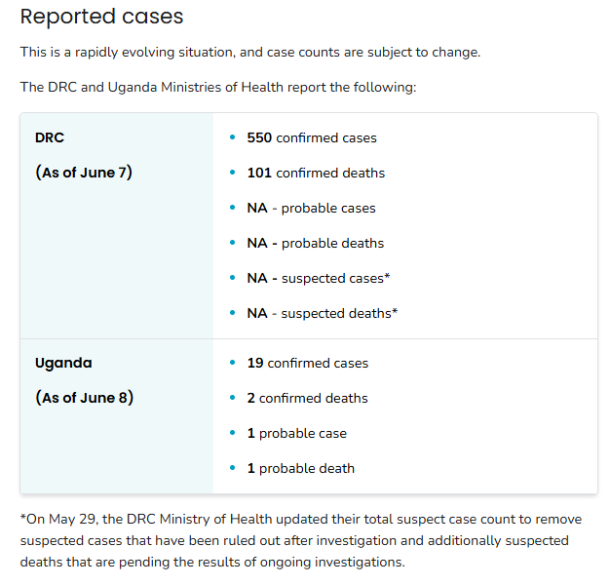
Ebola Outbreak: Current Situation
To date, no Ebola cases associated with this outbreak have been reported in the United States, and the risk to the general public remains low.
The overall risk to the American public and travelers remains low.
The DRC and Uganda Ministries of Health reported cases are as shown in the table.
Available at: Ebola Outbreak: Current Situation | Ebola | CDC, accessed on June 9, 2026.

Slide 9
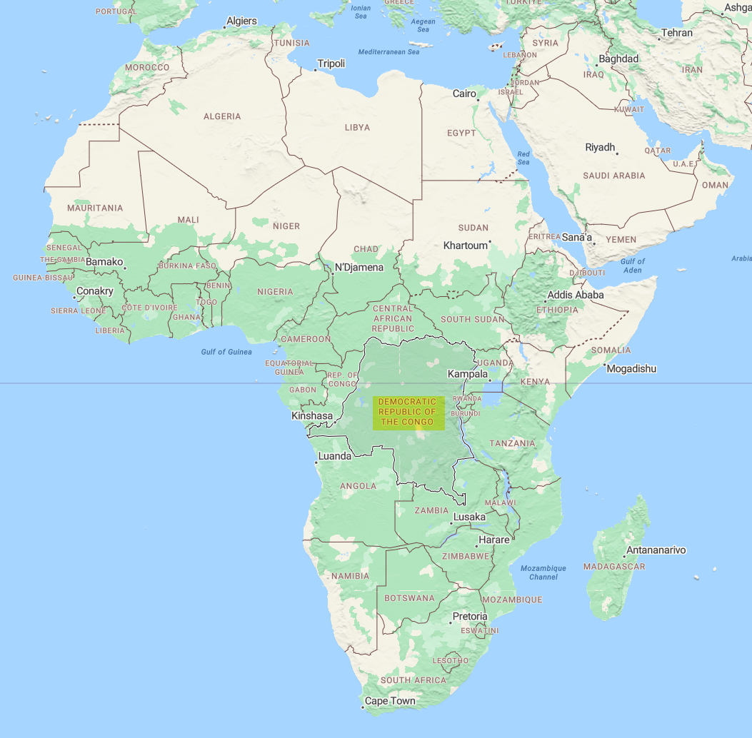
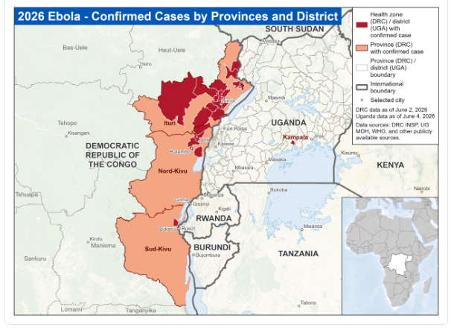
Ebola Outbreak: Current Situation
Available at: Ebola Outbreak: Current Situation | Ebola | CDC, accessed on June 9, 2026.

Slide 10
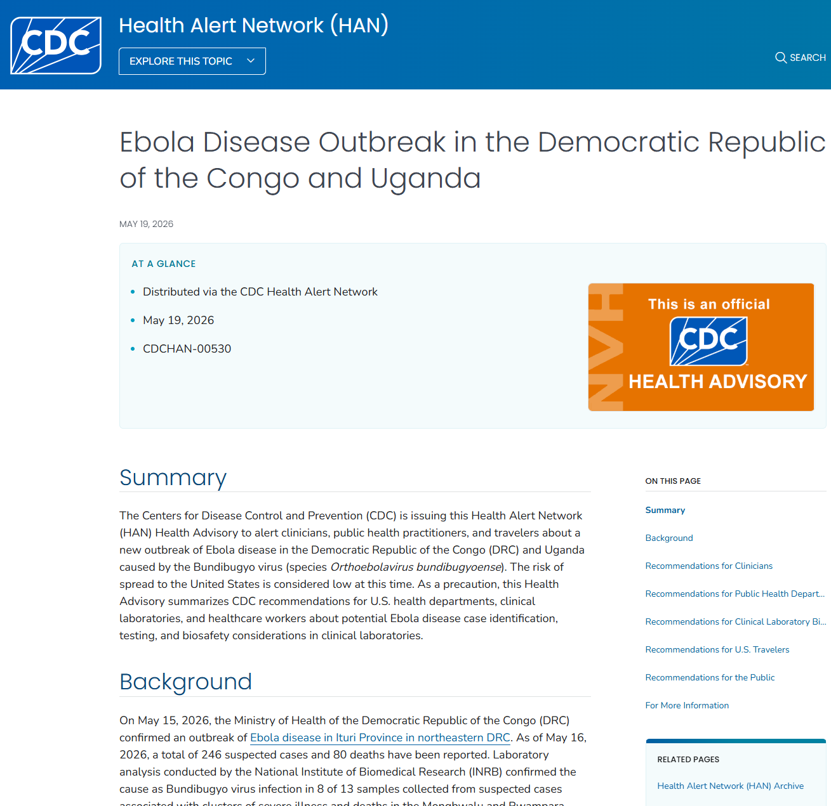
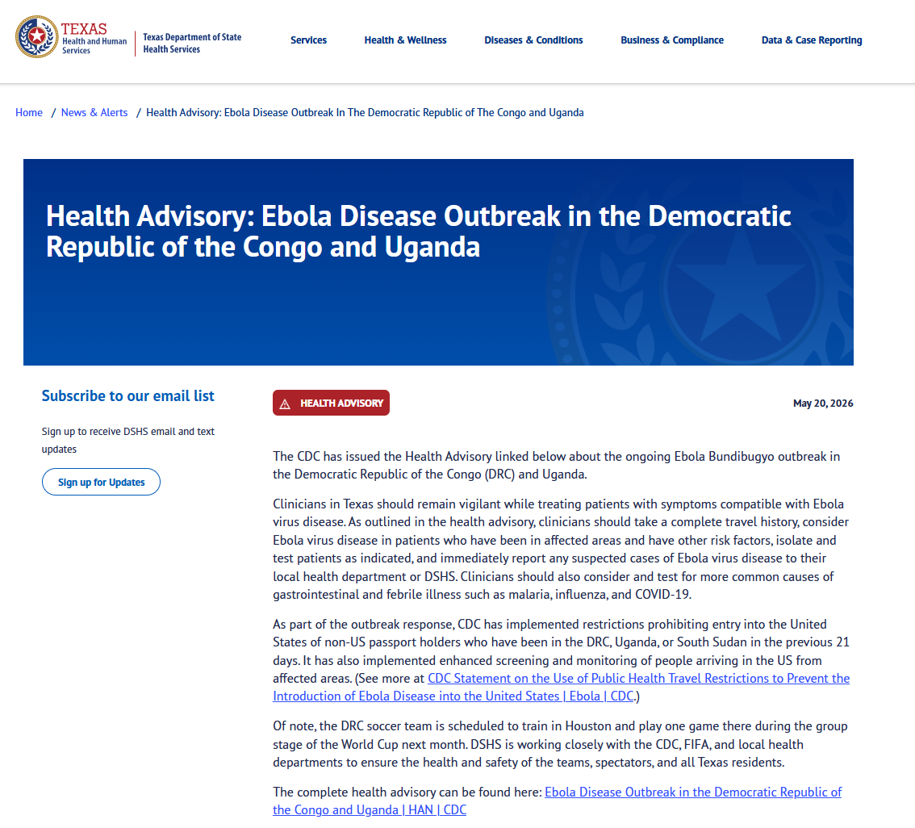
CDC and DSHS Ebola Disease Outbreak Health Advisories
Available at: Ebola Disease Outbreak in the Democratic Republic of the Congo and Uganda | HAN | CDC, accessed on June 9, 2026.
Available at: Health Advisory: Ebola Disease Outbreak in the Democratic Republic of the Congo and Uganda | Texas DSHS, accessed on June 9, 2026.

Slide 11
Travel and Monitoring
CDC has travel health notices in place for DRC and Uganda to help Americans planning travel to either country in the near future learn how to keep themselves safe from Ebola.
  DRC Level 3: Reconsider Nonessential Travel
  Uganda Level 2: Practice Enhanced Precautions
CDC is taking proactive public health measures to prevent Ebola from entering the United States.
  CDC temporarily restricted entry for certain travelers who were recently in DRC, Uganda, or South Sudan.
  As of Friday, May 22, 2026, U.S. citizens may still enter but will undergo enhanced public health screening.
  Travelers should monitor for Ebola symptoms for 21 days after leaving affected countries.
  Anyone who develops symptoms should avoid travel and contact public health authorities immediately.
Available at: Information for Travelers Returning from Ebola-Affected Areas | Ebola | CDC, accessed on June 9, 2026.

Slide 12
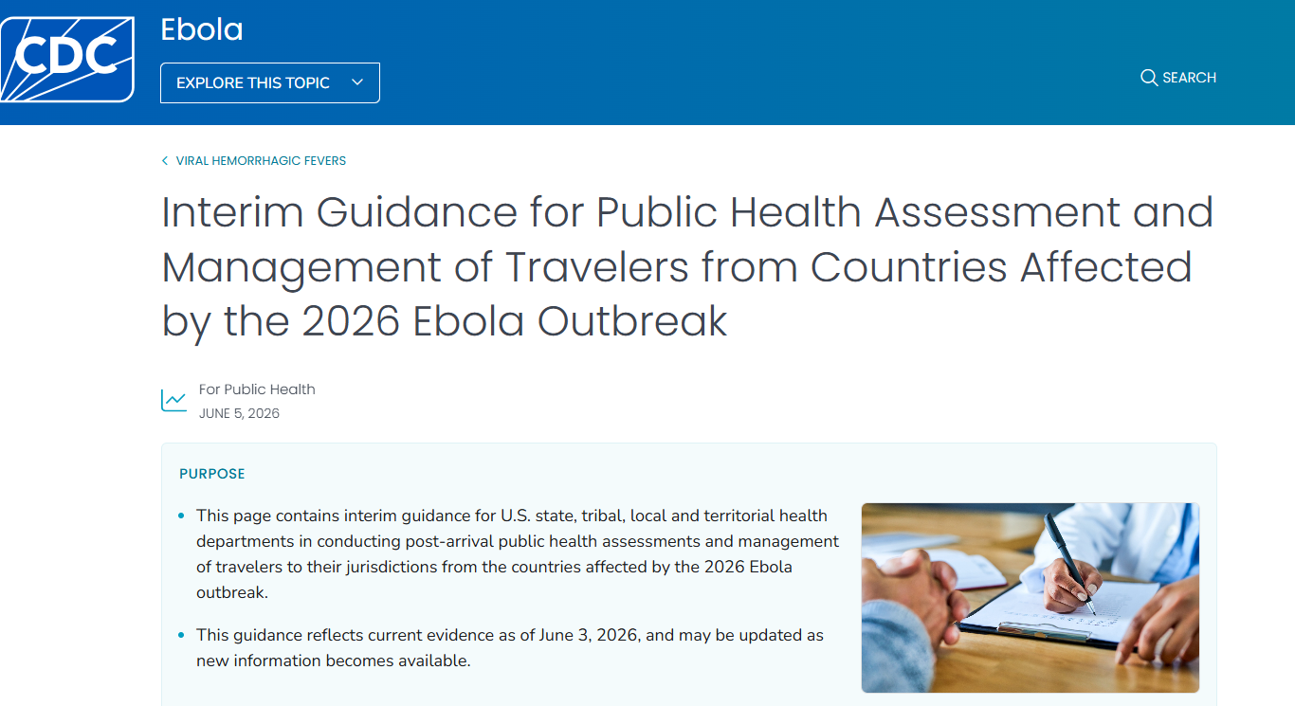
Travel and Enhanced Monitoring
Under a CDC order effective May 18, 2026, certain non-U.S. citizens who were in DRC, South Sudan, or Uganda, within the past 21 days are temporarily prohibited from entering the United States.
Travelers permitted to enter the United States who have recently been in DRC, South Sudan, or Uganda will undergo enhanced public health entry screening.
  These travelers will have their air travel re-routed to arrive at select airports. Airlines will work with affected travelers to rebook flights.
    Washington-Dulles International Airport (IAD)
    Hartsfield-Jackson Atlanta International Airport (ATL)
    George Bush Intercontinental Airport (IAH)
    John F. Kennedy International Airport (JFK)
Available at: Interim Guidance for Public Health Assessment and Management of Travelers from Countries Affected by the 2026 Ebola Outbreak | Ebola | CDC, accessed on June 9 2026.
Available at: Information for Travelers Returning from Ebola-Affected Areas | Ebola | CDC, accessed on June 9, 2026.

Slide 13
Texas Bundibugyo Monitoring
Public Health Region (Data as of 6/9/2026, 4:45pm) | Total PUMs | % of PUMs
PHR 1 | 4 | 1.8%
PHR 2/3 | 117 | 53.2%
PHR 4/5N | 14 | 6.4%
PHR 6/5S | 48 | 21.8%
PHR 7 | 21 | 9.5%
PHR 8 | 11 | 5.0%
PHR 9/10 | 2 | 0.9%
PHR 11 | 3 | 1.4%
Pending/Unknown | 0 | 0.0%
Grand Total Active PUMs | 220* | 100%
*220 PUMs under active monitoring in Texas.

Slide 14
Expectations for Hospitals
Texas does not have designated hospitals for triage of viral hemorrhagic fever suspects.
Hospitals must assess the patient and look for other causes of the symptoms, (i.e., malaria).
If other conditions are ruled out, physicians can request testing at a Laboratory Response Network site (Austin or Houston.)
Consultation is required with DSHS and CDC to receive approval to run Ebola test.
Patient transport/transfer to the UTMB Biocontainment Unit requires approval by DSHS.

Slide 15
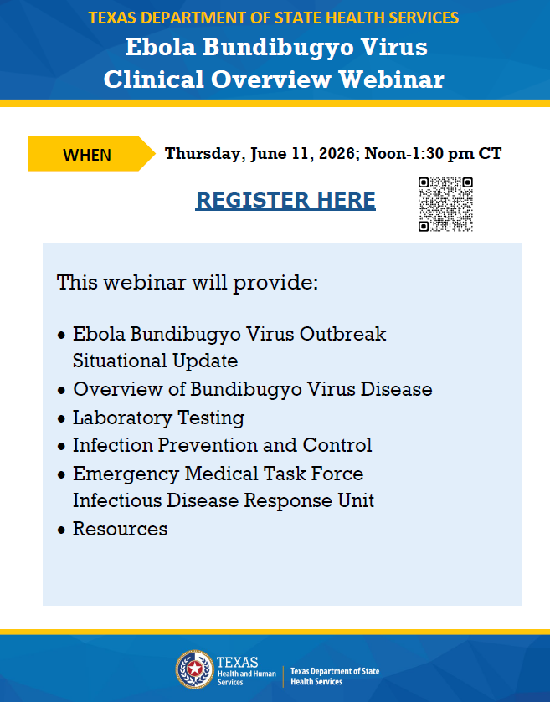

Slide 16
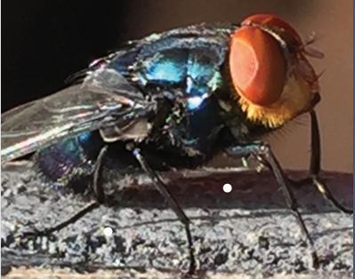
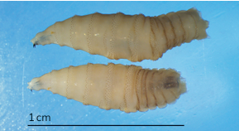
New World Screwworm

Slide 17
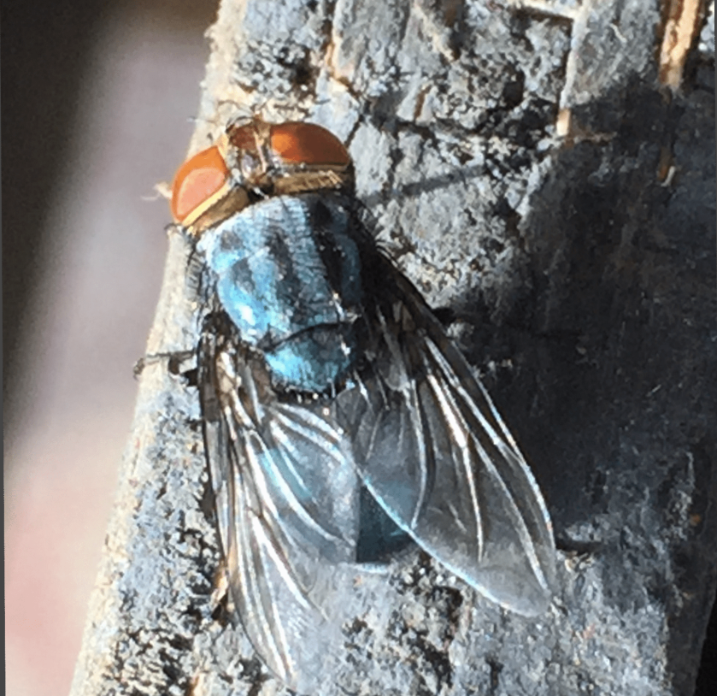
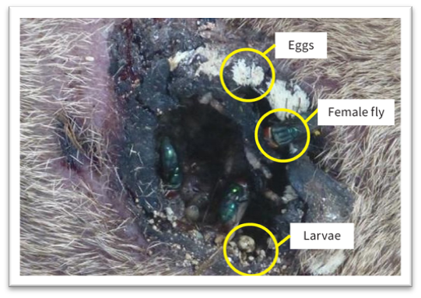
New World Screwworm Background
New World Screwworm (NWS) is a devasting pest.
The name screwworm refers to the larvae’s' feeding behavior as they burrow (screw) into the wound, feeding as they go like a screw being driven into wood.
  When NWS fly larvae burrow into the flesh of a living animal, they cause serious, often deadly damage.
  NWS can infest livestock, pets, wildlife, occasionally birds, and in rare cases, people.
  Severe infestations are almost always fatal if untreated.
Image: An adult New World screwworm fly
Image: an NWS infestation
Available: New World Screwworm Prevention for Animals & New World Screwworm Infestations in Animals | Photo Gallery, Accessed on June 9, 2026

Slide 18
New World Screwworm Background
NWS was eradicated from the US in 1960s and from Mexico in the 1980s using the Sterile Insect Technique (SIT).
SIT is a proven tool for fighting the spread of NWS.
  With this method, sterile male flies are released into an area where a known population has become established.
  The sterile male flies mate with wild female NWS flies, which then lay unfertilized eggs.
  Because female NWS flies mate just once in their lifespan, the NWS population progressively reduces and ultimately dies out.
NWS remains endemic in South America, Cuba, Haiti, and the Dominican Republic
Animals infested with NWS should be treated according to their veterinarian's recommendations.
Available: New World Screwworm Prevention for Animals & Eradicating New World Screwworm with Sterile Insect Technique Accessed on June 7, 2026

Slide 19
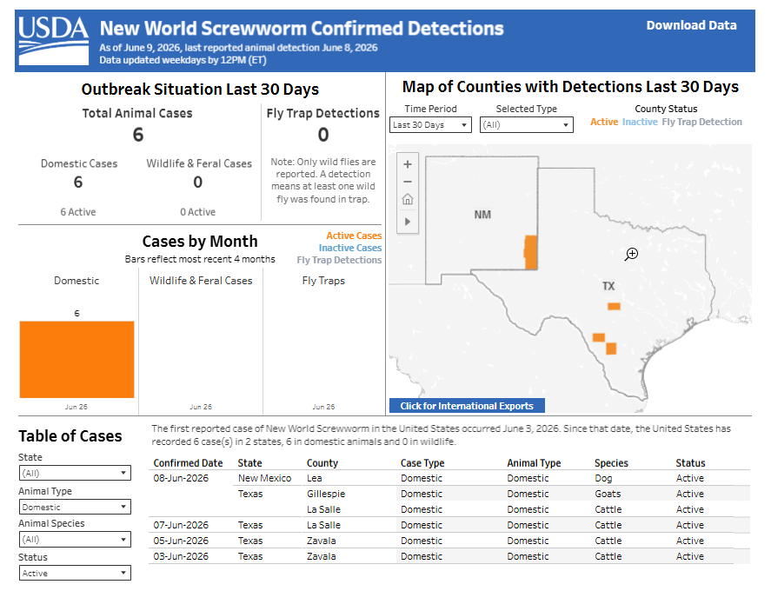

NWS Situational Update
As of June 9, 2026, there are six confirmed NWS animal cases in the U.S.
  Five confirmed NWS cases are in Texas.
    On June 3, 2026, the U.S. Department of Agriculture (USDA) confirmed the first case of NWS in a calf in the United States, Zavala County, Texas.
    On June 5, 2026, USDA confirmed a second case of NWS in a calf, also in Zavala County.
    On June 7, 2026, the USDA confirmed a case in calf in La Salle County.
    On June 8, 2026, the USDA confirmed a case in a bovine in La Salle County and a goat in Gillespie County.
  One confirmed animal NWS case is in NM.
    Dog in Lea County, NM
Available at: Confirmed Detections of New World Screwworm | Animal and Plant Health Inspection Service, accessed on June 9, 2026.
19

Slide 20
NWS Situational Update
No human NWS cases have been reported in the United States.
In Mexico and Central America, more than 171,700 NWS cumulative cases have been reported in animals, and more than 2,070 cases have been reported in people.
In the United States, the risk of infestation in people remains low. Risk is localized to areas where NWS flies are circulating.
Available at: New World Screwworm Outbreak | New World Screwworm | CDC, accessed on June 9, 2026
20

Slide 21
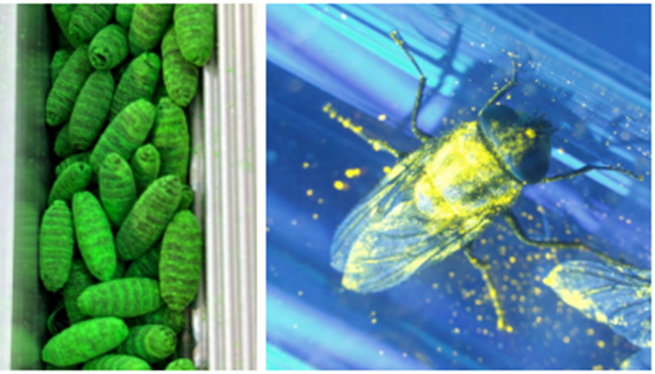
Sterile Insect (Fly) Operations
As part of the established NWS eradication strategy, USDA began releasing sterile flies over the area on June 4. These missions will disperse 2 million sterile screwworms twice a week to disrupt the pest’s lifecycle.
In addition to aerial releases, USDA is shipping another 4 million sterile flies per week to Texas. These will be deployed using 24 ground release chambers, strategically placed in and around the detection zone to maximize impact.
Image: Dyed sterile NWS pupae (left); sterile NWS fly glowing under UV light (right).
Available: https://www.aphis.usda.gov/sites/default/files/factsheet-sit-proven-tool-nws.pdf, accessed on June 7, 2026
Available at: Animal Health Officials Respond to Second Detection of New World Screwworm in the United States | Animal and Plant Health Inspection Service, accessed on June 9, 2026.

Slide 22
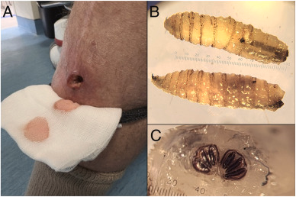
Signs and Symptoms of NWS in Humans
Feeling larvae move or seeing larvae within a skin wound or sore, or in the ears, nose, eyes, or mouth.
Painful skin wounds or sores that worsen within a few days.
A foul-smelling odor from the site of the infestation.
Bleeding from open sores.
Bacteria can also infect wounds where NWS maggots are present and may cause infection that can lead to symptoms like fever or chills.
Image: (A) Wound caused by NWS in a traveler; (B and C) NWS larvae recovered from traveler. Source: New World screwworm (Cochliomyia hominivorax) infestation in a returned traveller from Costa Rica – ScienceDirect. Accessed on June 9, 2026
Available at: Clinical Overview of New World Screwworm | New World Screwworm | CDC : Accessed on June 9, 2026

Slide 23
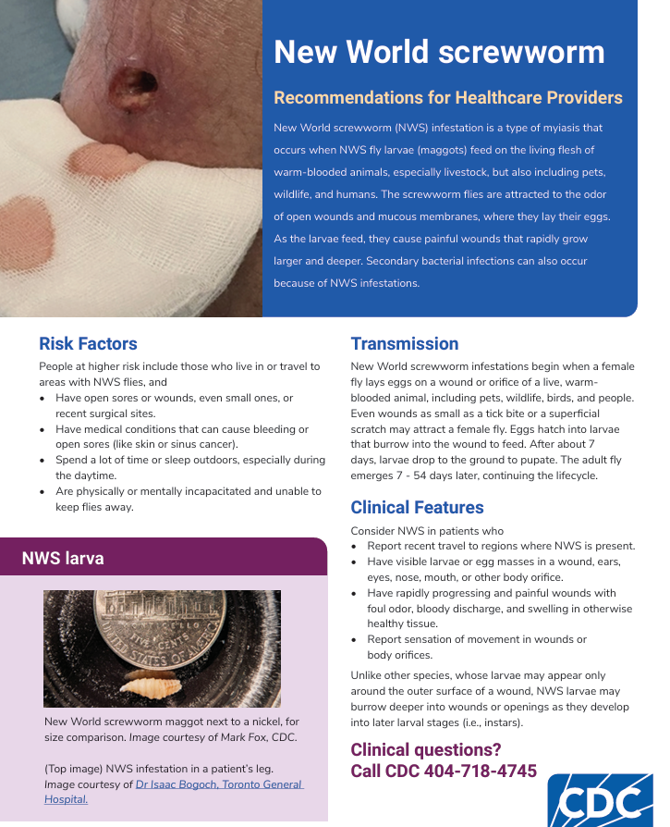
Human NWS Case Clinical Management
Currently, there is no U.S. Food and Drug Administration (FDA) approved medication to treat NWS infestation in humans.
There are anecdotal reports of using ivermectin in off-label treatment of NWS infestations in humans.
Treatment:
  Health care providers should remove and kill ALL visible larvae and eggs in patients with suspected NWS.
  This may require surgical removal.
  Failure to kill and properly dispose of all larvae and eggs may result in the introduction and spread of NWS in the local environment
  Re-examine treated lesions after 24 – 48 hours to confirm no larvae remain. Remove and safely dispose of any remaining larvae as described above.
  Monitor for and treat secondary bacterial infections as needed.
Available at: Clinical Overview of New World Screwworm | New World Screwworm | CDC & New World screwworm: Recommendations for Healthcare Providers accessed on June 9, 2026.

Slide 24
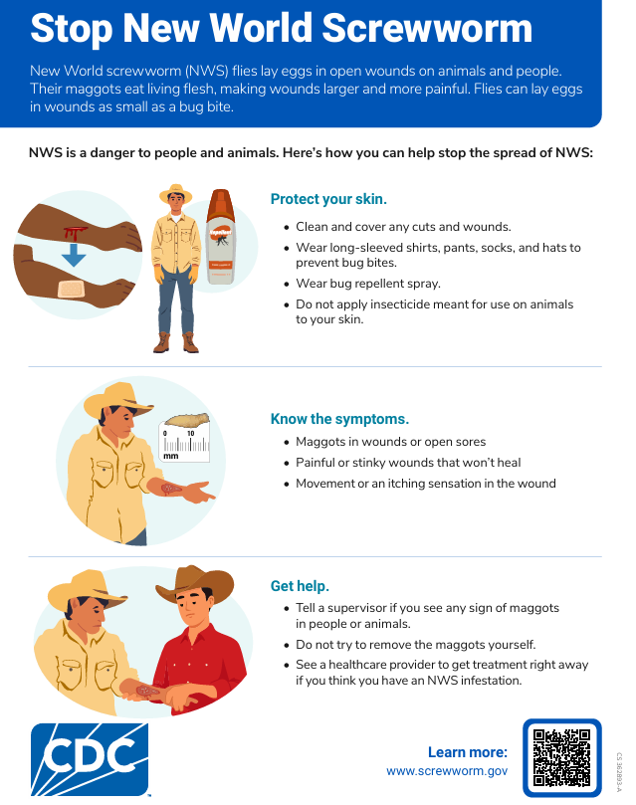
Personal Prevention of New World Screwworm
Preventing breaks in the skin and avoiding NWS flies is key to protecting yourself in areas where the flies are present.
Keep open wounds clean and covered, no matter how small or location on the body.
Sleep indoors with closed windows or screened open windows. If you are outside, sleep under a bed net or inside a screened tent.
Protect your skin and prevent insect bites by
  Using an EPA-registered insect repellent.
  Treating clothing and gear with products containing 0.5% permethrin.
  Wearing loose-fitting, long-sleeved shirts and pants, hats, and socks to limit access to your body by NWS flies and biting insects.
Available at: Stop New World Screwworm; accessed June 7, 2026
Available at: https://www.cdc.gov/new-world-screwworm/situation-summary/index.html ; accessed June 9, 2026

Slide 25
Summary
NWS infestation can be prevented.
Human cases can occur in areas where the flies are circulating and laying eggs.
Healthcare providers must handle larvae appropriately and send for identification.
Treatment requires extraction of all NWS larvae.
DSHS continues to partner with state and federal agencies in prevention and management of NWS cases.

Slide 26
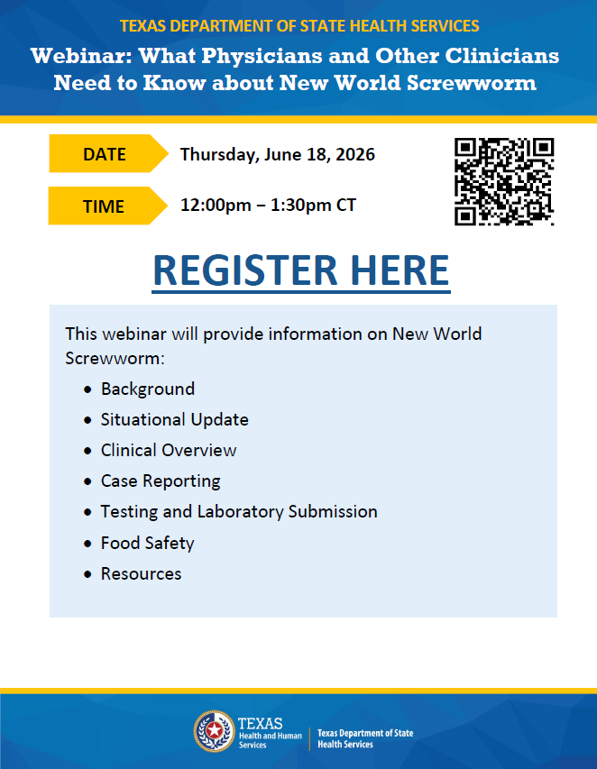

Slide 27
Thank you

