Slide 1
Emerging and Infectious Diseases Update
Varun Shetty, MD, MBA, MS
Chief State Epidemiologist
Texas Department of State Health Services
August 12, 2026

Slide 2
Discussion Topics
2026 FIFA World Cup Games in Texas
Cyclosporiasis Surveillance
Ebola Outbreak
New World Screwworm
Measles Update

Slide 3
DISCLAIMER
The information presented today is based current preliminary data and on CDC’s recent guidance. Information is subject to change.
August 11, 2026

Slide 4
2026 FIFA World Cup Games in Texas

Slide 5
DSHS Activities for 2026 FIFA World Cup
Games in Texas
Epidemiological Activities
Preparedness and Training Activities
Development of list of Health Conditions/Incidents (HCIs).
State, national, and global event monitoring.
Creation of resources.
  Web page
  World Cup Infectious Disease Consultation Hotline
State Medical Operations Center
  Formation of cross functional workgroups.
  Preparedness tabletop exercises.
    Radiation
    Mass casualty
    Food borne outbreak
    High Consequence Infectious Diseases
2026 Epidemiology and Laboratory Capacity (ELC) Conference.
  Tabletop exercises
  Panel discussions
Statewide Epi weekly calls.
  Selected World Cup HCIs

Slide 6
Summary
The FIFA 2026 World Cup brought an increase in travelers from around the world, as well as mass gatherings related to this event, potentially increasing the risk of infectious diseases, and additional demand on public health and healthcare systems.
DSHS in collaboration with local, state, and federal partners spent many months preparing to protect travelers and Texans from potential health threats, including foodborne illness and infectious diseases.
As expected for this time of year, we observed slight increases in ED visits for heat-related illnesses and some injuries, but overall, no major public health events occurred during the games or fan fest events in Texas.
The time and effort that was allocated towards preparing for this event ensured DSHS maintained timely situational awareness before, during, and after this major event.

Slide 7
Cyclosporiasis Surveillance

Slide 8
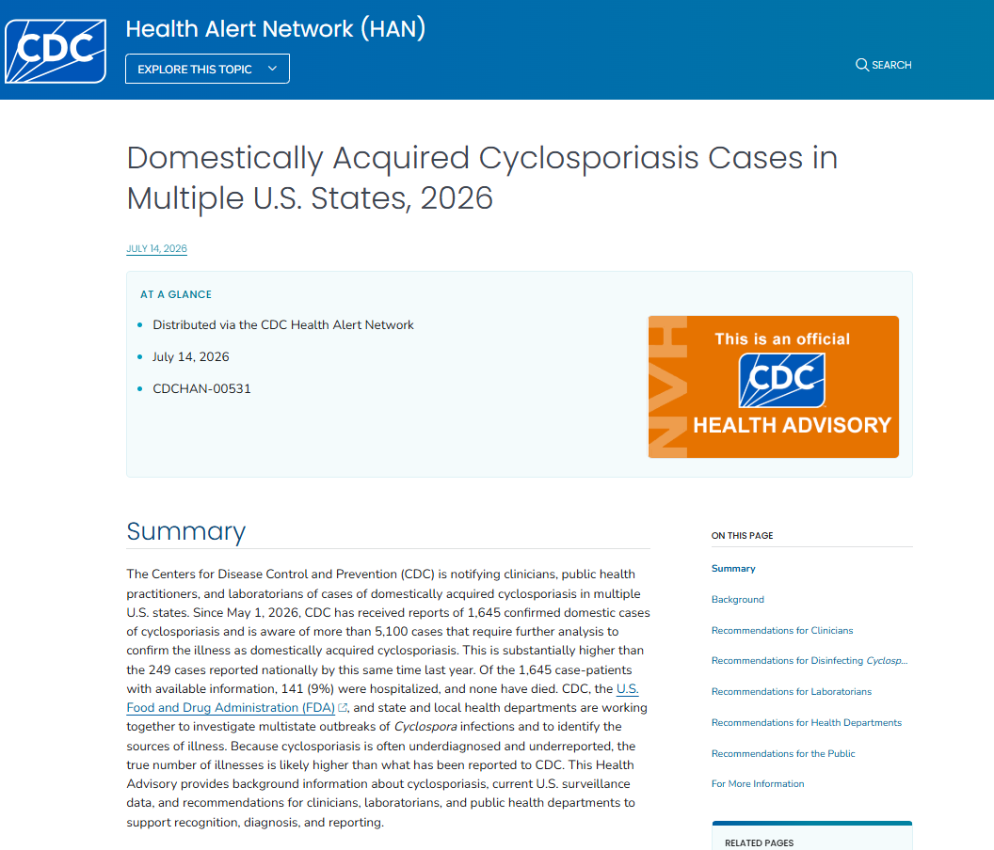
Available at: Domestically Acquired Cyclosporiasis Cases in Multiple U.S. States, 2026 | HAN | CDC, accessed on August 10, 2026.

Slide 9
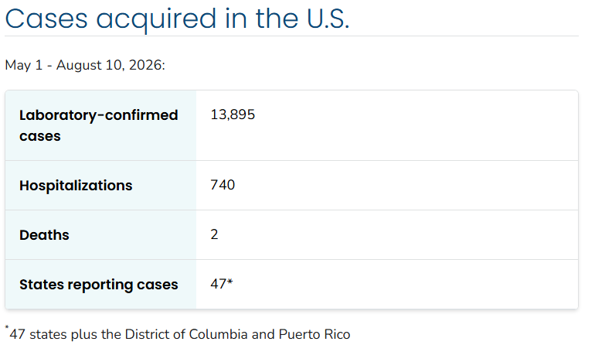
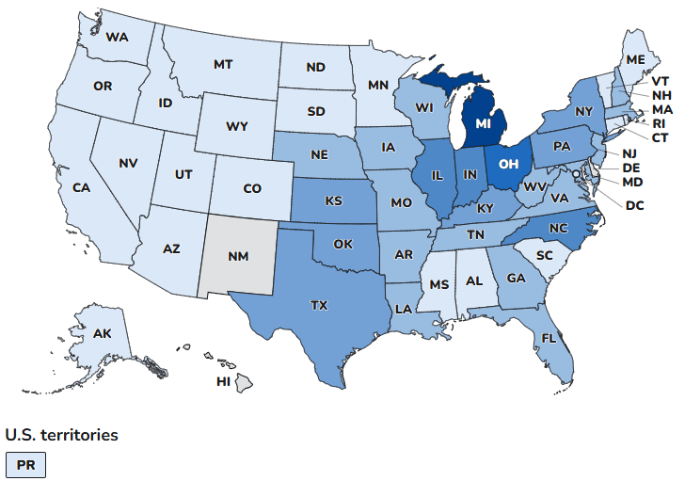
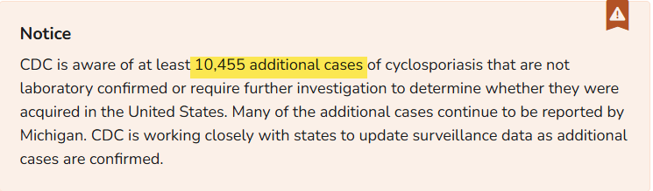
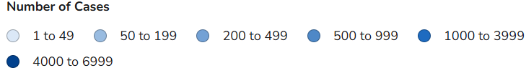
Cyclosporiasis in the United States
States of residence of the 10,468 people with laboratory-confirmed domestically acquired cyclosporiasis, May 1 – August 10, 2026
Available at: Surveillance of Cyclosporiasis | Cyclosporiasis | CDC, accessed on August 11, 2026.

Slide 10
Cyclosporiasis in Texas
Data Source: DSHS, Provisional Data

Slide 11
Cyclosporiasis in Texas
*2026 cases are from May 1 – August 10, 2026.

Slide 12
Ebola Outbreak

Slide 13
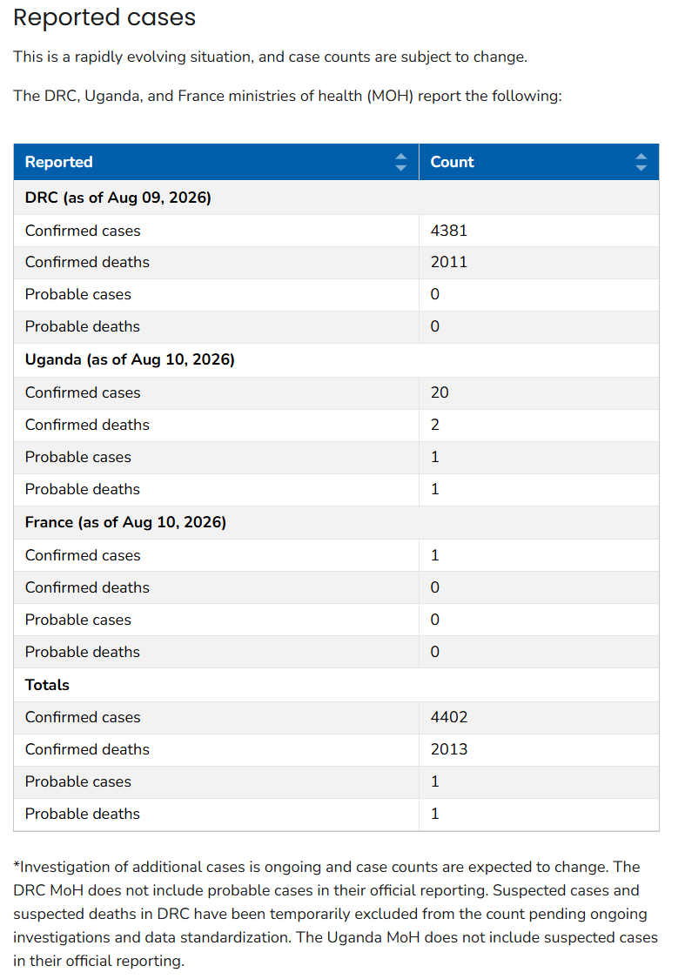
Ebola Outbreak in the Democratic Republic of the Congo (DRC) – Current Situation
To date, no Ebola cases associated with this outbreak have been reported in the United States, and the risk to the general public remains low.
The likelihood of Ebola spreading to the United States is considered very low.
The most current cases reported by the Centers for Disease Control and Prevention (CDC) are as shown in the table.
Available at: Ebola Outbreak: Current Situation | Ebola | CDC, accessed on August 11, 2026.

Slide 14
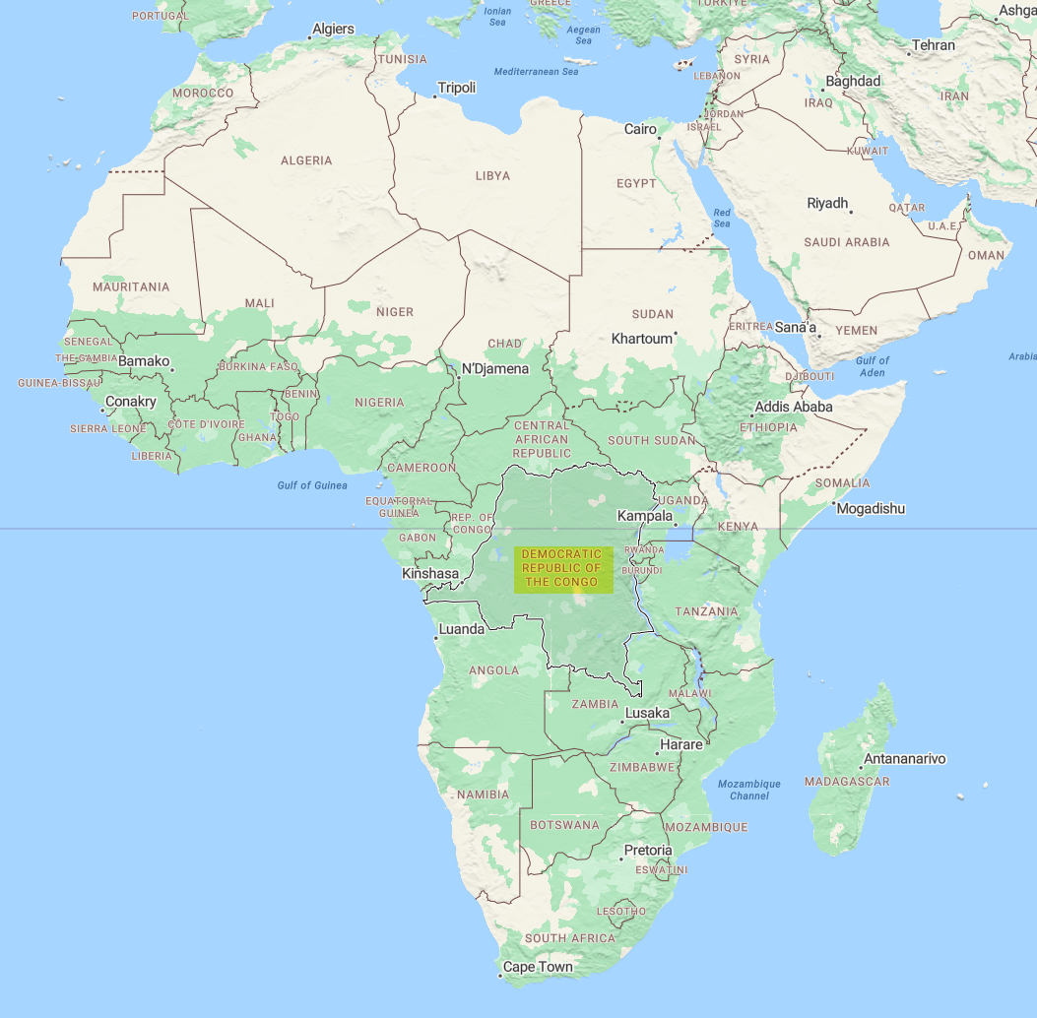
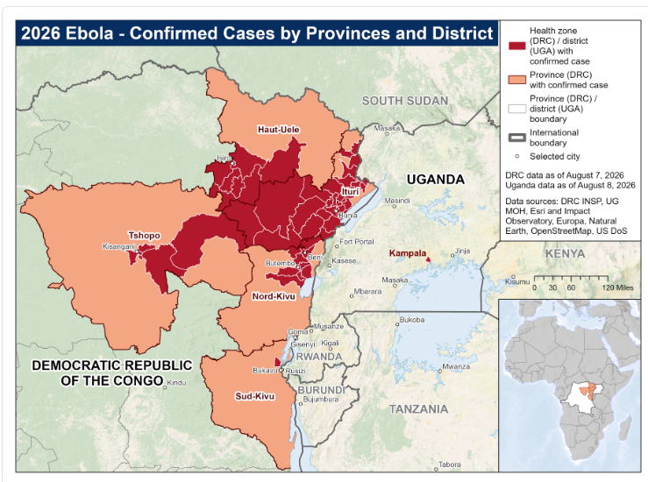
Ebola Outbreak: Current Situation
Available at: Ebola Outbreak: Current Situation | Ebola | CDC, accessed on August 11, 2026.

Slide 15
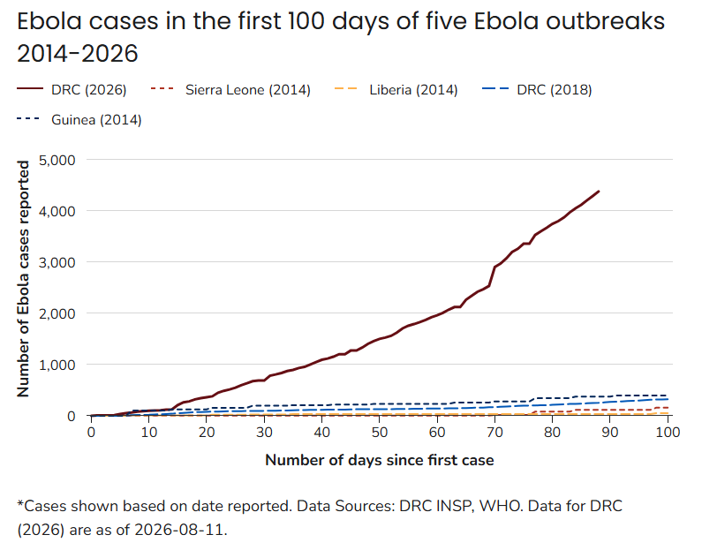
Ebola Outbreak – Current Situation
This outbreak is spreading substantially faster than previous Ebola outbreaks and is now the second-largest Ebola outbreak on record.
  This Ebola outbreak surpassed 1,000 confirmed cases within 40 days of response activation.
    In comparison, the 2018 Ebola outbreak in DRC took approximately 235 days to reach more than 1,000 cases.
  The number of reported deaths has risen rapidly as well, with more than 100 fatalities reported in the first week of July.
Available at: Ebola Outbreak: Current Situation | Ebola | CDC, accessed on August 11, 2026.

Slide 16
Ebola Outbreak - Current Situation
All United States citizens who have been in DRC should plan to remain outside DRC for 21 days before entering the United States. This includes all passengers with an intermediate stop in DRC or on multi-stop itineraries via DRC regardless of whether they disembark or stay on the airplane.
United States citizens who have been present in Uganda or South Sudan (and not present in DRC) within 21 days of arrival in the United States must only enter through designated airports for enhanced screening.
CDC recommends avoiding all travel (Level 4) to Ituri and Nord-Kivu (North Kivu) provinces and avoiding nonessential travel to Haut-Uele and Tshopo provinces in DRC. Travelers to other parts of DRC or Uganda should take enhanced precautions (Level 2) to avoid Ebola exposure and monitor for symptoms while traveling and for 21 days after leaving.
Available at: Ebola Outbreak: Current Situation | Ebola | CDC, accessed on August 11, 2026.

Slide 17
DSHS Ebola Related Activities
Continued monitoring of returning travels from these countries as per the guidance provided by the CDC.
On May 20, 2026, DSHS issued a Health Advisory: Ebola Disease Outbreak in the Democratic Republic of the Congo and Uganda.
DSHS has conducted two training webinars.
  Ebola Bundibugyo Virus – A Clinical Update.
  Ebola Bundibugyo Virus – Infection Control and Prevention Strategies.
DSHS has a dedicated Ebola webpage with information for healthcare providers, public health and the public, including:
  Recordings and slides from the webinars.
  Additional resources and tools.

Slide 18
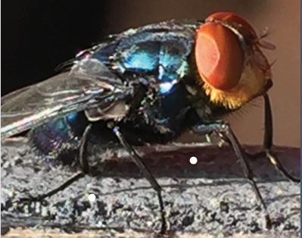
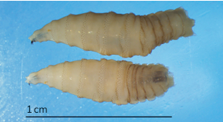
New World Screwworm

Slide 19
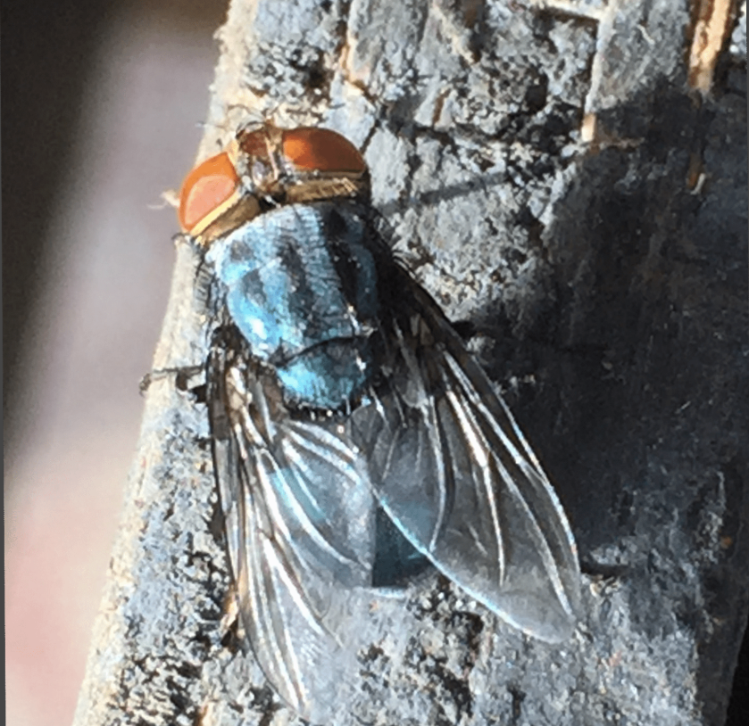
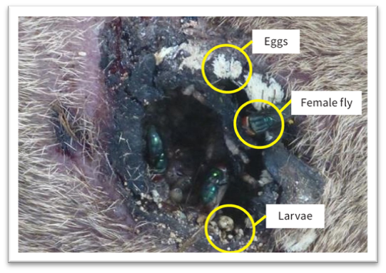
New World Screwworm
New World Screwworm (NWS) is a devasting pest.
The name screwworm refers to the larvae’s feeding behavior as they burrow (screw) into the wound, feeding as they go like a screw being driven into wood.
  When NWS fly larvae burrow into the flesh of a living animal, they cause serious, often deadly damage.
  NWS can infest livestock, pets, wildlife, occasionally birds, and in rare cases, people.
  Severe infestations are almost always fatal if untreated.
Image: An adult New World screwworm fly
Image: an NWS infestation
Available: New World Screwworm Prevention for Animals & New World Screwworm Infestations in Animals | Photo Gallery, Accessed on August 11, 2026

Slide 20
Texas New World Screwworm Situational Update
On June 3, 2026, USDA reported the first animal NWS case in the United States in a cattle in Zavala County, Texas.
As of August 10, 2026, there have been 44 animal NWS detections in Texas and one in New Mexico.
  Most recent detection was on August 5, 2026, in a sheep in Terrell County, Texas.
As of August 10, 2026, there have been no reports of human NWS cases acquired in in Texas or in the United States.
USDA: U.S. Department of Agriculture
Available at: https://www.cdc.gov/new-world-screwworm/situation-summary/index.html, & https://www.aphis.usda.gov/animals/animal-health/livestock-and-poultry-disease/current-status/us-confirmed-cases-new-world; accessed on August 11, 2026.

Slide 21
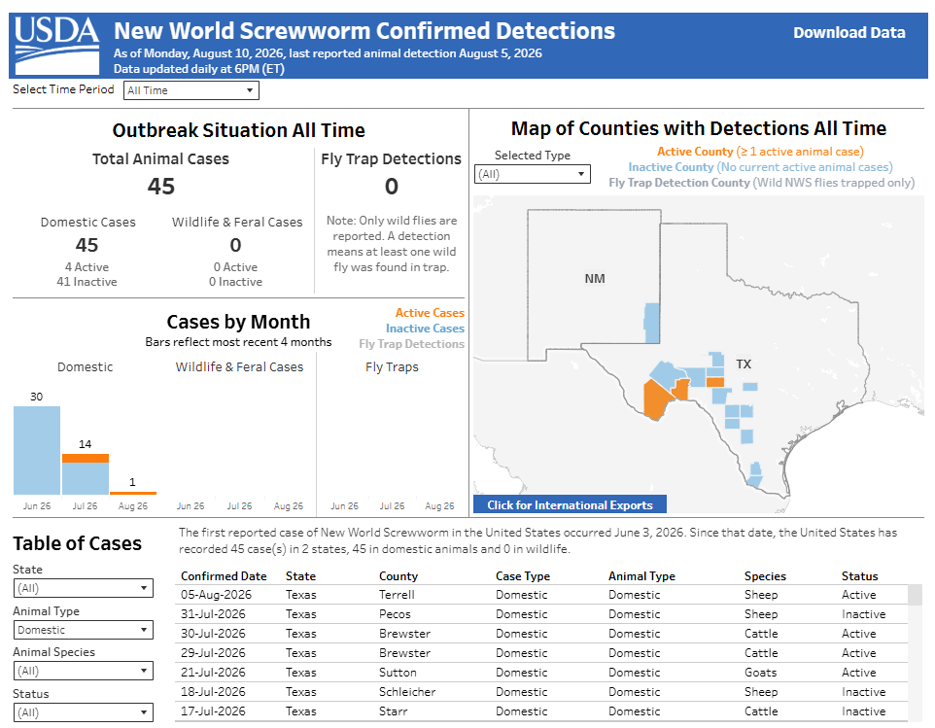
Available at: Confirmed Detections of New World Screwworm | APHIS; accessed on August 11, 2026.

Slide 22
DSHS NWS Tools and Resources
DSHS has a dedicated NWS web page: New World Screwworm | Texas DSHS.
  Information for healthcare providers: New World Screwworm Information for Healthcare Providers | Texas DSHS.
  Communication toolkit, available in English and Spanish: New World Screwworm Communications Toolkit | Texas DSHS.
  Resources
    Local health departments: How to report cases of NWS.
    Animal control officers: How to report cases of NWS .
    Animal control officers: How to report cases of NWS - pocket version.
    Webinar recording links and slide decks.
  DSHS lab submission guidance for NWS.

Slide 23
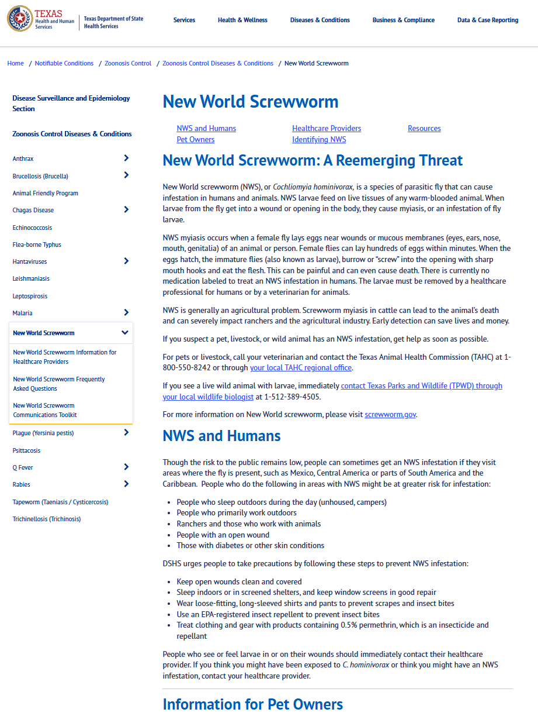
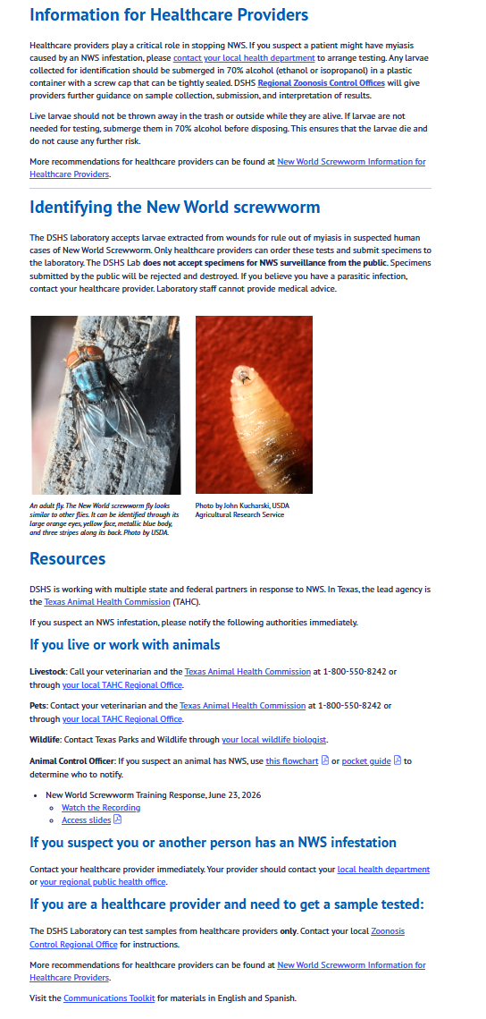
Available at: New World Screwworm (NWS) | Texas DSHS, accessed on August 10, 2026.

Slide 24
Measles Update

Slide 25
Measles Cases: United States and Texas (2015-2025)
Available at: Texas National Electronic Disease Surveillance System Based System & https://www.cdc.gov/measles/data-research/index.html, accessed on August 8, 2026.
Notes:
There were total of 762 cases associated with the measles outbreak that occurred in Texas in 2025.

Slide 26
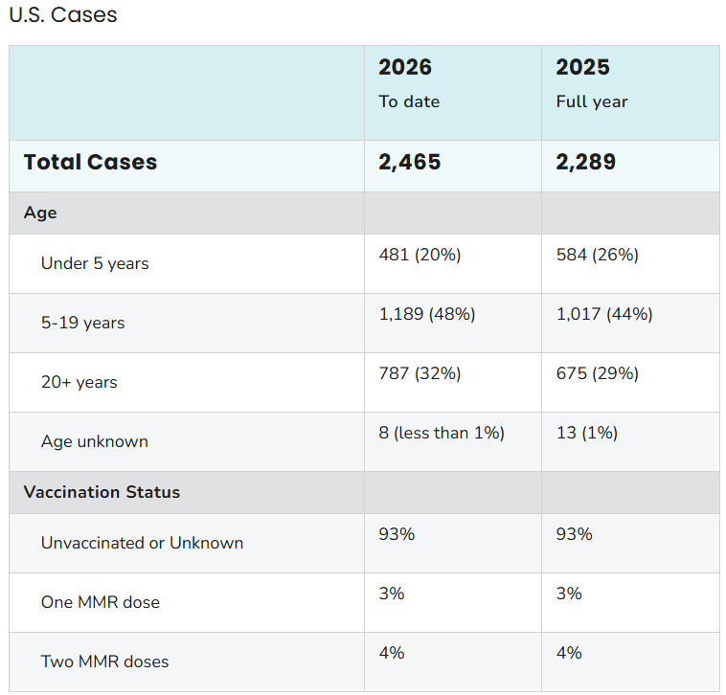
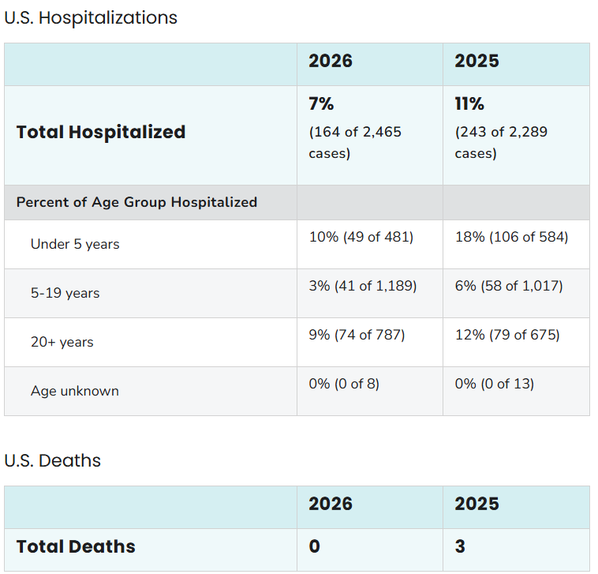
Measles Cases in the United States (2025 & 2026)
As of August 7, 2026
Available at: Measles Cases and Outbreaks | Measles (Rubeola) | CDC, accessed on August 11, 2026.

Slide 27
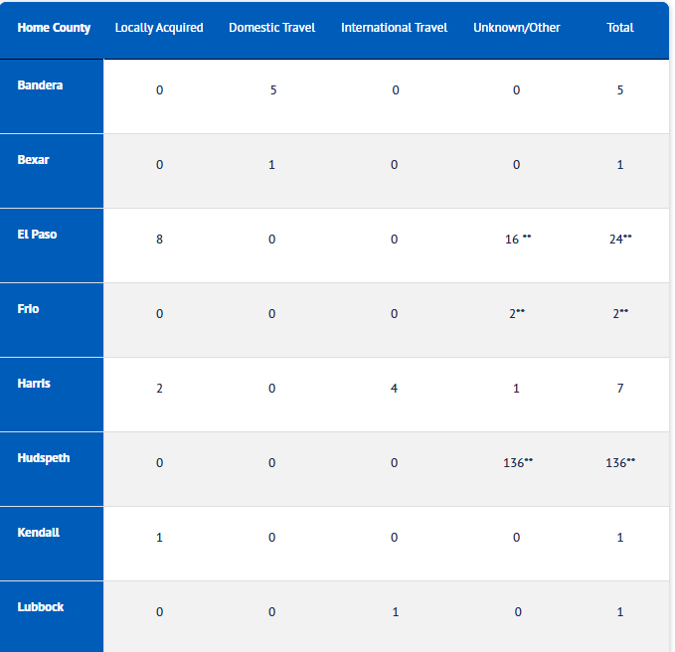
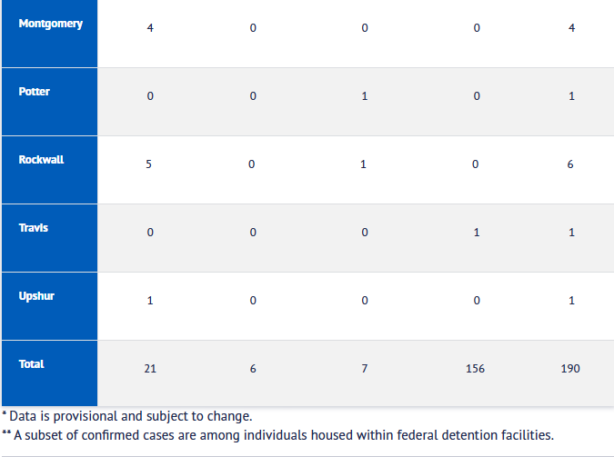
Measles Cases in Texas (2026)
2026 Measles Confirmed Cases in Texas Residents*: 190 cases as of August 7, 2026
Available at: Measles (Rubeola) Data | Texas DSHS, accessed on August 11, 2026.

Slide 28
Thank you

