Slide 1
HB 2844 Implementation Update
2026
Consumer Protection Division
Food & Drug Section
Food Safety Unit
Retail Food Safety Operations Branch

Slide 2
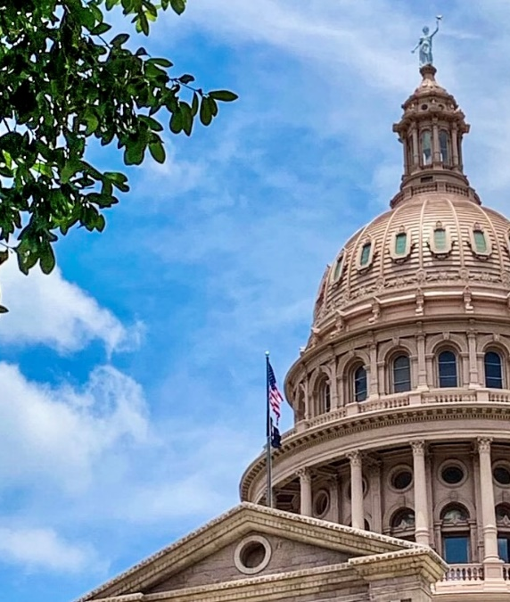
HB 2844 (89th)
Signed by Governor Abbott on June 20, 2025.
Authorization for Exec. Commissioner to begin adoption of rules on Sept. 1, 2025.
Rules required to be effective May 1, 2026.
Other parts of the bill, including statewide licensing, not effective until July 1, 2026.

Slide 3
What does HB 2844 do?
Adds new Texas Health and Safety Code Chapter 437B.
One statewide MFV license to be issued by DSHS.
Licensing, inspection, and enforcement under DSHS jurisdiction—local authority “preempted” regarding anything conflicting with HSC 437B.

Slide 4

Three-Tier Classification
Type I—prepackaged, non-TCS foods and low risk of harm to the public
Type II—food that requires limited
handling and preparation—cook-serve
Type III—complex preparation, cooking, holding, cooling, reheating, and service

Slide 5

Collaborative Agreement
437B.153: Authorizes DSHS to enter into “collaborative agreements” to reimburse Local Jurisdictions for conducting MFV inspections. However, HSC 437B.002 clarifies that local jurisdictions are not obligated to participate.
Proposed Reimbursement:
Type I: $250
Type II: $350
Type III: $400
Surveys, SOPs, Inspections

Slide 6

Statement of Work (SOW)
We have completed a draft SOW that is under review with Contract Management Services (CMS) and Legal
Plan to have the SOW ready for review by Local Partners soon

Slide 7

Statewide Database
Requires DSHS to establish and maintain a statewide database, accessible also to local jurisdictions, that contains:
names of licensed MFV’s
results of inspections
public complaints that resulted in disciplinary or corrective action
itineraries of MFV’s

Slide 8

Enforcement
Prescribes a structure and timeline for escalated enforcement by DSHS/HHSC in conjunction with the State Office of Administrative Hearings (SOAH). Includes:
Administrative Penalties
License Suspension
License Revocation
Due process for the operator

Slide 9

MFV Rules-25 TAC 226 (Title 25, Chapter 226, TX Administrative Code)
Draft rules posted for informal comment
09.23 – 10.17.2025
Must be presented at HHSC Exec. Council 02.12.2026
Proposed rules to post in Texas Register on
02.20.26 for 31 days
Formal comments
Effective 05.31.2026 ! ! !

Slide 10
Updates and Progress
RFSO Organization – Hiring and Expanding Positions
LHD Workgroup – Awaiting Approval
IT Implementation – Biweekly Planning Meeting
Proposed Rules – Prepared for EC and Texas Register
Guidance Documents – Weekly Planning Meeting
Create – Phase begins late February
Update – Phase begins late March
SOP Development – Weekly Planning Meeting
Document phase begins mid-late February
Contract Management Services (CMS) – SOW is under review by CMS and Legal.

Slide 11

QUESTIONS?
Image source: http://www.lhtech.us/FAQs.php
foodestablishments@dshs.texas.gov

