Slide 1
Emerging and Infectious Diseases Update
April 8, 2026

Slide 2
DISCLAIMER
The information presented today is based current preliminary data and on CDC’s recent guidance. Information is subject to change.
April 8, 2026

Slide 3
Measles
New World Screwworm
2025-26 Texas Respiratory Virus Illness
Varun Shetty, MD, MBA, MS
Chief State Epidemiologist
Texas Department of State Health Services

Slide 4
Measles

Slide 5
Measles in the Americas
As of March 14, 2026, the Pan American Health Organization (PAHO) reported 10,571 confirmed measles cases in 2026 in the Americas which includes Mexico, Canada and United States.
In 2025, PAHO reported 14,751 confirmed measles cases in the Americas.
5

Slide 6
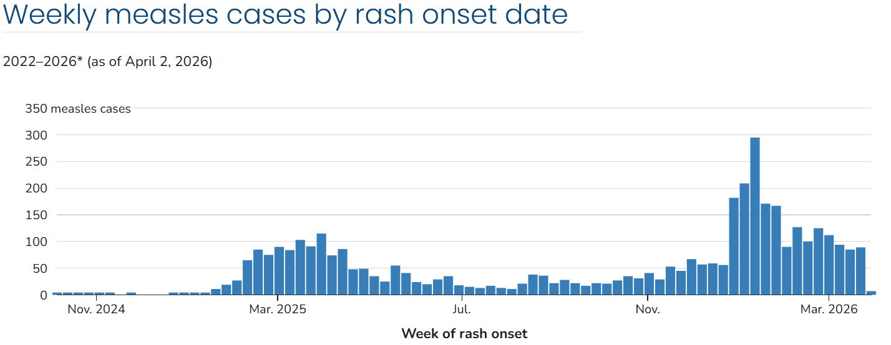
Measles in the United States
United States | 2026 (as of April 2, 2026) | 2025 (Full year)
Total Cases | 1,671 | 2,285
Total Outbreaks | 17 new outbreaks (94% of the total cases are outbreak associated) | 48 outbreaks (90% of the total cases are outbreak associated)
Total Hospitalized | 5% (91 or 1,671 cases) | 11% (242 of 2,285 cases)
Vaccination Status | 92% unvaccinated or unknown | 93% unvaccinated or unknown
Total Deaths | 0 | 3
Available at: Measles Cases and Outbreaks | Measles (Rubeola) | CDC, accessed on April 6, 2026.

Slide 7
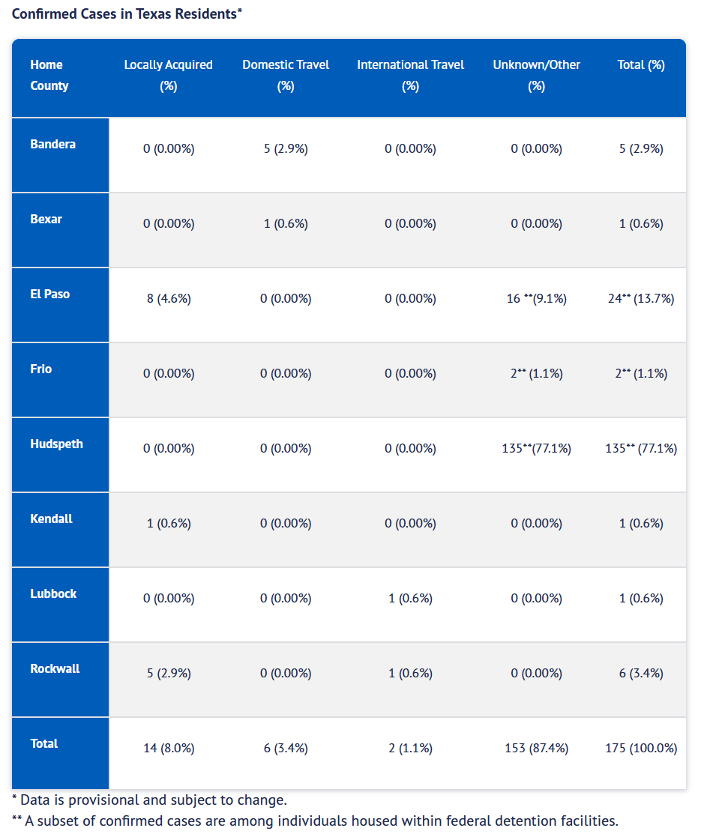
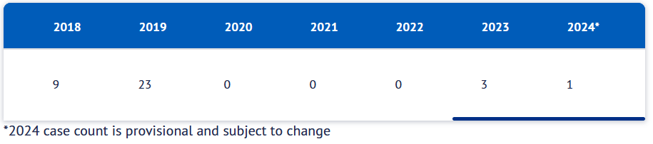
Texas Measles Cases in 2026
Confirmed Measles Cases in Texas Residents* in 2026
As of April 1, 2026, 175 confirmed measles cases in Texas residents have been reported in 2026.
In 2025, there were 762 confirmed measles cases reported in Texas.
2018 – 2024 measles cases in Texas
Available at: Measles (Rubeola) Data | Texas DSHS, accessed on April 7, 2026.
7
Notes:
Please update

Slide 8
New World Screwworm (NWS)

Slide 9
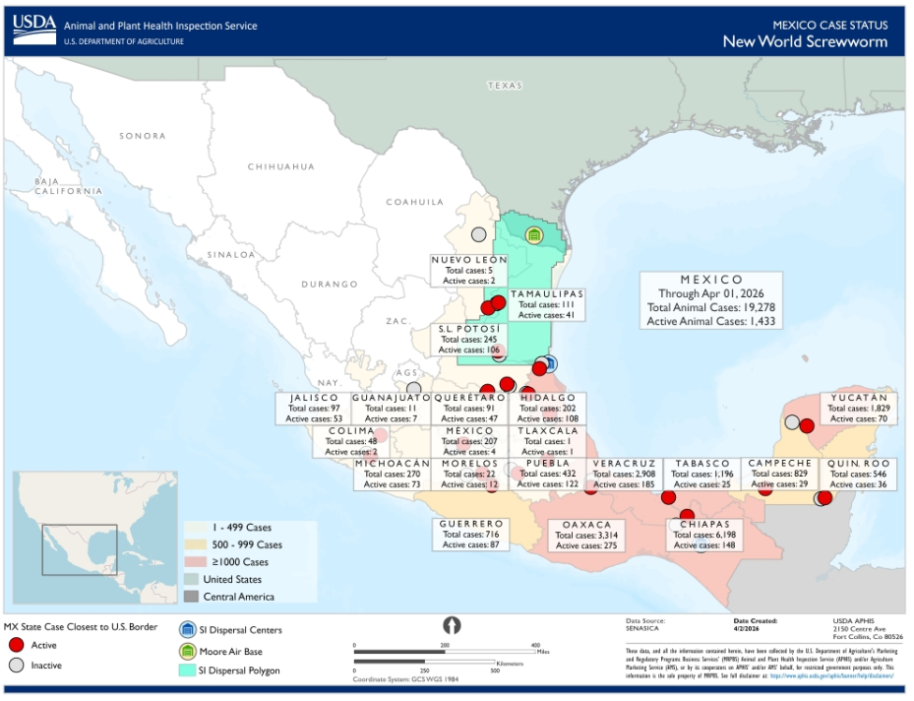
Current Status of NWS
Currently, the New World screwworm (NWS) fly is not present in the United States and there are no cases of NWS in the United States.
As of April 2nd, there are 1,433 currently active animal cases and 19,278 total cumulative in Mexico.
  Tamaulipas has had 111 animal cases.
  Additionally, cases are reported towards the west of Tamaulipas to include 106 active cases in San Luis Potosi and 2 active cases in southern Neuvo Lean.
Available at: Current Status of New World Screwworm | Screwworm.gov, accessed on April 7, 2026.
9

Slide 10
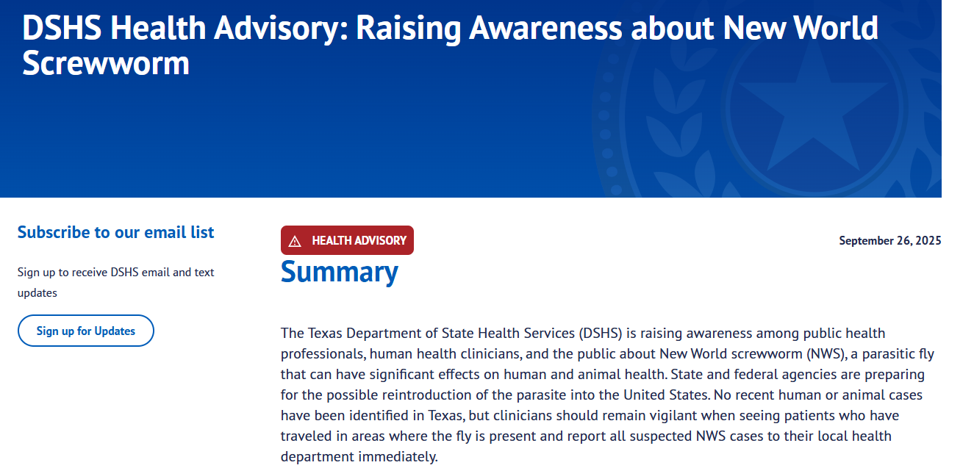
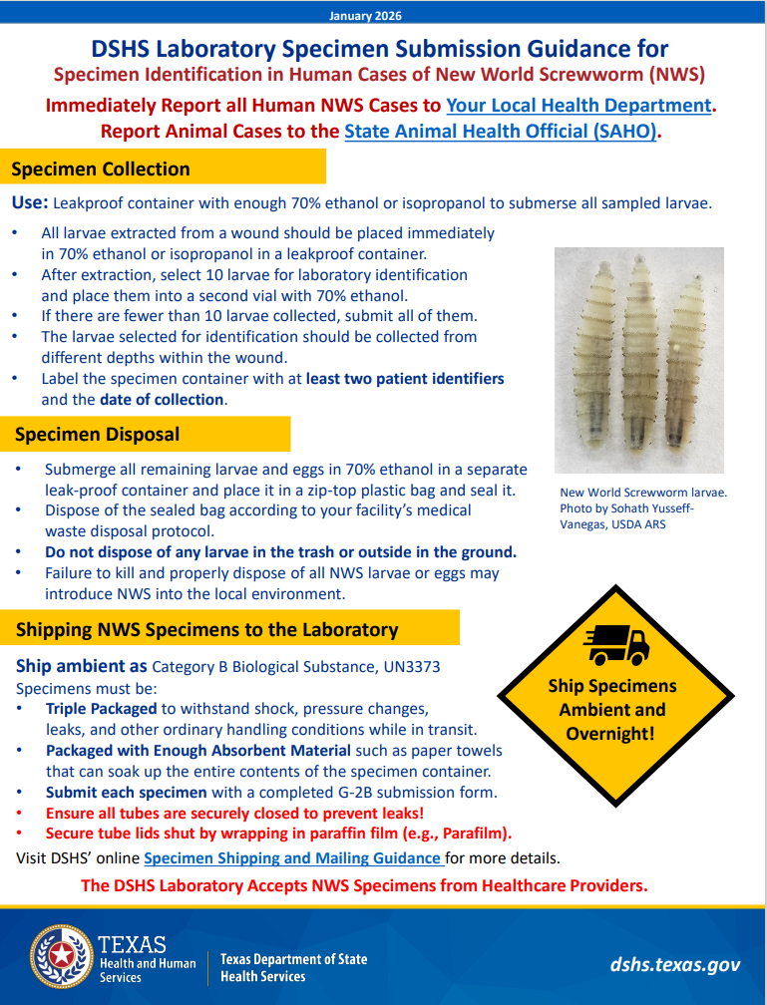
Texas NWS Preparation and Coordination
One Health approach
Ensure collection of appropriate specimens and establish submission process
Ensure appropriate disposal of all larvae
Case reporting and investigation
Communication planning
Education and training
Available at: DSHS Health Advisory: Raising Awareness about New World Screwworm | Texas DSHS; accessed on April 7, 2026.
Available at: DSHS Lab NWS Specimen Submission Guidance; accessed on April 7, 2026.

Slide 11
Texas Respiratory Virus Illness

Slide 12
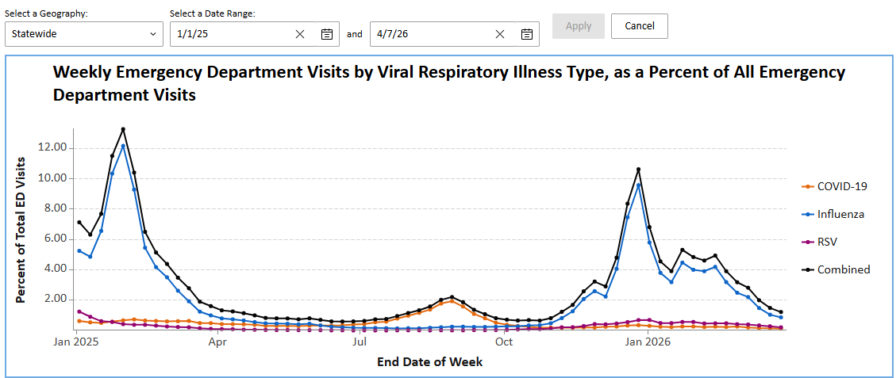
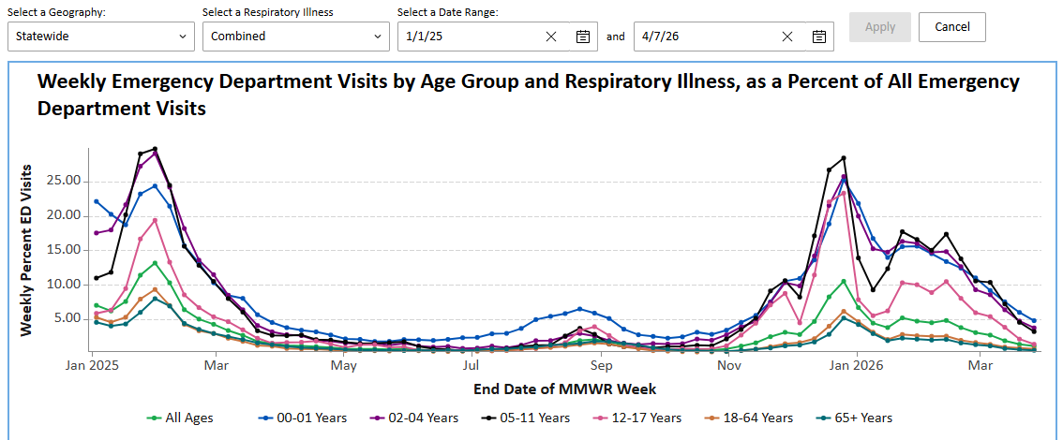
Texas Respiratory Virus Illnesses
Available at: TX Respiratory Illness Dashboard: Emergency Department Visits | Texas Respiratory Illnesses Dashboard, accessed on April 7, 2026.

Slide 13
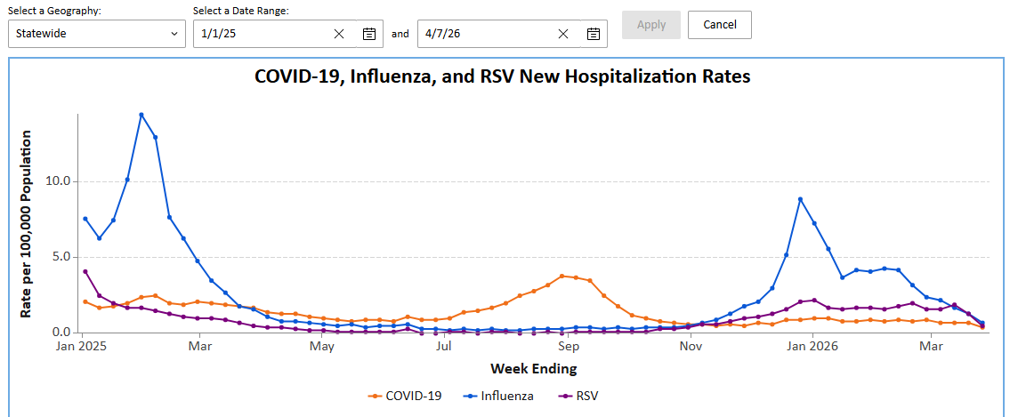
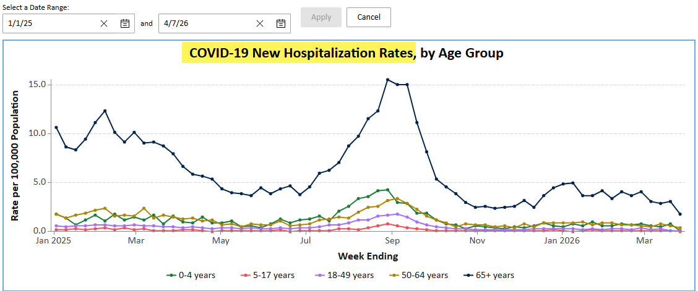
Texas Respiratory Virus Illnesses
Available at: TX Respiratory Illness Dashboard: Current Hospitalizations Data | Texas Respiratory Illnesses Dashboard, accessed on April 7, 2026.

Slide 14
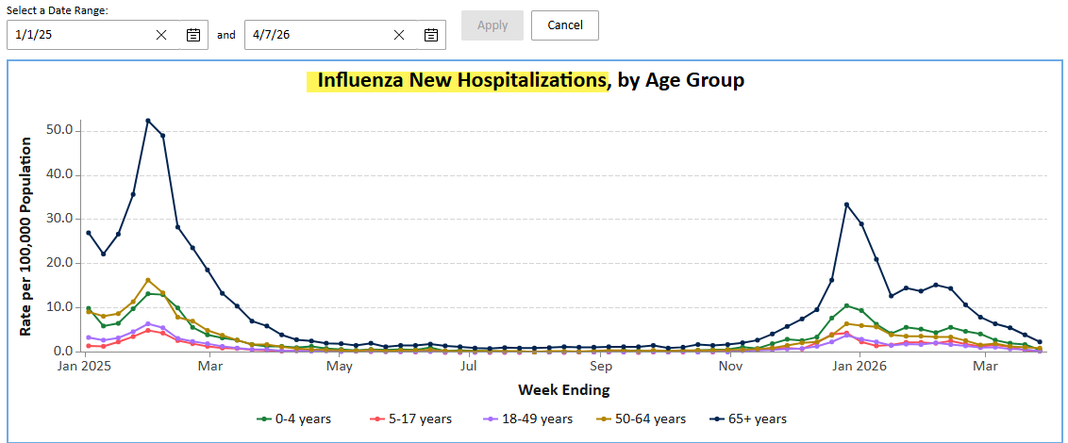
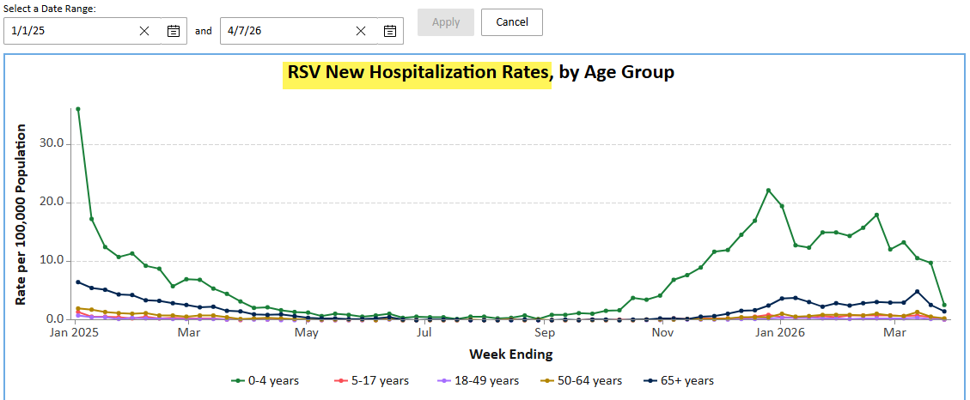
Texas Respiratory Virus Illnesses
Available at: TX Respiratory Illness Dashboard: Current Hospitalizations Data | Texas Respiratory Illnesses Dashboard, accessed on April 7, 2026.

Slide 15
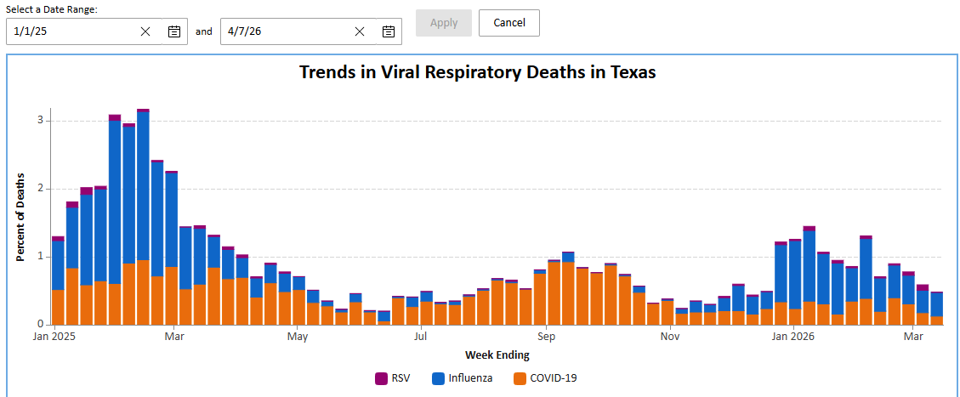
Texas Respiratory Virus Illnesses
Available at: TX Respiratory Illness Dashboard: Viral Respiratory Deaths | Texas Respiratory Illnesses Dashboard, accessed on April 7, 2026.

Slide 16
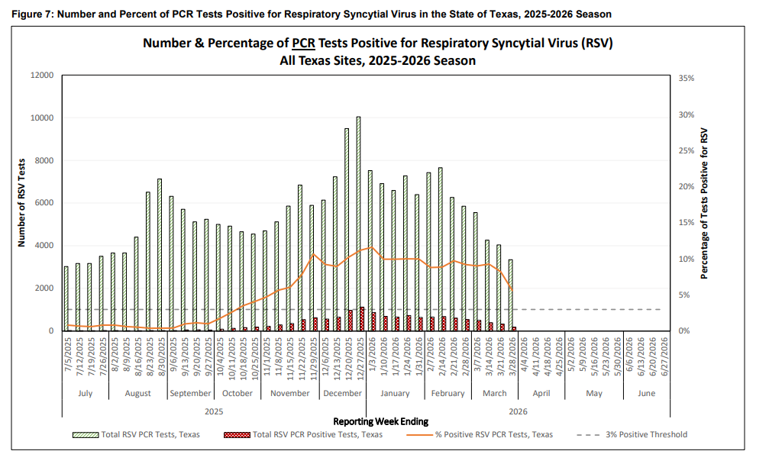
Texas Respiratory Syncytial Virus (RSV) Surveillance
Texas Respiratory Syncytial Virus (RSV) Surveillance
Available at: Texas Respiratory Virus Surveillance Report | MMWR Week 12, 2026 | 04.06.2026, accessed on April 7, 2026.
Available at: Texas Respiratory Virus Surveillance Report | MMWR Week 12, 2026 | 04.06.2026, accessed on April 7, 2026.

Slide 17
Respiratory Syncytial Virus (RSV) Immunization Products Ordering
Monica Gamez
Interim Deputy Commissioner
Infectious Disease Prevention Division
Texas Department of State Health Services

Slide 18
2025–2026 RSV Immunization Products Ordering
Texas Vaccine for Children providers may continue ordering the two RSV immunization products [Beyfortus® (nirsevimab) and ENFLONSIA™ (clesrovimab)] in the Vaccine Allocation and Ordering System through April 17, 2026.
Providers should review expiration dates of immunization products currently in stock and prioritize the use of doses with shorter expiration dates.
Providers, exercising clinical judgment and using shared clinical decision making, may continue to administer RSV infant immunizations through April 30, 2026.
Resources
  Guidance on administration of RSV immunization can be found here.
  Details of reporting adverse events after administration of RSV immunization is provided here.
  RSV Immunization Information Statement

Slide 19
Thank you

