Slide 1
HB 2844
Implementation
Update
2026
Consumer Protection Division
Food & Drug Section
Food Safety Unit
Retail Food Safety Operations Branch

Slide 2

MFV Rules-25 TAC 226
(Title 25, Chapter 226, TX Administrative Code)
Effective: 05.19.2026
Published in TAC 226

Slide 3

HB 2844 Implementation
  DSHS has been focused on:
    Operational Implementation
    SOP Development
    Training Development
    Internal Reorganization

Slide 4

Collaborative Agreement
437B.153: Authorizes DSHS to enter into “collaborative agreements” to reimburse Local Jurisdictions for conducting MFV inspections. However, HSC 437B.002 clarifies that local jurisdictions are not obligated to participate.
Proposed Reimbursement:
Type I: $250
Type II: $350
Type III: $400
Surveys, SOPs, Inspections

Slide 5

Local Health Department Workgroup
Workgroup meets once a week
Discuss Updates, Clarifications, and SOPs
MFV Guide, website updates, and SOPs have been completed

Slide 6
MFV Types
Type I
MFVs who don’t sell any time and temperature for safety (TCS) foods
MFVs who are otherwise deemed a low risk of harm to the public
Examples: Prepackaged ice cream vendors and prepackaged non-TCS snack vendors
Type II
MFVs who sell prepackaged TCS food that needs limited handling and preparation
MFVs who sell TCS food that is prepared to order and served for immediate consumption
MFVs whose processes include preparing, cold holding, thawing, and/or reheating commercially processed or packaged products
Examples: Coffee trucks, snow cone vendors, hot dog vendors
Type III
MFVs who prepare, cook, hold, and serve food from an FVV
MFVs whose processes include hot holding, cold holding, thawing, cooking, cooling, or reheating
Examples: Burger truck, BBQ truck, taco truck

Slide 7
Licensing Follow Up
There are two categories of applicants for the initial licensing and inspection plan starting in June.
Category One
If you have an existing mobile food unit or mobile food vendor license from a local health department in Texas, you can keep operating if you:
Provide proof of that license when you apply through DSHS
Submit the application and pay the fees
Print and keep the application summary on your food vending vehicle at all times
Category Two
If you do not have a current license anywhere in the state of Texas, you cannot operate until the pre-licensing inspection is completed. DSHS will prioritize your application.
What happens after the pre-licensing inspection is successfully completed?
You will be granted a DSHS MFV license that expires one year from the date of your successfully completed pre-licensing inspection.

Slide 8
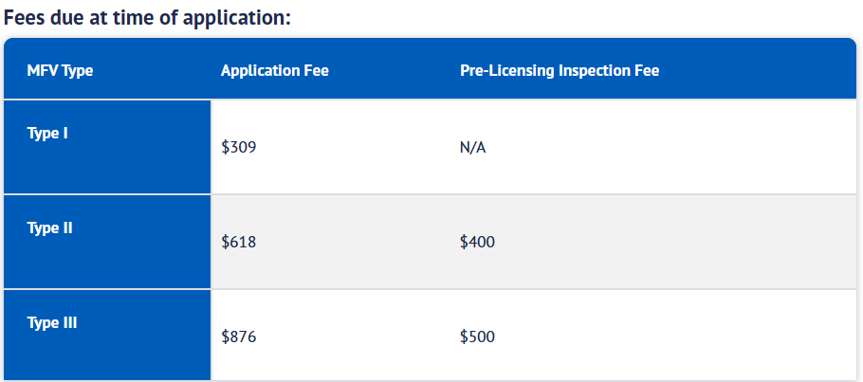
Application Fees

Slide 9
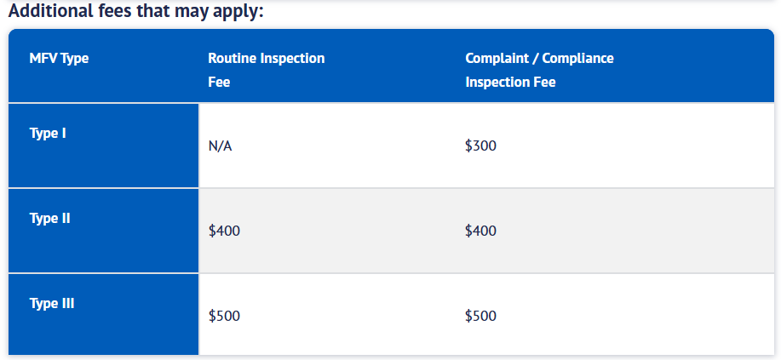
Other Fees

Slide 10
Operational Follow Up
Weekend Support and Emergency Closure
  DSHS staff will receive inquiries from local partners regarding requests for emergency closure, including on weekends
  DSHS is reviewing existing emergency closure processes to help standardize and ensure consistency across jurisdictions
Other Updates
  Trainings will be housed on TX Train
  Statewide MFV application portal live June 4th
  Training on related IT solution for DSHS/collaborative agreement partners to access licensure information - Mid June

Slide 11
New Contact Information for MFVs
Phone Number
512-712-3975
Email Address
MobileFoodVendor@dshs.Texas.gov

Slide 12

QUESTIONS?
foodestablishments@dshs.texas.gov

