Slide 1
Public Health Services Survey
Regional & Local Health Operations

Slide 2
Survey Background
Presentation Title

Slide 3
Public Health Services Survey
Background
Survey Development
Original survey sent to all Local Health Entity (LHEs) and Public Health Regions (PHRs) in April 2024
Received responses from ‘full-service’ LHEs.
Follow up survey sent to all 2024 respondents plus Bastrop County (new LHE) February 2026
Administered through Qualtrics and takes ~30 minutes to complete
Input provided by:
LHEs
DSHS Programs
DSHS PHRs
PHFPC
TACCHO
Notes:
2024: 67 respondents
2026: 56 respondents
2024 Survey was sent to all LHEs, and many smaller LHEs (i.e. environmental health depts and code enforcement like Port Aransas) responded all “no”s, so we excluded them in the 2026 survey)

Slide 4
Survey Goals
Gain an understanding of current public health services distribution across the state.
Develop common knowledge among all public health system partners of what services are provided and where.
Create opportunities for public health system partners to share knowledge and application of services.
Provide input into legislative and budget planning discussions.
Notes:
Glenna to fill out

Slide 5
Survey Details
Asks:
  Submitter information, name of public health entity and number of FTEs
  Does the LHE provide the following services:
Disease & Surveillance | Prevention & Community Health | Clinical & Support Services
HIV | Pop-Based Prevention | Immunizations
Syphilis | Community Preparedness | Primary Care
STD | Environmental Health | Oral Health
Hepatitis C | Public Health Sanitation | Mental/Behavioral Health
TB | Regulation, Inspection, Licensing | Eligibility/Social Services
Zoonosis Control |  | WIC
Notifiable Conditions Surveillance and Epi |  | Vital Statistics
 |  | Laboratory

Slide 6
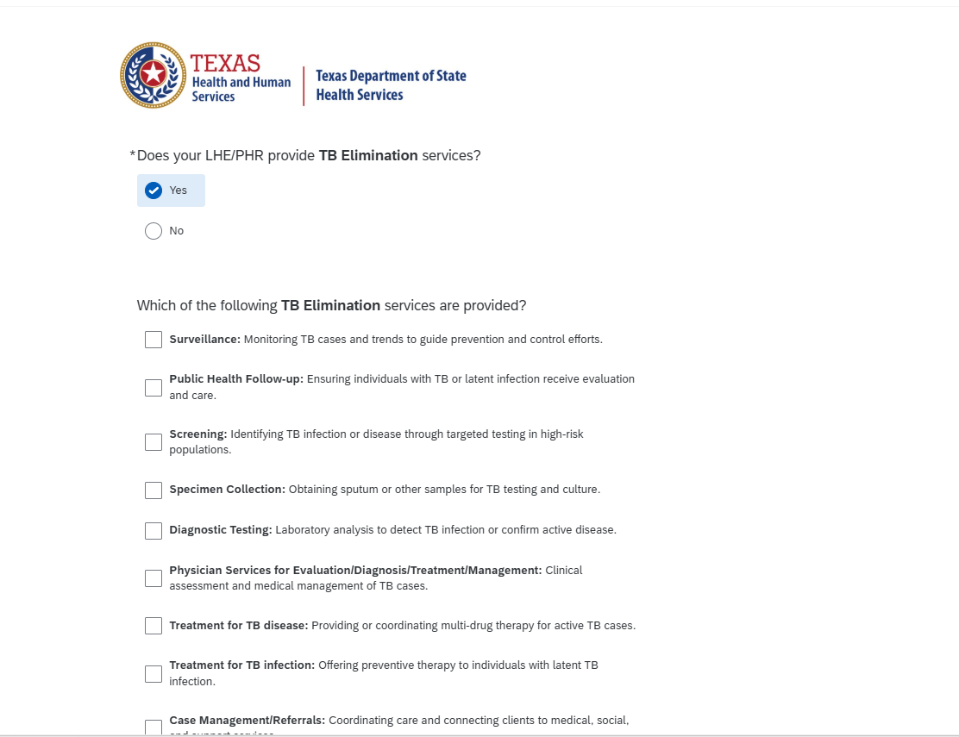
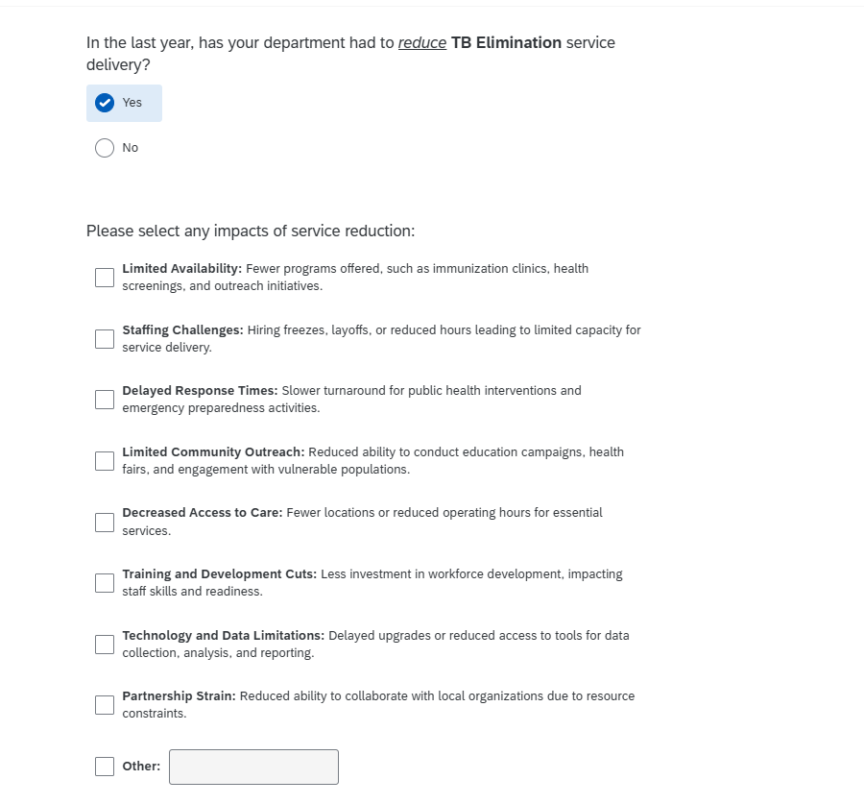
Survey Snapshot

Slide 7
Preliminary Survey Analysis
Presentation Title

Slide 8
Survey Data
Received 64 responses out of 66 survey recipients
  8 of those responses were from PHRs and were excluded from analysis for this report.
  This analysis includes data from 56 LHEs.
Full-Time Equivalent (FTE) Employees:
  Total FTEs: 7602
  Average FTEs per LHD: 136

Slide 9
Preliminary Survey Analysis
Strong participation across LHEs and all PHRs
Broad service coverage across most public health functions
Key finding: Service reductions reported across multiple service areas
Major pressures:
Staffing constraints
Funding instability
Reduced outreach and operational capacity

Slide 10
Public Health Services Provision
Presentation Title

Slide 11
Service Availability Snapshot
Most commonly provided services:
  Communicable disease (HIV, STD, TB)
  Immunizations
  Environmental health / inspections
Less consistently provided services:
  Oral health
  Mental/behavioral health
  Primary care
  Lab services

Slide 12
Communicable Disease Services
Widely provided across LHEs:
  HIV, STD, and TB services
Common service components:
  Surveillance and case investigation
  Screening and testing
  Case management and referrals
Reported challenges:
  Staffing shortages
  Reduced outreach capacity
  Delays in response and follow-up

Slide 13
Immunization Services
Nearly universal service across LHEs
Common activities:
  Vaccine administration
  Provider support and audits
  Community outreach and education
Key challenges reported:
  Staffing shortages
  Reduced outreach/community engagement
  Limited clinic availability

Slide 14
Service Reductions

Slide 15
Percentage of overall impacts by LHEs
Notes:
Interpreted as: 52% of LHEs reported at least having staffing challenges due to funding cuts in at least one of the services, followed by limited community outreach. The percentages total more than 100% as this was a “select all that apply” type of question, and each impacted LHE reported more than one impact.

Slide 16
Percentage of overall impacts among services
*# of LHEs reporting a reduction/ # of proving the service
Notes:
# of LHEs reporting “yes” for reduction / # of LHDs selecting “yes” for providing service
For anyone who indicated they provide POP-based/preventive services, over half reported reducing services.

Slide 17
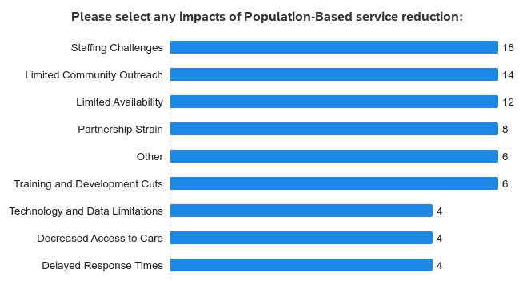
Example- Population based services
22 out of 42 LHEs who provide population-based service reported impact on their population-based services delivery.
Notes:
Interpreted as: Among 42 LHEs who provide population-based services, 22 were impacted by the service reduction with majority reporting staffing challenges.

Slide 18
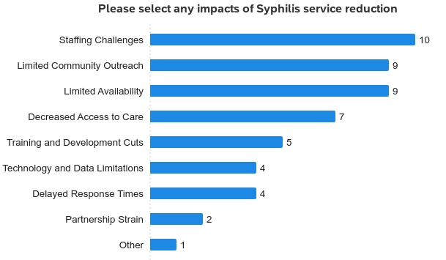
Example- Syphilis
12 LHEs reported impacts on their Syphilis services (25% of LHEs providing Syphilis services).

Slide 19
Which LHEs reported most impacts?
Out of 20 services, 6 LHEs reported impacts on more than 10 services
*The majority of those impacts were staffing challenges and limited availability for each of these LHEs.

Slide 20
Local Strengths & Adaptations
LHEs maintaining core services despite constraints
Examples of adaptation:
  Partnerships with regional/state programs
  Cross-program staffing
  Leveraging existing infrastructure
Observation:
Systems remain functional but are operating under significant strain
Notes:
Some not so bad news!

Slide 21
Key Takeaways
Public health services remain widely available
Service reductions are occurring in multiple areas
Workforce and funding challenges are primary drivers
Reduced outreach and program capacity are emerging risks
Continued support is needed to sustain essential services

Slide 22
Next Steps / Discussion
Perform more detailed survey analysis, including rates of change in service and workforce from 2024 to 2026
Identify priority service gaps
Assess opportunities for collaboration

Slide 23
Thank you!
rlho@dshs.texas.gov
Glenna Laughlin, MA, CHES
Director, Regional and Local Coordination
glenna.laughlin@dshs.texas.gov

