Slide 1
Emerging Infectious Diseases Update
PHFPC Briefing
Varun Shetty, MD, MBA, MS
Chief State Epidemiologist
Josh Hutchison
Deputy Commissioner
Texas Department of State Health Services
December 10, 2025

Slide 2
Discussion Topics
Respiratory Virus Illnesses
Pertussis
Monkeypox
New World Screwworm
Marburg in Ethiopia
Measles

Slide 3
DISCLAIMER
The information presented today is based current preliminary data and on CDC’s recent guidance. Information is subject to change.
December 10, 2025

Slide 4
Respiratory Virus Illnesses

Slide 5
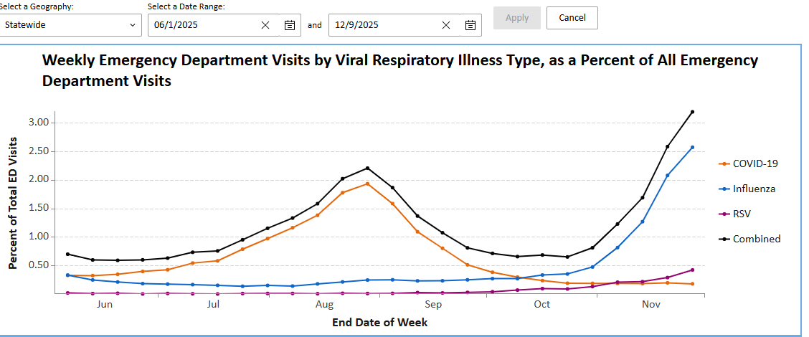
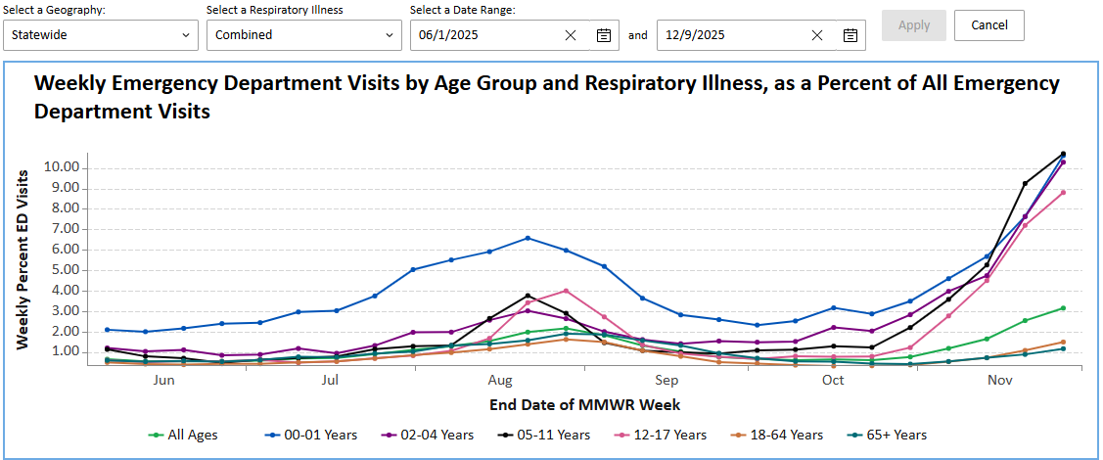
Texas Respiratory Virus Illnesses
Available at: TX Respiratory Illness Dashboard: Emergency Department Visits | Texas Respiratory Illnesses Dashboard, accessed on December 9, 2025.

Slide 6
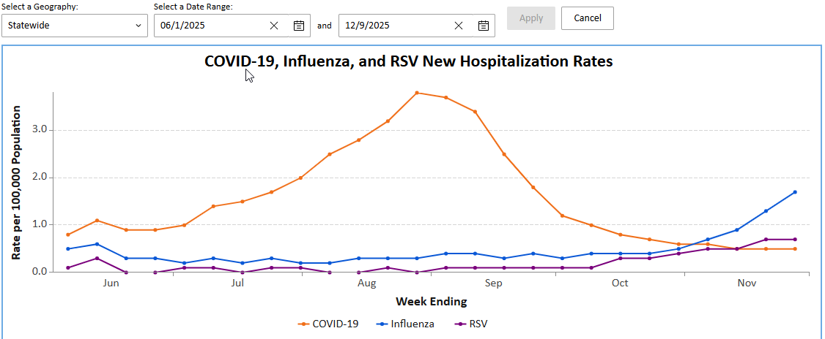
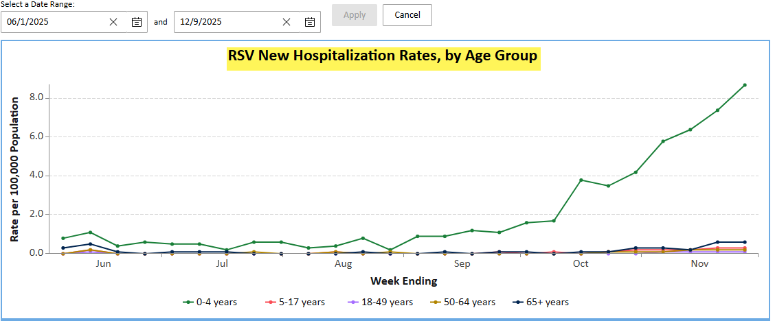
Texas Respiratory Virus Illnesses
Available at: TX Respiratory Illness Dashboard: Current Hospitalizations Data | Texas Respiratory Illnesses Dashboard, accessed on December 9, 2025.

Slide 7
Influenza A(H5) Human Cases
On November 13, 2025, Washington State Department of Health (DOH) reported a human case of avian influenza.
  An older individual with underlying health conditions with H5N5 avian influenza
  The person had a backyard flock of mixed domestic birds.
  DOH sampling identified avian influenza virus in the environment of the flock, making exposure to the domestic poultry, their environment, or wild birds the most likely source of exposure for this patient.
  People who had exposure to the backyard flock and environment are also being monitored for symptoms.
  On November 21, 2025, DOH announced the individual had deceased.
As of December 3, 2025, there are a total of 71 human cases of avian influenza A(H5) reported in the United States which includes 2 deaths.

Slide 8
Preventing Respiratory Illnesses
Core Prevention Strategies
Core prevention strategies are essential practices recommended for everyone. They provide a foundation of protection:
  Stay up to date with recommended immunizations. Talk to your doctor or trusted healthcare provider about what may be recommended for you and your family.
  Practice good hygiene like washing your hands regularly and cleaning commonly touched surfaces.
  Take steps for cleaner air as possible in places where people live and work.
  When sick with a respiratory illness:
    Use precautions to prevent spread. Stay home and away from others.
    Seek health care promptly for treatment if you have risk factors for severe illness; treatment may help lower your risk of severe illness.
Available: Preventing Respiratory Illnesses | Respiratory Illnesses | CDC, accessed December 9, 2025

Slide 9
2025-2026 Seasonal Influenza Vaccination
All 2025-2026 influenza vaccine available in the United States are trivalent vaccines.
Routine annual influenza vaccination for all individuals aged >6 months who do not have a contraindication to vaccination continues to be recommended.
On June 26, 2025, ACIP made a new recommendation that children aged <18 years, pregnant women and all adults receive seasonal influenza vaccines only in single-dose formulations that are free of thimerosal as a preservative.
FluMist (nasal spray live attenuated influenza vaccine -LAIV3) for self-administration is approved for recipients aged 18 through 49 years or administration by a caregiver aged >18 years for children and adolescents aged 2 through 17 years.
A comprehensive summary of influenza vaccines, age indications, dosage and administration are available here.
A recent article published in the Emerging Infectious Diseases journal showed that human seasonal influenza vaccines also confer partial protection against disease caused by H5N1 clade 2.3.4b virus in ferrets.
Available at: Prevention and Control of Seasonal Influenza with Vaccines: Recommendations of the Advisory Committee on Immunization Practices — United States, 2025–26 Influenza Season | MMWR, accessed on December 9, 2025

Slide 10
Respiratory Syncytial Virus (RSV) Immunization
Guidance for Infants and Young Children
To prevent severe RSV disease in infants:
  Either maternal RSV vaccination (Pfizer's Abrysvo), recommended for women during weeks 32 – 26 of pregnancy, administered September – January in most of the United States, or
  Infant immunization with a long-acting RSV monoclonal antibody (nirsevimab or clesrovimab) is recommended.
  Most infants will not need both maternal vaccination and infant RSV antibodies.
Administration of infant RSV antibody is recommended during October through March in most of the U.S.
  The optimal timing for infant RSV antibody administration is shortly before the RSV season begins (e.g., October–November), or within a baby's first week of life if born October through March (ideally during the birth hospitalization.)
Infant RSV antibodies are highly effective in preventing RSV-associated hospitalization.
Available: RSV Immunization Guidance for Infants and Young Children | RSV | CDC, accessed December 9, 2025

Slide 11
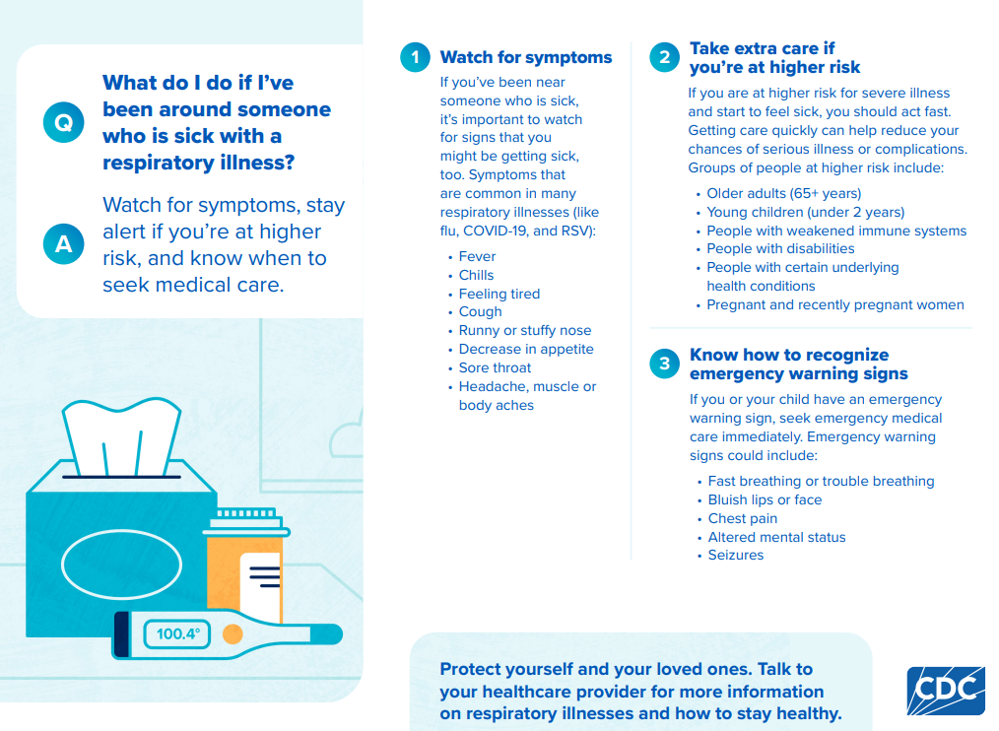
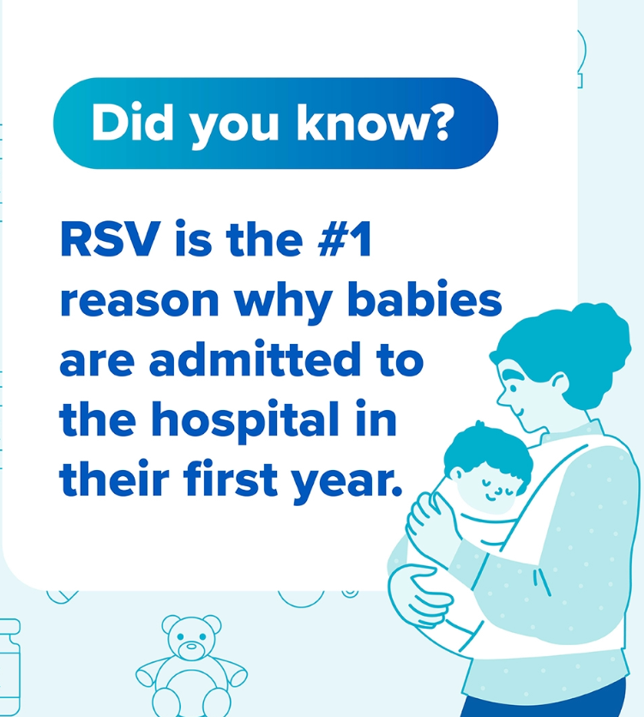
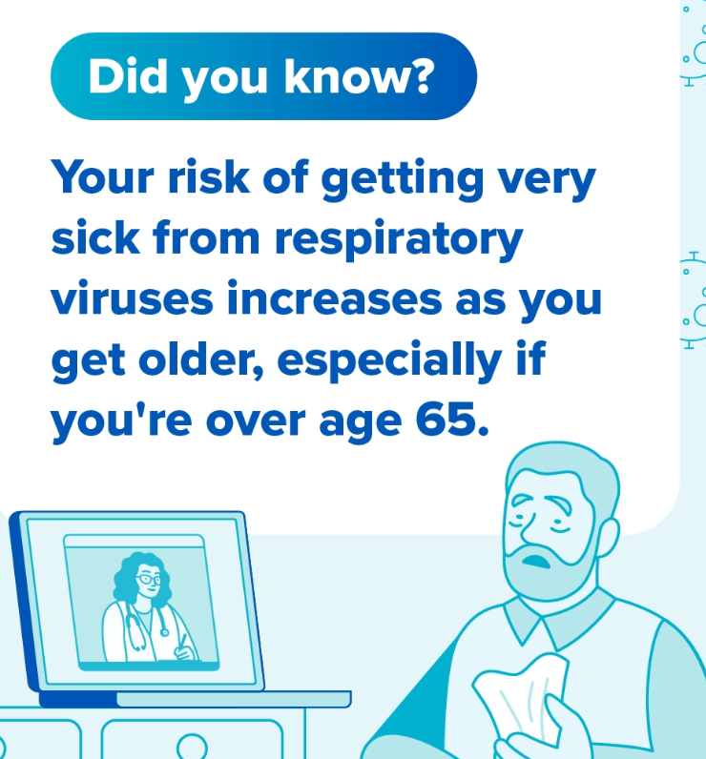
CDC Respiratory Illness Season Toolkit
CDC has developed a Respiratory Illness Season Toolkit
This toolkit provides essential resources and communication materials to assist public health partners in effectively engaging with the public, healthcare providers, and their partners before and during the respiratory illness season.
It includes sample social media messages, graphics, videos, handouts, and other respiratory illness-related tools for clinicians and other public health partners.
Available: Respiratory Illness Season Toolkit | Respiratory Illnesses | CDC, accessed on December 9, 2025

Slide 12
RSV Products Available Through TVFC
Infant RSV Immunization Products
Manufacturer | NDC | Brand | Description
Sanofi | 49281-0575-15 | Beyfortus® (50 mg) | Pre-filled syringe (50 mg/0.5 mL)
Sanofi | 49281-0574-15 | Beyfortus® (100 mg) | Pre-filled syringe (100 mg/mL)
Merck | 00006-5073-01 | ENFLONSIA™ | Pre-filled syringe 1-pack
Merck | 00006-5073-02 | ENFLONSIA™ | Pre-filled syringe 10-pack
Material RSV Vaccine
Manufacturer | NDC | Brand | Description
Pfizer | 00069-24-65-01 | Abrysvo® (0.5 mL) | One pack – single-dose vial

Slide 13
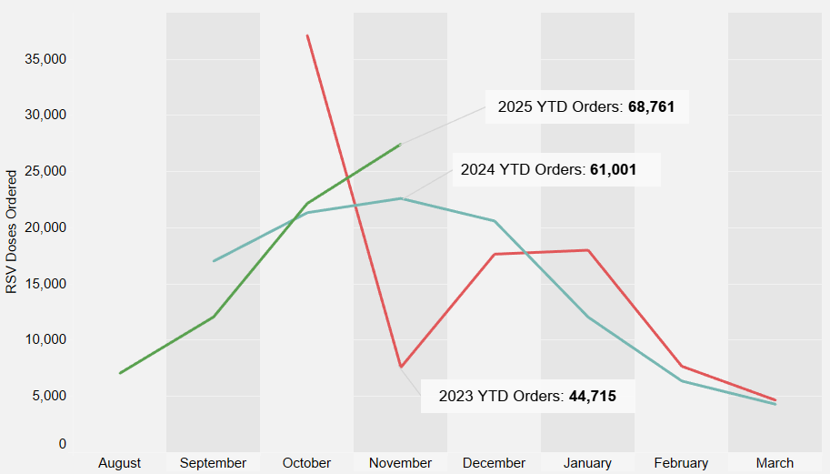
RSV Products Ordering by Season Year to
Date Ordering
Legend
2023
2024
2025
Data source: CDC Vaccine Tracking System (VTrckS)
Data is current as of November 24, 2025
RSV Products include: Beyfortus®, Abrysvo®, ENFLONSIA™

Slide 14
2025–2026 RSV Product Doses Ordered
Public Health Region (PHR) | Total 2025-2026 Orders by Brand
 | Beyfortus® 100mg | Beyfortus® 50mg | Abrysvo™ | ENFLONSIA™
PHR 1 | 1,295 | 1,555 | 3 | 49
PHR 2/3 | 6,090 | 9,110 | 59 | 683
PHR 4/5N | 1,840 | 2,405 | 13 | 125
PHR 6/5S | 5,495 | 6,145 | 71 | 325
PHR 7 | 4,440 | 4,690 | 32 | 52
PHR 8 | 650 | 685 | 3 | 243
PHR 9/10 | 1,495 | 1,675 | 3 | 240
PHR 11 | 3,160 | 3,510 | 1 | 803
City of Houston | 2,485 | 5,015 | 55 | 121
San Antonio | 1,435 | 2,555 | 40 | 110
Total | 28,385 | 37,345 | 280 | 2,751
Data source: CDC Vaccine Tracking System (VTrckS)
Data is current as of November 24, 2025

Slide 15
RSV Monoclonal Antibody Product
Doses Administered by Season
Data source from Texas Vaccines for Children Program administration data (VAOS).
Data is current as of November 24, 2025. 2023–2024 was the first season data was available.
TVFC Program added Enflonsia in October 2025.
Notes:
In this graph we have TVFC RSV Monoclonal Antibody Product Doses administered over time, by Respiratory Season.
The graph shows an overall increase in Pe doses administered in the TVFC program since between the 23-24, 24-25, and 25-26 RSV seasons
October 2025 includes 186 administrations of Enflonsia in addition to 28,086 administrations of Beyfortus. Previous seasons only included Beyfortus.

Slide 16
Pertussis

Slide 17
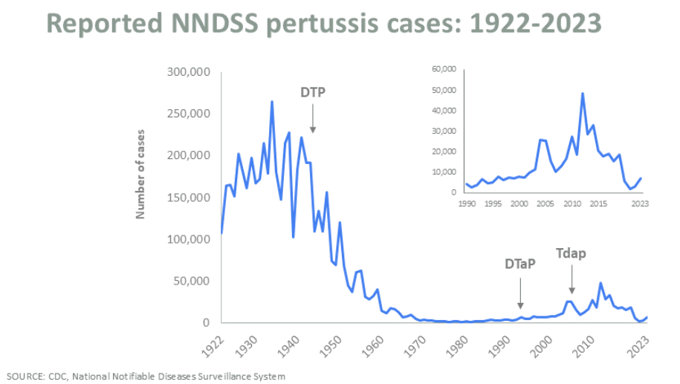
Pertussis Cases in the United States and Texas
United States
*Provisional data
Available at: Pertussis Surveillance and Trends | Whooping Cough | CDC, accessed on December 9, 2025.
Available at: Pertussis (Whooping Cough) | Texas DSHS

Slide 18
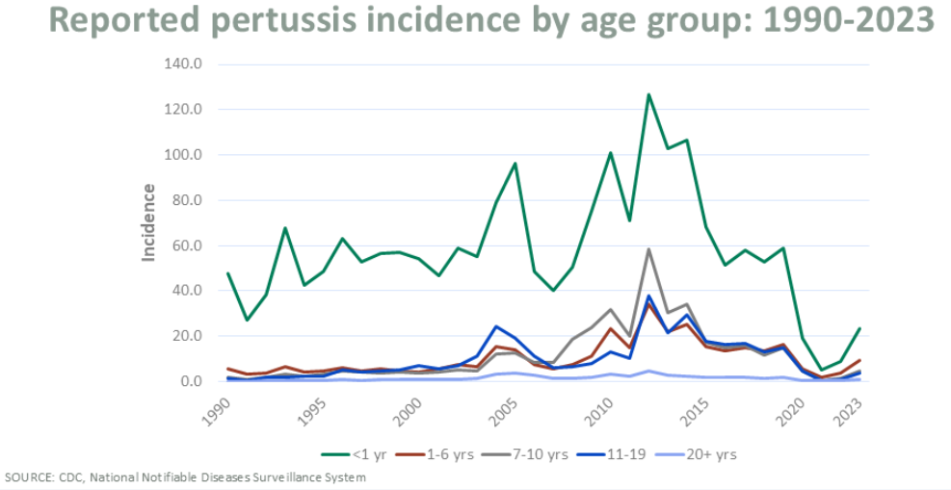
Pertussis Incidence by Age Group
United States and Texas
Infants under 1 year old have the highest incidence of pertussis in the United States and Texas.
United States
Available at: Pertussis Surveillance and Trends | Whooping Cough | CDC, accessed on December 9, 2025.
Data Source: Texas NEDSS, Produced by DSHS EAIDU Unit

Slide 19
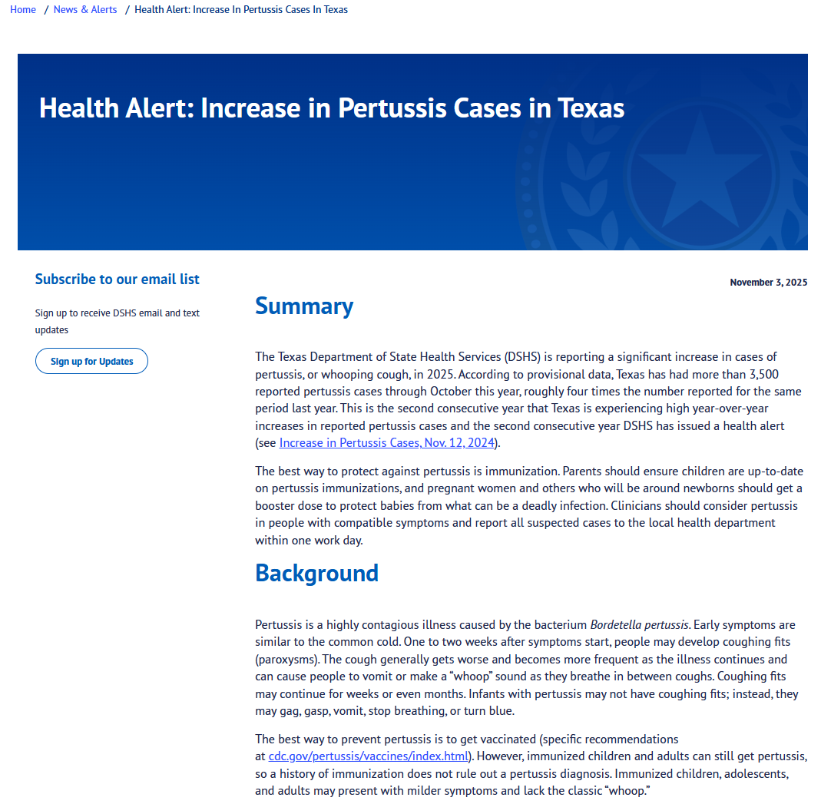
DSHS Health Alert -
Increase in Pertussis Cases in Texas
On November 3, 2025, the Texas Department of State Health Services (DSHS) issued a Health Alert: Increase in Pertussis Cases in Texas
According to provisional data, Texas has had more than 3,500 reported pertussis cases through October this year, roughly four times the number reported for the same period last year.
This is the second consecutive year that Texas is experiencing high year-over-year increases in reported pertussis cases and the second consecutive year DSHS has issued a health alert.
The best way to protect against pertussis is immunization.
  Parents should ensure children are up to date on pertussis immunizations, and pregnant women and others who will be around newborns should get a booster dose to protect babies from what can be a deadly infection.
Clinicians should consider pertussis in people with compatible symptoms and report all suspected cases to the local health department within one workday.
Available at: Health Alert: Increase in Pertussis Cases in Texas | Texas DSHS, accessed on December 9, 2025.

Slide 20
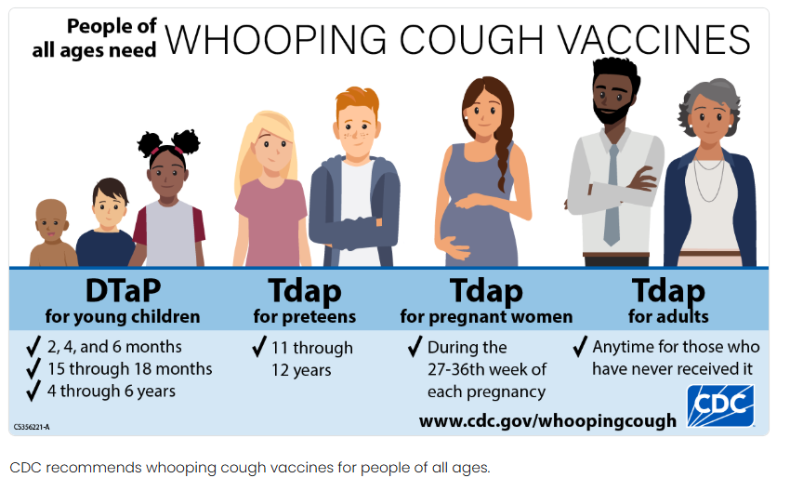
Pertussis Vaccination Recommendation Overview
Available at: Whooping Cough Vaccination | Whooping Cough | CDC, accessed on December 9, 2025.

Slide 21
Pertussis Vaccine Administration Data
(TVFC and ASN)
Data source from Texas Vaccines for Children Program administration data (VAOS).
Data is current as of December 8, 2025.

Slide 22
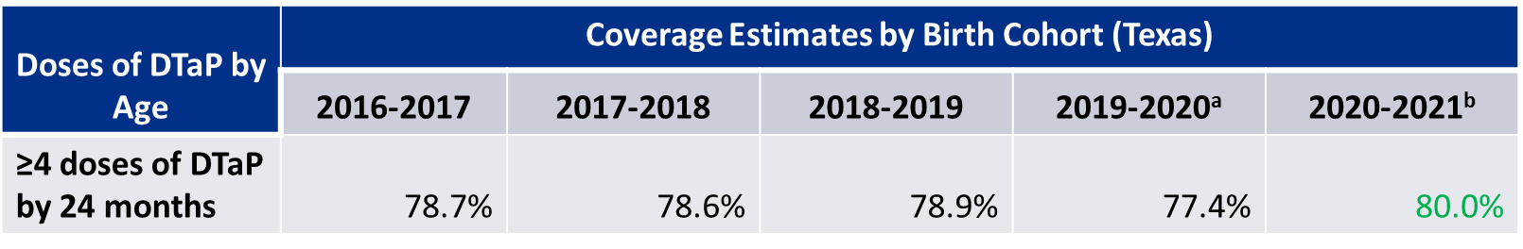
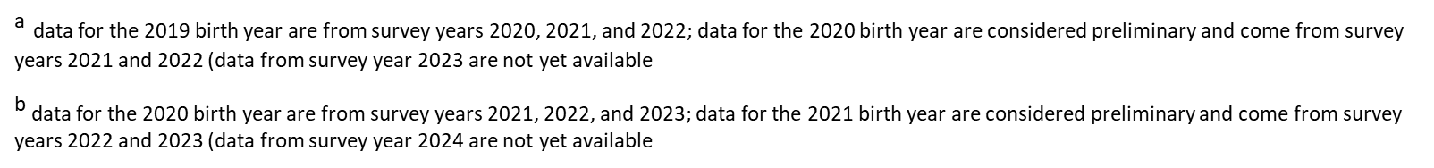
National Immunization Survey

Slide 23
Monkeypox

Slide 24
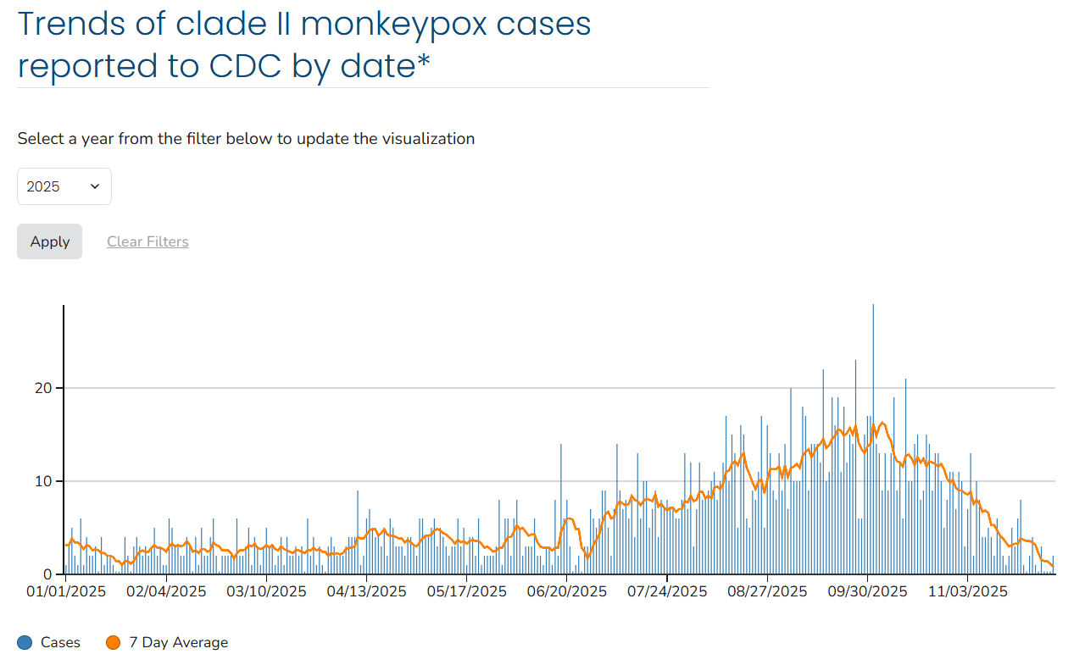
Monkeypox in the United States
Clade II monkeypox continues to circulate at low levels in the United States.
  The majority of U.S. cases of clade II monkeypox continue to be in people who are not vaccinated or who have only received one dose of JYNNEOS. Two doses of JYNNEOS are recommended to provide maximum protection.
As of December 3, 2025, there are 9 cases of clade I monkeypox reported in the U.S.
  Of these, 6 cases were in people who had recently traveled to areas affected areas associated with the outbreak in Central and Eastern Africa.
  Health authorities in Southern California have reported 3 cases of clade I monkeypox in people with no recent travel.
    All three individuals have recovered from the illness.
    Viral genomic (DNA fingerprint) data indicate that these three cases may be linked to a different US case reported in August 2025.
    CDC assesses the risk of clade I monkeypox in the U.S. to the general population as low.
Available at: U.S. Case Trends: Clade II Monkeypox | Monkeypox | CDC, accessed on December 9, 2025.
Available at: Monkeypox in the United States and Around the World: Current Situation | Monkeypox | CDC, accessed on December 9, 2025.

Slide 25
Monkeypox in Texas
On December 1, 2025, DSHS issued a Dear Provider letter to providers who treat high-risk population for monkeypox.
  The letter provides updates and guidance related to recent trends in monkeypox virus clade I and clade II transmission.
  To date, there have been no clade I monkeypox cases identified in Texas. However, clade II monkeypox continues to spread with an uptick in reported cases in recent months. Preliminary data suggests that between July and October 2025, Texas saw an average of 42 cases per month, compared with an average of 15 cases per month between January and June 2025.
  Over the last year, most monkeypox cases in Texas have occurred in the largest metropolitan areas. However, more recent data trends suggest the spread of monkeypox virus (MPXV) to other parts of the state, including areas that had not had recent cases. Given these trends, the Texas Department of State Health Services (DSHS) is urging providers to remain vigilant in diagnosing and reporting cases.
Notes:
we generally continue to see ~10-30 cases per month

Slide 26
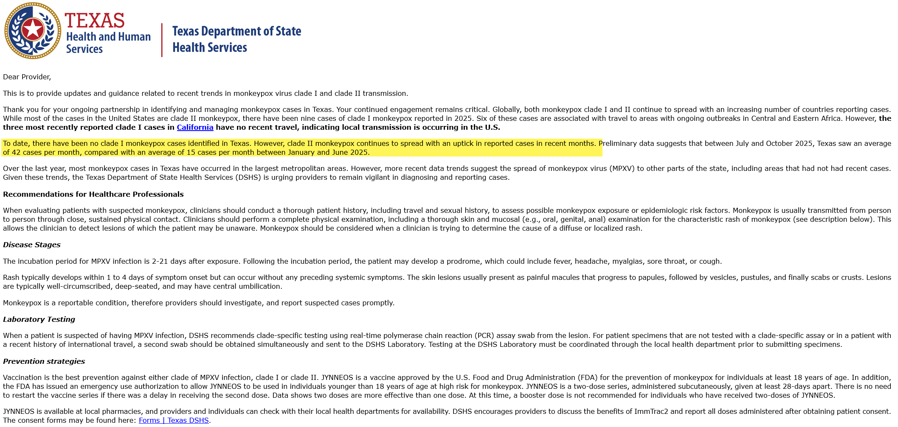
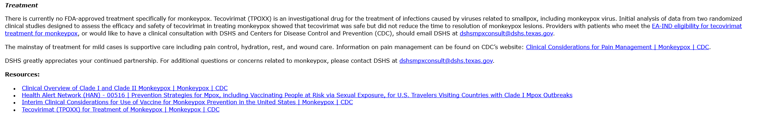
Notes:
we generally continue to see ~10-30 cases per month

Slide 27
Monkeypox Vaccine (Jynneos®)
JYNNEOS® vaccine is licensed to prevent smallpox and monkeypox and is recommended by the Advisory Committee on Immunization Practices (ACIP) for certain people at risk for exposure to orthopoxvirus infections, including monkeypox.
  It is fully licensed in the U.S. for subcutaneous administration in individuals >18 years of age
  In addition, the U.S. Food and Drug Administration (FDA) issued an emergency use authorization to allow the vaccine to be used:
    By intradermal injection (0.1mL) for prevention of monkeypox disease in individuals >18 years of age determined to be at high risk for monkeypox, and
    By subcutaneous injection (0.5mL) for prevention of monkeypox disease in individuals < 18 years of age determined to be at high risk for monkeypox.
  The vaccine is a two-dose series, given at least 28 days apart, regardless of route of administration.
  Jynneos® can be given as post-exposure prophylaxis (PEP) both to people with known or presumed exposure to monkeypox virus.
    As PEP, the vaccine should be given as soon as possible, ideally within 4 days of exposure; administration 4 through 14 days after exposure may still provide some protection against moneybox.
Available at: Interim Clinical Considerations for Use of Vaccine for Monkeypox Prevention in the United States | Monkeypox | CDC, accessed on December 9, 2025.

Slide 28
Monkeypox Vaccine (Jynneos®) Resources
Bavarian Nordic’s JYNNEOS® website
Emergency Use Authorization FDA Insert - JYNNEOS
Use of JYNNEOS (Smallpox and Mpox Vaccine, Live, Nonreplicating) for Persons Aged ≥18 Years at Risk for Mpox During an Mpox Outbreak: Recommendations of the Advisory Committee on Immunization Practices — United States, 2023 | MMWR
Use of JYNNEOS (Smallpox and Monkeypox Vaccine, Live, Nonreplicating) for Preexposure Vaccination of Persons at Risk for Occupational Exposure to Orthopoxviruses: Recommendations of the Advisory Committee on Immunization Practices — United States, 2022 | MMWR
Estimated Effectiveness of JYNNEOS Vaccine in Preventing Mpox: A Multijurisdictional Case-Control Study — United States, August 19, 2022–March 31, 2023 | MMWR

Slide 29
New World Screwworm

Slide 30
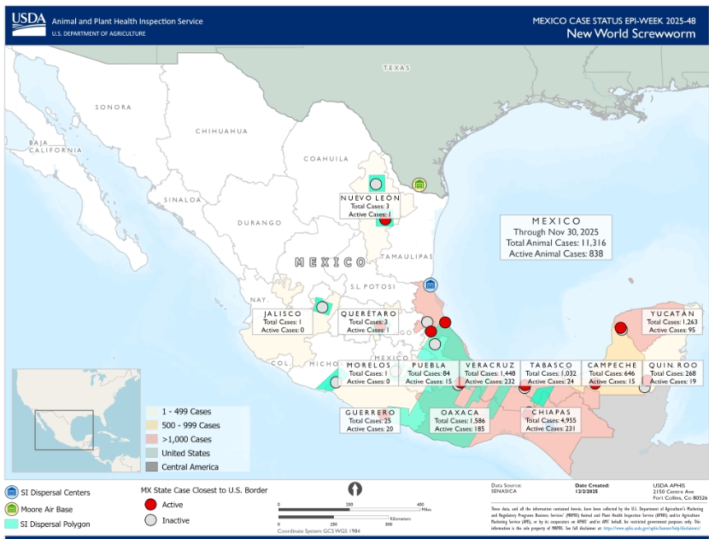
Current Situation of NWS
As of November 25, 2025, more than 135,000 NWS cases in animals and over 980 cases in people have been reported in Central America and Mexico.
On December 1, 2025, Mexico confirmed a new animal case of NWS, located in the state of Neuvo Leon, less than 135 miles from the U.S.-Mexico Border.
Currently, the NWS fly has not been detected in the United States and there is no immediate risk of infestation to people.
New World Screwworm Outbreak | New World Screwworm | CDC, Accessed on December 9, 2025
https://www.aphis.usda.gov/livestock-poultry-disease/cattle/ticks/screwworm/outbreak-central-America Accessed on December 9, 2025
https://www.gob.mx/senasica/articulos/atendemos-oportunamente-caso-aislado-de-gusano-barrenador-en-montemorelos-nuevo-leon?idiom=es; Accessed on December 9, 2025
Notes:
This map shows the reported cases from the COPEG website.
In animals, NWS is a foreign animal disease and must be reported to USDA within 24 hours of diagnosis.
Animal health officials will quarantine the animal until daily wound care and treatments with larvicides and insecticides have successfully eliminated the screwworm larvae. The USDA and CDFA investigate cases, and determine if additional control measures, such as insecticidal treatment of the environment or sterile fly release, are warranted.
Infested animals may present with enlarging, draining, foul-smelling wounds and weight loss; they may isolate themselves and show signs of discomfort. Animals may die from secondary infection or toxicity in 7-14 days if not treated. Wounds that might become infested include those caused by: •Tick bites, •Castration or dehorning, •Branding, •Shearing, and •Sore mouth in sheep. In addition, screwworms can infest the navels of newborn mammals, and mucous membranes of bodily orifices, including: nostrils and sinuses, eyes, mouth, ears, vulva, anus, prepuce, and urethral fossa
In animals, NWS is a foreign animal disease and must be reported to USDA within 24 hours of diagnosis.
l Animal health officials will quarantine the animal until daily wound care and treatments with larvicides and insecticides have successfully eliminated the screwworm larvae. The USDA and CDFA investigate cases, and determine if additional control measures, such as insecticidal treatment of the environment or sterile fly release, are warranted.

Slide 31
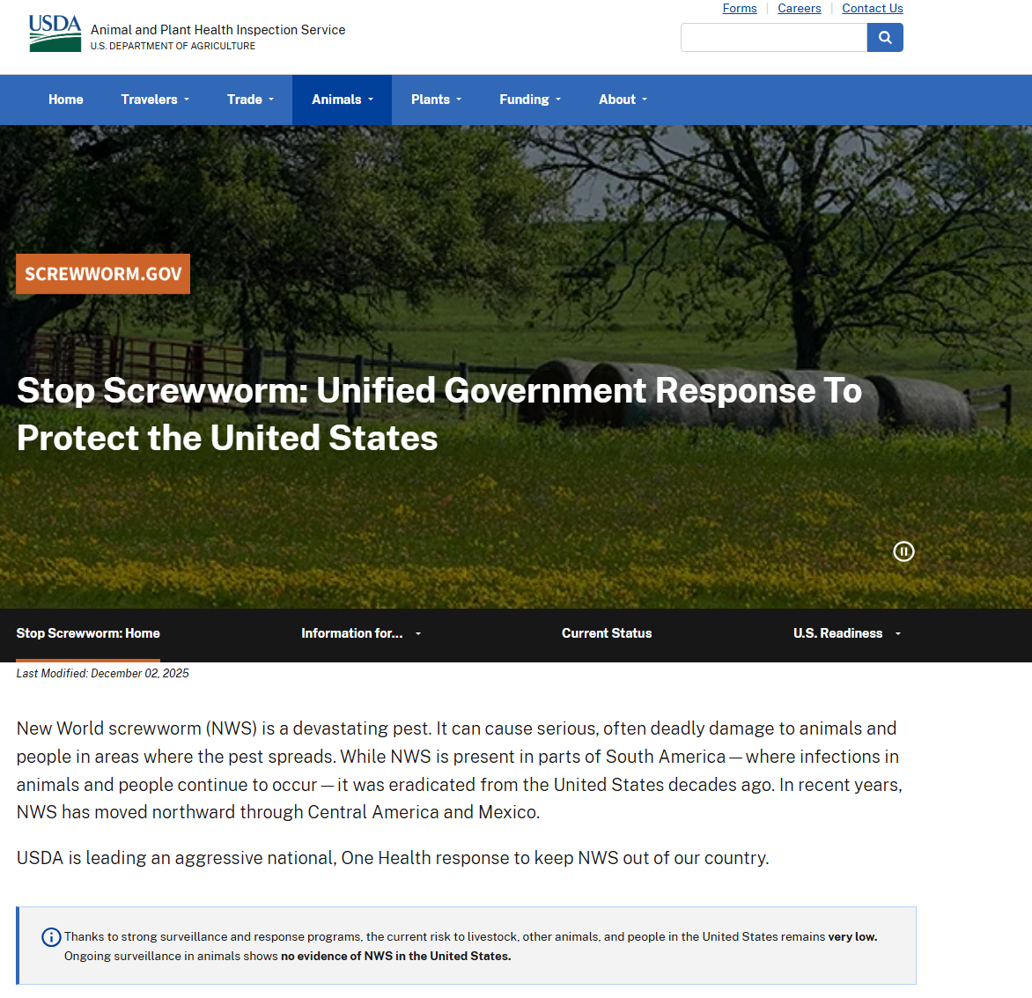
Current Situation of NWS
One Health Approach: A unified government response to protect the United States from NWS was announced to include partnerships with State, Tribal, local, and Territorial governments and industry.
On November 21, 2025, USDA launched Screwworm.gov, centralizing New World Screwworm Information across the federal government
The next Texas NWS taskforce meeting will be in January or February 2026
Available at Screwworm.gov | Unified Government Response To Protect the United States, Accessed on December 9, 2025

Slide 32
Marburg in Ethiopia

Slide 33
Marburg Outbreak in Ethiopia
Current Situation
On November 14, 2025, the Ethiopia Ministry of Health reported the country's first Marburg outbreak.
As of December 9, 2025, Ethiopia has reported laboratory-confirmed Marburg among 13 people, 8 of whom have died.
Though Ethiopia hasn't had a reported outbreak of Marburg before, the type of bat that carries the virus is found in southern Ethiopia.
To date, there have been no reported Marburg illnesses related to this outbreak outside of Ethiopia.
To date, there have been no reported cases Marburg illnesses related to this outbreak in the United States and the risk to the people in the United States is low.
On November 17, CDC has issued a Level 1 - Practice Usual Precautions - Travel Health Notices ─ for travelers to Ethiopia. Ethiopia is experiencing its first outbreak of Marburg virus disease (Marburg) in the South Ethiopia Regional State (formerly SNNPR) and travelers are recommended to practice usual precautions.
Available at: Marburg Outbreak in Ethiopia: Current Situation | Marburg | CDC, accessed on December 8, 2025.

Slide 34
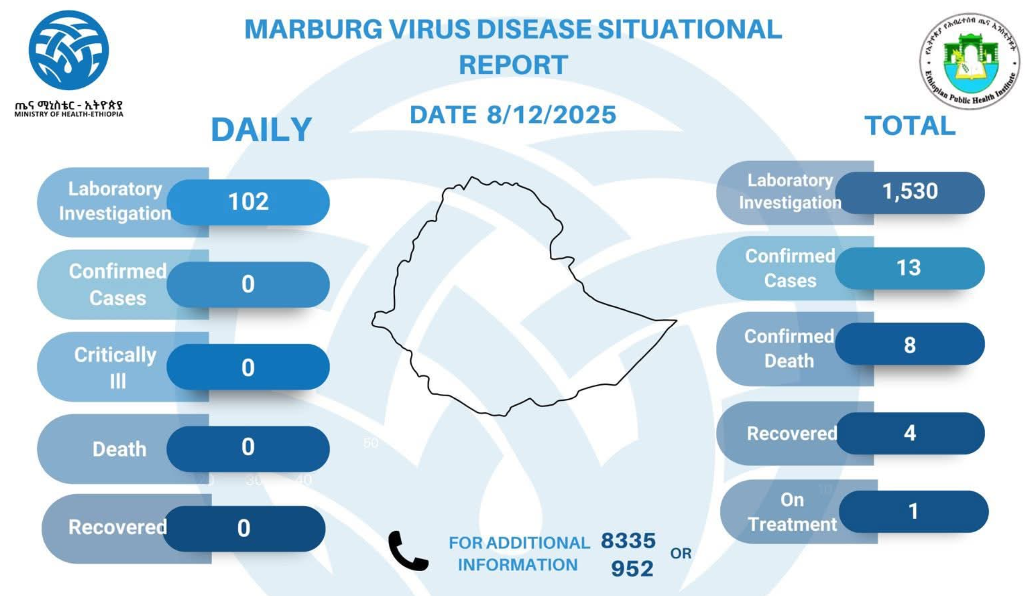
Available at: Ministry of Health ETHIOPIA (@FMoHealth) / X, accessed on December 9, 2025.

Slide 35
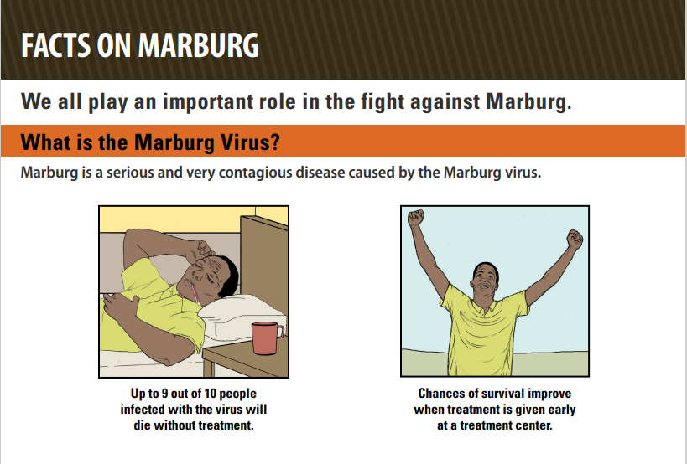
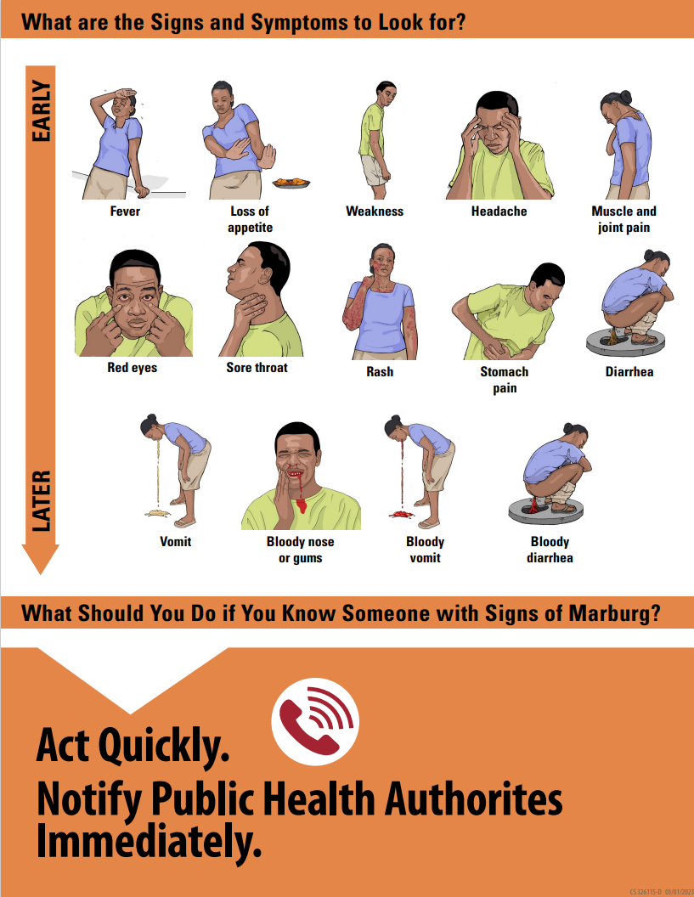
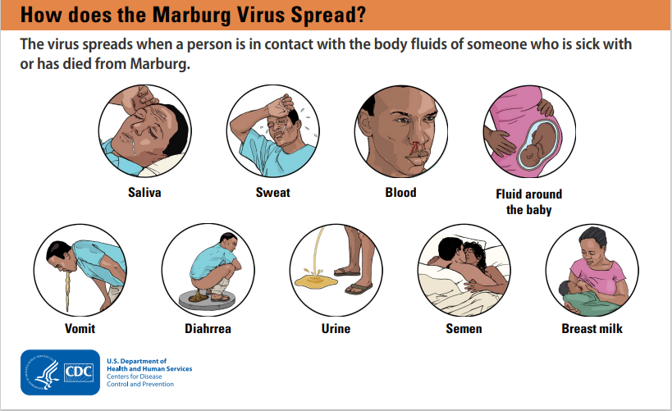
Available at: Facts on Marburg, accessed on December 8, 2025.

Slide 36
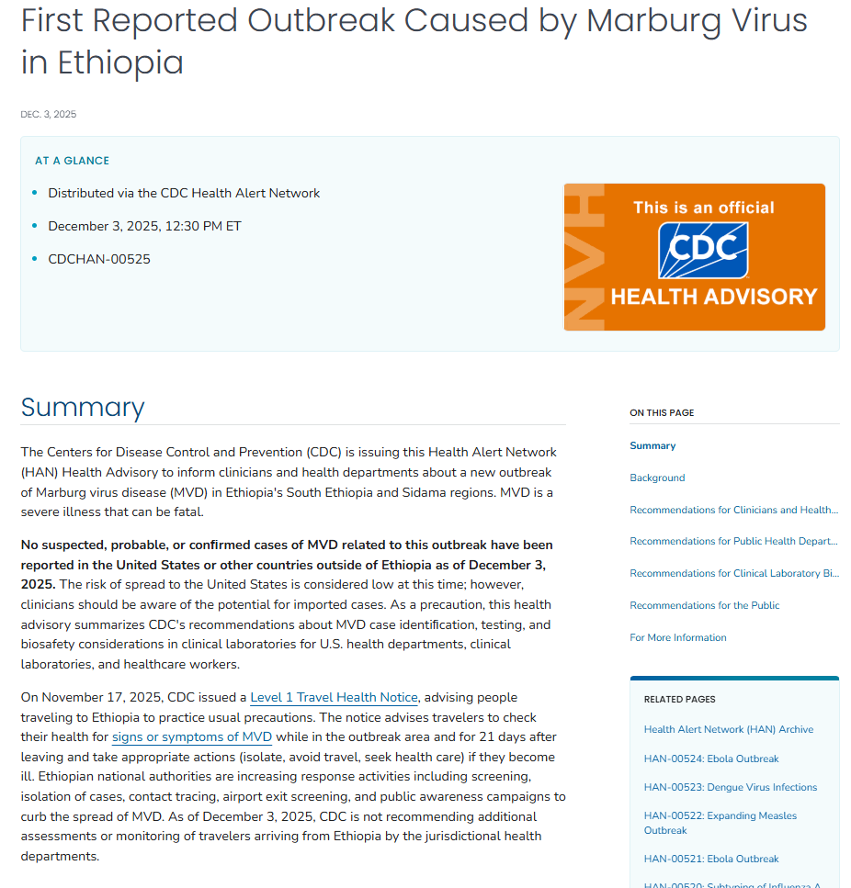
CDC Health Alert
On December 3, 2025, CDC issued a health alert First Reported Outbreak Caused by Marburg Virus in Ethiopia | HAN | CDC
  No suspected, probable, or conﬁrmed cases of MVD related to this outbreak have been reported in the United States or other countries outside of Ethiopia as of December 3, 2025.
  The risk of spread to the United States is considered low at this time; however, clinicians should be aware of the potential for imported cases.
  As a precaution, this health advisory summarizes CDC's recommendations about MVD case identiﬁcation, testing, and biosafety considerations in clinical laboratories for U.S. health departments, clinical laboratories, and healthcare workers.
Available at: First Reported Outbreak Caused by Marburg Virus in Ethiopia | HAN | CDC, accessed on December 8, 2025.

Slide 37
Measles

Slide 38
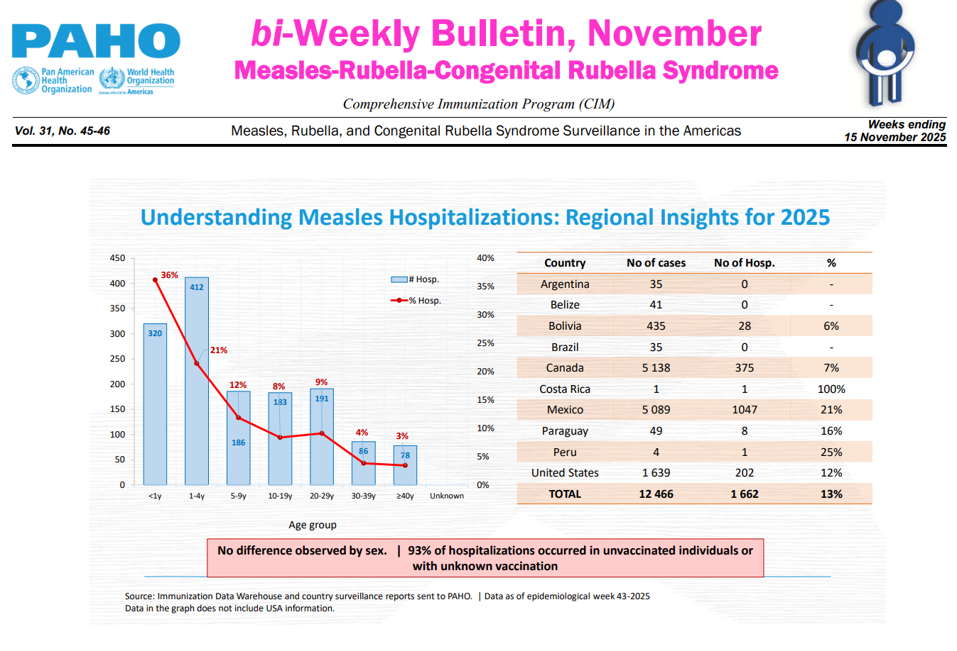
Measles in the Americas
Pan America Health Organization (PAHO): As of November 15, 2025, there are a total of 12,912 confirmed measles cases reported in the Americas in 2025 which includes Mexico, Canada and United States.
Available at: PAHO bi-Weekly Measles-Rubella Bulletin, accessed on December 8, 2025.

Slide 39
Measles in Canada
Canada is currently experiencing a large, multi-jurisdictional outbreak of measles that began in October 2024 with cases in Alberta, British Columbia, Manitoba, New Brunswick, Nova Scotia, Ontario, Prince Edward Island, Quebec, Saskatchewan, and the Northwest Territories.
  While transmission has slowed recently, the outbreak has persisted for over 12 months, primarily within under-vaccinated communities.
  Canada: As of December 8, 2025, a total of 5,298 measles cases (4,926 confirmed, 372 probable), including 2 deaths reported in 2025.
    The most recent week (MMWR 48: November 23-29, 2025) 37 new measles cases (32 confirmed, 5 probable) were reported.
On November 10, 2025, the Government of Canada posted the following:
  The Pan American Health Organization (PAHO) has notified the Public Health Agency of Canada (PHAC) that Canada no longer holds measles elimination status.
  PAHO's Measles and Rubella Elimination Regional Monitoring and Re-Verification Commission reviewed recent epidemiological and laboratory data, confirming sustained transmission of the same measles virus strain in Canada for a period of more than one year.
  PHAC is collaborating with the PAHO and working with federal, provincial, territorial, and community partners to implement coordinated actions—focused on improving vaccination coverage, strengthening data sharing, enabling better overall surveillance efforts, and providing evidence-based guidance.
Available at: Measles and Rubella Weekly Monitoring Report — Canada.ca, accessed on December 9, 2025.

Slide 40
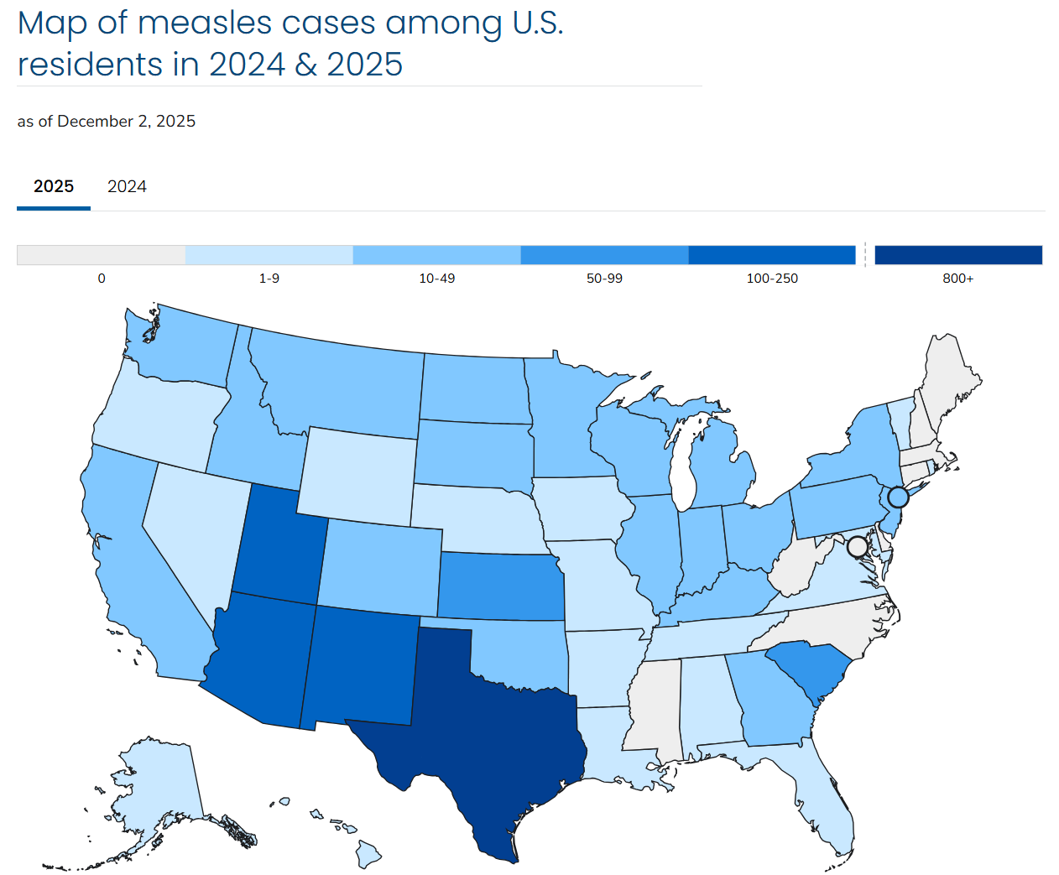
Measles in the United States
United States: As of December 8, 2025, a total of 1,828 confirmed measles cases
  12% of cases hospitalized
  3 deaths
  1,597 (87%) are outbreak associated from 46 outbreaks this year
Available at: Measles Cases and Outbreaks | Measles (Rubeola) | CDC, accessed on December 9, 2025.

Slide 41
Thank You

