Slide 1
Welcome New Members
ACTCR Informational Meet and Greet

Slide 2
Presentation Acknowledgements
Federal Funding
We acknowledge support from the following federal agencies.
  The Centers for Disease Control and Prevention provides financial support under Cooperative Agreement #1NU58DP007140. The contents of this presentation are solely the responsibility of the authors and do not necessarily represent the official views of the CDC or US Department of Health and Human Services.
  The National Cancer Institute’s Surveillance, Epidemiology and End Results Program provides financial support under Contract #75N91021D00011.
State Agency Funding
We acknowledge support from the following Texas state agencies.
  Texas Department of State Health Services
  Cancer Prevention and Research Institute of Texas
Additional Acknowledgments
The TCR also thanks all cancer reporters for their hard work and collaboration. Cancer reporters help us meet national high quality and timeliness standards and enable us to serve as the primary source of cancer data in Texas.

Slide 3
What We’ll Cover
Who is TCR
What is ACTCR
What does it mean to be an ACTCR member
Communication between TCR and ACTCR members
What happens at an ACTCR meeting
What are the Chair and Vice Chair Positions
How and when do members cast votes
Where to find helpful materials
Q & A opportunity

Slide 4
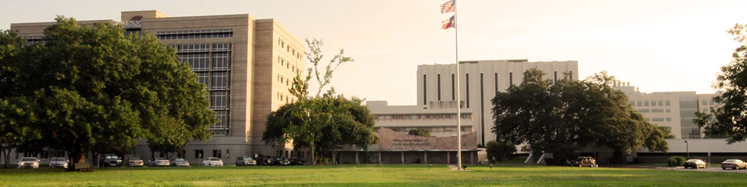
Who is TCR
The TCR is part of the Texas Department of State Health Services, the state public health agency within Texas Health and Human Services.
TCR is one of the largest registries in the US.
TCR is one of only 15 state registries that are both an NCI SEER and CDC’s National Program of Cancer Registries (NPCR) designated registry .
Notes:
Consisting of a central office and 2 regional offices, TCR uses a combination of passive and active surveillance that measures cancer burden, comprehensive cancer control efforts, health disparities, progress in prevention, diagnosis, treatment, and survivorship; Without this data priorities cannot be adequately addressed in public health, academic institutions, or the private sector

Slide 5
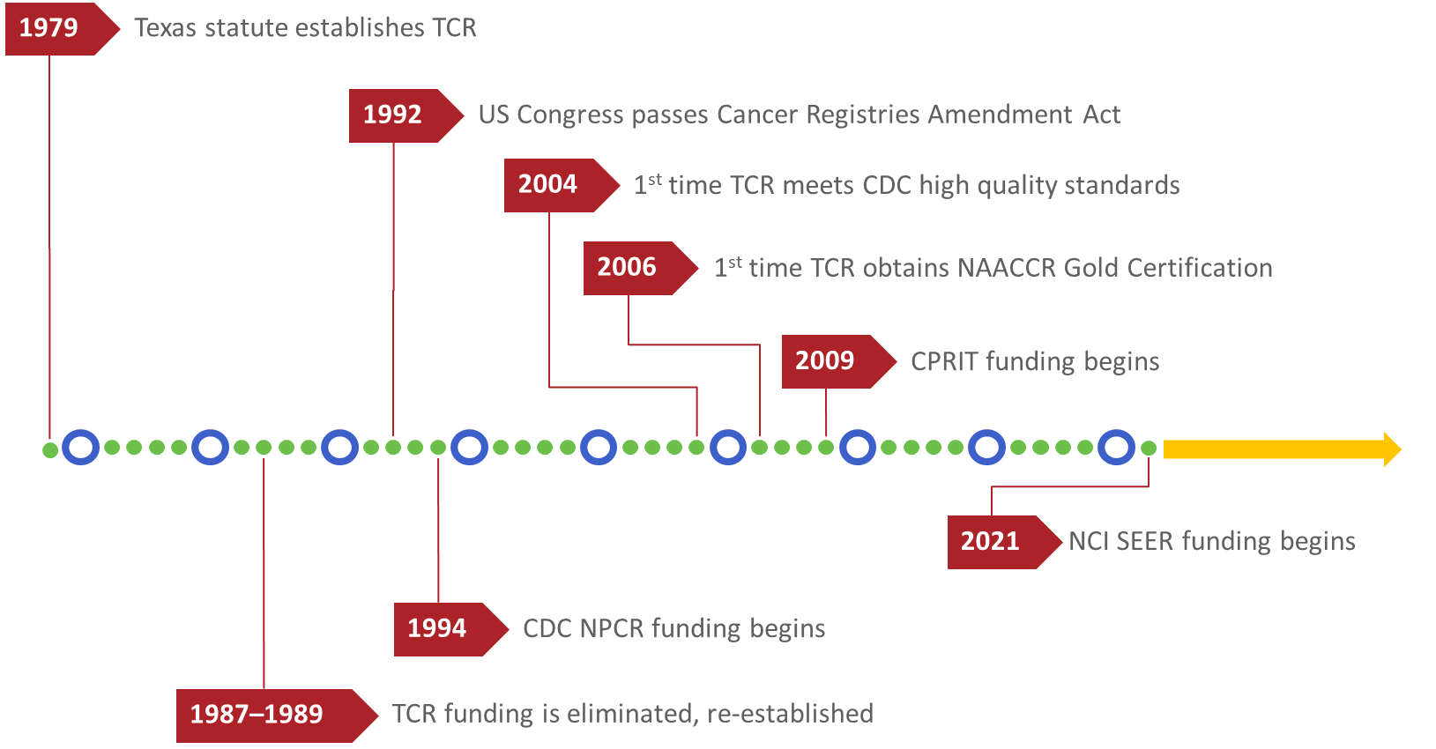
TCR Milestones
Notes:
In terms of the history, here is a timeline of TCR’s major milestones.
The 3rd time is the charm for trying to become a SEER Registry.
TCR applied in 1983 and 1992 but were not successful. This is something TCR has worked towards for not quite 40 years and could not be more thrilled.

Slide 6
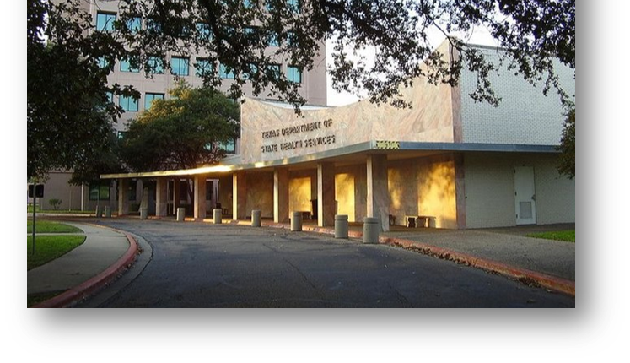
TCR Philosophy
TCR’s mission is to collect, maintain, and disseminate high quality cancer data that contribute towards cancer prevention and control, research, improving diagnoses, treatment, survival, and quality of life for all cancer patients.
Notes:
TCR data are available on a variety of state and national websites.
Types of data available on TCR Cancer Statistics webpage include:
Interactive tools, maps, graphs, Data tables which include Cancer Incidence and Mortality Rates, Expected Cancer Cases and Deaths, Estimated Cancer Prevalence, Cancer Survival, and Potential Years of Life Lost; and Web reports

Slide 7
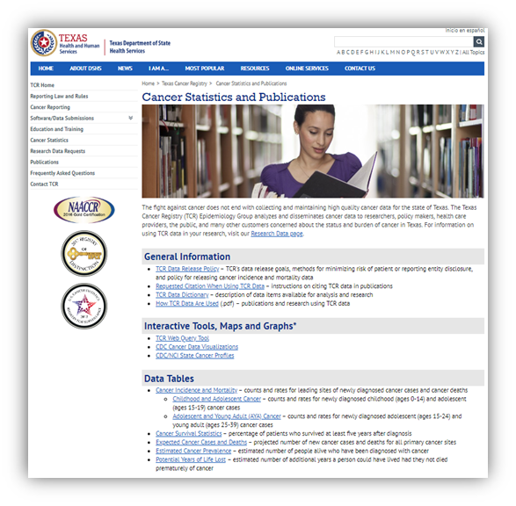
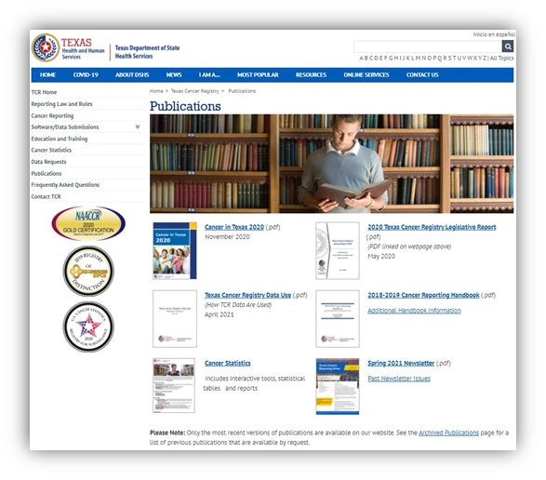
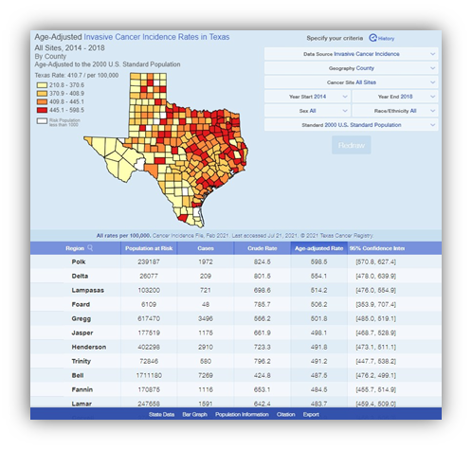
TCR Products and Stats
TCR Products Include:
Annual report on Cancer in Texas
How TCR Data Are Used (annual)
Texas Cancer Reporting Newsletter
Data tables
  Cancer incidence and mortality rates
  Expected cancer cases and deaths
  Estimated cancer prevalence
  Cancer survival
  Potential Years of Life Lost.
The web query tool received 13,530 queries in 2022.

Slide 8
TCR Partners
Four NCI-designated cancer centers
  University of Texas MD Anderson Cancer Center
  Dan L. Duncan Cancer Center at Baylor College of Medicine
  Simmons Comprehensive Cancer Center at UT Southwestern
  Mays Cancer Center at UT Health San Antonio
Cancer Prevention and Research Institute of Texas
  CPRIT is a $6 billion, 20-year initiative – the largest state cancer research investment in the history of the US and the second largest cancer research and prevention program in the world.
Advisory Committee to the Texas Cancer Registry

Slide 9

What is ACTCR
ACTCR is a mix of professionals in various fields in the cancer sphere that advises TCR on important research, funding, and data quality initiatives.

Slide 10
Problems Before ACTCR
Needs of the TCR, reporters, cancer control, and research community were not being met.
Diverse and sometimes conflicting point of views about goals, priorities, and the process prevented progress.
The TCR also desperately needed external support to gain the resources needed to become statewide and meet national data quality standards.

Slide 11
Creation of ACTCR
ACTCR was founded on the premise that the Texas Cancer Registry (TCR) and whole Texas cancer community needed better communication for cooperative work.
It began as the Texas Cancer Data Work Group in 1997.
In 2007 the name changed to the Advisory Committee to the Texas Cancer Registry (ACTCR)
This group became and remains a strong advocate for the TCR.

Slide 12
More on ACTCR
ACTCR’s mission statement is:
  “To advise and support the Texas Cancer Registry in achieving its mission.”
ACTCR’s vision statement is:
  “To contribute significantly to the knowledge of cancer for use in improving the health of Texans.”
ACTCR fulfills the NPCR’s requirement for TCR to establish and regularly convene with an advisory committee.
Notes:
The committee should assist in building consensus, cooperation and planning for the TCR, fulfilling both its mission and vision statements in the process

Slide 13
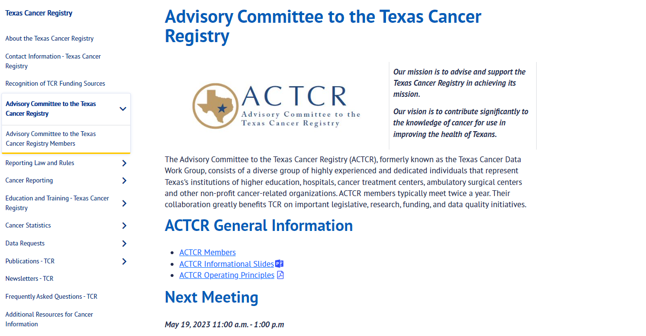

ACTCR Homepage
Notes:
Click the title bar once for an arrow to point out the members link, then again (2nd time) for the arrow to disappear. Click the title bar a third time for and arrow to point out the ACTCR Operating Principles link and click again (4th time) for it to disappear.

Slide 14

Who are ACTCR Members
ACTCR members represent a variety of professionals in the cancer field in accordance with NPCR program standards. These include reps from:
Other cancer control programs funded in whole or in part through the CDC
Hospital cancer registrars
American Cancer Society
Clinical Pathology Laboratories
Pathologists
Clinicians
Notes:
Other members could also be representatives from
Institutions of higher education
• Cancer treatment centers, with a focus on both American College of Surgeons
Commission on Cancer accredited and non-accredited centers
• Research institutions
• Epidemiologists
• TCR data users
• Ambulatory surgery centers
• Other state and local governmental entities
• Other appropriate representatives as determined by the ACTCR Chair and TCR Branch
Manager

Slide 15
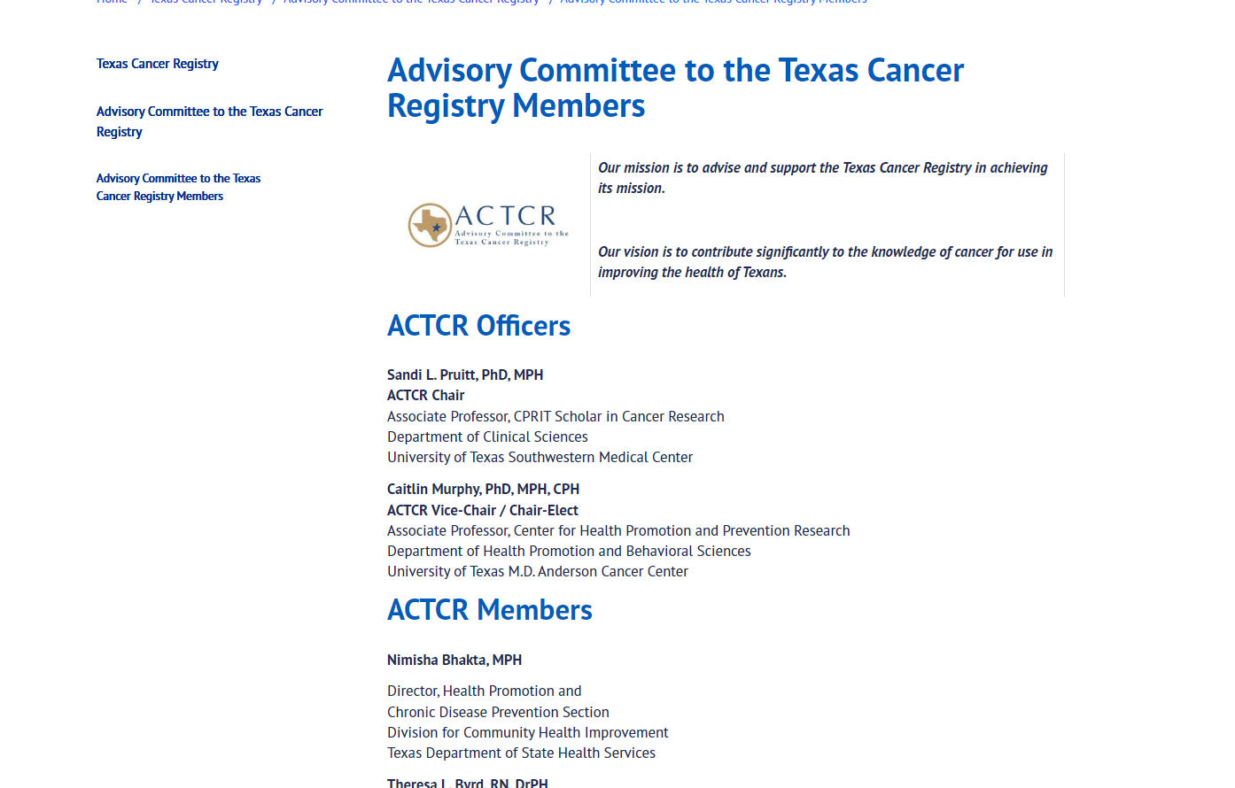
ACTCR Members Page

Slide 16
Expectations for Membership
ACTCR members are expected to:
Regularly and actively attend meetings or send a substitute delegate
Provide input on matters concerning TCR
Provide letters of support to the TCR for registry funding and/or project proposals
Actively participate in any ad hoc committees or workgroups
Collaborate with fellow members
And when unable to meet these commitments, notify the Chair and/or TCR ACTCR Coordinator (Kristen) of your resignation.
Membership should not exceed 30 members and strive for balanced regional and operational representation.
Notes:
There are two regular meetings a year, attending one is typically sufficient for regular attendance
Most of the input will be provided in the meetings, but occasionally TCR will reach out in emails with polls or questions for members
The biggest part of ACTCR membership so far is participation in meetings and the occasional email normally requesting scheduling as evident, there may be occasion for creating a committee or writing a letter, but overall the time commitment isn’t as daunting as this might make it seem

Slide 17
Benefits for Members
How does advisory committee membership benefit members?
They feel as though they are custodians of an incredible valuable resource.
It provides an opportunity to see the “bigger picture” of cancer reporting.
They feel as advocates with greater strength in numbers.
They see a tremendous value to hear their points of view and have the opportunity to openly discuss.
The invaluable face-to-face dialog develops important relationships.
They experience the chance to contribute towards and protect a critical resource in order to be successful in their work

Slide 18
Communication
Outside of the biannual meetings, communication typically consists of:
Monthly emails updating members on TCR activities
Polling for the next meeting date and notification of said date no less than 30 days before the meeting
Occasional email regarding a special project, announcement, or question that may need member’s timely feedback.
Notes:
For regular meetings the timeline is 30 days, there may be occasional for special meetings, such as this meet and greet, where the timeline for notification is within 5 days of the meeting.

Slide 19
ACTCR Meetings
Before meetings, members can find materials on TCR’s ACTCR page
Meetings begin with the Chair’s introduction and any relevant member business
A majority of the meeting will then focus on TCR news/changes/updates, allowing members to give input and guidance
Meetings end with a chance for members to bring up any other related business
Notes:
Materials include things like the agenda, PowerPoint being presented on, and any other relevant handouts
Follow up after meetings with meeting minutes detailing what was discussed

Slide 20
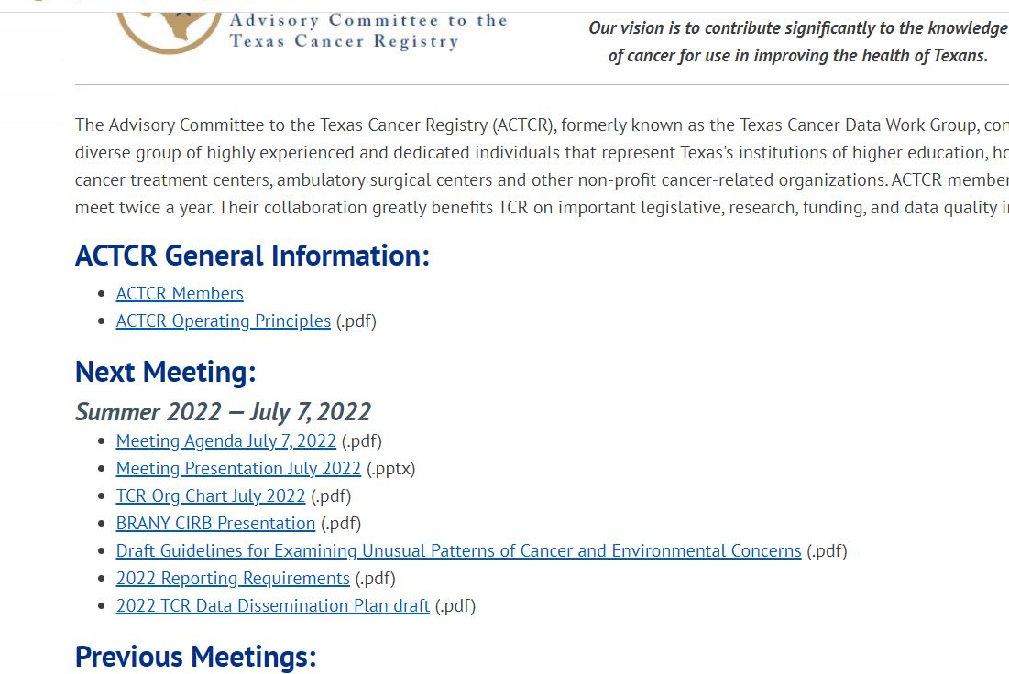
Materials for Meetings

Slide 21
Chair and Vice Chair
The Chair presides over meetings, the Vice Chair presides when the Chair is unavailable.
Chair terms last two meetings (around one year) and the Vice Chair becomes Chair.
Before the Vice Chair becomes Chair, there are a set of procedures in place to ensure that a new Vice Chair is chosen and has accepted the position. For more info on this, see Article VII Section 1 in the ACTCR Operating Principles.
Notes:
There are exceptions to the term durations, such as the continuation of Philip and Sandi’s position due to our brief hiatus, as long as members agree

Slide 22
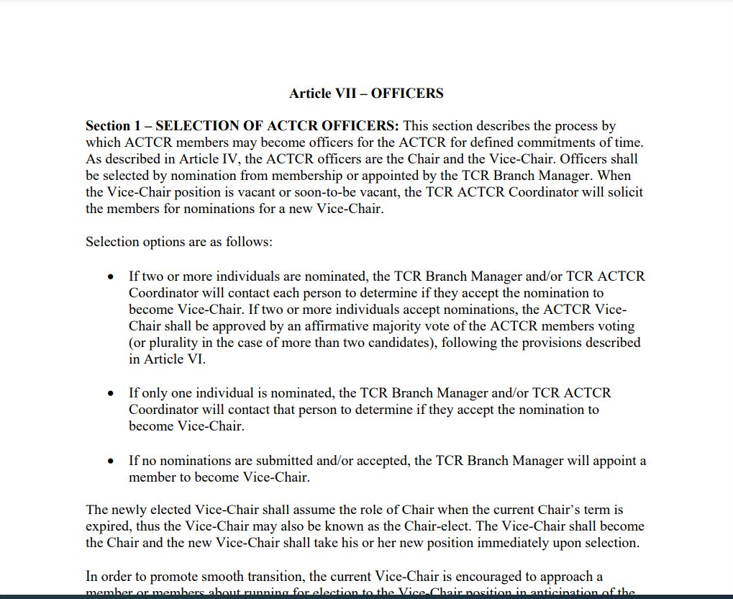
ACTCR Operating Principles

Slide 23
Chair and Vice Chair Cont’d
After six months, former officers become eligible to serve again, but it is highly encouraged that they provide informal leadership due to their experience.
Members interested in becoming Vice Chair without being nominated can express this in writing to the TCR ACTCR Coordinator (Kristen).
Notes:
The application will be considered as per the guidelines outlined in article VII section 1 of the ACTCR Operating Principles

Slide 24
Voting
Any member can request a vote on an opinion, preference, or advice on any relevant business item.
One vote per member, if member is unavailable may have appointed delegate vote instead.
If a vote is cast during a meeting, all attendees can vote, absentee voting may be allowed for those not in attendance depending on the subject.
Some votes may take place between meetings as long as all members are informed with a deadline to cast by at least seven days away from notification.
Notes:
This includes calling a vote if there is more than one nomination for vice chair
Votes can be cast by hand, voice, written, or electronically depending on the circumstance
If there is absentee voting, the TCR ACTCR Coordinator (Kristen) will notify members of the vote and provide a deadline by which they would need to cast

Slide 25
Current Priorities for Focus
SEER start up activities
  Learning new SEER requirements
  Preparing for 2022 new SEER data items
  Adding 10 new staff positions
  Moving to SEER*DMS
Annual SEER, NPCR-CDC, and NAACCR data submissions
Planning transition back from full-time telework to the office

Slide 26

Helpful Materials Links
TCR Homepage
About TCR Page
TCR Contact Us
ACTCR Page
ACTCR Operating Principles
ACTCR Members Page
Notes:
The ACTCR homepage will have all relevant materials before a meeting. The Web Query Tool is an excellent way to use our cancer statistics geographically. The Publications page will have relevant items such as our Cancer Reporting Handbook, Cancer in Texas Report, and biannual Newsletter. The statistics page has many of the data tables mentioned in the about TCR section for those that are curious.

